Slide 1
SALES ACCOUNT MANAGEMENT [SAM] SYSTEM
By
Anand Varun and
Gohil Kushal

Slide 2
Index
Introduction
Company Profile
Scope of system
Need for system & existing system
Objective of system
Proposed system
Feasibility study
Fact Finding Technique
Software/Hardware Requirement
Data Dictionary / Table Specification
Screenshot
Advantage of system
Limitation of system
Future Enhancement
Report
Bibliography & References

Slide 3
Introduction
The retail industry is one of the industries that is growing at in fast pace Where the number of retail business keep on increasing from time to time to meet The demand from consumers of specified areas. There are different types of retail shops available for a consumer to choose ranging from hypermarket to mini market according to their convenience. Most of the shops can be found in Residential areas, streets, or shopping malls.
A retail store sells a wide range of goods and services from wholesalers or suppliers To end-user. Thus, the nature of the retail business required good management of inventory levels to meet the demand of the customers. The traditional way retailer keeps their sales details is in spreadsheets which Are not effective anymore when the size of the shop gets bigger.

Slide 4
COMPANY PROFILE
Our company was introduced in the year 2009 entitled to “Sales & Marketing Solutions ltd.” Initialy based in Gurgaon Haryana . now with efforts of all supporters , we are now a pan india networked company . an Information Technology Enabled Services organization concentrated on executing Lead Generation and white paper syndication programs by utilizing Innovation to drive beneficial income development for our clients over the globe. We are gifted and experienced experts who are knowledgeable with the test of giving financially savvy Deals and Advertising QUALIFIED Leads. We have enthusiasm for building, adjusting, and overseeing groups crosswise over differing and complex associations and utilize this energy to make the best lead gen campaigns.

Slide 5
SCOPE OF SYSTEM
Within the boundary of the project, The System aims in having the following aspects:
SYSTEM - BOUNDARY: To Overcome Various Issue Mentioned In Introduction Of Desktop-Based Application, We Here Make One Changes To Put The Data On Server, It Can Be Remote Anywhere, Recently “Cloud Servers” Can Be Used Which Make Our End User A Cost Efficient Deal.
SYSTEM - END USER: The End User Of The System Is The Admin Of Shop Instead Of The Consumer Of The Shop, Where In General System Is The End User.

Slide 6
SCOPE OF SYSTEM
DATABASE: This Contains 2 Tables Where One Table Will Contain User Registration Data And The Second Will Contain User Input Data.
LOGIN / SIGNUP: Here Is The Twist In Our System, The User Of System Is The Admin Of The Shop Who Maintaining The Inventory. He Is Authorized To Register Himself Or Subordinate And Manage The System.
HOW IS THIS BUILD? Make Sure To Glance Over The Documentation, To Get Answers To The Queries Like Duration Of The Overall Project, What Technology Used, How The Analysis Done And Etc

Slide 7
NEED & EXISTING SYSTEM
EXISTING SYSTEM:
There Are Hundreds of ERP Software Already In Market Providing Facility of Inventory & Sales Management Like TALLY ERP9, EASYSHOP, RETAILWARE 5.0, MARG 9+, etc BUT, They are not a specialized in this facility, From Personal Experience to Handling This Software, They Provide Other Facilities Like Accounts Management, Retail Counter Billing Etc. So Cause Of, Not Focused, There Are Some Functional Bugs in Them, We try to conceptualize this bug into a new solution to the Inventory management

Slide 8
NEED & EXISTING SYSTEM
WHY WE NEED THIS? :
As We Will Further Explained More Details of Our System’s Objective.
We Need This System To Manage An Inventory And Sales Simultaneously In A Synchronous Manner.
To Overcome The Drawbacks Of Existing System Till The Date.
And As The Concept WEB Is Building In Various Other Industries, So We Try To Create A WEB Based Retail Industry Software.

Slide 9
OBJECTIVE OF SYSTEM
To Provide A Function To Manage Goods In The Store More Efficiently. Basic Functions Such As ‘Add’, ‘Delete’, And ‘Update’ For Data Management Will Be Made Available.
To Provide A Function To Add A Customer In The Database So That Next Time Customer Comes To Shop Again We Can Get His Previous Data.
To Provide A Function To Add A Product In The Database So That Users Can Select The Product From The Dropdown And It Will Easy For Us To Get The Report.

Slide 10
PROPOSED SYSTEM
As Mentioned Already the System – End User Before, This Is Just To Emphasize It More Clearly, Our System Target the Owners or Sole Traders Who Mostly Unable To Manage Their Inventory Whole Manually, And As Business Expands This Issue Get More Complex, So To Make Them to Focus on Growth and Expansion of Business to Give Our Country’s Economy Strength to Be ‘VISHWA GURU ‘Again!

Slide 11
FEASIBILITY STUDY
TECHNICAL FEASIBILITY:
Technical Aspect Is The Most Important Part In The System Development. As The System Is Web Based, HTML CSS JS Used To Develop the Interface And PHP for the Functions with the Database. For The Database Aspect, MSQL Will Be Used Which Will Link The System Interface With The Data Storage. The Exposure Gain in ‘Business System Development’ Subject Through Course Curriculum Has Given Us the Credibility to Develop the Program as Specified . Moreover, Online Tutorial on System Development Also Vastly Available On The Internet Which Will Helps Us in Development Stage

Slide 12
FEASIBILITY STUDY
ECONOMICAL FEASIBILITY:
Basic Analysis Has Been Done In Investigating the Economical Feasibilities Of The Project. The Financial Analysis Demonstrates That the New System Will Reveals A Positive Economic Feasibility. In Term of Software Designing and License It Can Be Found On Open Source in the Internet Thus, Owner Does Not Need To Purchase The Software From The Vendor. New System Will Be Requiring Extra Cost on the Hardware Implementation Part. In Term of Special Staff Training, The New System Will Not Need Any Extra Cost. Normally, Newly Develop System Will Need For Special Training for the User, However In This Case the System the Handling Part Is Very Easy And Eliminate The Need For Training. Besides, a Friendly Interface Makes Staff Work With Less Stress.

Slide 13
FEASIBILITY STUDY
OPERATIONAL FEASIBILITY:
The Risk of Familiarity with the Application Is Medium Because the Users/Staff Never Used To Computerized System. Thus, There Is a Need for Brief Introduction On Handing the System In Order To Implement the System. Besides, As Most Of The Staffs in the Store Are Not IT Literate, the To-Be System Will Be User-Friendly And Easy To Operate.

Slide 14
FACT FINDING TECHNIQUE
QUESTIONARIES:
We Have Designed A Questionary With Some Basics Questions Regarding To Solve Our Facts About How Exactly The Retail Market Is Work, How They Manage Inventory Manually Etc.
GROUND LEVEL ANALYSIS:
Although Have Experienced Issue Of ‘Stock Is Not Available ‘, We Go At Local Businesses To Help Us Analyze Their Daily Routine Business Activities, This Make Us To Find Where We Can Use Hit The Stroke Theory In Manual Inventory System.

Slide 15
FACT FINDING TECHNIQUE
MEETING WITH END USER:
As Most Of The End User Directly Relate To Our System, We Decides To Meet Them And Go At Deep To Solve The System Issue. They Told Us, Their Market Affect As Consumer Get Dissatisfied Due To Lack Of Products Consumer Want From Them.

Slide 16
SOFTWARE & HARDWARE REQUIREMENT
Processor: Intel Pentium
RAM: 2 GB + [8 GB Preferred For Large Scaled Business]
Hard Disk: 10 GB +
Operating System: Windows, Mac, Linux, UNIX, Raspberry Pi, Etc
Front-End Tech Used: HTML, CSS, JavaScript
Back-End Support: PHP, MySQL

Slide 17
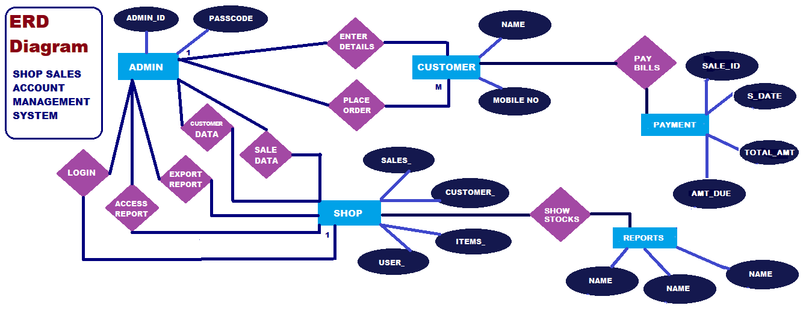
ANALYSIS ANALYSIS & DESIGN

Slide 18
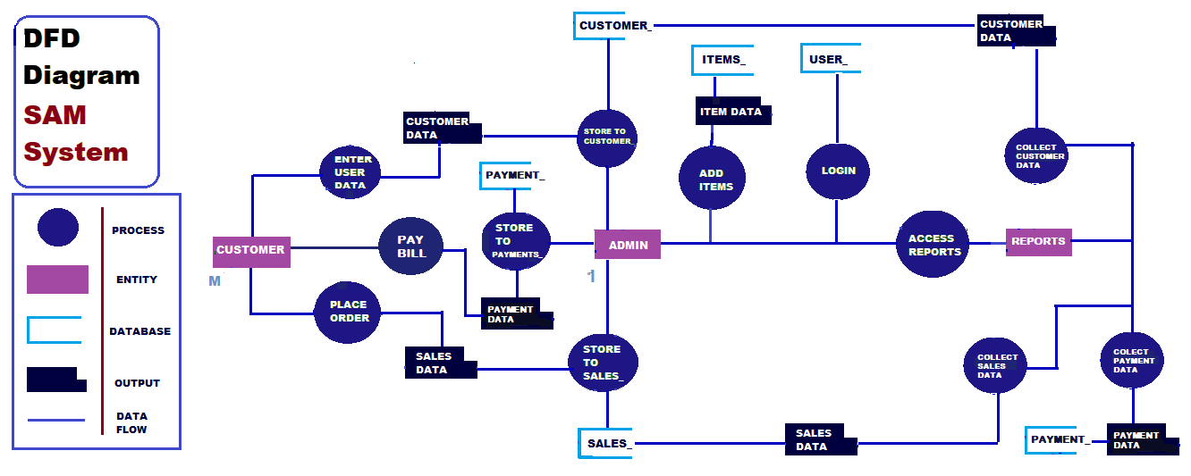
ANALYSIS ANALYSIS & DESIGN

Slide 19
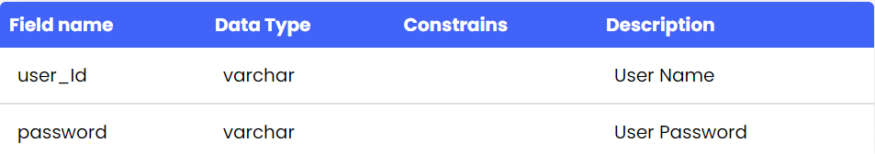
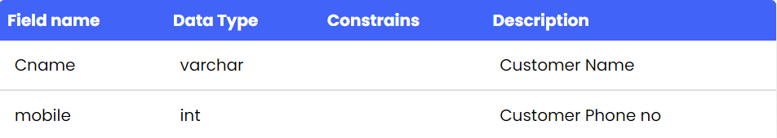
DATA DICTIONARY

Slide 20
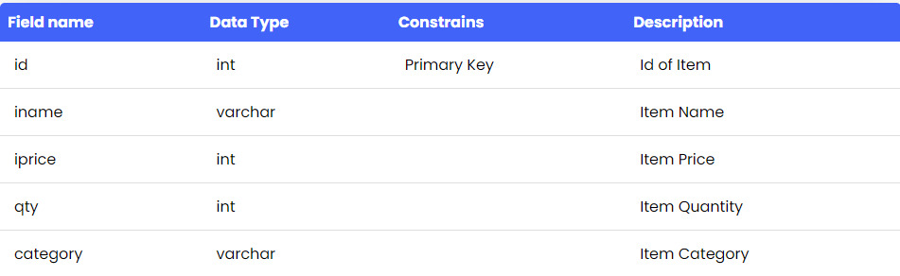
DATA DICTIONARY

Slide 21
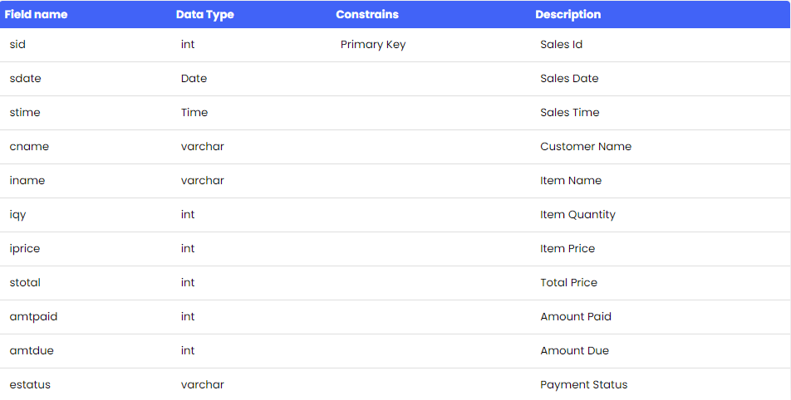
DATA DICTIONARY

Slide 22
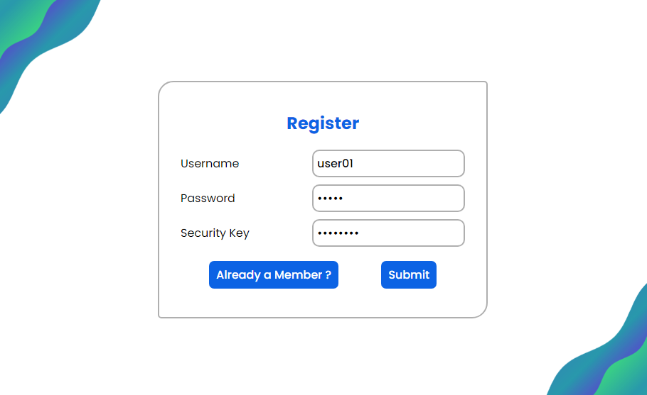

Slide 23
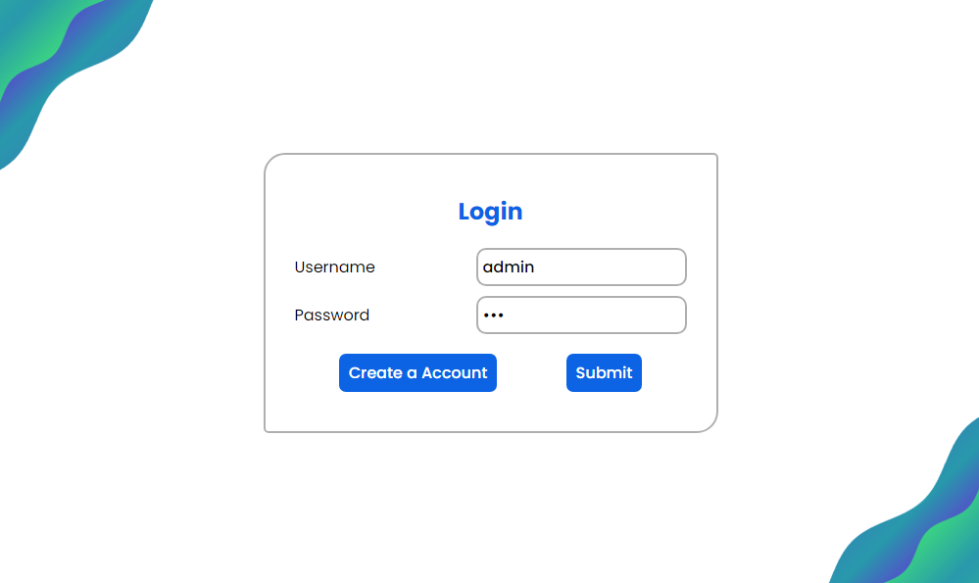

Slide 24
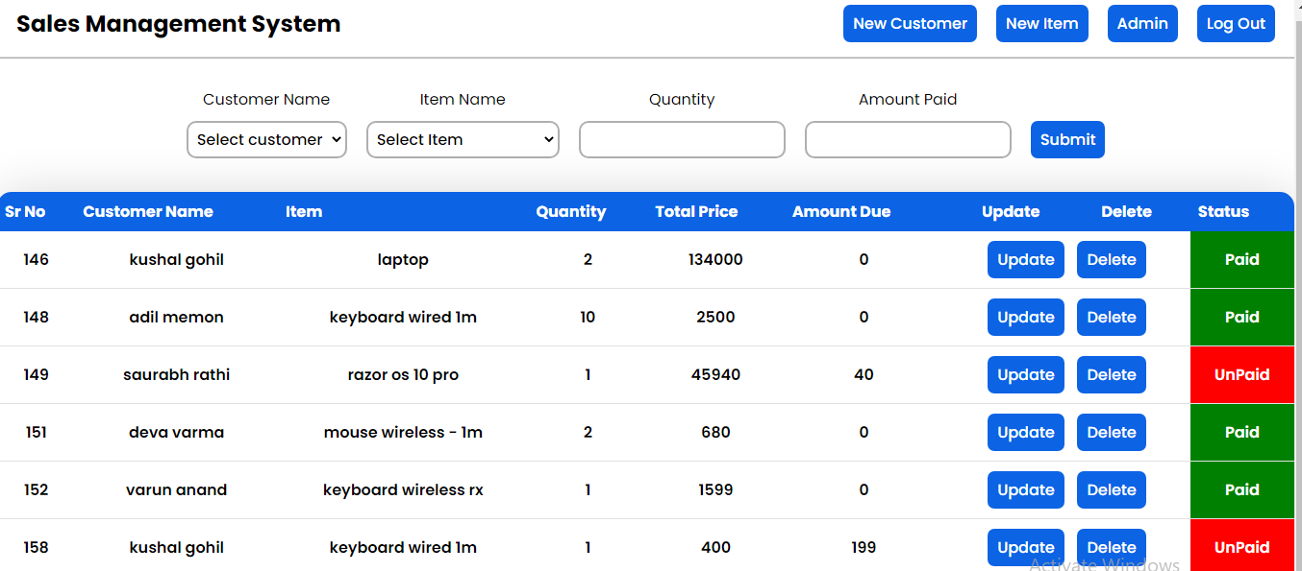

Slide 25
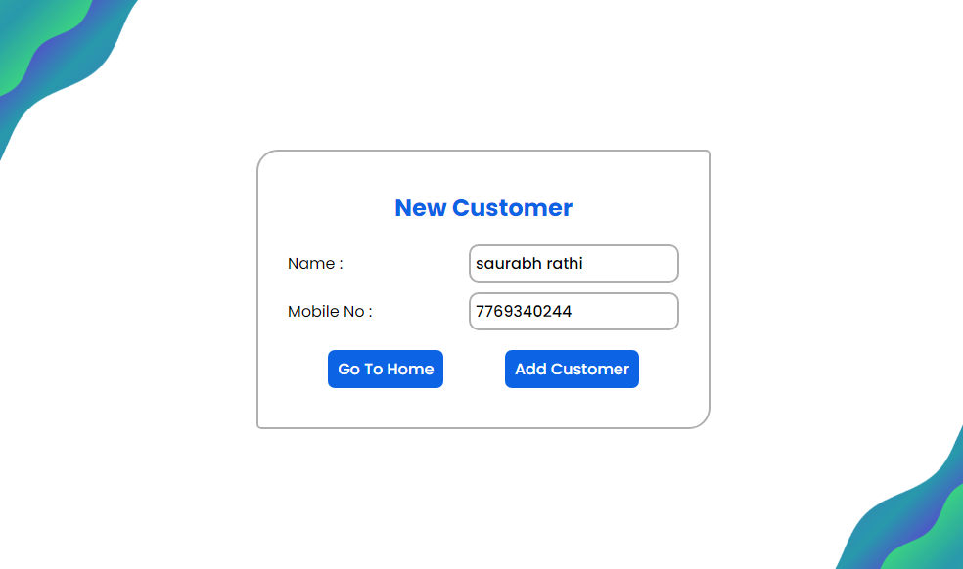

Slide 26
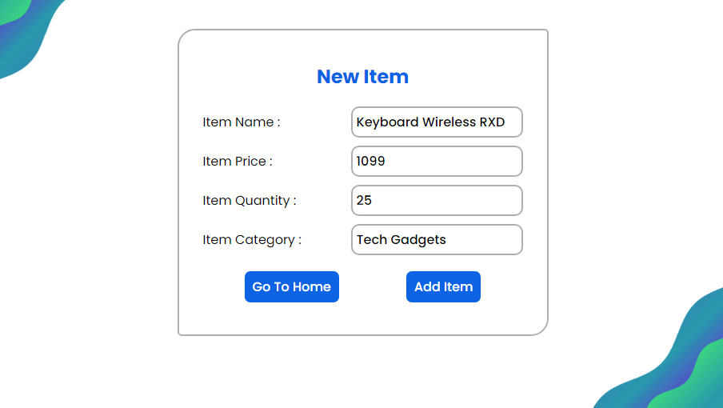

Slide 27
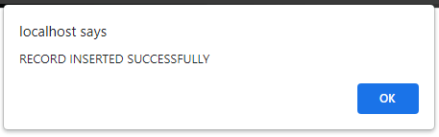
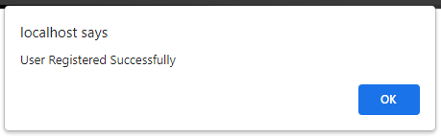
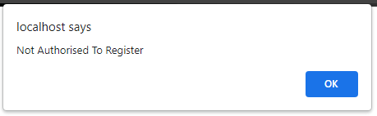

Slide 28
ADVANTAGES & LIMITATIONS
Sales Management Increases Profitability: Activities Such As Forecasting, Controlling and Managing Inventory Increase Sales and Productivity of the Store Resulting In Greater Profitability. Besides, Accuracy Improvements On The Inventory Level Will Result In Reduction Of Fixing Costly Mistakes.
Sales Management Improves Cash Flow: Purchasing The Correct Inventory In The Right Amount To Meet Customer Demand And At The Same Time Eliminating Slow Moving, Obsolete Inventory Leads To Better Cash Flow And Eventually To Higher Profits.

Slide 29
ADVANTAGES & LIMITATIONS
Sales Management Improves Decision-Making: Real-Time Business Intelligence Across All Areas Of The Store Is Possible With Rapid, Accurate Data Collection. Not Only That, Issues And Events Integrated With The System Enables To Proactively Identify And Solve The Issues
Sales Management Increases Customer Satisfaction: Anticipating In Seasonal Promotion And Changing Marketing Conditions By Having The Right Products In Stock For Customers

Slide 30
LIMITATION OF SYSTEM
As No one can be perfect 100%, we too have some limitations those are targets of our future enhancements.
First, we encountered initial level limit is the reports are not yet available for the admin as this panel is under construction!!
Another one is, we have to use API of payment gateway, so User’s consumer satisfaction for his consumers will grow with 30 – 40 %.
Are some of points we encountered during the manual testing, so as AGILE methodology, our Next Inception Model will be to overcome this drawbacks.
Updates of new version will be soon available on our consumer federal panel

Slide 31
FUTURE ENHANCEMENT
Admin Dashboard Panel.
Payment Gateway
Cloud Server Service [CSC]
UI / UX Updates As Per Feedbacks
AI & ML for Stock Predictions

Slide 32
CONCLUSION
In summary, the project works is relevancy to the objectives set. The project is designed based on preliminary study that had been carried on with Rahmath Store. Thus activities of developing the system which is planning and analysis is based on the result retrieved from the interview on observation. Not only that, as this would be the first computerized system that will be used by the store, the functions only focused on solving major problem which is inventory management problem. The interfaces design is also categorized as user friendly due to lack of IT background of the workers which means the system can be handle by people not even from IT background. Due to time constraints, it is not possible for the developer to implement many functions in the system, thus the developer have few future works suggestion for continuation.

Slide 33
BIBLIOGRAPHY & BIBLIOGRAPHY & REFERENCES
In summary, the project works is relevancy to the objectives set. The project is designed based on preliminary study that had been carried on with Rahmath Store. Thus activities of developing the system which is planning and analysis is based on the result retrieved from the interview on observation. Not only that, as this would be the first computerized system that will be used by the store, the functions only focused on solving major problem which is inventory management problem. The interfaces design is also categorized as user friendly due to lack of IT background of the workers which means the system can be handle by people not even from IT background. Due to time constraints, it is not possible for the developer to implement many functions in the system, thus the developer have few future works suggestion for continuation.

Slide 34

Thank You

