Slide 1
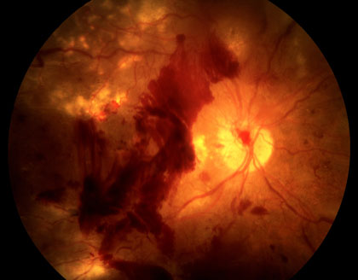
Diabetic Retinopathy Detection
Arvind Rathore V
(20BTRCA008)
Sai Ruthvik M
(20BTRCA029)
Sreenivasan R S
(20BTRCA045)
Under the guidance of,
Prof. Narasimhayya B E

Slide 2
Abstract:
Advancement in medicine has been a long and ardous process, and with the help of technology, new drugs and diagnostic procedures have been made in order to help identify diseases and analyse them. More than 6.25% percent of the world are diabetic according to WHO and this number is expected to double by the year 2050. One of the conditions that follow with diabetes, is diabetic retinopathy which occurs when the blood sugar levels are high enough to damage the retina causing loss in vision. Using Deep Learning and AI, This project is dedicated in finding a measure of detection for people with early stage diabetic retinopathy in order to save their vision.
Keywords: Diabetic Retinopathy, Diagnosis, EfficientNetV2 Computer Vision, CNN

Slide 3
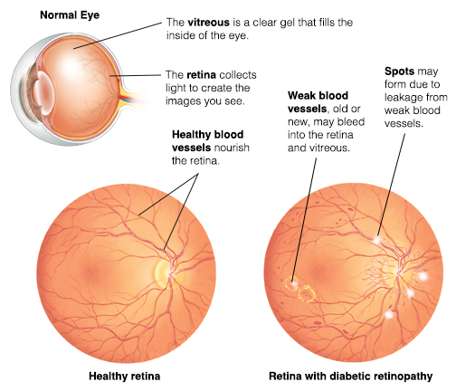
Introduction
Motivation:
Diabetic macular edema is a common cause of vision loss in Diabetic macular edema (DME) is a prevalent cause of vision loss among individuals with diabetic retinopathy.
Globally, there are approximately 21 million patients suffering from diabetic macular edema.
However, the challenge lies in the diagnosis process, particularly due to the limited number of diagnostic centers compared to the large patient population

Slide 4
Main Objective:
The main objective of this project is to address the complex issue of detection which can be implemented through a multiclass classification model leveraging a Deep Learning architecture. With early detection and timely intervention, the eyesight of millions can be saved before they are completely lost.
Scope:
The implemented model will allow the users to identify whether the given sample has the condition of diabetic retinopathy or not with accurate prediction results. The model however, will not concern itself with the treatment, or any further decision making actions based on the results provided.

Slide 5
Literature Review
Paper | Abstract | Methodology | Outcomes
Automated Diabetic Retinopathy Detection Using Horizontal and Vertical Patch Division-Based Pre-Trained DenseNET with Digital Fundus Images | Paper developed an automated diabetic retinopathy image classification system using horizontal and vertical patch division for deep-feature extraction, a new dataset with three classes, transfer learning with DenseNet201, and discriminative feature selection with neighborhood component analysis, achieving high accuracy for both three-class and five-class classifications. | Horizontal and vertical patch division for DR image classification. Transfer learning using pretrained DenseNet201 architecture for feature extraction. | High accuracy and efficiency of the model Assists doctors in screening and grading the severity of DR
Detecting diabetic retinopathy severity through fundus images using an ensemble of classifiers | Initial data preprocessing involves adaptive equalization, color normalization, and Gaussian filtering. Image segmentation is then employed to extract relevant markers and features. Classification is achieved using an ensemble of classifiers with a "weight voting" technique, showing varied performance across different severity levels. | Data preprocessing: adaptive equalization, color normalisation, Gaussian filter, removal of optic disc and blood vessels. Image segmentation for relevant markers. Extraction of features from fundus images. | High accuracy in distinguishing different stages of diabetic retinopathy Robust and reliable classification system through image preprocessing techniques
Algorithm-based diagnostic application for diabetic retinopathy detection | It analyzes ophthalmoscopic images to identify the optic disc and lesions associated with diabetic retinopathy. The primary goal is to enhance early detection and ultimately reduce visual impairment related to diabetes. The application comes equipped with a user-friendly graphical interface, facilitating easy image analysis for efficient diagnosis and monitoring. | Analysis of retinal images obtained using Optomed Smartscope(r) PRO ophthalmoscope Morphological algorithms for identifying optic disc and lesions characteristic of DR | Advanced technologies improve efficiency of diabetic retinopathy diagnosis. Automatic methods based on neural networks and image analysis algorithms.

Slide 6
Paper | Abstract | Methodology | Outcomes
A Prospective Study on Diabetic Retinopathy Detection Based on Modify Convolutional Neural Network Using Fundus Images at Sindh Institute of Ophthalmology & Visual Sciences | A deep learning model, trained and validated on a private dataset, was tested in real time at the Sindh Institute of Ophthalmology & Visual Sciences. The model successfully classified test images into DR-Positive and DR-Negative categories, demonstrating an accuracy of 93.72%, sensitivity of 97.30%, and specificity of 92.90%. | The paper uses a deep learning model based on convolutional neural networks. The model consists of convolutional and pooling layers. The dataset is divided into training, validation, and testing datasets. The model classifies images into DR-Positive and DR-Negative categories. The model's performance is evaluated by clinical experts. | Achieves 93.72% accuracy, 97.30% sensitivity, and 92.90% specificity on test data Trained and validated on a private dataset and tested in real time at SIOVS Classifies test images into DR-Positive and DR-Negative
Early detection of diabetic retinopathy based on deep learning and ultra‑wide‑feld fundus images | Diabetic retinopathy stands as a significant contributor to visual impairment and blindness. Early detection and treatment play a vital role, particularly in low-income countries. The combination of deep learning techniques and ultra-wide-field fundus photography emerges as a promising approach to enhance detection capabilities. The effectiveness of early treatment diabetic retinopathy study 7-standard field images has been recognized, and the use of ultra-wide-field fundus photography covers up to 82% of the retinal surface, providing a comprehensive perspective for improved diagnosis and management of diabetic retinopathy. | Automatic segmentation of the ETDRS 7SF for DR detection. Deep learning architecture (ResNet-34) used as a classifier. Optic disc and macula detection for excluding undesirable regions. | ResNet architecture provides easier optimization and accuracy gain for deep networks. UWF fundus photography provides a wide captured area for DR detection. ETDRS 7SF images segmented from UWF photography save time and efforts

Slide 7
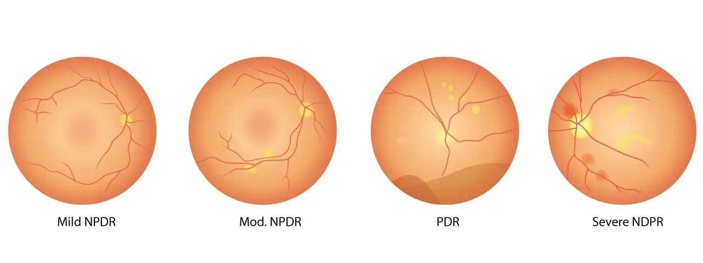
Methodology
The proposed methodology involves employing the EfficientNet-V2 model for the classification
Upon developing the model, it would be deployed on an API which would then take the images uploaded and classify them into multiple categories.

Slide 8
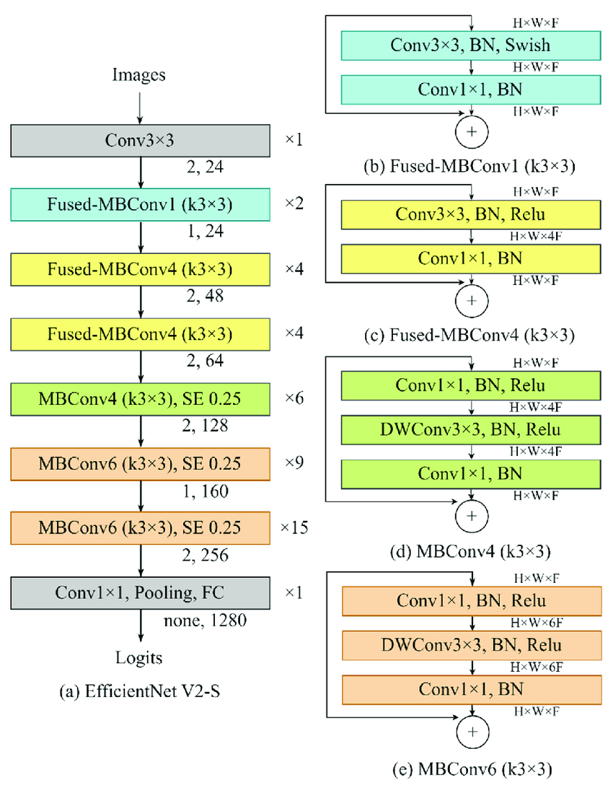
EfficientNet-V2
EfficientNet-V2 is the enhanced version of the EfficientNet CNN model series trained in the ImageNet dataset.
The Efficient Net V2 model boasts a higher performance than its predecessors with an addition of training aware neural architecture search and scaling.
The model also introduces progressive learning which adaptively adjusts regularization along with image size.

Slide 9
EfficientNet-V2
FusedMB Convolutions refer to the fusion of multiple operations, such as convolution and activation, into a single computational step. This optimization reduces memory access and improves computational efficiency, especially on resource-constrained devices like mobile phones and edge devices.
In EfficientNetV2, FusedMB Convolutions streamline the computation by combining operations within each convolutional block, reducing the overall number of operations needed during inference while maintaining expressive power.

Slide 10
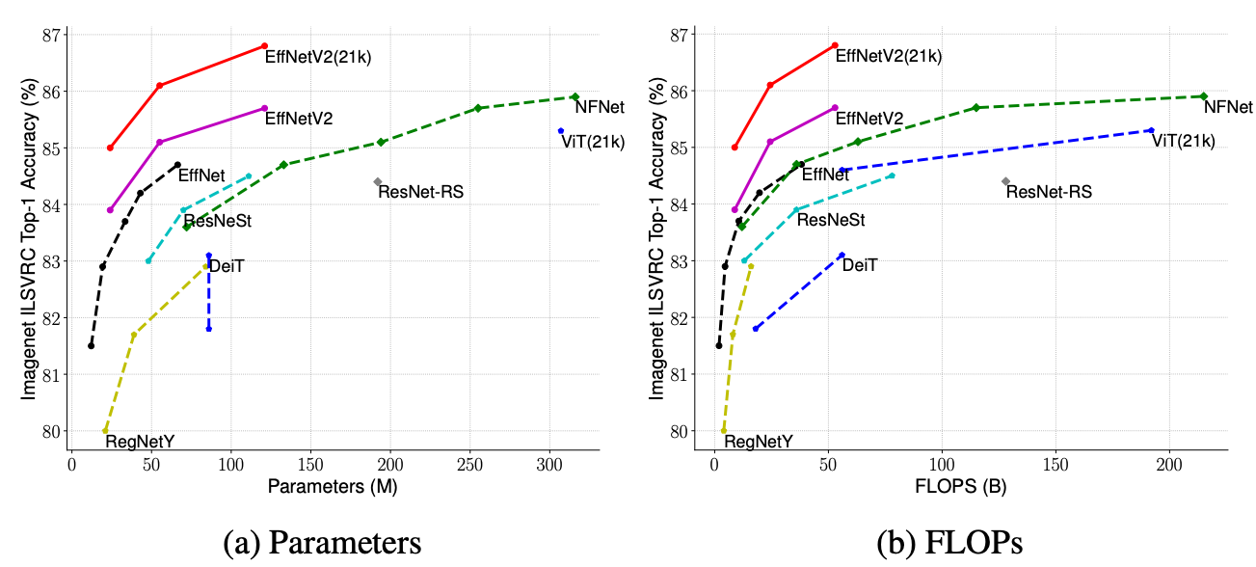

Slide 11
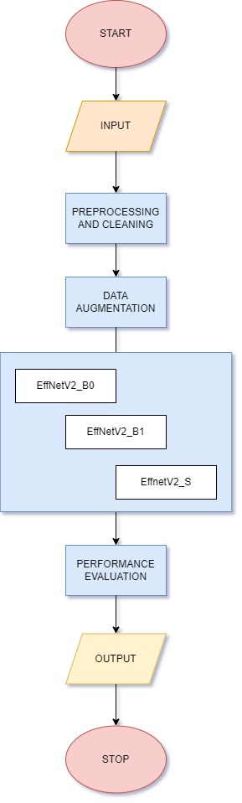
System Architecture
1. Leveraging Different EfficientNet-V2 Variants: The system aims to utilize three variants of the EfficientNet-V2 model - effnetv2_b0, effnetv2_b1, and effnetv2_s - each offering unique characteristics and performance trade-offs.
2. Stacking Ensemble Approach: Individual models process input images independently and generate predictions. These predictions are then combined at a higher level, typically through a meta-learner or averaging mechanism, to produce the final ensemble prediction.
3. Exploiting Complementary Strengths: Each model variant captures different aspects of the input data due to variations in depth, width, and resolution. By combining models of varying scales, the ensemble can capture a broader range of features and patterns, enhancing robustness and generalization capability.
4. Superior Performance and Robustness: The proposed system offers a powerful solution for image classification tasks by leveraging the strengths of multiple model variants. The combination of effnetv2_b0, effnetv2_b1, and effnetv2_s in a stacking ensemble enhances performance and robustness, making the classifier capable of handling diverse input data scenarios.

Slide 12
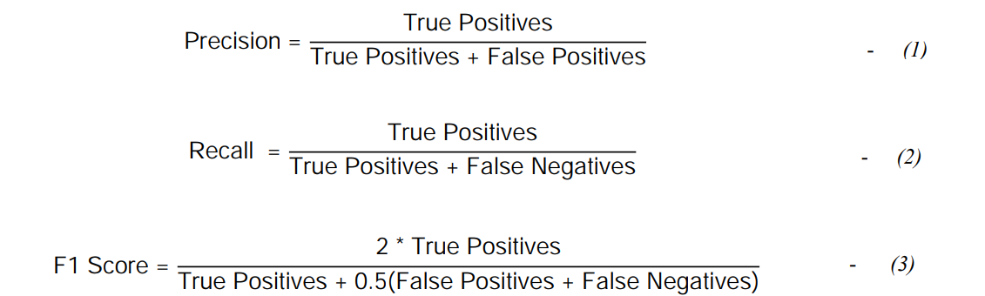
Evaluation Metrics
This study employs different evaluation metrics to observe and analyze the performance of the model. Namely, they are Precision, Recall, F1 Score and Accuracy. The formula relating to the same has been given below in equations 1, 2 and 3.

Slide 13
Implementation
Software and Hardware Requirements
Python 3 is the latest major version of the Python programming language, emphasizing code readability and simplicity. In the context of machine learning, Python 3 is the preferred version due to its extensive ecosystem of libraries and frameworks, such as NumPy, Pandas, Scikit-learn, TensorFlow, and PyTorch.
TensorFlow is an open-source machine learning framework developed by Google. It facilitates the creation and training of deep learning models through a flexible, high-level API. TensorFlow allows developers to build and deploy machine learning applications, leveraging computational graphs for efficient processing on CPUs or GPUs.
The following set of experiments have been conducted A100 GPU or V100 GPI provided by the Google Colab with 40GB of virtual random access memory.
The specifications of the A100 GPU is given below as example.
FP64: 9.7 TFLOPS
FP64 Tensor Core: 19.5 TFLOPS
FP32: 19.5 TFLOPS
TF32: 156 TFLOPS
GPU Memory: 80 GB HBM2e
GPU Memory Bandwidth: 1,935 Gb/s
Thermal Design Power: 300W

Slide 14
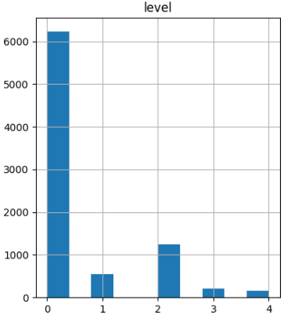
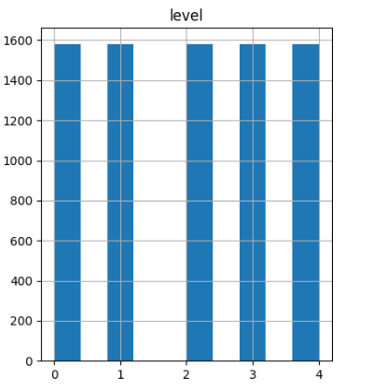
Dataset and Pre-processing
The data had been collected from the EyePacs foundation, a free platform for retinopathy screening.
The data under study was a sample of 8392 images of a total of 35,321 images from the original dataset with labelled images of left and right eye fundus corresponding to 5 target classes that are No DR, Mild DR, Moderate DR, Severe DR and Proliferative DR.

Slide 15
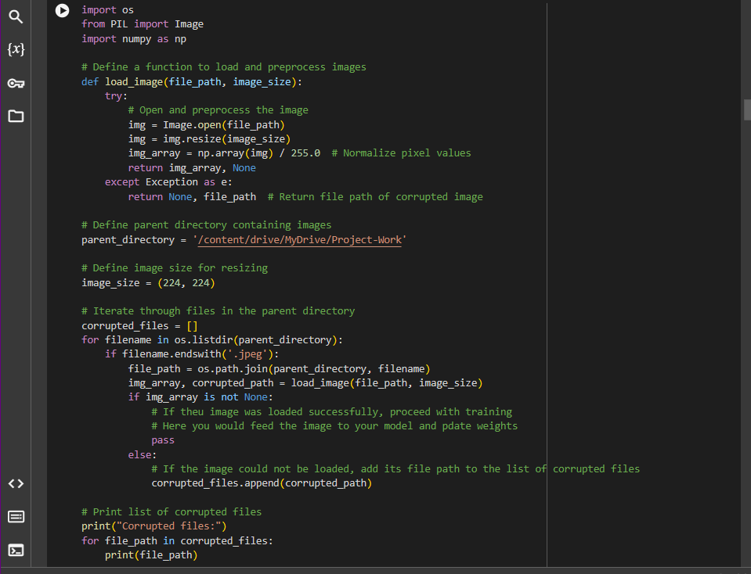
Data Cleaning Step – Removal of Corrupted Images
During initial phase of loading the images, it was noticed that some of the images were corrupted. Thus a specialized code was written in order to make note of such corrupted images, which were then removed manually from the region of observation.

Slide 16
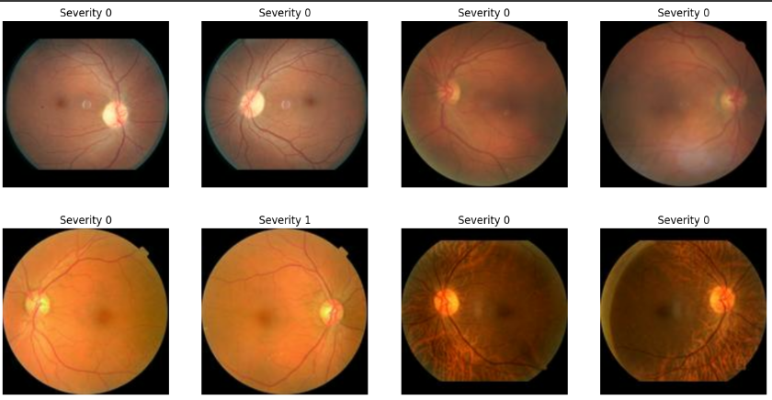
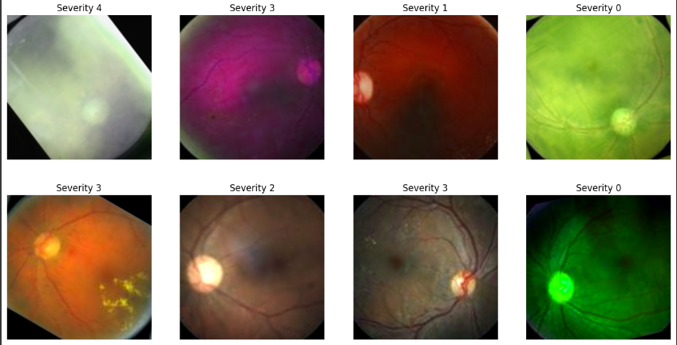
Image Augmentation Steps
Additionally different augmentation methods have been applied to the data such as random flip, random rotation, random contrast, random hue, and random brightness in order to augment the training data for better learning representations. This can be viewed in Fig.

Slide 17
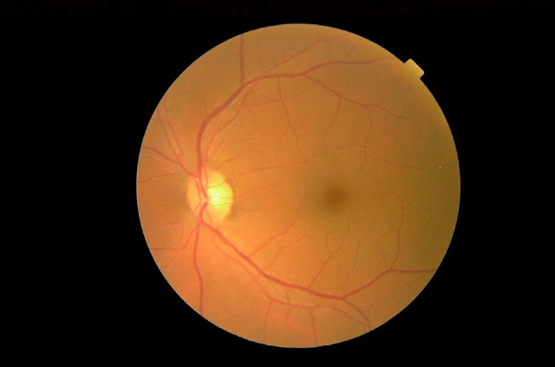
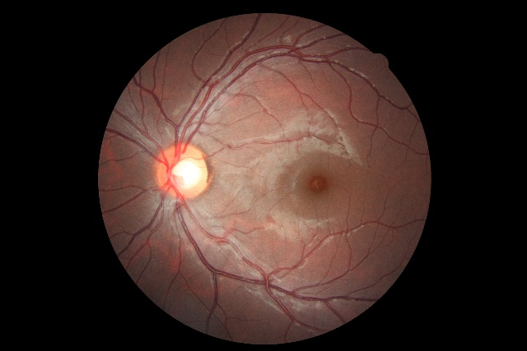
Additional Image Augmentation Steps
One of the observations from the data was that there were plenty of black areas with rather minimal focus on the fundus (region of interest). Thus a specialized augmentation step was made in order to minimize the black areas present inside the data

Slide 18
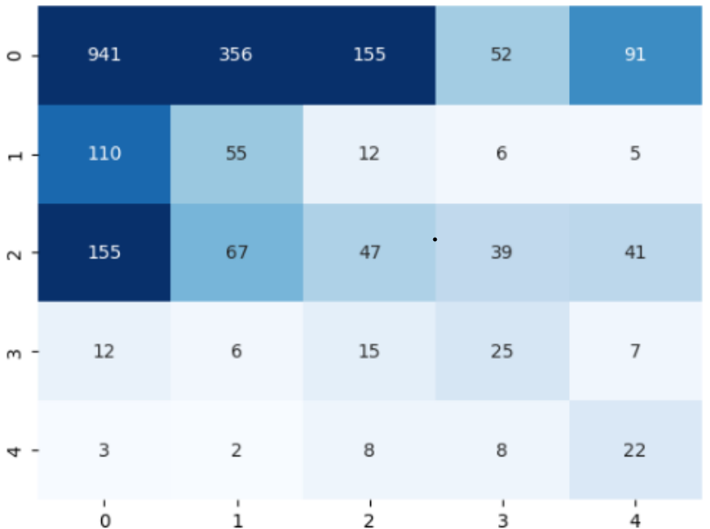
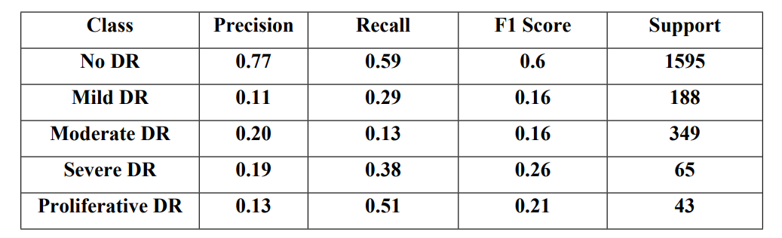
Result and Discussion
PREDICTION RESULTS OF EFFICIENTNETV2S
From Fig , It can be noted from the confusion matrix on EfficientNetV2S that the model is unable to classify that well. We notice a great many false negatives when looking at the first class which can imply that the feature representation is not learnt well. This can be due to the fact that the data is highly imbalanced for the first class, i.e Class 0 (No DR) as compared to the rest of the other classes. Table 5.1 displays the scores and metrics of the same.
Recall
Precision

Slide 19
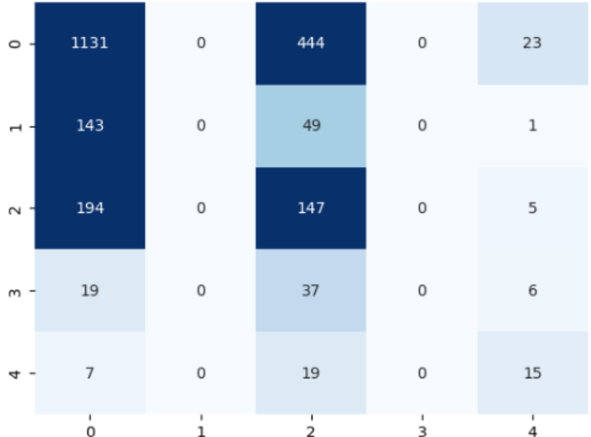
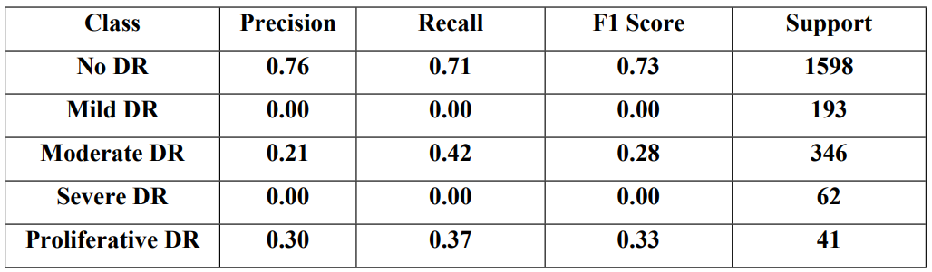
Prediction Results of EfficientNetV2B0
From Fig, It can be noted from the confusion matrix on EfficientNetV2B0 that the model is unable to classify properly. We notice a great many false positives when looking at the first and third class which can imply that the feature representation is not learnt well as compared to EfficientNetV2S which was able to learn somewhat better.
Recall
Precision

Slide 20
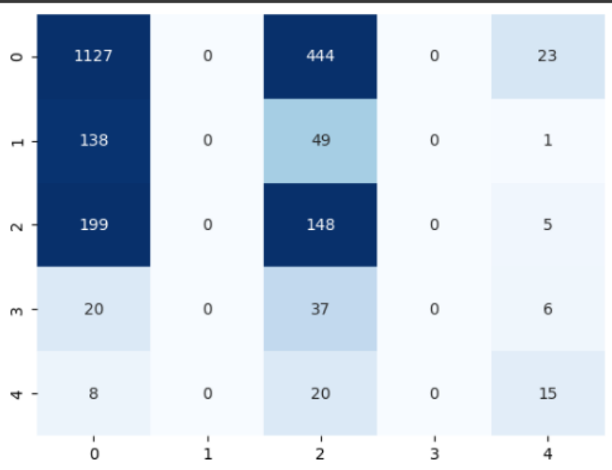
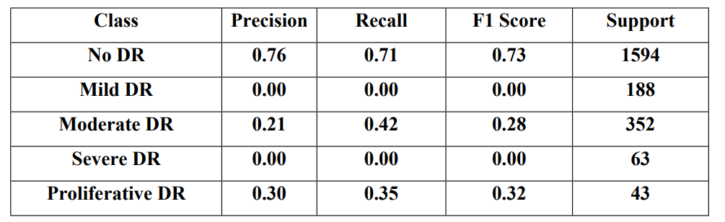
Prediction Results of EfficientNetV2B1
From Fig, It can be noted from the confusion matrix on EfficientNetV2B1 that the model is not that different from the B0 model. We notice a great many false positives when looking at the first and third class which can imply that the feature representation is not learnt well as compared to EfficientNetV2S which was able to learn somewhat better.
Recall
Precision

Slide 21
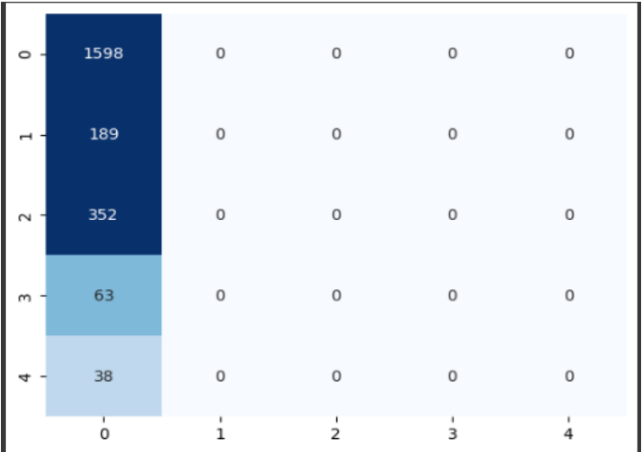
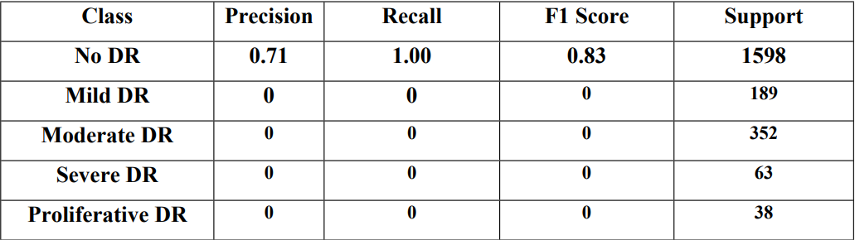
Prediction Results of Proposed Ensemble Model
From Fig, we can see that the proposed ensemble model which was a stacking model of predictions based on that of the EfficientNetV2B0, EfficientNetV2B1, and EfficientNetV2S performs even more poorly as compared to the other models as the features were not well learnt from the previous models given from the data. This can also be indicative of the fact that the model was able to learn the features of No DR properly but unable to accurately identify the other classes.
Recall
Precision

Slide 22
CONCLUSIONS AND FUTURE SCOPE
1. Utilizing Ensemble Learning with EfficientNetV2_S: The study demonstrates the effectiveness of ensemble machine learning techniques, particularly the stacking ensemble approach, in advancing the identification of diabetic retinopathy. The use of state-of-the-art deep learning architecture, EfficientNetV2_S, enhances the model's capabilities.
2. Challenges with Imbalanced Data: The dataset provided by the EyePacs Foundation exhibits significant class imbalance, with one class dominating the majority of the samples. This imbalance poses challenges for the model in learning feature representations effectively, particularly for minority classes.
3. Improvement through Data Preprocessing and Augmentation: Various preprocessing and augmentation techniques, such as adjusting saturation, contrast, brightness, hue, and employing random undersampling and oversampling methods, lead to slight improvements in model performance. However, there are indications of overfitting, suggesting the need for careful consideration of augmentation strategies.
4. Unmet Goal of Parameter Reduction for Edge Devices: Despite the study's goal of minimizing model parameters to lessen the burden on edge devices, this objective is not achieved. Future research directions include exploring alternative feature learning methods and pooling strategies, such as Fractional Max Pooling, to address this challenge effectively.
5. Future Prospects and Exploration: The study identifies avenues for future research, including investigating different techniques for handling dataset imbalance and considering novel approaches like combining fundus images from both left and right eyes to enhance feature representation. These avenues hold promise for improving the performance and robustness of diabetic retinopathy identification systems.

Slide 23
REFERENCES
[1] Diabetic retinopathy is the leading cause of visual loss
[2] Diabetic Retinopathy: Present andPast
https://www.sciencedirect.com/science/article/pii/S1877050918308068
[3] Detection of Diabetic Retinopathy using Convolutional Neural Networks
https://link.springer.com/article/10.1007/s11042-022-14165-4
[4] Identification of Diabetic Retinopathy through Machine Learning
https://www.hindawi.com/journals/misy/2023/9832745/
[5]Predicting the risk of developing diabetic retinopathy using deep learning
https://www.thelancet.com/journals/landig/article/PIIS2589-7500(20)30250-
8/fulltext

