Slide 1
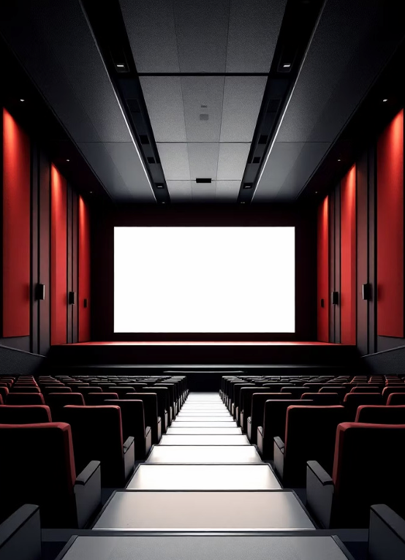
Movie Recommendation System Analysis
A technical deep dive into content-based filtering using TF-IDF vectorization and cosine similarity
Made By - ADITI

Slide 2

Executive Summary
System Overview
This content-based recommendation engine processes 4,803 movies with 24 attributes, utilizing TF-IDF vectorization and cosine similarity to generate personalized suggestions without requiring user ratings.
Key Technologies
Python with Pandas and NumPy for data manipulation
Scikit-learn for TF-IDF vectorization
Cosine similarity for matching
Difflib for fuzzy title matching

Slide 3
Data Loading & Initial Inspection
Dataset Structure
4,803 movies × 24 columns including budget, genres, overview, vote average, cast, crew, and director fields
Sample Highlights
Top entries include Avatar (budget
$237M,
Action/Adventure/Fantasy/Sci-Fi, rating 7.2) and Pirates of the Caribbean sequels
Data Types
Textual features (genres, keywords, tagline) combined with numerical attributes (budget, ratings) for comprehensive analysis

Slide 4
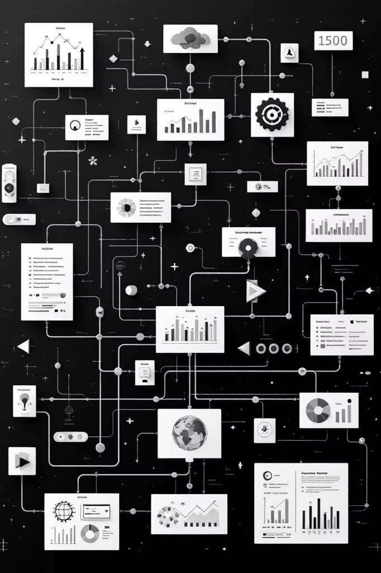
Data Cleaning Pipeline
01 02
Remove Duplicates
Applied drop_duplicates() to ensure unique movie entries and prevent bias in recommendations
Identify Features
Selected genres, keywords, tagline, cast, and director for content analysis
03
Handle Missing Values
Filled null entries with empty strings via iterative loop to avoid imputation bias in textual features

Slide 5
Feature Engineering Process
Feature Concatenation
Five selected features merged into single
combined_features column:
movies_data['genres'] + movies_data['keywords'] + movies_data['tagline'] + movies_data['cast'] + movies_data['director']
This creates unified text representation for each movie.
Vectorization Results
TfidfVectorizer() transformed text into sparse matrix: Shape: (4,803 movies × 17,318 features)
Non-zero elements: 124,266
Density: ~0.15%
TF-IDF weighting captures term importance across movie descriptions.

Slide 6
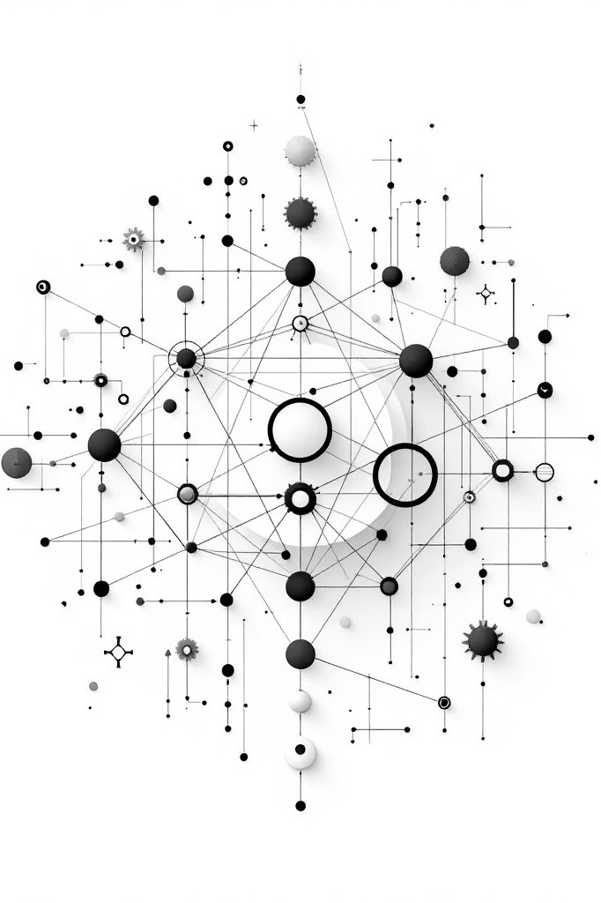



Model Architecture
Text Vectorization
TF-IDF converts movie descriptions into numerical vectors
Cosine Similarity
Computes pairwise similarity matrix (4,803 × 4,803)
Efficient Retrieval
Diagonal elements = 1.0 (self-similarity), off-diagonal values indicate matches

Slide 7
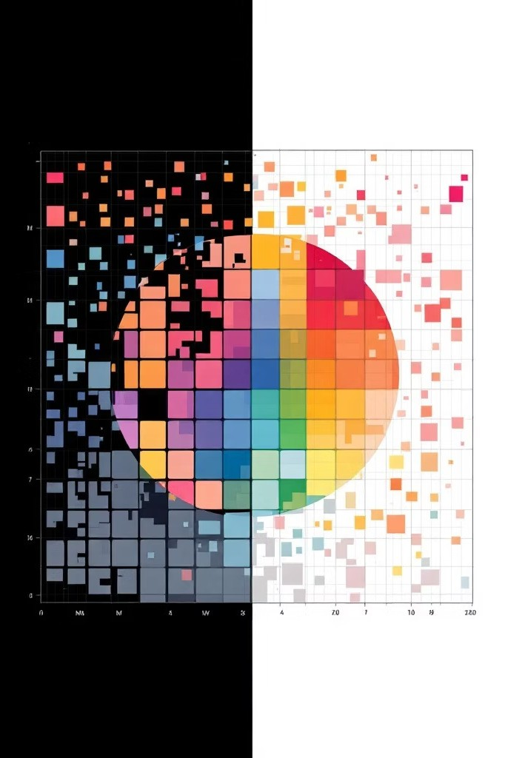
Similarity Matrix Analysis
4,803
Matrix Dimension
Square matrix capturing all pairwise movie relationships
1.0
Self-Similarity
Diagonal elements represent identical movie matches
0.072
Avatar-Pirates
Moderate similarity score reflecting genre overlap
The similarity matrix enables efficient top-N retrieval without collaborative filtering or user ratings, making it scalable for large catalogs.

Slide 8

Recommendation Logic
Query Processing
User inputs favorite movie (e.g., "Guardians of the Galaxy")
difflib matches against 4,803 titles with fuzzy matching
Retrieves movie index from dataset
Extracts corresponding similarity row
Sorts indices by cosine scores (descending)
Selects top 5 non-self matches
Returns movie titles as recommendations
Implementation Notes
System can return up to 30 recommendations, excluding the input movie itself from results.
The interactive loop supports multiple queries, enabling users to explore different starting points.

Slide 9
Sample Output: Guardians of the Galaxy
1. Avatar
High similarity score reflecting shared sci-fi and action elements
2. The Chronicles of Riddick
Space opera with similar visual spectacle and adventure themes
3. Star Trek Beyond
Franchise sequel with ensemble cast in space adventure setting
4. Star Trek Into Darkness
Continuation of modern Trek reboot with action-oriented storytelling
5. Moonraker
Classic space-themed James Bond adventure with sci-fi elements
Recommendations prioritize highest cosine similarity scores, balancing genre matching with cast and crew attributes.

Slide 10
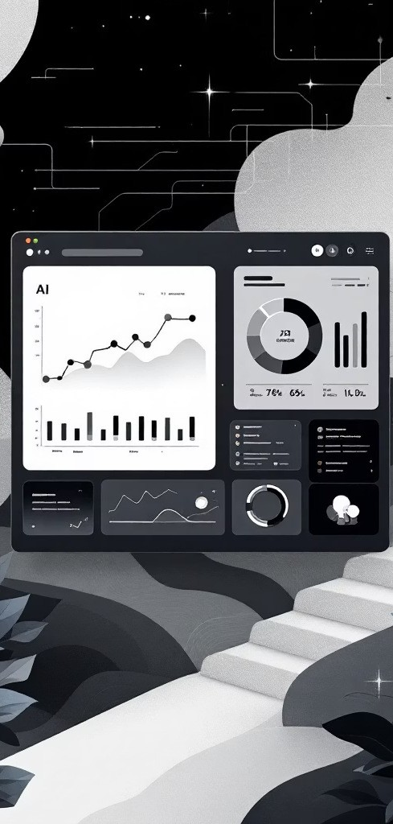

Conclusion & Next Steps
Content-Based Strengths
No cold-start problem, interpretable recommendations, scalable without user ratings
Improvement Opportunities
Integrate collaborative filtering, add user feedback loops, implement genre weighting
Production Readiness
Vectorized matching enables sub-second queries; consider caching similarity matrix
This system demonstrates effective content-based filtering using TF- IDF and cosine similarity, providing a foundation for hybrid recommendation approaches combining multiple signals.

