Slide 1
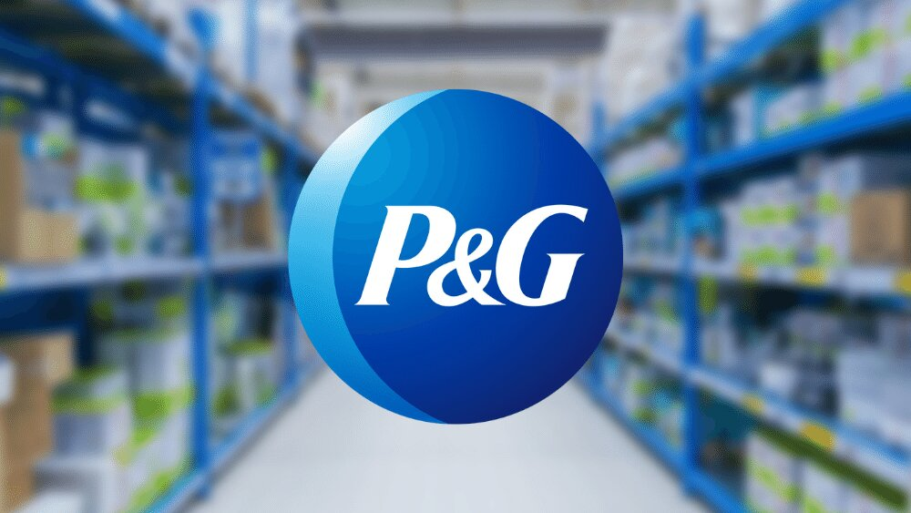
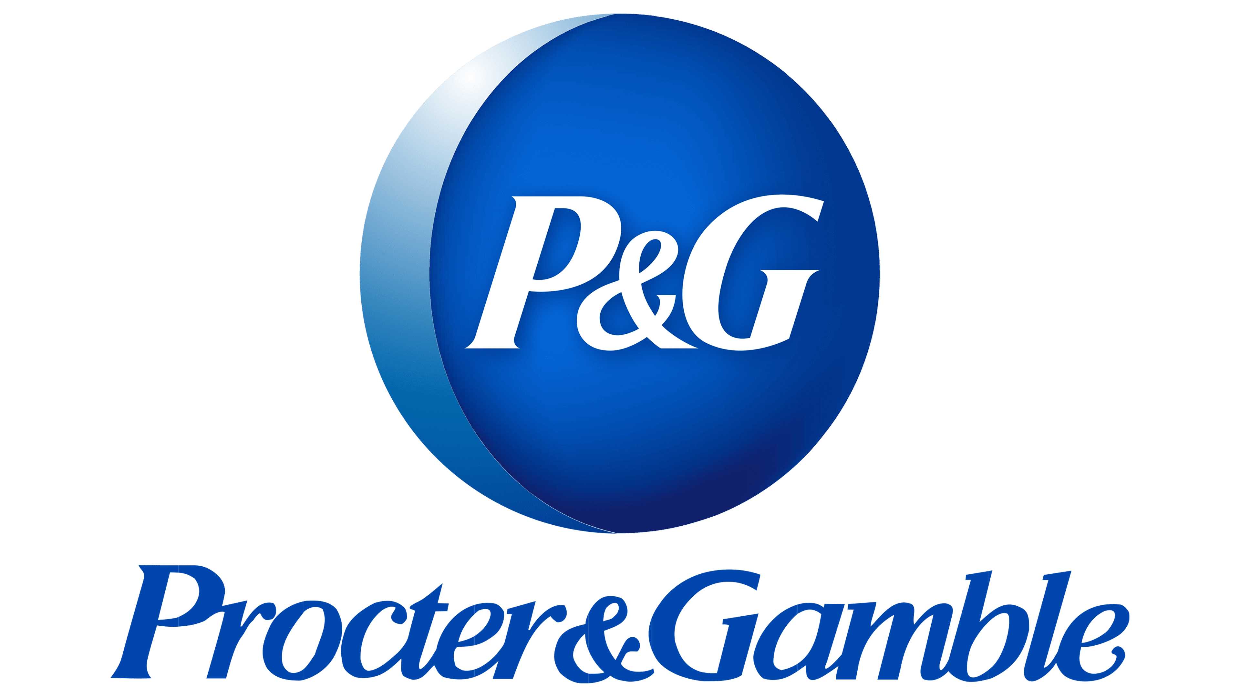
Procter & Gamble (P&G) Annual Report 2025
A Global Leader in Consumer Goods
Stock Price: $152.49 | Fortune 500 Rank: #51 | Market Cap: $370B
Submitted by: Aditi, Harsh Yadav, Aanchal, Jatin, Sagar, Yug
Submitted to: Dr. Amarjeet Kaur

Slide 2
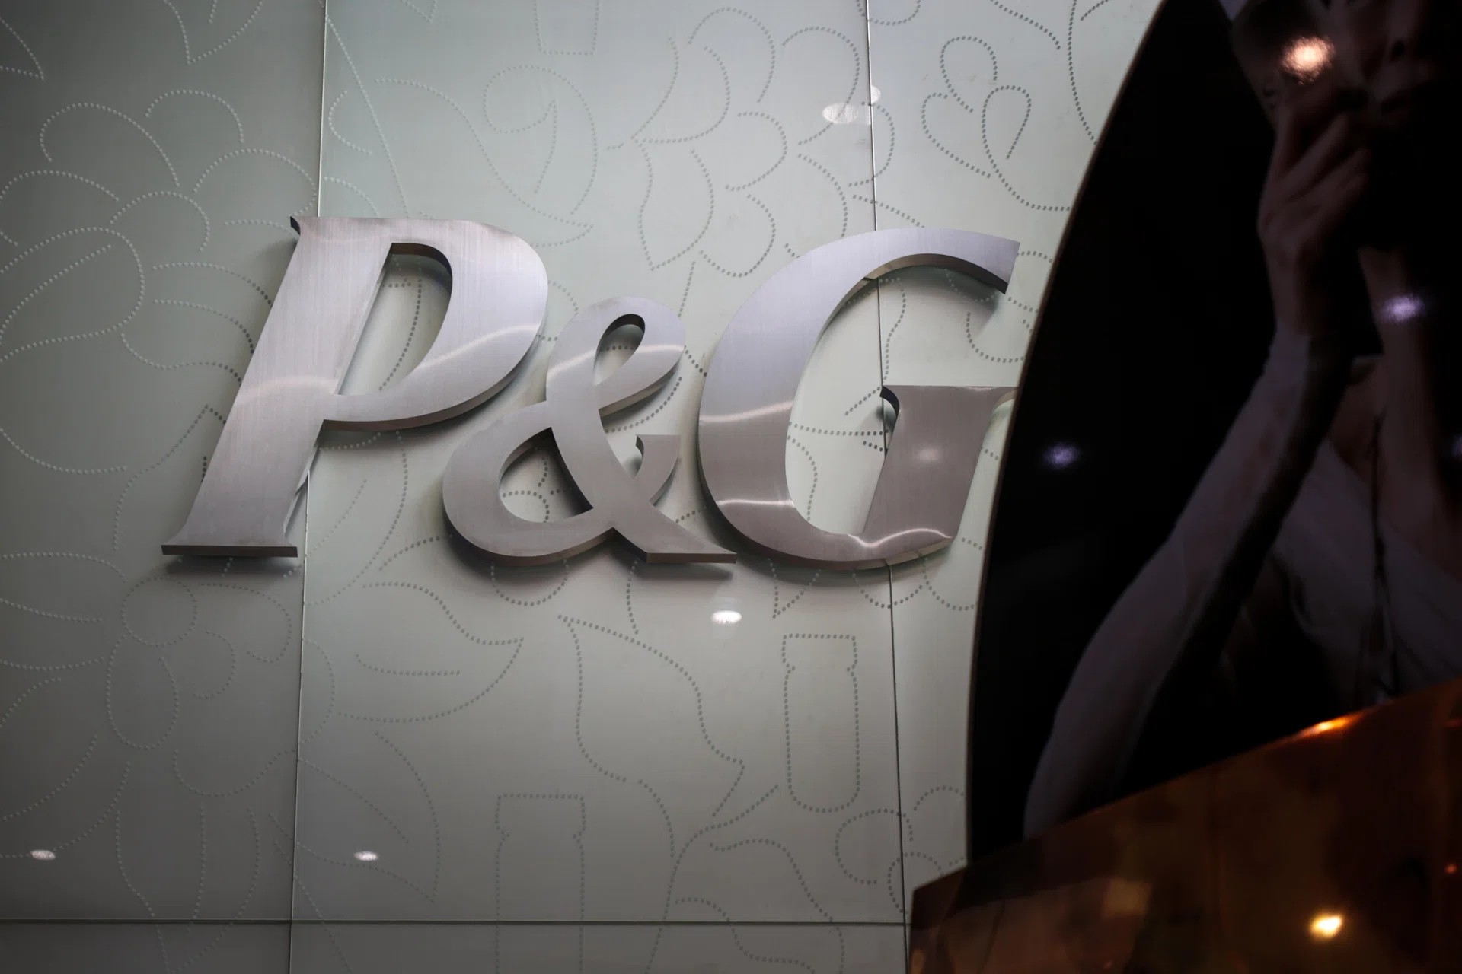
Company Overview
• Founded: 1837 | HQ: Cincinnati, Ohio, USA
• Industry: FMCG | Operations in 180+ countries
• CEO: Jon Moeller → Shailesh Jejurikar (from Jan 2026)
• Brands: Tide, Pampers, Gillette, Oral-B, Olay, Pantene
• Competitors: Unilever, Colgate, Johnson & Johnson
• Focus on innovation, sustainability, and customer trust.

Slide 3
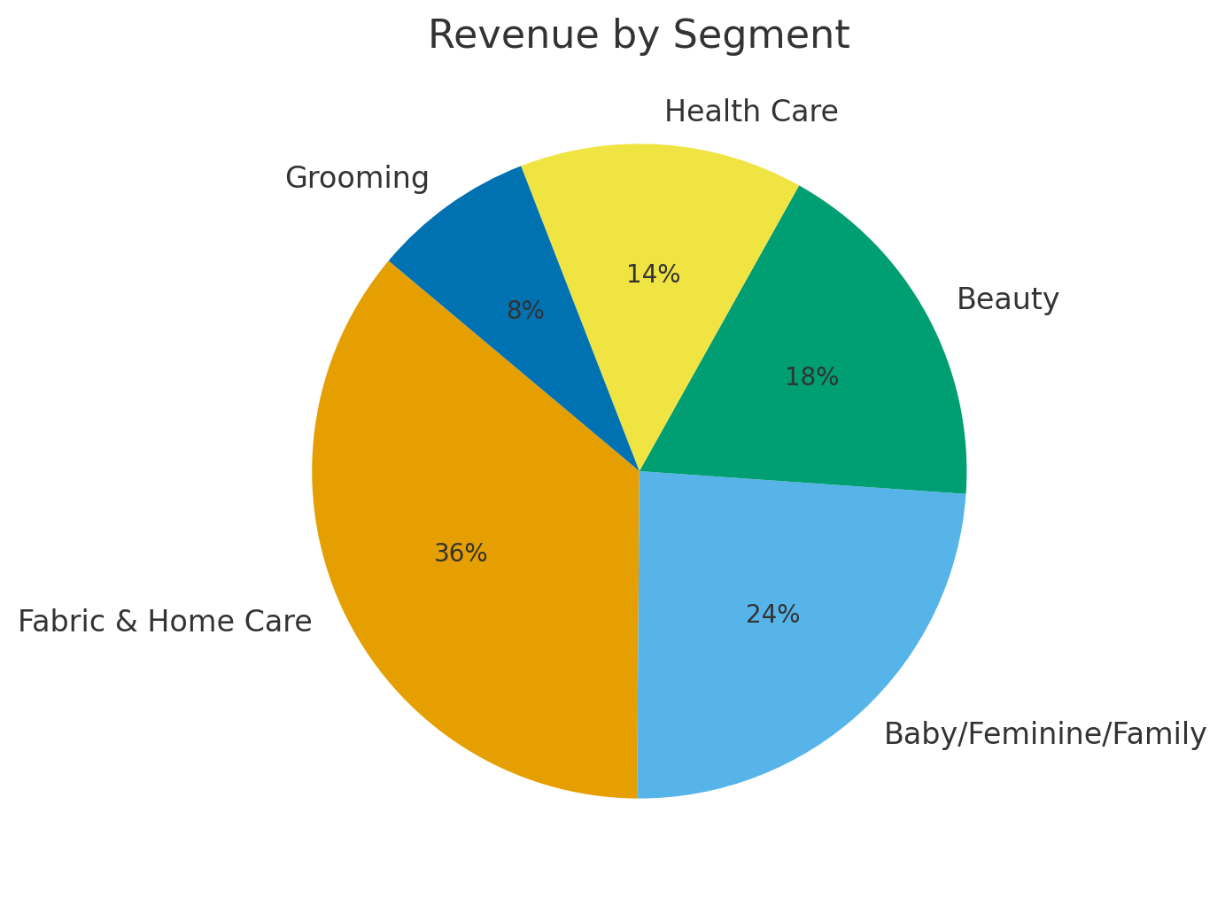
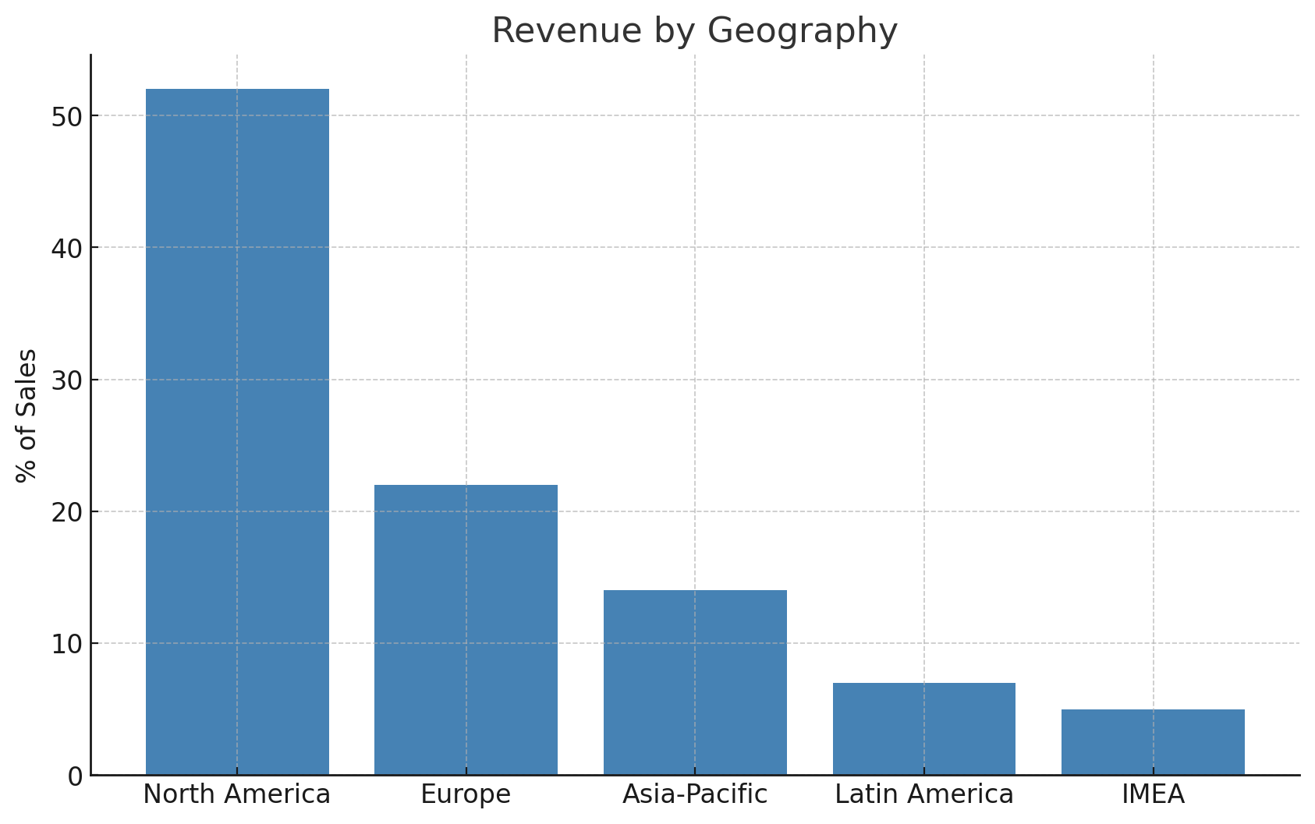
Revenue Overview
Segments by Revenue Share (FY 2025):
Fabric & Home Care: 36%
Baby, Feminine & Family Care: 24%
Beauty: 18%
Health Care: 14%
Grooming: 8%
Geographic Sales Share:
North America: 52%
Europe: 22%
Greater China: 7%
Latin America: 7%
Asia Pacific: 7%
IMEA: 5%
Brands: Tide, Pampers, Gillette, Oral-B, Olay, Pantene, Vicks

Slide 4
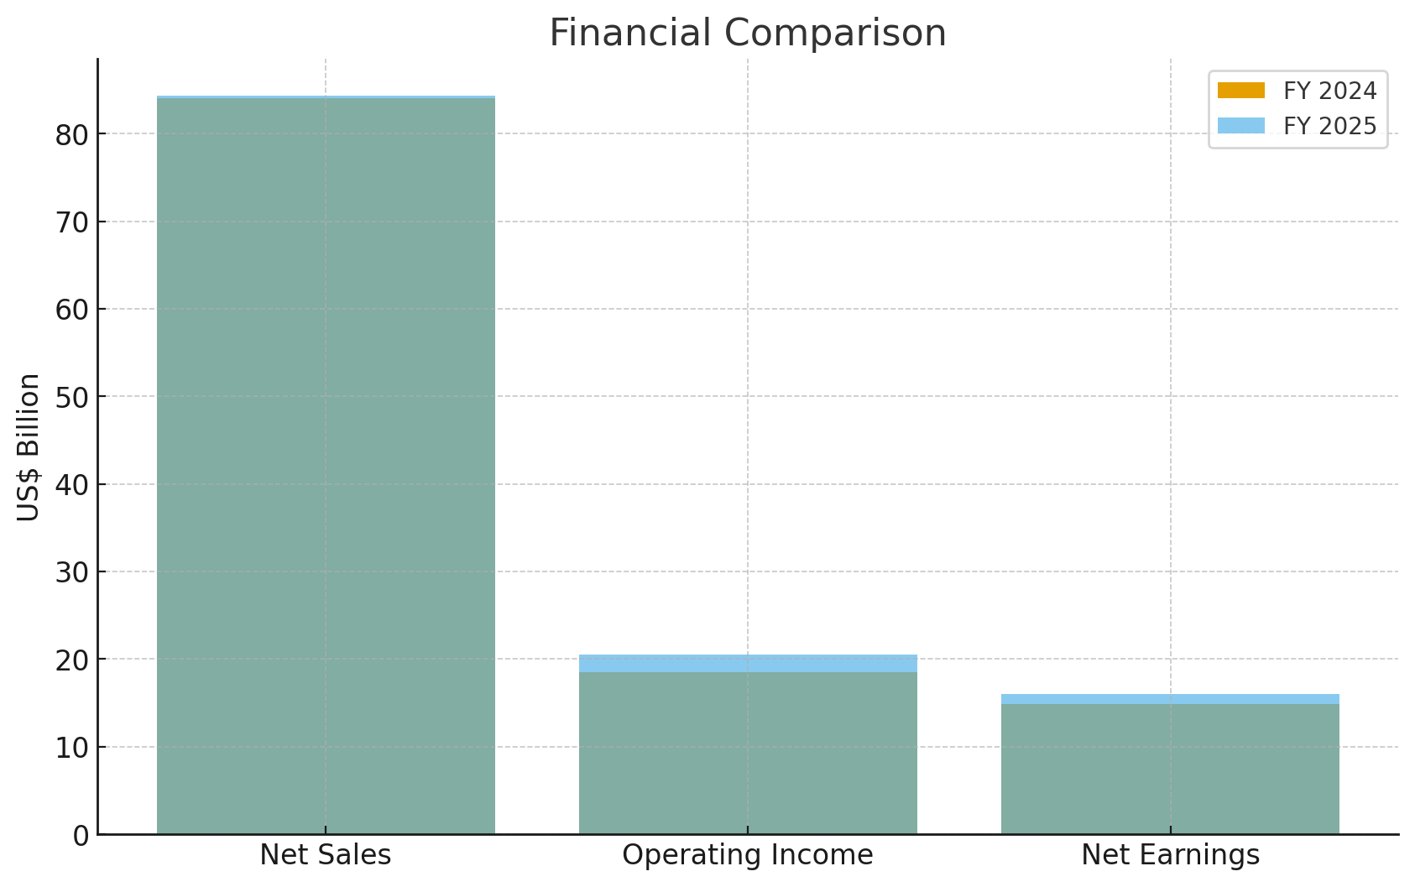
Financial Highlights (FY 2025 vs FY 2024)
Metric | 2025 | Growth vs 2024
Net Sales | $84.3 | 0.36%
Operating Income | $20.5 | 10.81%
Net Earnings Attributable to P&G | $16.0 | 7.38%
Net Earnings Margin | 19.10% | +1.3 pts
Diluted Net Earnings per Share | $6.51 | 8.13%
Core Earnings per Share | $6.83 | 3.64%
Operating Cash Flow | $17.8 | -10.10%
Dividends per Common Share | $4.08 | 6.52%
Capital Returned | $15.0B | Dividends + Share Buybacks
Free Cash Flow Productivity | 105% | Exceeded Target

Slide 5
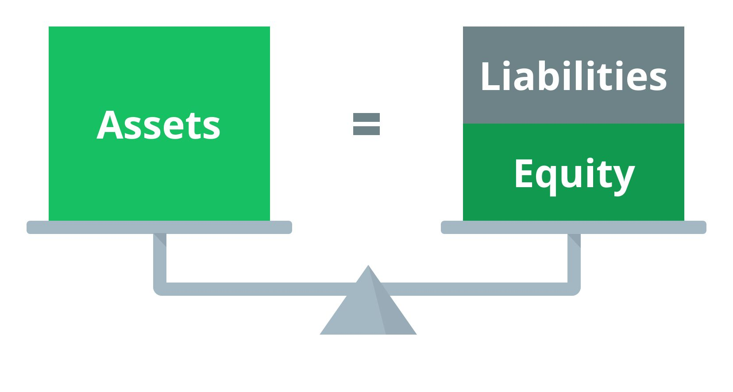
Balance Sheet & Key Ratios
• Total Assets: $125.2B = Liabilities: $72.9B + Equity: $52.3B
• Current Ratio: 0.70 (Industry Avg: 1.0)
Current ratio= current assets/current liabilities
• Debt-to-Assets: 0.58 (Industry Avg: 0.5)
Debt to assets ratio=Total liabilities/Total/assets
• Strong equity base and manageable debt structure.
• Consistent dividend payouts showing financial health.

Slide 6
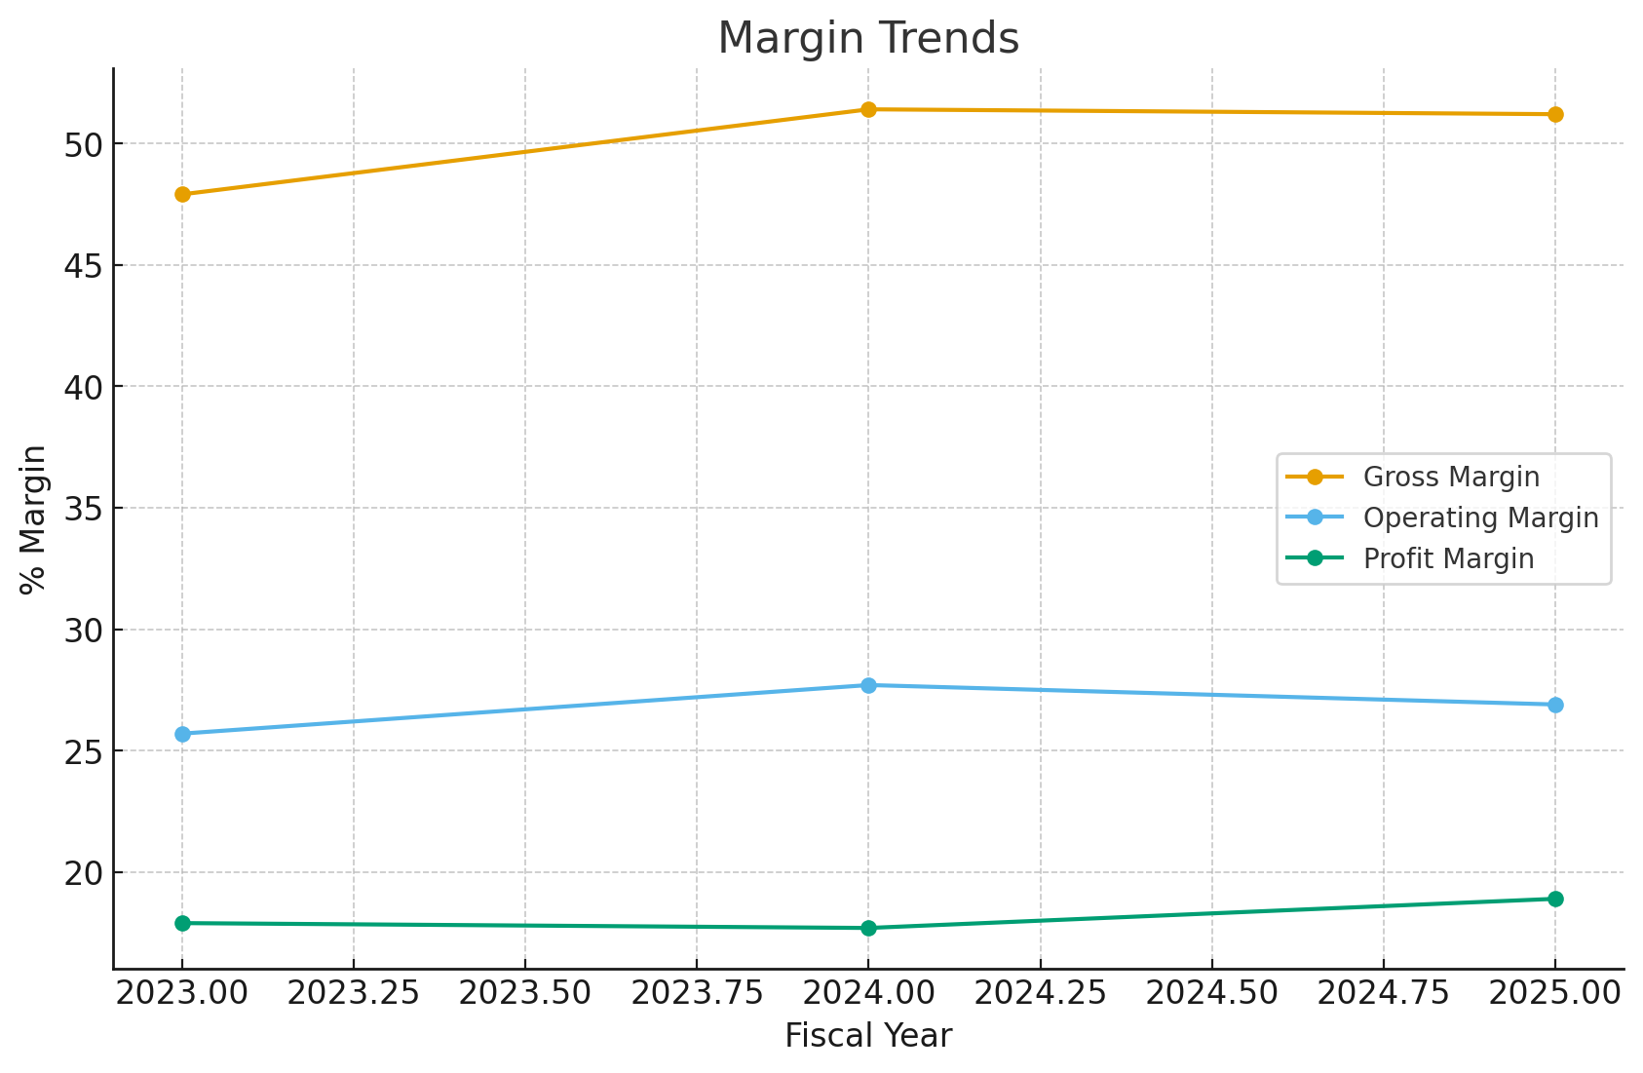
Profitability Ratios (2023–2025)
Common Size Income Statement (FY 2025):
Gross Margin: 51.16%
Operating Margin: 26.90%
Profit Margin: 18.95%
Return on Assets: 12.76%
3-Year Revenue Trend:
2023: $82.0B → 2024: $84.0B → 2025: $84.3B
Comparison vs. Industry:
Operating & Profit Margins above industry average
ROA slightly below industry benchmark
EPS Growth:
Basic EPS: $6.67 Diluted EPS: $6.51

Slide 7
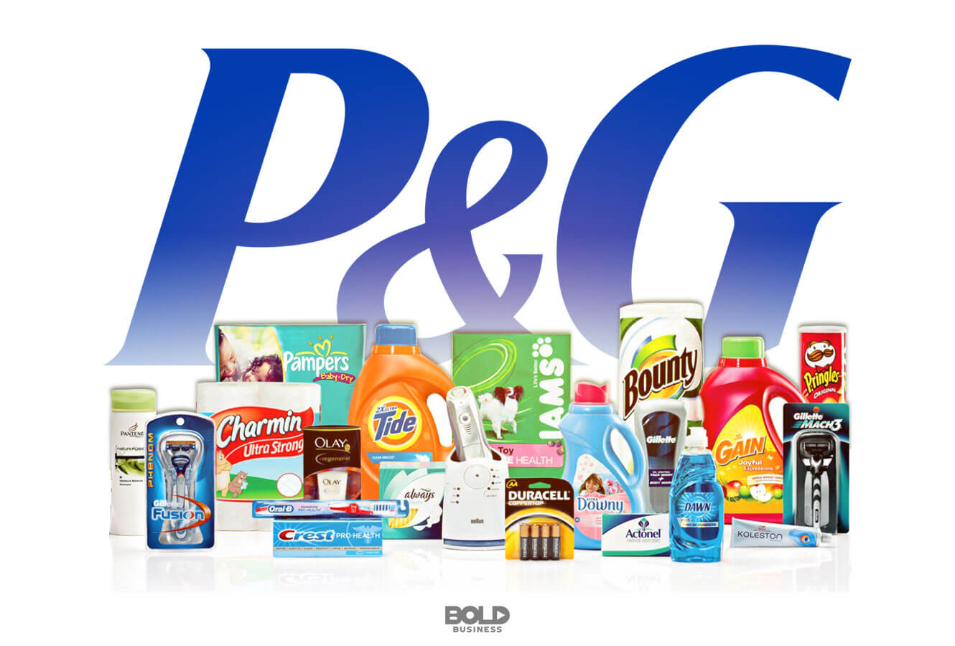
Key Insights & Conclusion
• Deloitte & Touche LLP provided a clean audit opinion.
• Leadership transition ensures strategic continuity.
• Sustainability efforts in water, waste, and climate.
• Altman Z-Score of 5.5 indicates very low bankruptcy risk.
• P&G maintains its position as a financially strong, globally trusted brand.

