Slide 1
Chapter 4
Object Based Databases

Slide 2
Object-Based Databases
Overview of OO concepts
Object Structures
Complex Data Types and Object Orientation
Structured Data Types and Inheritance in SQL
Table Inheritance
Array and Multiset Types in SQL
Object Identity and Reference Types in SQL
Comparison of Object-Oriented and Object-Relational Databases

Slide 3
Need for OBD
Traditional/ relational database applications consist of data processing tasks, such as banking & Payroll management, with relatively simple data types, which are well suited to the relational data model.
As database systems where applied for wider range of applications, such as compute-aided & geographical information systems, limitations imposed by relational model emerged as an obstacle.
The solution was to introduce object based databases ,which can allow one to deal with complex data types.
OO databases try to maintain a direct correspondence between real-world and database objects so that objects do not lose their integrity and identity and can easily be identified and operated upon.
In contrast, in traditional database systems, information about a object is often scattered over many relations or records, leading to loss of direct correspondence between a real-world object and its database representation.

Slide 4
Object Identity, Object Structure
Objects:
  User defined complex data types
  Objects –An object has structure or state (variables) and methods (behavior/operations)
  Two components: state (value) and behavior (operations). Similar to program variable in programming language, except that it will typically have a complex data structure as well as specific operations defined by the programmer
An object is described by four characteristics
  Identifier: a system-wide unique id for an object
  Name: an object may also have a unique name in DB (optional)
  Lifetime: determines if the object is persistent or transient
  Structure: Construction of objects using type constructors

Slide 5
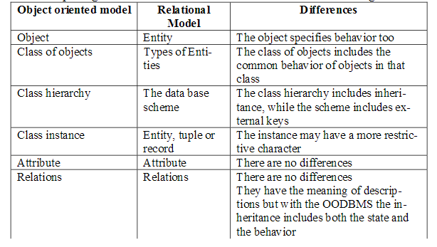
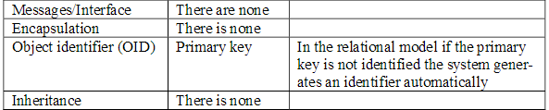
Comparing OODBMS and RDBMS : Data modeling

Slide 6
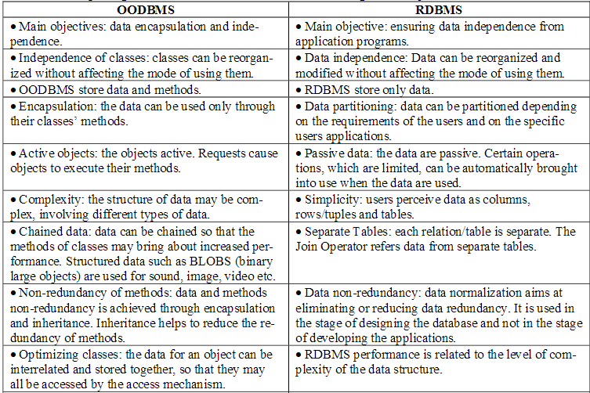
Comparing OODBMS and RDBMS : Objectives

Slide 7
Object-Relational Data Models
They try to Extend the relational data model by including object orientation and constructs to deal with added data types.
  ORDBMS=RDBMS+OODBMS
Allow attributes of tuples to have complex types, including non-atomic values such as nested relations.
Preserve relational foundations, in particular the declarative access to data, while extending modeling power.

Slide 8
Comparing OODBMS & ORDBMS
OODBMSs and ORDBMSs both support user-defined ADTs, structured types, object identity and reference types, and in-heritance.
They both support a query language for manipulating collection types.
ORDBMSs support an extended form of SQL, and OODBMSs support ODL/OQL.
ORDBMSs consciously try to add OODBMS features to an RDBMS, and OODBMS in their turn have developed query languages based on relational query languages.
Both OODBMSs and ORDBMSs provide DBMS functionality such as concurrency control and recovery.
OODBMSs try to add DBMS functionality to a programming language, whereas ORDBMSs try to add richer data types to a relational DBMS

Slide 9
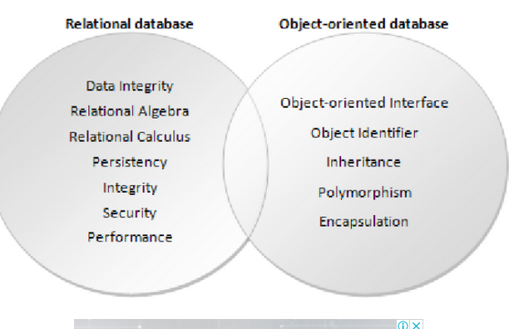
An object-relational database is an advanced and enhanced version of object-oriented database. In other words, an object-relational database is a hybrid of the relational model and the object-oriented model.

Slide 10
Complex Data Types
Motivation:
  Permit non-atomic domains (atomic ≡ indivisible)
  Example of non-atomic domain: set of integers, or set of tuples
  Allows more intuitive modeling for applications with complex data
Intuitive definition:
  allow relations whenever we allow atomic (scalar) values — relations within relations
  Retains mathematical foundation of relational model
  Violates first normal form.

Slide 11
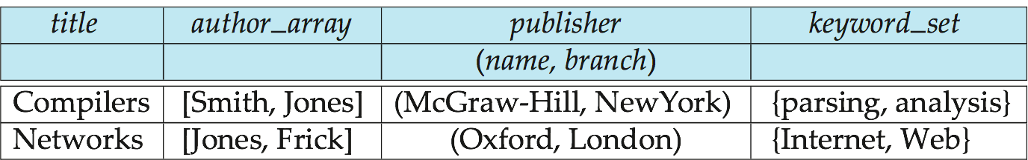
Example of a Nested Relation
Example: library information system
Each book has
  title,
  a list (array) of authors,
  Publisher, with subfields name and branch, and
  a set of keywords
Non-1NF relation books

Slide 12
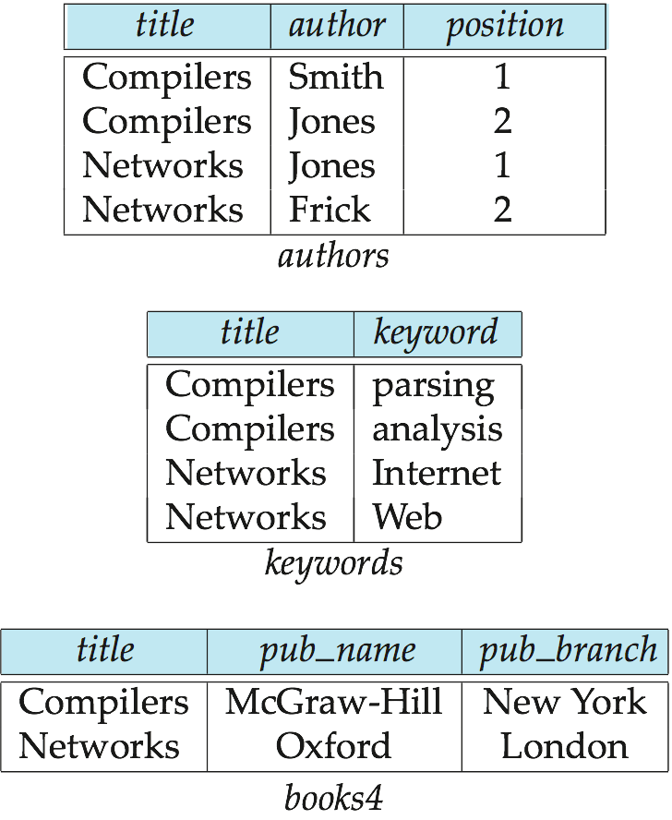
4NF Decomposition of Nested Relation
Suppose for simplicity that title uniquely identifies a book
  In real world ISBN is a unique identifier
Decompose books into 4NF using the schemas:
  (title, author, position )
  (title, keyword )
  (title, pub-name, pub-branch )
4NF design requires users to include joins in their queries.

Slide 13
Complex Types and SQL
Extensions introduced in SQL:1999 to support complex types:
  Collection types
    E.g. arrays, multisets
  Structured types
    Nested record structures like composite attributes
  Inheritance
  Object orientation
    Including object identifiers and references
Not fully implemented in any database system currently
  But some features are present in each of the major commercial database systems

Slide 14
Structured Types and Inheritance in SQL
Structured types (a.k.a. user-defined types) can be declared and used in SQL
create type Name as
(firstname varchar(20),
lastname varchar(20))
final
create type Address as
(street varchar(20),
city varchar(20),
zipcode varchar(20))
not final
  Note: final and not final indicate whether subtypes can be created
Structured types can be used to create tables with composite attributes
create table person (
name Name,
address Address,
dateOfBirth date)
Dot notation used to reference components:
  e.g. select name.lastname, address.city from person

Slide 15
Structured Types (cont.)
We can also create a table whose rows are a user-defined type
create type PersonType as (
name Name,
address Address,
dateOfBirth date)
not final
  create table person of PersonType
We can create table in alternative way to define composite attributes in SQL calling unnamed row types.
create table person_r(
name row(firstname varchar(20),
lastname varchar(20)),
address row(street varchar(20),
city varchar(20),
zipcode varchar(20)),
dateOfBirth date)
This is quite similar to previous table except that the attributes name & address have unnamed types and rows of table have unnamed type as well

Slide 16
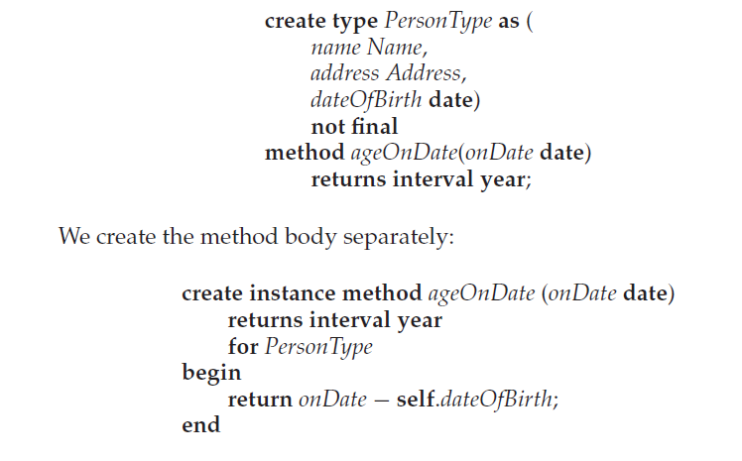
Methods
Can add a method declaration with a structured type.
for clause indicates which type this method is for, while keyword instance indicates that this method executes of an instance of person type.
The variable self refers to the person instance on which the method is invoked
Method can be invoked an instance of type. If we have created a table person of type PersonType ,we could invoke the method ageOnDate()
select name.lastname,ageOnDate(current_date)
from Person;

Slide 17
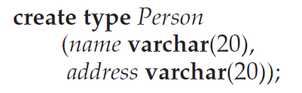
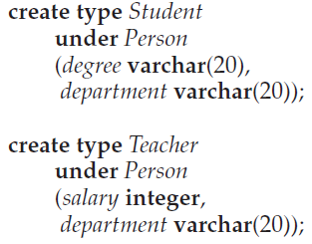
Type Inheritance
Suppose that we have the following type definition for people:
Using inheritance to define the student and teacher types
Subtypes can redefine methods by using overriding method in place of method in the method declaration

Slide 18
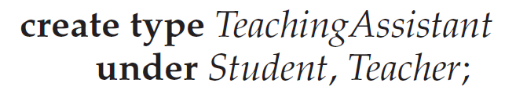
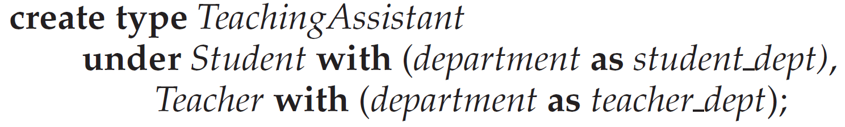
Multiple Type Inheritance
SQL:1999 and SQL:2003 do not support multiple inheritance
If our type system supports multiple inheritance, we can define a type for teaching assistant as follows:
To avoid a conflict between the two occurrences of department we can rename them
Each value must have a most-specific type

Slide 19


Table Inheritance
Tables created from subtypes can further be specified as subtables
Tuples added to a subtable are automatically visible to queries on the supertable
  E.g. query on people also sees students and teachers.
  Similarly updates/deletes on people also result in updates/deletes on subtables
  To override this behaviour, use “only people” in query
Conceptually, multiple inheritance is possible with tables
  e.g. teaching_assistants under students and teachers
  But is not supported in SQL currently
    So we cannot create a person (tuple in people) who is both a student and a teacher

Slide 20
Consistency Requirements for Subtables
Consistency requirements on subtables and supertables.
  Each tuple of the supertable (e.g. people) can correspond to at most one tuple in each of the subtables (e.g. students and teachers)
  Additional constraint in SQL:1999:
  All tuples corresponding to each other (that is, with the same values for inherited attributes) must be derived from one tuple (inserted into one table).
    That is, each entity must have a most specific type
    We cannot have a tuple in people corresponding to a tuple each in students and teachers

Slide 21
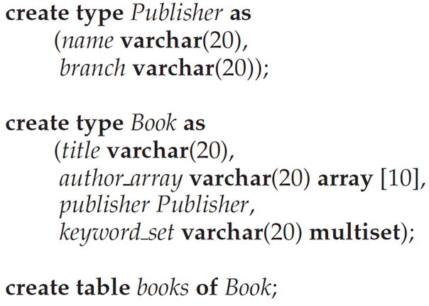
Array and Multiset Types in SQL
Example of array and multiset declaration:
Multiset is unordered collection where an element may occurred multiple times.
Array are ordered so distinguish from one author to another

Slide 22
Creation of Collection Values
Array construction
array [‘Silberschatz’,`Korth’,`Sudarshan’]
Multisets
  multiset [‘computer’, ‘database’, ‘SQL’]
To create a tuple of the type defined by the books relation: (‘Compilers’, array[`Smith’,`Jones’],
new Publisher (`McGraw-Hill’,`New York’), multiset [`parsing’,`analysis’ ])
To insert the preceding tuple into the relation books
insert into books
values
(‘Compilers’, array[`Smith’,`Jones’],
new Publisher (`McGraw-Hill’,`New York’),
multiset [`parsing’,`analysis’ ]);

Slide 23
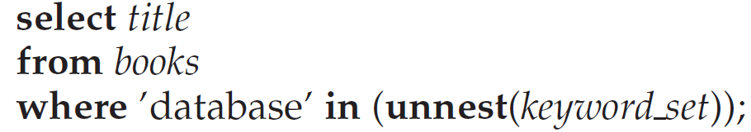
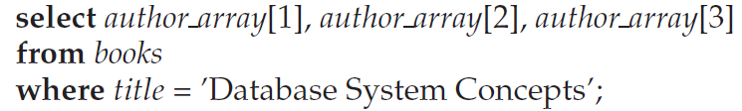

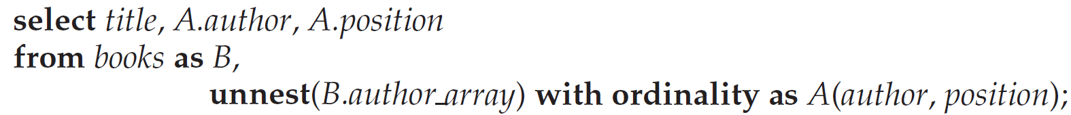
Querying Collection-Valued Attributes
To find all books that have the word “database” as a keyword,
We can access individual elements of an array by using indices
  E.g.: If we know that a particular book has three authors, we could write:
To get a relation containing pairs of the form “title, author_name” for each book and each author of the book
To retain ordering information we add a with ordinality clause

Slide 24
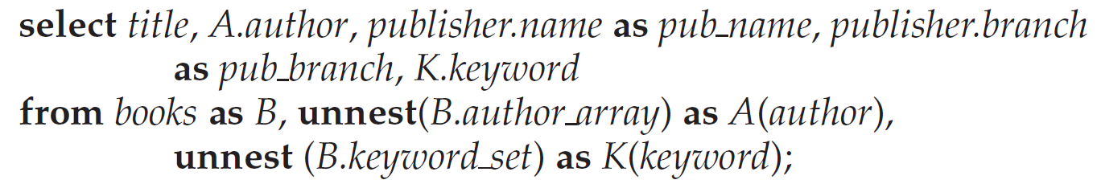
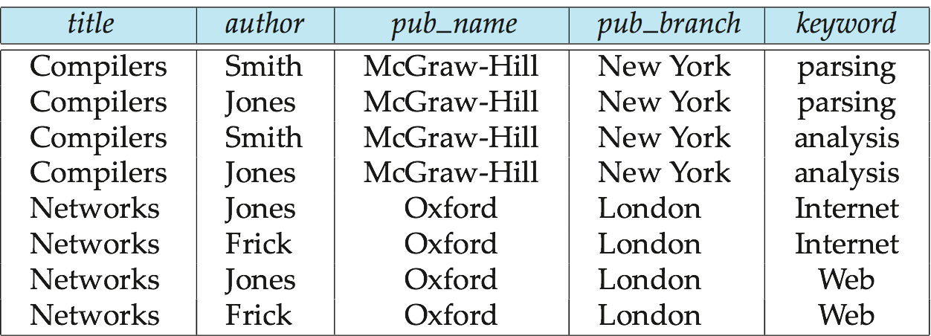
Unnesting
The transformation of a nested relation into a form with fewer (or no) relation-valued attributes us called unnesting.
E.g.
Result relation flat_books

Slide 25
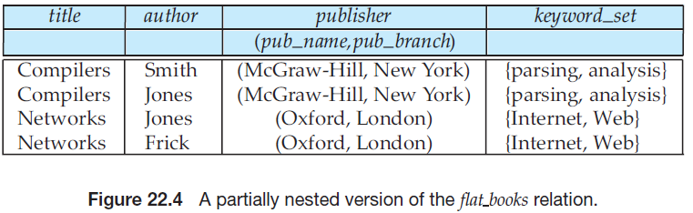
Nesting
Nesting is the opposite of unnesting, creating a collection-valued attribute
Nesting can be done in a manner similar to aggregation, but using the function collect() in place of an aggregation operation, to create a multiset
To nest the flat_books relation on the attribute keyword:
select title, author, Publisher (pub_name, pub_branch ) as publisher,
collect (keyword) as keyword_set
from flat_books
groupby title, author, publisher

Slide 26
Nesting (Cont.)
To nest on both authors and keywords:
select title, collect (author ) as author_set,
Publisher (pub_name, pub_branch) as publisher,
collect (keyword ) as keyword_set
from flat_books
group by title, publisher
Another approach to creating nested relations is to use subqueries in the select clause which uses Order by clause for desire order for output
select title,
array (select author
from authors as A
where A.title = B.title order by A.position) as author_array,
Publisher (pub-name, pub-branch) as publisher,
multiset (select keyword
from keywords as K
where K.title = B.title) as keyword_set
from books4 as B

Slide 27
Object-Identity and Reference Types
Object –Oriented Languages Provide the ability to refer objects
An attribute of a type can be reference to an object of a specified type
Suppose we define a type Department with a field name and a field head which is a reference to the type Person, with table people as scope:
create type Department (
name varchar (20),
head ref (Person) scope people)
create table departments of Department
Here ,the reference is restricted to the tuple of table people. it makes references behave like foreign keys

Slide 28
Object-Identity and Reference Types
So we can omit the declaration scope people from the type declaration and instead make an addition to the create table statement:
create type Department (
name varchar (20),
head ref (Person))
create table departments of Department
(head with options scope people)

Slide 29
Object-Identity and Reference Types
Using the WITH OPTIONS clause of CREATE TABLE, you can define that a relationship exists between a column in one table and the objects in the same or another table.
In the example illustrated above, the head for each Department is actually a reference to an object in the People table.
Referenced table must have an attribute that stores the identifier of the tuple, called the self-referential attribute
create table people of Person
ref is person_id system generated;
Here , person _id is attribute name ,and system generated statement specifies that identifier is generated automatically by database.

Slide 30
Object-Identity and Reference Types
Now in order to initialize a reference attribute ,we need to get the identifier of the tuple that is to be referenced. we can get this identifier value of a tuple by means of a query.
To create a tuple with a reference value, we can first create the tuple with a null reference and then set the reference separately:
insert into departments
values (`CS’, null)
update departments
set head = (select p.person_id
from people as p
where name = `John’)
where name = `CS’

Slide 31
User Generated Identifiers
An alternative to system generated identifiers is to allow users to generate identifiers.
The type of the self- referential attribute must be specified as part of the type definition of the referenced table, and the table definition must specify that the reference is user generated
create type Person
(name varchar(20)
address varchar(20))
ref using varchar(20)
create table people of Person
ref is person_id user generated

Slide 32
User Generated Identifiers
When creating a tuple, we must provide a unique value for the identifier:
  insert into people (person_id, name, address )
  values (‘01284567’, ‘John’, `23 Coyote Run’)
We can then use the identifier value when inserting a tuple into departments
  Avoids need for a separate query to retrieve the identifier:
insert into departments
values(`CS’, `02184567’)

Slide 33
User Generated Identifiers (Cont.)
Can use an existing primary key value as the identifier:
create type Person
(name varchar (20) primary key,
address varchar(20))
ref from (name)
create table people of Person
ref is person_id derived
When inserting a tuple for departments, we can then use
insert into departments
values(`CS’,`John’)

Slide 34
Path Expressions
References are dereferenced in SQL 1999 by “–>” symbol
Ex. Find the names and addresses of the heads of all departments:
select head –>name, head –>address
from departments
An expression such as “head–>name” is called a path expression
Since head is a ref to a tuple in the people table, the attribute name in the query is the name attribute from the people table
References can be used to help avoid explicit joins
  If department head were not a reference, a join of departments with people would be required to get at the address

Slide 35
Persistent Programming Languages
Languages extended with constructs to handle persistent data
Programmer can manipulate persistent data directly
  no need to fetch it into memory and store it back to disk (unlike embedded SQL)
Persistent objects:
  Persistence by class - explicit declaration of persistence
  Persistence by creation - special syntax to create persistent objects
  Persistence by marking - make objects persistent after creation
  Persistence by reachability - object is persistent if it is declared explicitly to be so or is reachable from a persistent object

Slide 36
Object Identity and Pointers
Degrees of permanence of object identity
  Intraprocedure: only during execution of a single procedure
  Intraprogram: only during execution of a single program or query
  Interprogram: across program executions, but not if data-storage format on disk changes
  Persistent: interprogram, plus persistent across data reorganizations
Persistent versions of C++ and Java have been implemented
  C++
    ODMG C++
    ObjectStore
  Java
    Java Database Objects (JDO)

Slide 37
Persistent C++ Systems
Extensions of C++ language to support persistent storage of objects
Several proposals, ODMG standard proposed, but not much action of late
  persistent pointers: e.g. d_Ref<T>
  creation of persistent objects: e.g. new (db) T()
  Class extents: access to all persistent objects of a particular class
  Relationships: Represented by pointers stored in related objects
    Issue: consistency of pointers
    Solution: extension to type system to automatically maintain back-references
  Iterator interface
  Transactions
  Updates: mark_modified() function to tell system that a persistent object that was fetched into memory has been updated
  Query language

Slide 38
Persistent Java Systems
Standard for adding persistence to Java : Java Database Objects (JDO)
  Persistence by reachability
  Byte code enhancement
    Classes separately declared as persistent
    Byte code modifier program modifies class byte code to support persistence
      E.g. Fetch object on demand
      Mark modified objects to be written back to database
  Database mapping
    Allows objects to be stored in a relational database
  Class extents
  Single reference type
    no difference between in-memory pointer and persistent pointer
    Implementation technique based on hollow objects (a.k.a. pointer swizzling)

Slide 39
Comparison of O-O and O-R Databases
Relational systems
  simple data types, powerful query languages, high protection.
Persistent-programming-language-based OODBs
  complex data types, integration with programming language, high performance.
Object-relational systems
  complex data types, powerful query languages, high protection.
Object-relational mapping systems
  complex data types integrated with programming language, but built as a layer on top of a relational database system
Note: Many real systems blur these boundaries
  E.g. persistent programming language built as a wrapper on a relational database offers first two benefits, but may have poor performance.

Slide 40
End of Chapter 22

Slide 41
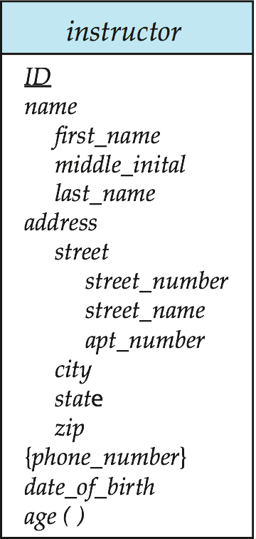
Figure 22.05

Slide 42

Figure 22.07

Slide 43
create type Name as
(firstname varchar(20),
lastname varchar(20))
final
create type Address as
(street varchar(20),
city varchar(20),
zipcode varchar(20))
not final
create type Person
(name varchar (20),
address varchar(20))
create type Student
Under Person
(degree varchar (20),
department varchar(20))

