Slide 1


AGRICULTURAL DECISION SUPPORT SYSTEM
BATCH-67
TEAM MEMBERS:
2003A52127 ADUPA VIVEK
2003A52115 NEERIPELLY VAIBHAVI
2003A52034 KOLETI MAHALAXMI
2003A52060 MOHAMMED SHAREEQ
2003A52121 THUNGANI VISHNU SRI
GUIDE NAME:
Mrs. NEELIMA GURRAPU

Slide 2
INTRODUCTION:
.
.
In India, agriculture serves as the backbone of the economy, yet farmers often face challenges due to traditional farming practices, leading to suboptimal crop yields and environmental degradation.
To address these issues, a paradigm shift towards precision agriculture is necessary.
Precision agriculture involves the use of advanced technologies and data analytics to optimize agricultural practices and improve productivity.
Our research focuses on developing an Agricultural Decision Support System (ADSS) that leverages machine learning algorithms to assist farmers in making informed decisions for crop selection and fertilizer usage.

Slide 3

PROBLEM STATEMENT:
Challenges Faced by Farmers:
Farmers encounter numerous challenges in optimizing crop yield, selecting suitable crops, and determining the right fertilizers.
Factors such as climate change, soil variability, and market demand add complexity to decision-making.
Need for Data-Driven Solutions:
Traditional methods often lack precision and may result in suboptimal outcomes.
There's a pressing need for intelligent systems that leverage data to provide actionable insights for farmers.

Slide 4

SOLUTION OVERVIEW:
Our Approach:
We propose a comprehensive solution comprising three
key components:
1. Crop yield Suggestion
2. Crop recommendation
3. Fertilizer prediction
How It Works:
These components utilize machine learning algorithms and data analysis techniques to provide tailored recommendations to farmers.
By harnessing the power of data, we aim to empower farmers to make informed decisions and enhance agricultural productivity sustainably.

Slide 5
CROP YIELD SUGGESTION
Description:
The crop yield Suggestion component focuses on suggesting the yield of various crops based on environmental factors such as temperature, humidity, and soil type.
Machine learning models analyze historical data to classify crops into different yield categories, enabling farmers to anticipate productivity levels accurately.
Importance:
Accurate crop yield classification enables farmers to optimize resource allocation, plan harvest schedules, and manage market expectations effectively.

Slide 6
Dataset Overview:
Contains crop yield production data along with remarks.
124,969 records.
Remarks are binary, with a mean value indicating yield status.
Data Preprocessing:
Handled missing values by filling with column means.
Encoded categorical variables using LabelEncoder for model compatibility.
Feature Selection and Scaling:
Selected features and target variable (yield production) for model training.
Split data into training and testing sets.
Scaled features using StandardScaler for uniformity.

Slide 7
Machine Learning Models:
Implemented Random Forest, Decision Tree, K-Nearest Neighbors, Gaussian Naive Bayes, and SVM algorithms for Suggestion.
Model Evaluation:
Evaluated models based on accuracy, sensitivity, and specificity.
Visualized model comparison using bar plots.
Model Saving and Comparison:
Saved the best performing model for future use.
Created a comparison table to compare scores of different models.
Plotted performance comparison of algorithms using line plots.

Slide 8
CROP RECOMMENDATION
Description:
The crop recommendation component suggests suitable crops for cultivation based on factors such as climate conditions, soil characteristics, and market demand.
Utilizing predictive analytics, the system identifies crops with the highest likelihood of success in a given region, considering both agronomic and economic factors.
Benefits:
Farmers can diversify their crop portfolios, mitigate risks associated with climate variability, and capitalize on market opportunities by following tailored recommendations.

Slide 9
Data Overview:
Dataset contains environmental parameters such as temperature, humidity, pH, and rainfall, along with nutrient levels (N, P, K).
Includes a target variable consisting of crop labels and a binary label indicating suitability (label1).
It consists of 3100 rows
Data Preprocessing:
Utilized encoding techniques like LabelEncoder to convert categorical variables into numerical format for model compatibility.
Scaled features using StandardScaler to standardize data and bring all features to a similar scale, preventing bias in model training.
Model Training & Evaluation:
Employed machine learning classifiers like Logistic Regression, Decision Tree, Random Forest, K-Nearest Neighbors, and Support Vector Machine.
Models evaluated based on accuracy score to determine performance. Evaluated accuracy, sensitivity, and specificity for each classifier.

Slide 10
Hyperparameter Tuning:
Utilized Grid search technique to optimize hyperparameters for enhanced model performance.
Model Comparison:
Compared accuracies of different algorithms using bar chart visualization.
Confusion Matrix Analysis:
Calculated and visualized confusion matrix for the best performing classifier.
Performance Comparison Plot:
Plotted mean accuracy, sensitivity, and specificity scores of each algorithm for performance comparison.

Slide 11
FERTILIZER PREDICTION
Description:
The fertilizer prediction component assists farmers in selecting the most appropriate fertilizers for their crops, optimizing nutrient management and soil health.
Machine learning algorithms analyze soil nutrient levels, crop requirements, and environmental conditions to recommend the ideal fertilizer formulations.
Impact:
Precision fertilizer application reduces input costs, minimizes environmental impact, and maximizes crop yields, leading to sustainable agricultural practices.

Slide 12
Importing Libraries:
Utilized essential libraries such as Pandas, Seaborn, Matplotlib, NumPy, and warnings for data processing, visualization, and Machine learning.
Loading and Exploring the Dataset:
Loaded the dataset using Pandas and displayed the first few rows to understand its structure.
Checked data types, null values, and unique values in each column to gain insights into the dataset.
It has 1432 rows
Data Preprocessing:
Renamed columns for consistency and clarity.
Handled missing values by dropping rows with null values.
Encoded categorical variables like 'Soil Type', 'Crop Type', and 'Fertilizer Name' using LabelEncoder for model compatibility.

Slide 13
Exploratory Data Analysis (EDA):
Conducted EDA for continuous variables (Temperature, Humidity, Moisture, Nitrogen, Potassium, Phosphorous) using histograms, box plots to understand distributions and identify outliers.
Analyzed the relationship between categorical variables (Soil Type, Crop Type) and continuous variables.
Model Training and Evaluation:
Split the data into training and testing sets using train_test_split.
Trained multiple classification models including Logistic Regression, Random Forest, Gradient Boosting, Support Vector Machine, K-Nearest Neighbors, and Decision Tree.
Evaluated models using accuracy score, classification report, and confusion matrix.
Hyperparameter Tuning:
Performed Grid search with Cross-validation to tune hyperparameters for improving model performance.
Model Comparison and Selection:
Compared the performance of different models using accuracy scores and selected the best-performing model.

Slide 14
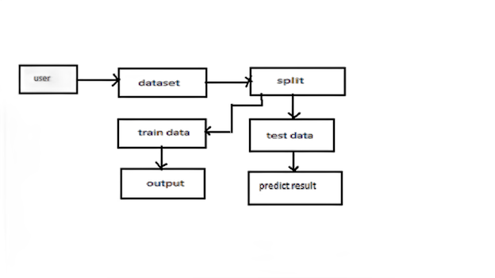
SYSTEM ARCHITECTURE DIAGRAM

Slide 15
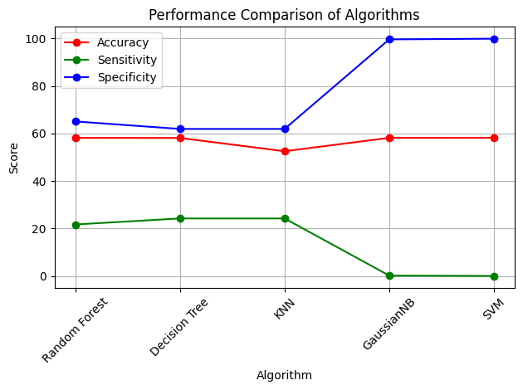
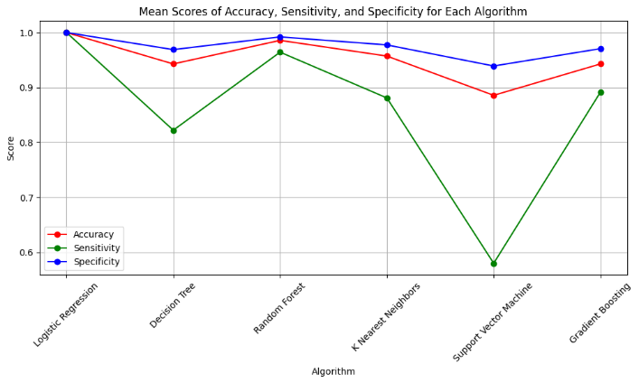
COMPARISION AND RESULTS:
Model | Accuracy
Random Forest | 0.8067
Decision Tree | 0.8016
K-Nearest Neighbors | 0.7880
-Gaussian Naive Bayes | 0.8726
SVM | 0.8731
Model | Accuracy
Random Forest | 0.9995
Decision Tree | 1.0000
K-Nearest Neighbors | 0.9620
Support Vector Machine | 0.9987
Logistic Regression | 0.8653
Model | Accuracy
Random Forest | 0.9857
Decision Tree | 0.9482
K-Nearest Neighbors | 0.9571
Support Vector Machine | 0.8857
Logistic Regression | 1.0000
Gradient Boosting | 0.9428
CROP YIELD SUGGESTION
CROP RECOMMENDATION SYSTEM
FERTILIZER RECOMMENDATION SYSTEM

Slide 16
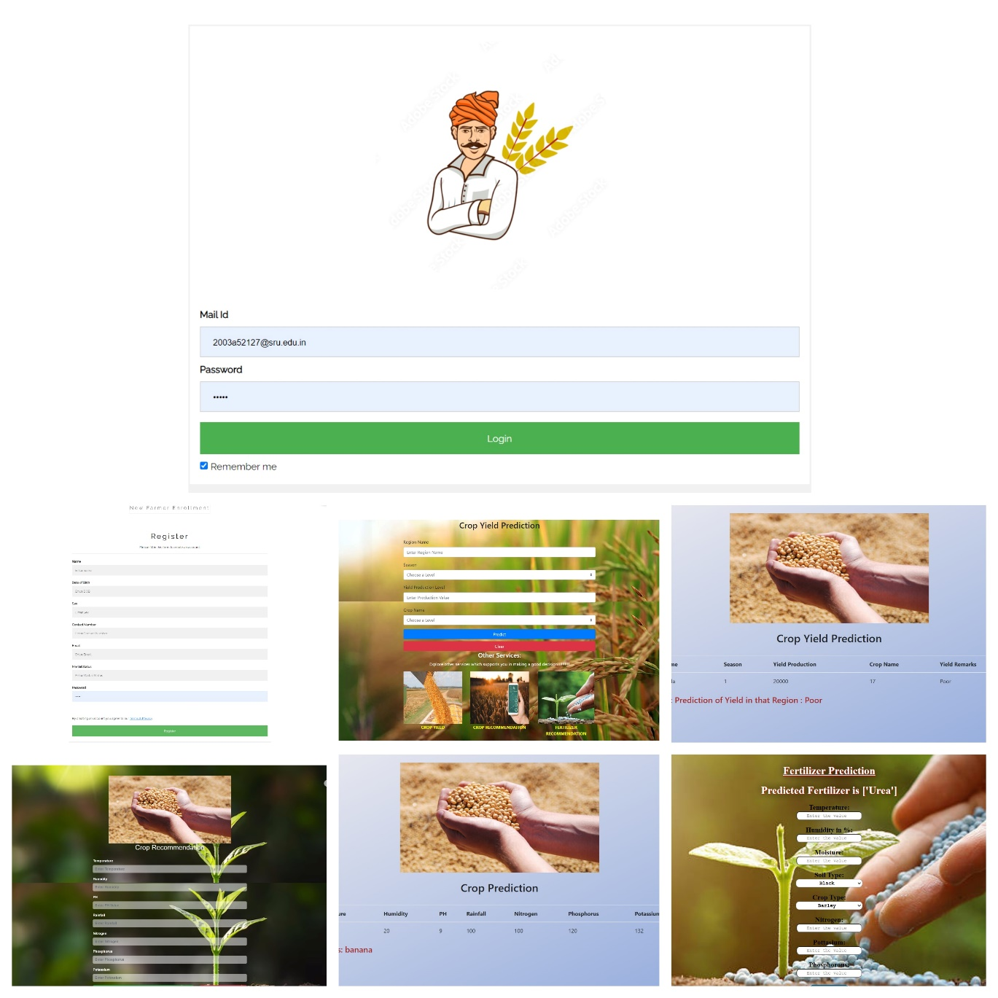
:**
Login Page:
- Enables user authentication with username and password.
- Includes registration option for new users.
- Ensures secure access to system features.
2. Register Page:
- Allows new user registration with basic details.
- Validates user input for accuracy and security.
- Redirects users to login page after successful registration.
3. Crop Yield suggestion Page:
- Classifies crop yield based on environmental parameters.
- Utilizes machine learning for accurate predictions.
4. Crop Recommendation Page:
- Recommends suitable crops based on user input.
- Considers environmental factors and user preferences.
- Offers detailed crop information and interactive features.
5. Fertilizer Recommendation Page:
- Recommends optimal fertilizers for crop growth.
- Considers soil nutrient levels and crop requirements.
6. Results Pages:
- Displays outcomes of predictions and recommendations.
INTERFACE IMAGES:

Slide 17
EXPERIMENTAL OUTCOME
Description:
Our project aims to recommend the most suitable crop for a particular land based on key parameters such as annual rainfall, temperature, humidity, and soil pH.Users input data related to temperature, humidity, and soil pH to generate personalized crop recommendations.
Additionally, users can input NPK (Nitrogen, Phosphorus, Potassium) values, crucial nutrients for crop growth, to receive recommendations for required NPK fertilizers tailored to the recommended crop.
Outcome:
Accuracy: Our experimental results demonstrate high accuracy across all components, indicating the effectiveness of our data-driven approach in agricultural decision-making.The Highest accuracy algorithms are
Crop Yield Suggestion:SVM
Crop Recommendation :Decision tree
Fertilizer Recommendation:Logistic Regression
Impact: By providing accurate crop yield classification,crop and fertilizer recommendations, our system empowers farmers to optimize resource allocation, increase productivity, and promote sustainable agricultural practices.

Slide 18
FUTURE SCOPE:
Looking ahead, there is immense potential to expand the capabilities of our system and explore new avenues for innovation in agriculture. Future developments may include:
Integration of GPS technology to automate data collection and crop prediction based on precise geographic coordinates.
Collaboration with government agencies to access real-time data on weather forecasts and market trends, enabling more accurate and timely decision-making.
Development of predictive models to anticipate and mitigate food shortages and crises, thereby promoting food security and resilience in agricultural systems.
By embracing these opportunities and leveraging advancements in technology and data science, we can unlock new possibilities for sustainable agriculture and contribute to the prosperity of farming communities.

Slide 19
CONCLUSION
Our agricultural decision support system offers a user-friendly interface and robust functionality to assist farmers in making informed decisions about crop selection and cultivation practices.
By leveraging machine learning and data analytics, we aim to mitigate the risks associated with traditional farming methods and enhance agricultural productivity and profitability.
The implementation of our system addresses the existing challenges faced by farmers, including the potential for erroneous crop selection and income reduction due to suboptimal farming practices.
By providing comprehensive recommendations and insights, our system empowers farmers to optimize resource allocation, maximize yields, and improve market competitiveness.
By continually refining our system and integrating emerging technologies, we can further enhance its efficacy and impact on agricultural practices.

Slide 20
REFERENCES
[1] Raskar, S., Abhang, A., Pethe, N., & Attar, V.Z. (2022). Crop Yield Prediction and Recommendation System. 2022 IEEE Pune Section International Conference (PuneCon), 1-6.
[2] Kushwaha, A.K. (2015). Crop yield prediction using Agro Algorithm in Hadoop.
[3] Girish L, Gangadhar S, Bharath T R, Balaji K S, Abhishek K T (2018)“Crop Yield and Rainfall Prediction in Tumakuru District using Machine Learning”.
[4] Katarya, R., Raturi, A., Mehndiratta, A., & Thapper, A. (2020). Impact of Machine Learning Techniques in Precision Agriculture. 2020 3rd International Conference on Emerging Technologies in Computer Engineering: Machine Learning and Internet of Things (ICETCE), 1-6.
[5]Iniyan, S., Varma, V.A., & Naidu, C.T. (2023). Crop yield prediction using machine learning techniques. Adv. Eng. Softw., 175, 103326.
[6] Shivani, S., Kale., Preeti, Patil. (2019). A Machine Learning Approach to Predict Crop Yield and Success Rate. doi: 10.1109/PUNECON46936.2019.9105741
[7] Morve, P., Khandagle, K., Donurkar, V., SameershaFakeerProf.N., G., & Bhojne (2023). CROP RECOMMENDATION SYSTEM USING MACHINE LEARNING. International Research Journal of Modernization in Engineering Technology and Science.
[8]Ramya, J., Scholar, M., & Sankar, D.M. (2023). Crop Recommendation Using Supervised Learning Techniques. 2023 4th International Conference on Smart Electronics and Communication (ICOSEC), 1076-1084.
[9] Kulkarni, N., Srinivasan, G., Sagar, B., & Cauvery, N.K. (2018). Improving Crop Productivity Through A Crop Recommendation System Using Ensembling Technique. 2018 3rd International Conference on Computational Systems and Information Technology for Sustainable Solutions (CSITSS), 114-119.

Slide 21
[10] Shedthi, B.S., Shetty, V., Anusha, Shetty, R.R., Shetty, A., & Alva, B.D. (2022). Crop and Nutrient Recommendation System using Machine Learning for Precision Agriculture. 2022 International Conference on Artificial Intelligence and Data Engineering (AIDE), 230-235.
[11]Krupa, Patel. (2023). Multi-criteria Agriculture Recommendation System using Machine Learning for Crop and Fertilizesrs Prediction.. Current agriculture research journal, 11(1):137-149. doi: 10.12944/carj.11.1.12
[12]Nihar, Patel., Deep, Patel., Samir, B., Patel., Vibha, Patel. (2020). Crop Yield Estimation Using Machine Learning. 328-342. doi: 10.1007/978-981-16-0708-0_27
[13]Thombare, Shubhangi, Radhakisan., Zaware, Payal, Eknath., Dongare, Snehal, Anil., Kasar, Yogesh, Shivaji. (2022). Farmer’s Friend: An AI Model to Predict Crop Yield and Provide Suggestion. International Journal of Advanced Research in Science, Communication and Technology, 124-130. doi: 10.48175/ijarsct-4023
[14]John, Fiadjoe. (2023). Crop Yield Prediction Using Deep Learning. 93-102. doi: 10.1007/978-981-19-5936-3_9

Slide 22
THANK YOU

