Slide 1

BANK CUSTOMER CHURN PREDICTION
SCHOOL OF COMPUTER SCIENCE AND ENGINEERING
TEAM 6
TEAM DETAILS:
NAME | ROLL NO | USN
Krishna Hasaraddi[Leader] | 315 | 01FE21BCS100
Gayatri Betageri | 304 | 01FE21BCS029
Gauri Thambkar | 314 | 01FE21BCS098
Aishwarya Patil | 318 | 01FE21BCS112

Slide 2
CONTENTS
CONTENTS | SLIDE NO
PROBLEM STATEMENT | 3
INTRODUCTION | 4
OBJECTIVES | 5
DATASET OVERVIEW | 6-7
FUNCTIONAL REQUIREMENTS | 8-13
VISUALISATION | 13-28
PREDICTION MODEL | 28-31
REFRENCES | 32

Slide 3
PROBLEM STATEMENT:
The problem is to perform Exploratory Data Analysis (EDA) on the bank customer churn prediction dataset from Kaggle.
This project aims to gain insights and understand the underlying patterns, relationships, and distributions within the dataset with data predicting customer churn in the banking industry to inform subsequent analysis and modeling tasks.

Slide 4
INTRODUCTION
Businesses sell products and services to make money and the major metric that determines the success or failure of a business is its customer.
The way to maximize a company’s resources is often by increasing revenue from recurring subscriptions and trusted repeat business rather than investing in acquiring new customers.
Identifying customers at risk of churn, will help businesses to know exactly what marketing efforts they should make with each customer to maximize their likelihood of staying.
Customer Churn prediction is a means of knowing which customers are likely to leave or unsubscribe from your service.
By conducting Exploratory Data Analysis, we aim to uncover meaningful patterns, identify key variables, and gain a comprehensive understanding of the dataset to support further analysis and modeling.

Slide 5
OBJECTIVES:
The objectives of this project are as follows:
Identify key features to predict how many customers are likely to churn, based on the input features.
Understand and analyze the data of the customers who have churned out to identify any patterns or outliers.
Explore relationships between different features and the target variable which is to retain the customers for a longer time and to reduce customer turnover.
Gain more insights and observations that can guide us subsequently to predict more accurately.

Slide 6
DATASET OVERVIEW:
Dataset has 10002 rows and 14 columns
No NULL values
Dataset Shape : (10002, 14)
10002: Rows
13: Attributes
CSV file size: Churn_Modelling.csv (685 kB)
Data types:float64(5), int64(5), object(3)

Slide 7
ATTRIBUTES:
# | Column | Non-Null Count | Dtype
0 | RowNumber | 10002 non-null | Int64
1 | CustomerID | 10002 non-null | Int64
2 | Surname | 10002 non-null | Object
3 | CreditScore | 10002 non-null | Int64
4 | Geography | 10001 non-null | Object
5 | Gender | 10002 non-null | Object
6 | Age | 10001 non-null | Float64
7 | Tenure | 10002 non-null | Int64
8 | Balance | 10002 non-null | Float64
9 | NumOfProducts | 10002 non-null | Int64
10 | HasCrCard | 10001 non-null | Float64
11 | IsActiveMember | 10001 non-null | Float64
12 | EstimatedSalary | 10002 non-null | Float64
13 | Exited | 10002 non-null | Int64

Slide 8
FUNCTIONAL REQUIREMENTS
Data Loading
Data Cleaning
Descriptive Statistics
Visualization

Slide 9
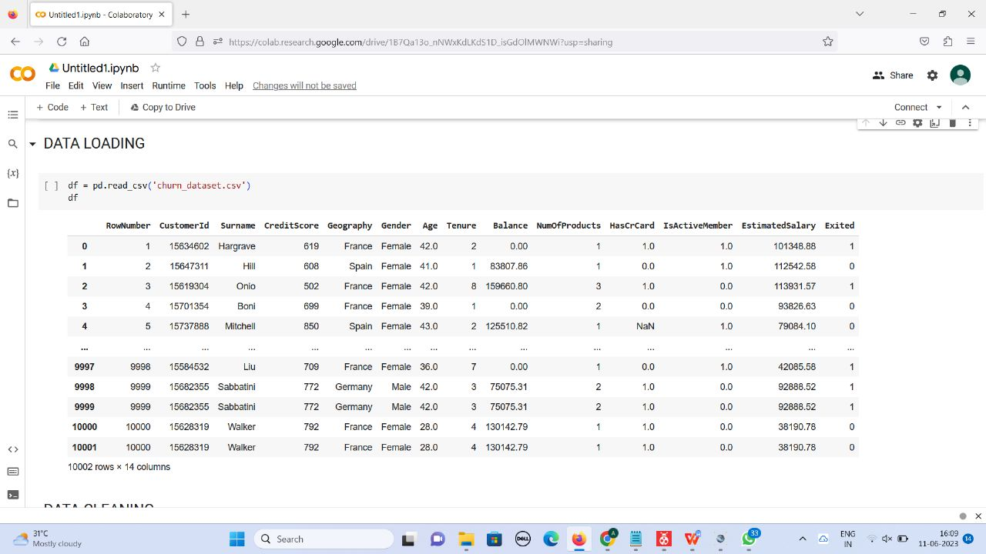
DATA LOADING

Slide 10
DATA CLEANING:
Handles:
Incorrect Data
Incomplete Data
Inconsistent Data
Noisy Data

Slide 11
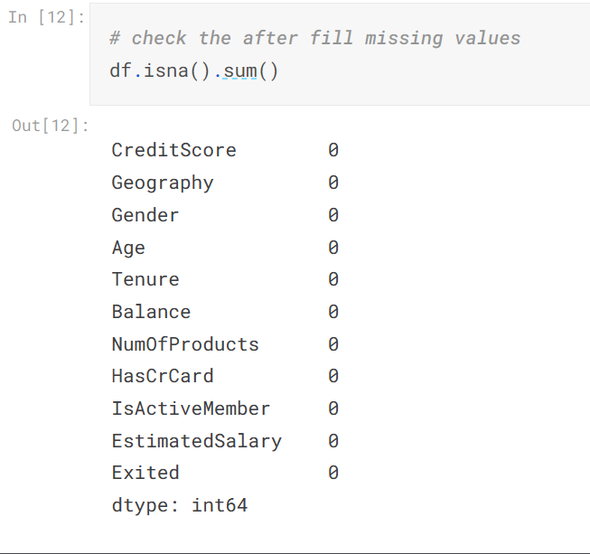
HANDLING MISSING VALUES
Insight:
No missing data.

Slide 12
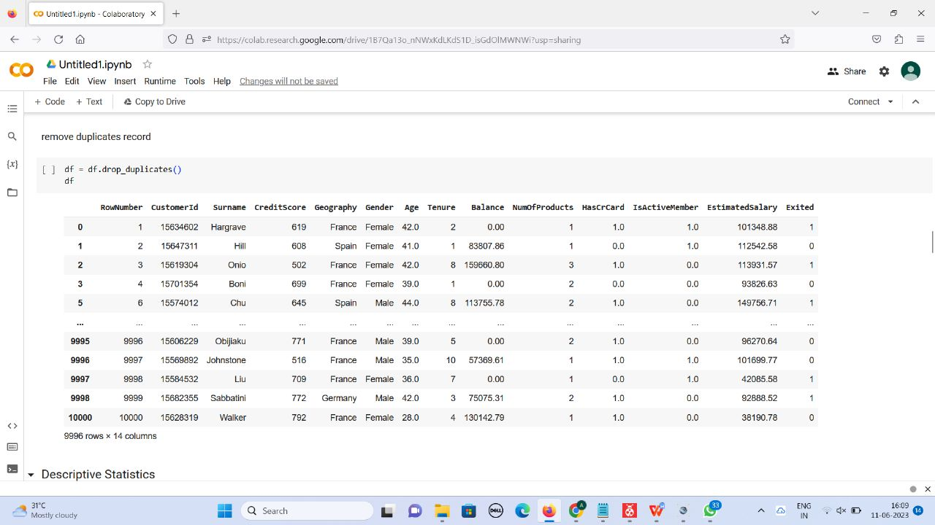
HANDLING DUPLICATE VALUES

Slide 13
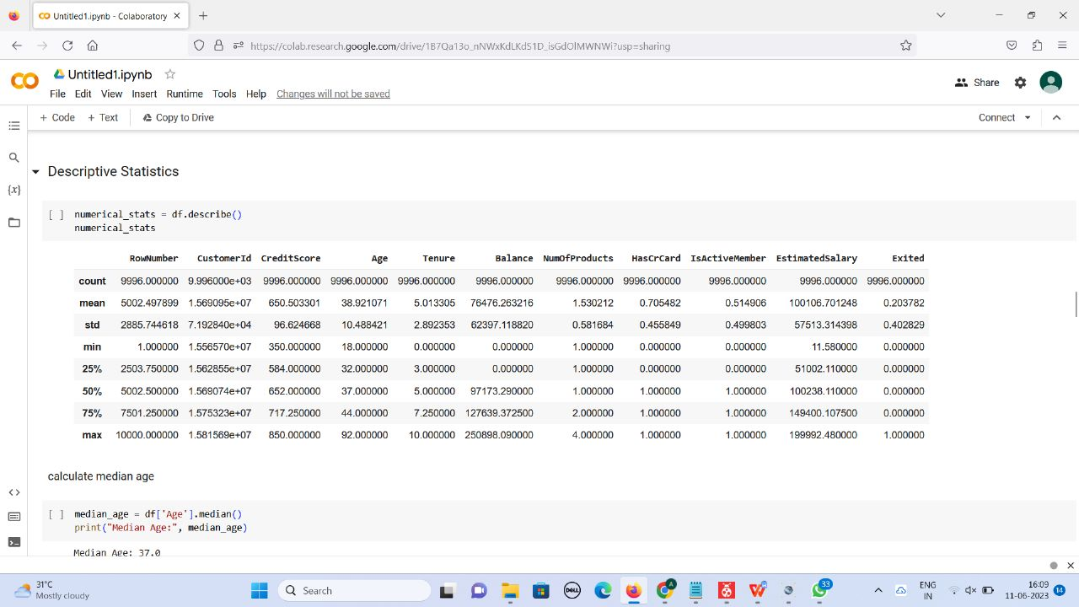
DESCRIPTIVE STATISTICS-VISUALIZATION

Slide 14
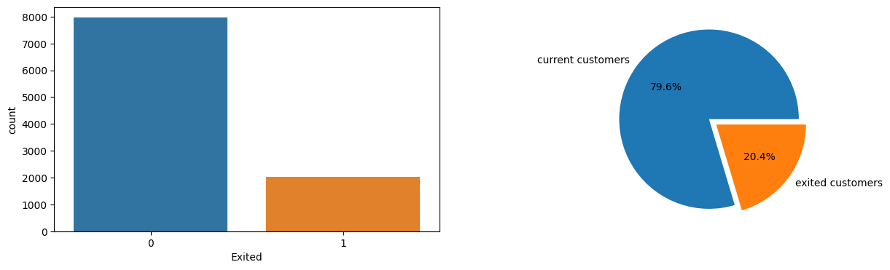
Churn Distribution
Insight of the exited columns: According to data actual exited customers are 2037 and they contribute to a percentage of 20.4%.

Slide 15
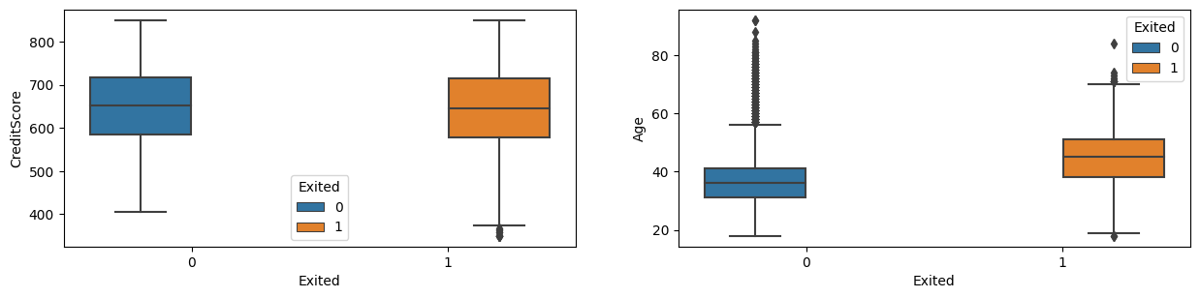
Credit Score and Age vs Exited
Insight of the CreditScore column: minimum of 404 to max 850 CreditScore customers are exited.
Insight of the Age column: mostly minimum age 40 of range and maximum of the age 60 range are customers exited.

Slide 16
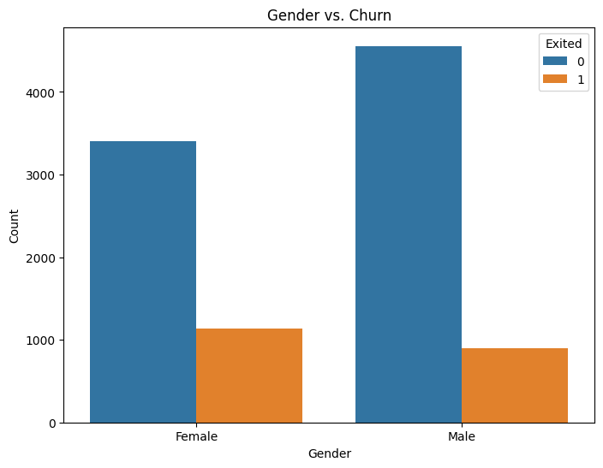
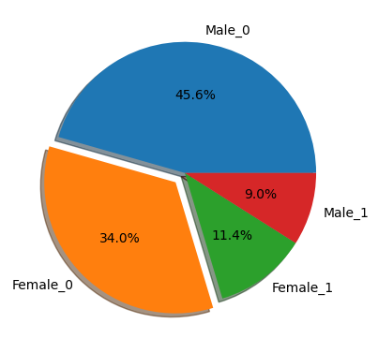
Gender vs Churn
Insight of the Gender column: Mostly female customers exited compared to male customers and this contributes to 11.4% of the customers.

Slide 17
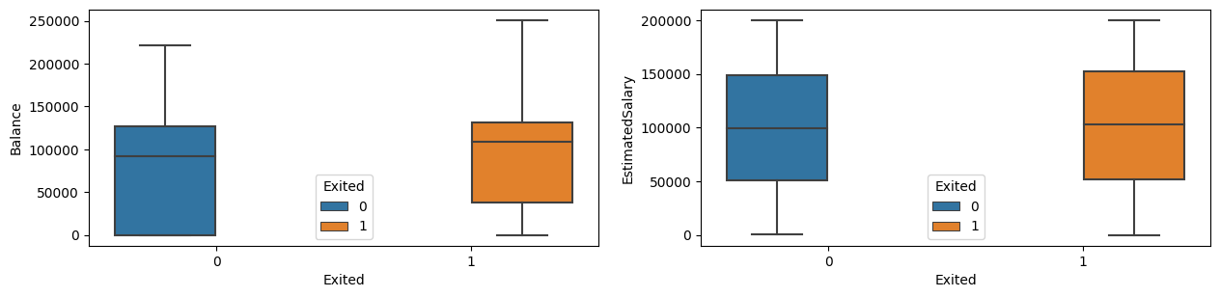
Balance and Estimated Salary vs Exited
Insight of the Balance column: the range of minimum balance 50000 and maximum balance of the 250000 customers are exited.
Insight of the EstimatedSalary column: mostly range of 25% EstimatedSalary 50000 above and maximum EstimatedSalary of the 250000 customers are exited

Slide 18
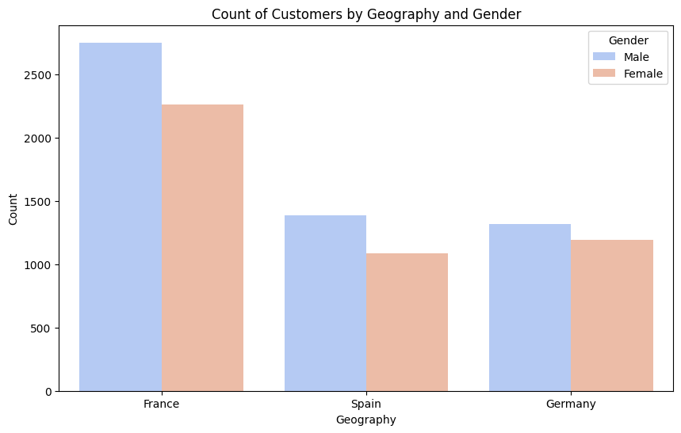
COUNT OF CUSTOMERS BY GEOGRAPHY AND GENDER
Insight:
By getting the count of customers of the bank on the basis of geography and even gender, we can get to know the maximum number of customers are from France whereas Spain and Germany show a very less count of customers compared to France.

Slide 19
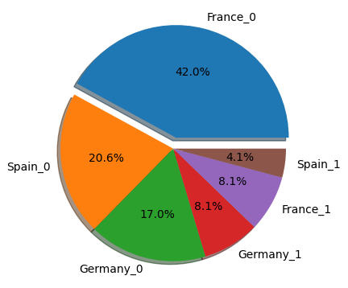
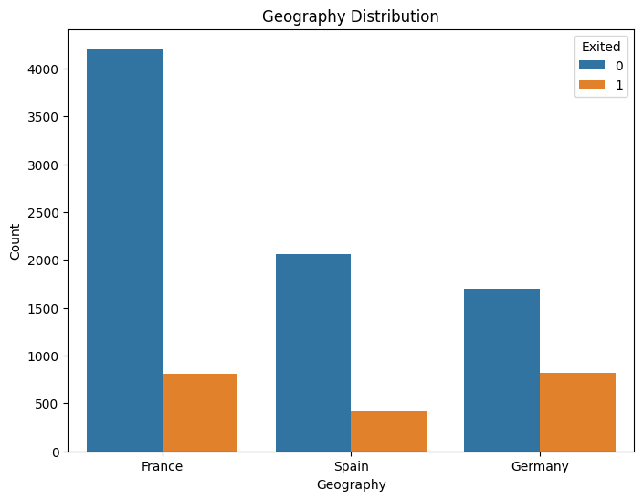
Churned on the basis of Geography Distribution
Insight of the Geography column: Most customers are exited from Germany, France, and Spain in the order.

Slide 20
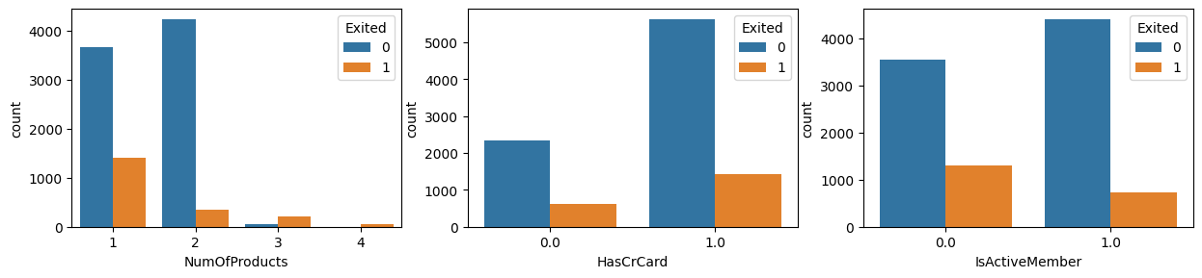
Count of customers vs Num of Products
Insight of the NumOfProducts column: most of the 1 NumOfProducts customers exited around 1409.

Slide 21
Credit Card and Active Members vs Count
Insight of the HasCrCard column: most of the 1 HasCrCard customers exited around 1424.
Insight of the IsActiveMember column: mostly 0 number of active members are exited around 1302.

Slide 22
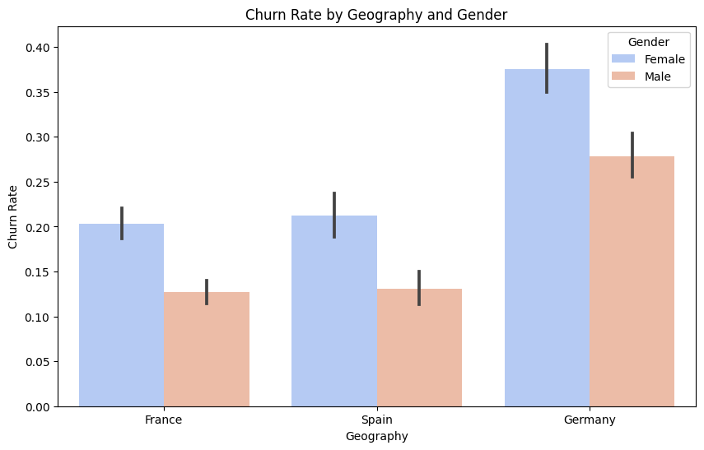
CHURN RATE BY GEOGRAPHY AND GENDER
Insight:
Comparing on the basis of gender there are more number of females who have churned out, and when compared on the basis of geography Germany has maximum churn rate.

Slide 23
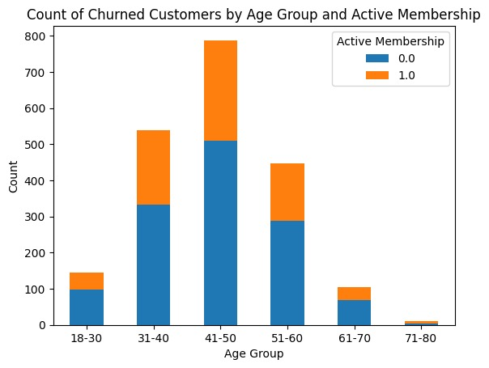
Count of churned customers by Age group vs Active membership
Insight:
Comparing on the basis of age group and active membership, the maximum number of customers having active membership lies between the age group 41-50.

Slide 24
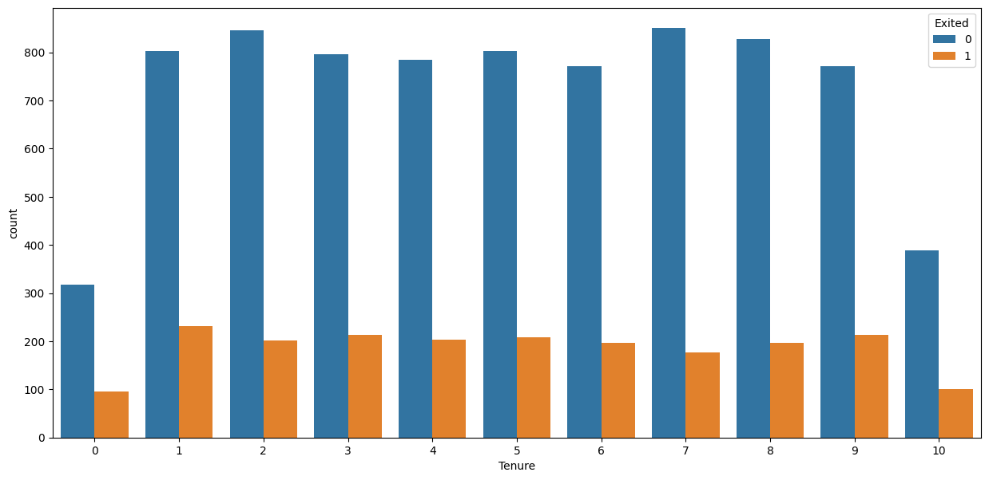
Tenure
Insight of the Tenure column: the last 10 customers around 102 customers are exited and 8,9-year-old customers are around 213,197 exited.

Slide 25
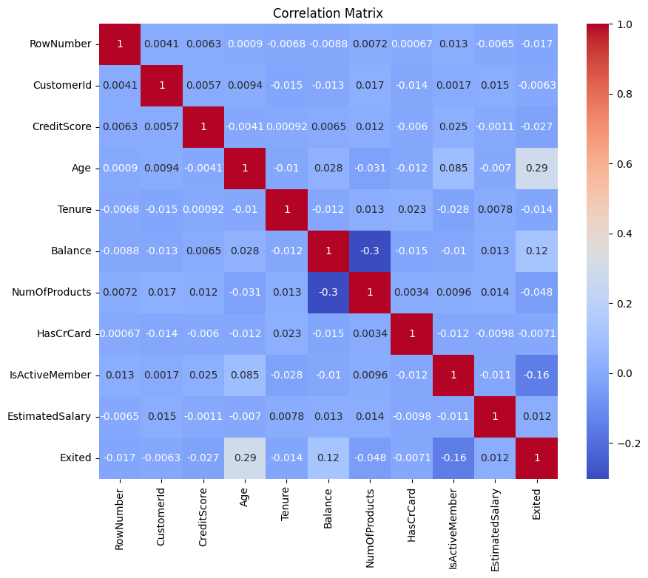
CORRELATION MATRIX-Showing the relationship between different attributes
Insight, the correlation is. The positive correlation shows is 0.02 to 0.1.
Insight, the correlation is. The negative correlation. It ranges from -0.02.

Slide 26
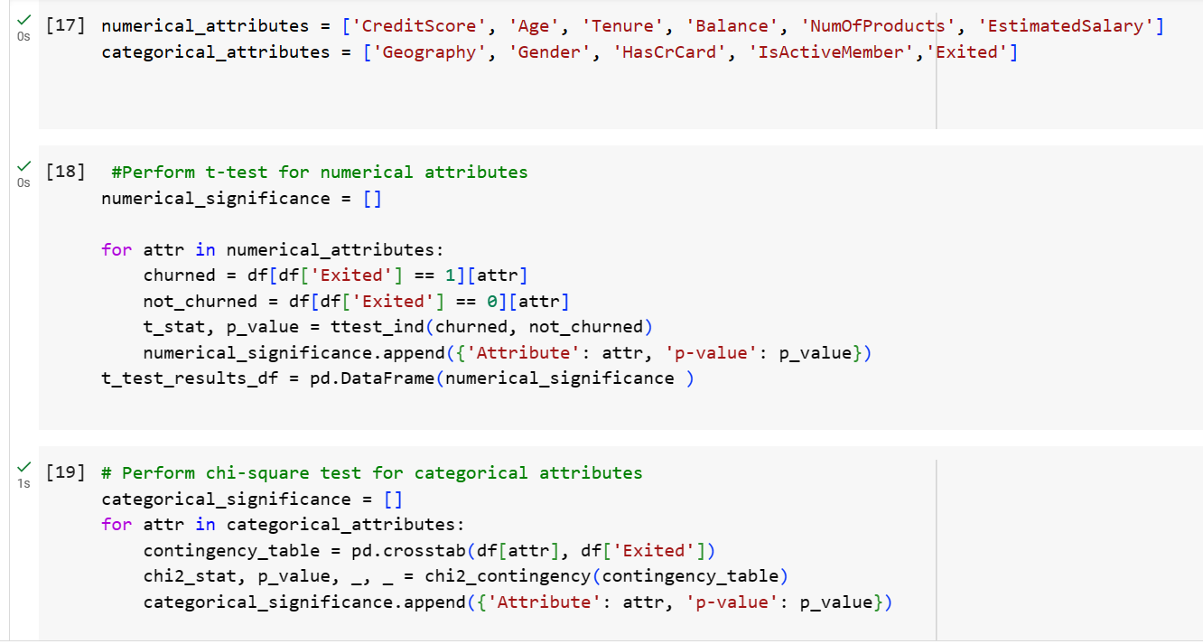
CAUSE AND EFFECT RELATIONSHIP ATTRIBUTES

Slide 27
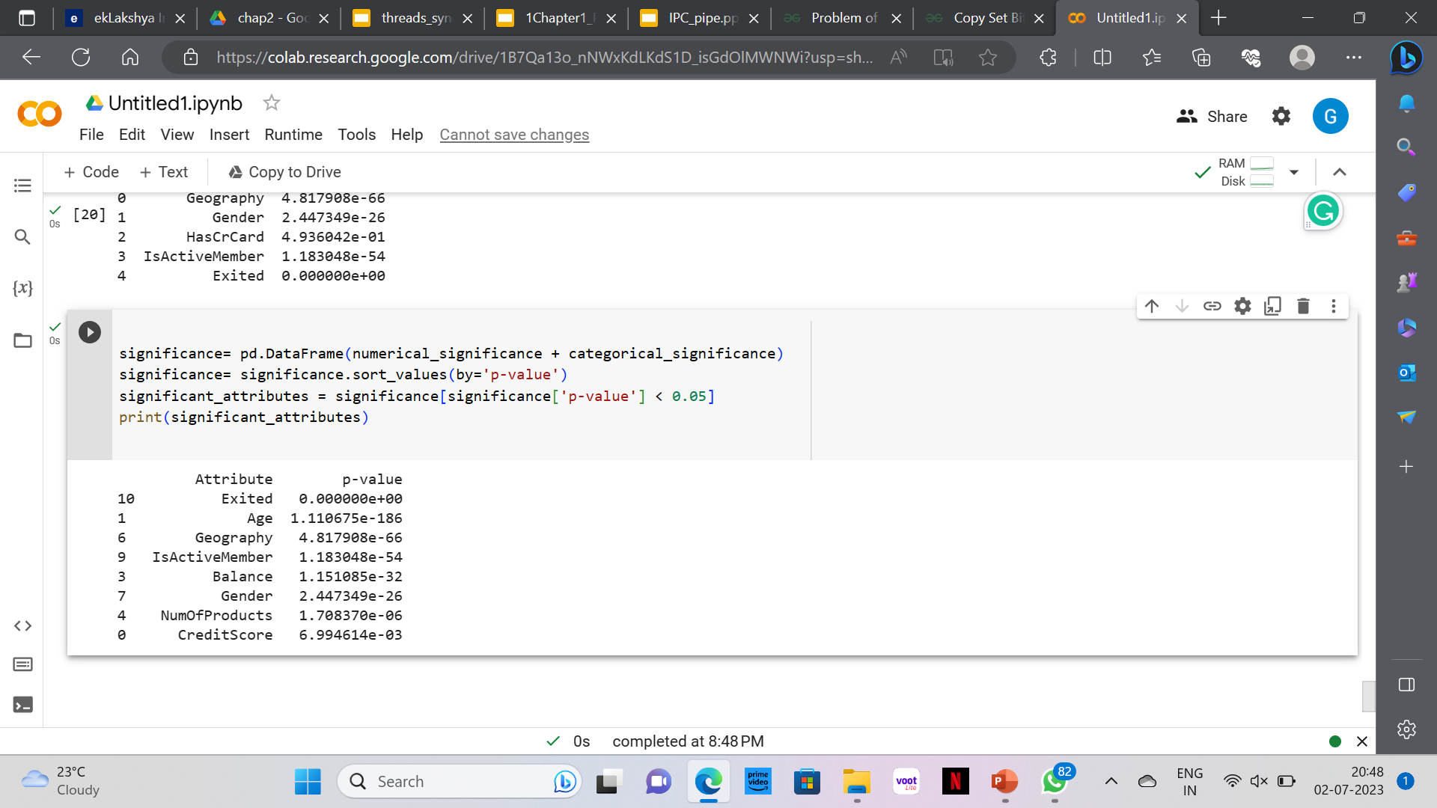
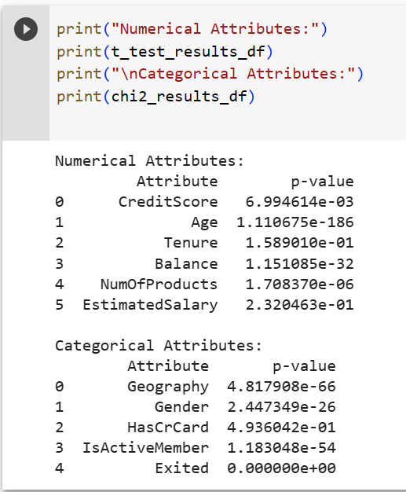

Slide 28
Prediction Model
Decision Tree can be suitable for predicting churn in the bank churn dataset.
Decision Trees are versatile and can handle both numerical and categorical features.
They are also capable of capturing complex relationships between features.
Decision Trees are interpretable models, which means they provide insight into the decision-making process.
They can help identify the most important features for predicting churn and provide understandable decision rules.

Slide 29
Logistic Regression
Logistic Regression is a widely used statistical technique for binary classification, particularly in the field of machine learning and data analysis. It is used to model the relationship between a binary dependent variable (also known as the target or outcome variable) and one or more independent variables (predictors or features). The primary goal of logistic regression is to predict the probability of an event occurring based on the input features.
In the context of churn prediction in the banking industry, logistic regression can be employed to determine the probability of a customer churning (the event of interest) based on the significant attributes identified

Slide 30
Decision Tree
Decision Tree is a non-linear model that recursively splits the data into subsets based on the most significant features, ultimately creating a tree-like structure.
Selecting relevant features is crucial for building an effective Decision Tree model. The Decision Tree algorithm starts by evaluating all possible features and selecting the one that provides the best split (separation) of the data based on a certain criterion.
Once the Decision Tree is built, it can be used to predict the churn status of new customers. For a given set of input features, the data travels down the tree's branches until it reaches a leaf node. The majority class (churn or not churn) of the samples in that leaf node is then assigned as the predicted churn status for the new customer.
One of the key advantages of Decision Trees is their interpretability. The tree structure allows us to understand the decision-making process and identify the most critical features that influence customer churn.

Slide 31
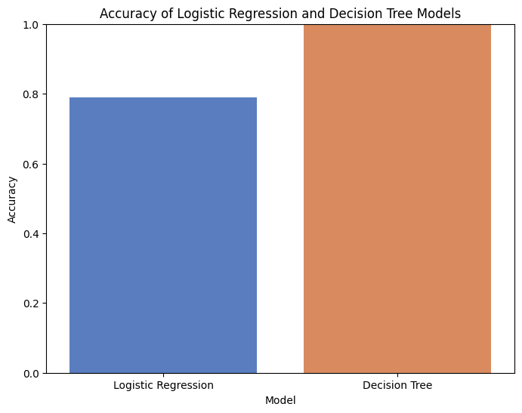
Both models are evaluated based on their accuracy in predicting churn.
Decision Trees offer interpretability, enabling us to understand the underlying decision-making process, and also the accuracy of 99.96%.
Logistic Regression provides probabilistic insights into the likelihood of churn and the accuracy of 78.98%.

Slide 32
REFRENCES
PYTHON_FOR_DATA_ANALYSIS
GEEKS_FOR_GEEKS

Slide 33
THANK YOU!

