Slide 1

YOLOv8-Enhanced Facial Recognition for One-Shot Learning Attendance System
Machine Learning Course Project
C Div- Team 4
Project Guide- Mrs. Anupama P. Bidargaddi
Name | Roll No | USN
Gayatri Betageri | 303 | 01FE21BCS029
Gauri Thambkar | 312 | 01FE21BCS098
Krishna Hasaraddi | 313 | 01FE21BCS100
Aishwarya Patil | 315 | 01FE21BCS112

Slide 2
Outline of Presentation
Project Goal
Literature Survey
Problem Statement
Objectives
Dataset Description
Model Architecture
Results
Future scope and conclusion
References

Slide 3
Project Goal
Develop a YOLOv8-enhanced facial recognition model capable of one-shot learning to accurately identify and recognize individuals for attendance tracking.
Implement one-shot learning techniques to reduce the number of training data required, while maintaining high precision and accuracy in attendance recognition.
Leverage YOLOv8 architecture to enhance the robustness and efficiency of the facial recognition model.
Evaluate the performance of the one-shot learning attendance recognition system against traditional deep learning models, emphasizing precision, accuracy, and efficiency metrics.
Optimize the system to minimize human error in attendance tracking by providing a seamless and reliable solution for identifying and verifying individuals in real time.

Slide 4
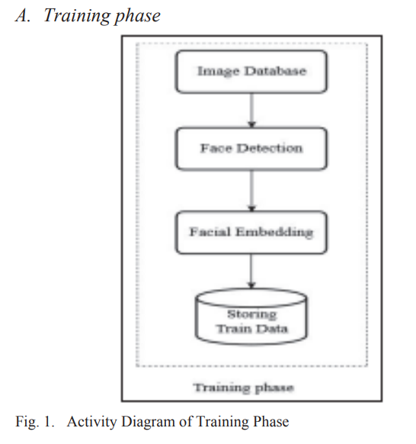
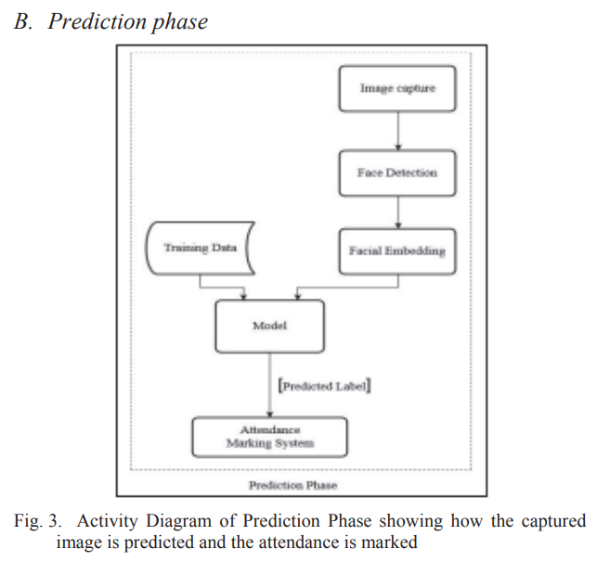
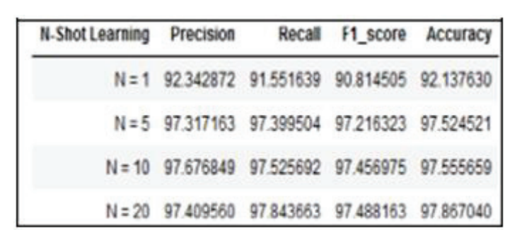
Automated Attendance System using Few-Shot Learning Approach
Introduction:
Methodology:
Result:
The proposed system carries out the face recognition task through an image/video stream to record the attendance in lectures or sections and maintain the database of attendance.
Objectives:
Conclusion:
To enhance the model’s ability to accurately carry out the face recognition task, even in limited data, by integrating few-shot learning theory with Convolutional neural network and pre trained FaceNet model.
Multi-Task Cascaded Convolutional Neural Network is used to detect face and crop the required part.
MTCNN uses a cascade structure with 3 networks(P-Net, R-Net, O-net).
FaceNet is used to convert each image into a vector.
By this approach, the accuracy of the system is hardly affected when going from N=20 to N=5 in the N-shot learning algorithm. This characteristic reduced the size of the dataset up to 5 photos per person while keeping the accuracy still high enough.

Slide 5
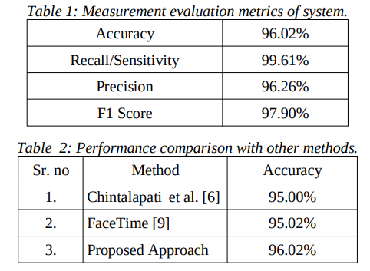
An End-to-End Real-Time Face Identification and Attendance System using Convolutional Neural Networks
Introduction:
To implement an attendance system using Convolutional Neural Networks (CNN) that processes CCTV footage or video of a class, capturing the entire class in a single frame and automatically marking the attendance.
Methodology:
The methodology involves three main tasks of the proposed end-to-end approach: creating and training datasets, the function of the recognizer, and attendance manipulation. The first step involves creating a dataset by capturing 5-10 seconds of video for each student. The software then processes the video to segment it into frames and subsequently processes the frames to detect and recognize faces. The system uses the MultiTask Cascaded Convolutional Neural Network (MTCNN) for face detection and the FaceNet module for face recognition. Finally, the attendance of recognized individuals is saved in a spreadsheet corresponding to the entered subject and date. The proposed approach aims to improve the performance of the end-to-end attendance system and is evaluated using experimental results.
Result:
Objective:
To establish a streamlined and accurate attendance procedure by leveraging state-of-the-art face detection and recognition methods within a CNN framework, ensuring accuracy, simplicity, and efficient data management i.e. save the data in spreadsheets corresponding to the subject and date.
Conclusion:
The proposed system successfully addresses challenges like occlusion, alignment, orientation, and luminescence. Tested in real classroom environments, it exhibits impressive results, proving its practical suitability.

Slide 6
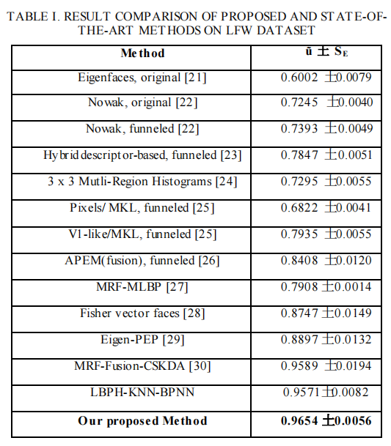
Deep-learning-based group-photo Attendance System using One-Shot Learning
Introduction:
Methodology:
Result analysis:
Tracking attendance through traditional paper involved manual effort and proxy attendance. However, a face-based system using facial recognition automated this process, reducing the chances of cheating tricks.
MTCNN was used to ensure accurate face detection and alignment in images. A ResNet34 model was trained using Triplet loss and semi-hard negative mining to generate face embeddings.
One-shot learning principles were applied, enabling the model to generate embeddings for new identities from just a few images.
A custom face-matching algorithm was devised, significantly enhancing efficiency for their attendance use case. They developed a full attendance system with an Android app and backend server, evaluated the face recognition model on the LFW benchmark, and accessed their attendance system using a public dataset.
Objective:
The objective was to develop an automated, smartphone-based facial recognition attendance system for universities and schools that was robust, efficient, and capable of accommodating new students with minimal training images.
Conclusion:
The facial recognition attendance system, leveraging ResNet34 and custom algorithms, attains high accuracy and practicality. Its scalability through one-shot learning simplifies enrollment, making this system efficient for education.

Slide 7
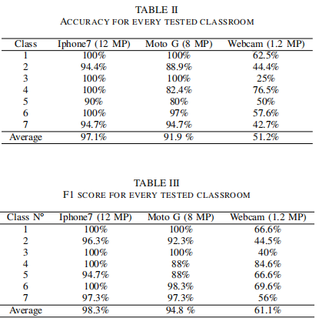
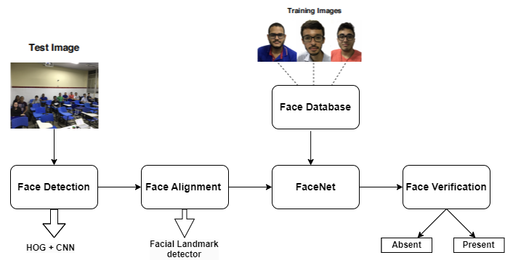
Automatic Attendance Management System based on Deep One-Shot Learning
Introduction:
Methodology:
Result Analysis:
The use of facial recognition to automate student attendance was examined, aiming to minimize the time consumed by attendance-taking practices in classrooms.
Objective:
It aimed to introduce an approach utilizing facial recognition and deep one-shot learning to manage student attendance. It provided insights into deep learning, centered on face recognition in related studies, and highlighted its ability to address attendance assessment with minimal resources.
Conclusion:
The results showed that this approach could be effective even in uncontrolled environments and with limited resources, indicating its promise as a solution for automating the attendance assessment task in academic environments.

Slide 8
Problem Statement
YOLOv8-Enhanced Facial Recognition for One-Shot Learning Attendance System.

Slide 9
Objectives
Develop a one-shot learning model to enable efficient recognition.
Implement state-of-the-art classification methods, to accurately classify individuals based on their facial features extracted by YOLOv8.
Evaluate the performance of the one-shot learning model compared to traditional deep learning models for attendance recognition systems.

Slide 10
Dataset Description
50 students database is taken.
A webcam is used to collect live photos for marking attendance.

Slide 11
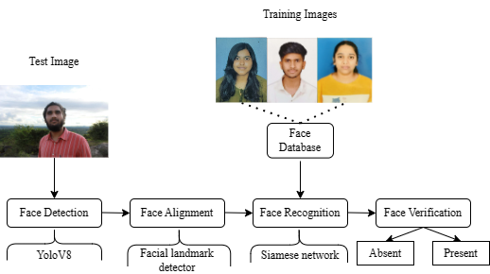
Model Architecture
Face Detection: The initial phase entails identifying the presence of a face within the captured image. We've made the YOLOv8 detector a core component of our methodology to enable quick and reliable face detection.
Face Alignment: To enhance accuracy, we proceed to align the detected faces to a standardized position. We've adopted the 'face-alignment' library, engineered atop the PyTorch ecosystem.
Student Recognition: Following successful alignment, our system employs facial recognition technology to match the aligned face with known student profiles. The foundation of our system is built upon the One-Shot Learning Model, a strategy that relies on using a single sample to handle subsequent samples.

Slide 12
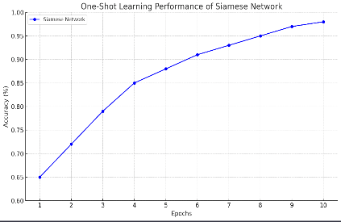
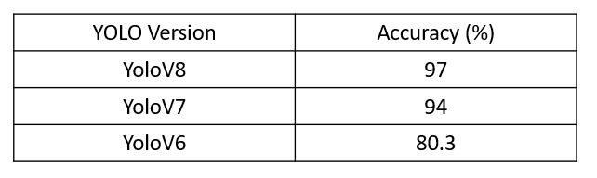
Results
Our work had an accuracy of 97% for 50 students’ datasets using a webcam.
Fig 1 provides a comparative overview of different versions of the YOLO object detection algorithm.
In Fig 2 starting at an accuracy of 65 the network demonstrates consistent improvement with each epoch reaching an accuracy of 98 by the tenth epoch illustrating the network's ability to effectively learn from limited data.
Fig 1
Fig 2

Slide 13
Future Scope and Conclusion
Our facial recognition system represents a significant advancement in biometric technology.
It addresses challenges such as inaccurate attendance records and security vulnerabilities in traditional methods.
The system offers reliability and cost-effectiveness, suitable for businesses, universities, and seminaries.
It operates independently of internet connectivity, compatible with standard PCs and laptops.
However, processing may be slower in environments with a high number of users.
The recent requirement for mask-wearing presents a new obstacle.
We are diligently working on enhancements to ensure accurate identification even when faces are obscured by masks.

Slide 14
References
[1] Rasool, A., Roohi, S. and Majumder, A., 2020, June. Automated attendance system using few-shot learning approach. In 2020 8th International Conference on Reliability, Infocom Technologies and Optimization (Trends and Future Directions)(ICRITO) (pp. 43-46). IEEE.
[2] Priya, R.L., Nanda, S., Dandekar, M., Devnani, A. and Kadakoti, R., 2021, July. Face-Recognition Based Attendance System using One-Shot Learning. In 2021 12th International Conference on Computing Communication and Networking Technologies (ICCCNT) (pp. 01-07). IEEE.
[3] Rai, A., Karnani, R., Chudasama, V. and Upla, K., 2019, December. An end-to-end real-time face identification and attendance system using convolutional neural networks. In 2019 IEEE 16th India Council International Conference (INDICON) (pp. 1-4). IEEE.
[4] Bhat, A., Rustagi, S., Purwaha, S.R. and Singhal, S., 2020, July. Deep-learning based group-photo attendance system using one shot learning. In 2020 International Conference on Electronics and Sustainable Communication Systems (ICESC) (pp. 546-551). IEEE.
[5] Menezes, A.G., Sá, J.M.D.C., Llapa, E. and Estombelo-Montesco, C.A., 2020, July. Automatic attendance management system based on deep one-shot learning. In 2020 International Conference on Systems, Signals and Image Processing (IWSSIP) (pp. 137-142). IEEE.
[6] Bhat, A., Rustagi, S., Purwaha, S.R. and Singhal, S., 2020, July. Deep-learning based group-photo attendance system using one shot learning. In 2020 International Conference on Electronics and Sustainable Communication Systems (ICESC) (pp. 546-551). IEEE.
[7] Balcoh, N.K., Yousaf, M.H., Ahmad, W. and Baig, M.I., 2012. Algorithm for efficient attendance management: Face recognition based approach. International Journal of Computer Science Issues (IJCSI), 9(4), p.146.
[8] Bah, S.M. and Ming, F., 2020. An improved face recognition algorithm and its application in attendance management system. Array, 5, p.100014.
[9] Lukas, S., Mitra, A.R., Desanti, R.I. and Krisnadi, D., 2016, October. Student attendance system in classroom using face recognition technique. In 2016 International Conference on Information and Communication Technology Convergence (ICTC) (pp. 1032-1035). IEEE.
[10] Kawaguchi, Y., Shoji, T., Lin, W., Kakusho, K. and Minoh, M., 2005, October. Face recognition-based lecture attendance system. In The 3rd AEARU workshop on network education (pp. 70-75).
[11] Arsenovic, M., Sladojevic, S., Anderla, A. and Stefanovic, D., 2017, September. FaceTime—Deep learning based face recognition attendance system. In 2017 IEEE 15th International symposium on intelligent systems and informatics (SISY) (pp. 000053-000058). IEEE.

Slide 15
References
[12] Kar, N., Debbarma, M.K., Saha, A. and Pal, D.R., 2012. Study of implementing automated attendance system using face recognition technique. International Journal of computer and communication engineering, 1(2), pp.100-103.
[13] Bertinetto, L., Henriques, J.F., Valmadre, J., Torr, P. and Vedaldi, A., 2016. Learning feed-forward one-shot learners. Advances in neural information processing systems, 29
[14] Koch, G., Zemel, R. and Salakhutdinov, R., 2015, July. Siamese neural networks for one-shot image recognition. In ICML deep learning workshop (Vol. 2, No. 1)
[15] Wang, Y., Yao, Q., Kwok, J.T. and Ni, L.M., 2020. Generalizing from a few examples: A survey on few-shot learning. ACM computing surveys (csur), 53(3), pp.1-34.
[16] Cheng, C.S., Shao, H.C. and Lin, C.W., 2022, October. Task-Aware Few-Shot Visual Classification with Improved Self-Supervised Metric Learning. In 2022 IEEE International Conference on Image Processing (ICIP) (pp. 3531-3535). IEEE.
[17] Yang, Q., Yang, X. and Ji, X., 2022, September. NAM Net: Meta-Network with Normalization-based Attention for Few-Shot Learning. In 2022 2nd International Conference on Computer Science, Electronic Information Engineering and Intelligent Control Technology (CEI) (pp. 473-476). IEEE.
[18] Yang, R., Xu, X., Li, X., Wang, L. and Pu, F., 2020, September. Learning relation by graph neural network for SAR image few-shot learning. In IGARSS 2020-2020 IEEE International Geoscience and Remote Sensing Symposium (pp. 1743-1746). IEEE.
[19] Cai, Q., Pan, Y., Yao, T., Yan, C. and Mei, T., 2018. Memory matching networks for one-shot image recognition. In Proceedings of the IEEE conference on computer vision and pattern recognition (pp. 4080-4088).
[20] Kozerawski, J. and Turk, M., 2018. Clear: Cumulative learning for one-shot one-class image recognition. In Proceedings of the IEEE Conference on Computer Vision and Pattern Recognition (pp. 3446-3455).
[21] Peng, Z., Li, Z., Zhang, J., Li, Y., Qi, G.J. and Tang, J., 2019. Few-shot image recognition with knowledge transfer. In Proceedings of the IEEE/CVF international conference on computer vision (pp. 441-449).

Slide 16
Thank You

