Slide 1

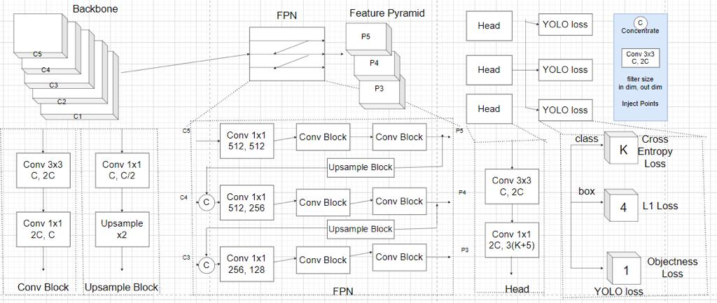
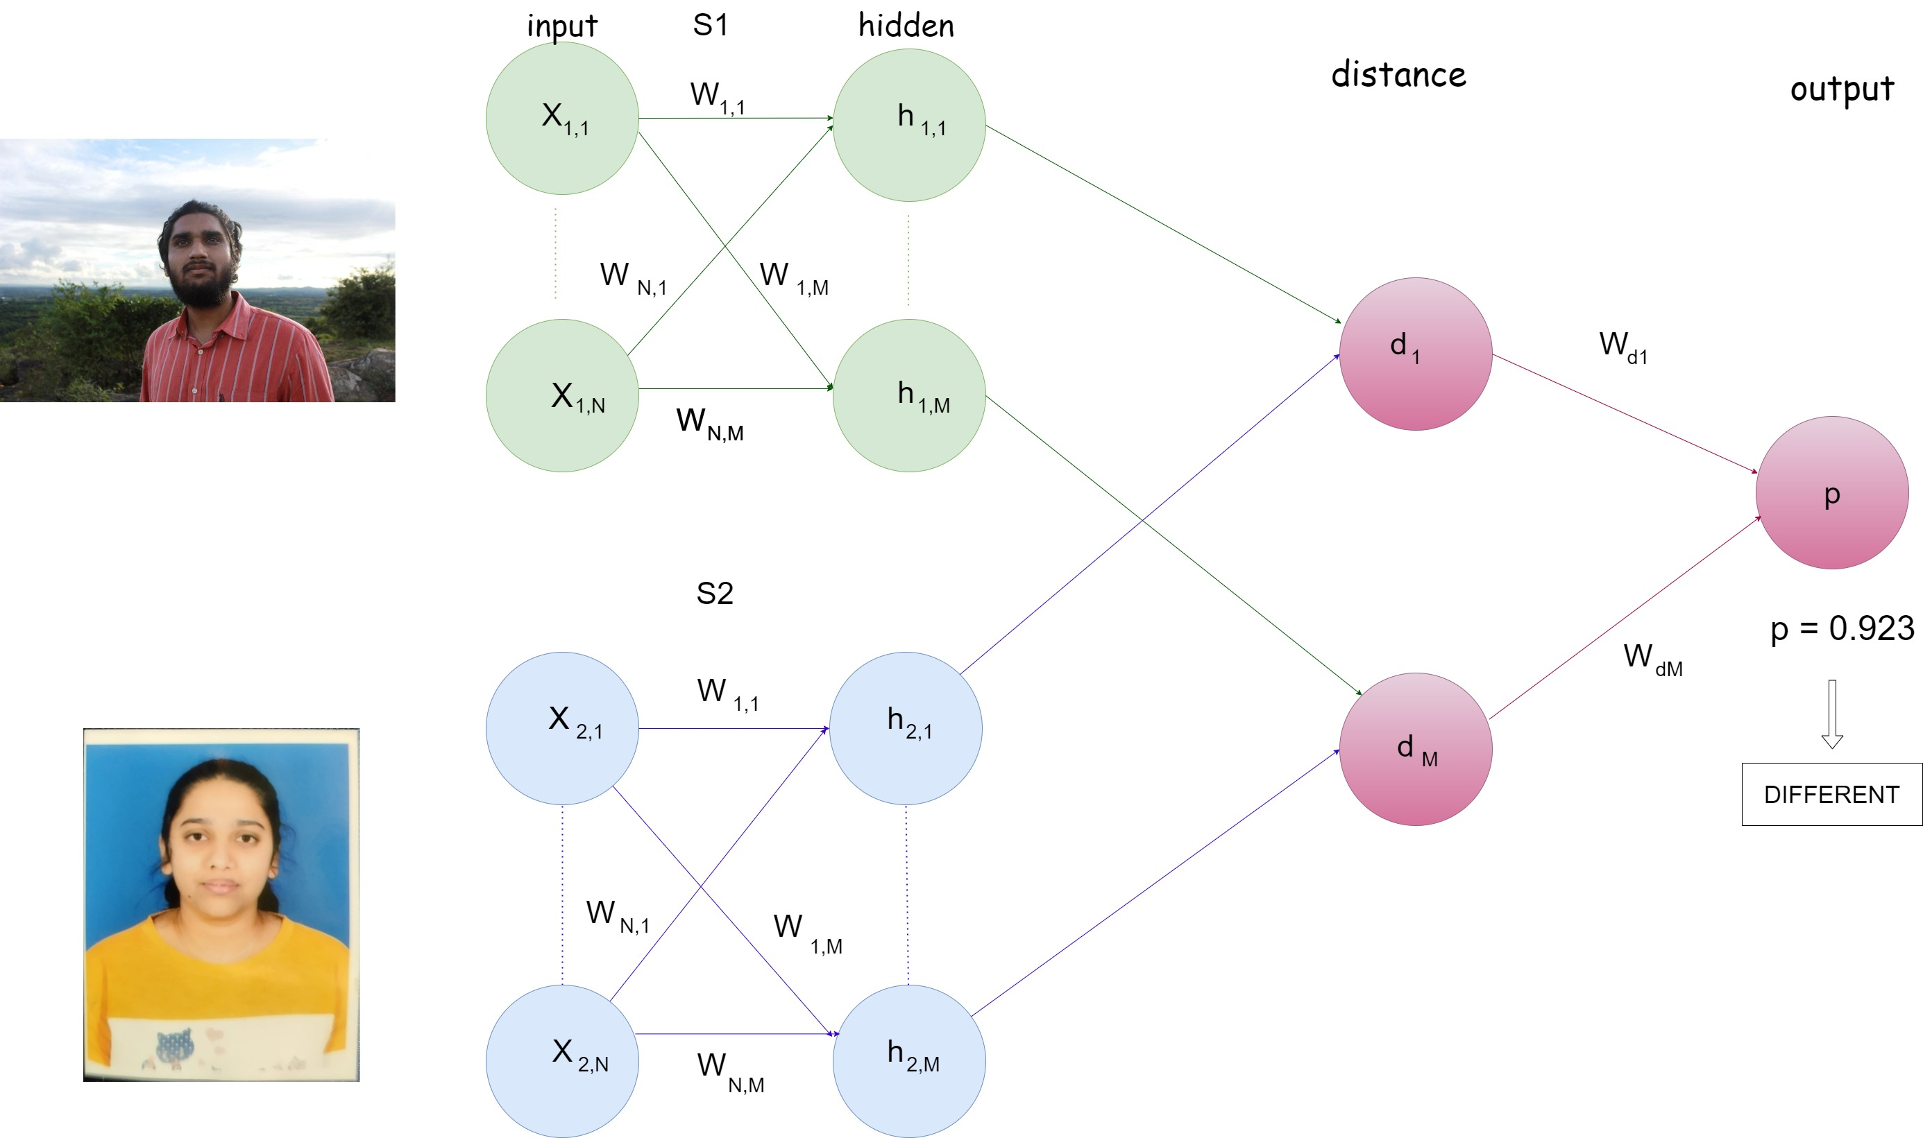
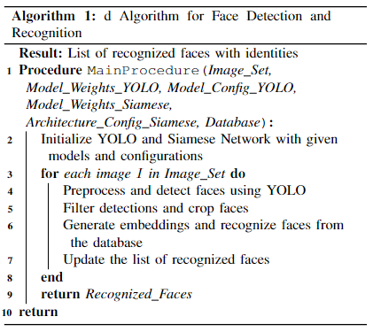
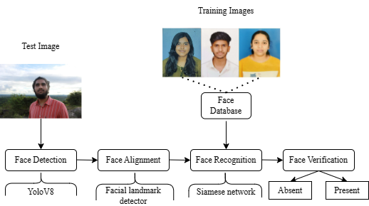
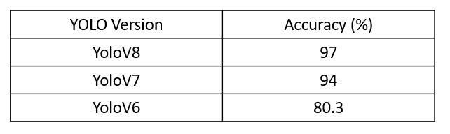
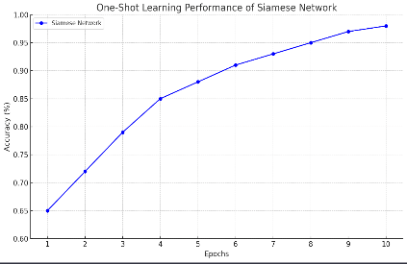
Minor project 2023-24
YOLOv8-Enhanced Facial Recognition for One-Shot Learning Attendance System
Team member’s names: Krishna Hasaraddi, Gauri Thambkar, Aishwarya Patil, Gayatri Betageri
Guided by: Mrs. Anupama P. Bidargaddi
TM
Problem Statement
Yolo Architecture Siamese Network for Face Recognition
The multi-step pipeline it goes through to achieve this is:
Face Detection
Face Alignment
Student Recognition
Developing an enhanced facial recognition system based on YOLOv8 architecture for efficient one-shot learning attendance tracking.
Architecture
Proposed work / Algorithm
Objectives
Develop a one-shot learning model to enable efficient recognition.
Implement state-of-the-art classification methods, to accurately classify individuals based on their facial features extracted by YOLOv8.
Evaluate the performance of the one-shot learning model compared to traditional deep learning models for attendance recognition systems.
Face Detection: The initial phase entails identifying the presence of a face within the captured image. We've made the YOLOv8 detector a core component of our methodology to enable quick and reliable face detection.
Face Alignment: To enhance accuracy, we proceed to align the detected faces to a standardized position. We've adopted the 'face-alignment' library, engineered atop the PyTorch ecosystem.
Student Recognition: Following successful alignment, our system employs facial recognition technology to match the aligned face with known student profiles. The foundation of our system is built upon the One-Shot Learning Model, a strategy that relies on using a single sample to handle subsequent samples.
Our work had an accuracy of 97% for 50 students’ datasets using a webcam.
Fig provides a comparative overview of different versions of the YOLO object detection algorithm.
In Fig starting at an accuracy of 65 the network demonstrates consistent improvement with each epoch reaching an accuracy of 98 by the tenth epoch illustrating the network's ability to effectively learn from limited data.
Methodology
Results/ Discussion
This system adeptly tackles challenges like cover attendance and the unreliability constantly set up in conventional attendance styles with their jacked security features.
Conclusions

