Slide 1
RAILWAYS DATABASE MANAGEMENT SYSTEM
TEAM:
NAME: PULLURU SUPRAJ ROLL NUMBER: 21CSB0A45 SECTION: A
EMAIL ID: ps21csb0a45@student.nitw.ac.in
NAME: TERLI SAI JAYA CHANDRA ROLL NUMBER: 21CSB0A60 SECTION: A
EMAIL ID: ts21csb0a60@student.nitw.ac.in
PROBLEM DEFINITION
This Railways System Database is modeled such that we can access the details of stations, trains, train schedules, employees, ticket details, stalls and counters present in railway stations related information quickly.
PROBLEM ANALYSIS
The Railway System needs to maintain a lot of information regarding tickets , stalls , counters and employees.
For maintaining this information we need to create an e cient database.
We analyzed some data of Indian Railways and made a database.
We need to store various information like details of stations , trains, details about the trains, schedules of trains, stalls and counters working under diIerent stations, various employees working under a station, in a train, delay that a train makes on arrival.
For example a ticket consists of data like start station, destination station , train number, seat number.

Slide 2
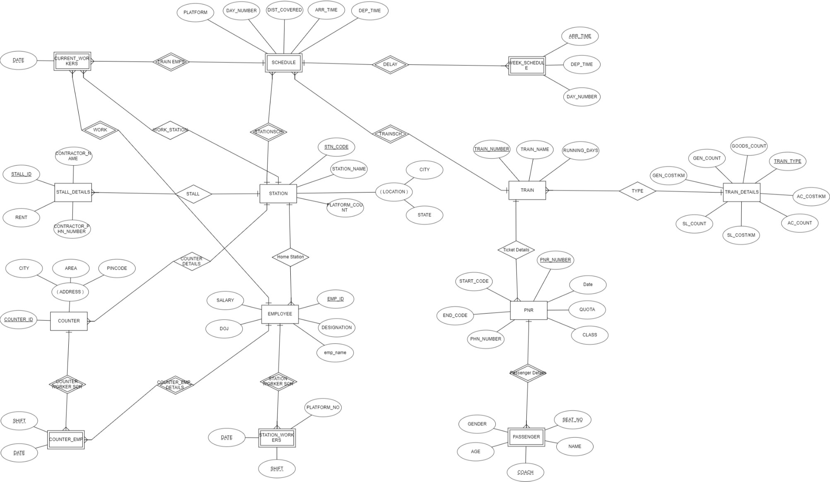
ER MODEL

Slide 3
RELATIONAL MODEL
TRAIN TRAIN_NUMBER RUNNING_DAYS TRAIN_NAME TRAIN_TYPE(FK) | TRAIN_DETAILS TRAIN_TYPE GOODS_COUNT GEN_COUNT GEN_COST/KM SL_COUNT SL_COST/KM AC_COUNT AC_COST/KM | STATION STN_CODE STATION_NAME CITY STATE PLATFORM_COUNT | PNR PNR_NUMBER DATE TRAIN_NUMBER (FK) START_CODE END_CODE CLASS QUOTA PHN_NUMBER
PASSENGER PNR NUMBER (FK) SEAT_NO COACH NAME AGE GENDER | EMPLOYEE EMP_ID EMP_NAME DESIGNATION SALARY DOJ HOME_STN_CODE (FK) | COUNTER COUNTER_ID STN_CODE (FK) CITY AREA PINCODE | STALL_DETAILS STALL_ID STN_CODE (FK) RENT CONTRACTOR_NAME CONTRACTOR_PHN_NUMB ER

Slide 4
STATION_WORKERS EMP_ID (FK) DATE SHIFT PLATFORM_NO | COUNTER_EMP COUNTER_ID (FK) SHIFT DATE EMP_ID (FK) | SCHEDULE TRAIN_NUMBER (FK) STN_CODE (FK) ARR_TIME DEP_TIME DAY_NUMBER DIST_COVERED | WEEK_SCHEDULE TRAIN_NUMBER (FK) STN_CODE (FK) ARR_TIME DEP_TIME DAY_NUMBER
CURRENT_WORKERS
TRAIN_NUMBER (FK)
START_STN_CODE (FK)
DATE
EMP_ID (FK)
END_STN_CODE (FK)

Slide 5
NORMALIZATION
Function Dependencies for each relation :
TRAIN
TRAIN_NUMBER → RUNNING_DAYS,TRAIN_NAME,TRAIN_TYPE TRAIN_NAME → TRAIN_TYPE
TRAIN_DETAILS
TRAIN_TYPE → GOODS_COUNT,GEN_COUNT,GEN_COST/KM, SL_COUNT,SL_COST/KM,AC_COUNT,AC_COST/KM 3.STATION
STN_CODE → STATION_NAME,CITY,STATE, PLATFORM_COUNT
4.PNR
PNR_NUMBER → DATE,TRAIN_NUMBER,START_CODE,END_CODE,CLASS,QUOTA,PHN_NUMBER 5.PASSEGNER
PNR NUMBER,COACH, SEAT_NO → NAME, AGE,GENDER 6.EMPLOYEE
EMP_ID → EMP_NAME , DESIGNATION,SALARY,DOJ,HOME_STN_CODE 7.COUNTER
COUNTER_ID → STN_CODE, CITY,AREA,PINCODE 8.STALL_DETAILS
STALL_ID → STN_CODE, RENT,CONTRACTOR_NAME,CONTRACTOR_PHN_NUMBER
9.STATION_WORKERS

Slide 6
EMP_ID ,DATE,SHIFT → PLATFORM_NO
COUNTER_EMP
COUNTER_ID,SHIFT, DATE → EMP_ID 11.SCHEDULE
TRAIN_NUMBER , STN_CODE → ARR_TIME,DEP_TIME, DAY_NUMBER,DIST_COVERED 12.WEEK_SCHEDULE
TRAIN_NUMBER , STN_CODE ,ARR_TIME →DEP_TIME, DAY_NUMBER 13.CURRENT_WORKERS
TRAIN_NUMBER , START_STN_CODE ,DATE, EMP_ID → END_STN_CODE
1NF :
All attributes are atomic.
It is in table format.
There is a unique name for every attribute/column.
There are no derived attributes.
Relations are in 1 NF.
NF :
There are no partial dependencies.
Relations are in 2 NF.
NF :
There is one transitive dependency in Relation 1
We are decomposing it as below :

Slide 7
1. TRAIN
14. TRAIN_TYPE
TRAIN_NUMBER
RUNNING_DAYS
TRAIN_NAME (FK)
TRAIN_NAME
TYPE (FK)
Now both the relations are in 3NF.
MODIFIED FD’s:
1.TRAIN
TRAIN_NUMBER → RUNNING_DAYS,TRAIN_NAME,TRAIN_TYPE
14. TRAIN_TYPE :
TRAIN_NAME → TRAIN_TYPE

Slide 8
IMPLEMENTATION IN SQL
CREATION OF TABLES :
--1.TRAIN RELATION CREATE TABLE TRAIN(
TRAIN_NUMBER NUMBER, RUNNING_DAYS CHAR(7), TRAIN_NAME VARCHAR(255), PRIMARY KEY (TRAIN_NUMBER),
FOREIGN KEY (TRAIN_NAME) REFERENCES TRAIN_TYPE
);
--3.STATION RELATION CREATE TABLE STATION(
STATION_CODE VARCHAR(255), STATION_NAME VARCHAR(255), CITY VARCHAR(255),
STATE VARCHAR(255), PLATFORM_COUNT NUMBER, PRIMARY KEY (STATION_CODE)
);
--2.TRAIN_DETAILS RELATION CREATE TABLE TRAIN_DETAILS(
TRAIN_TYPE VARCHAR(255), GOODS_COUNT INT, GEN_COUNT INT, GEN_COST_KM FLOAT, SL_COUNT INT, SL_COST_KM FLOAT, AC_COUNT INT, AC_COST_KM FLOAT, PRIMARY KEY (TRAIN_TYPE)
);
--4.PNR RELATION CREATE TABLE PNR(
PNR_NUMBER NUMBER, JDATE DATE, TRAIN_NUMBER NUMBER , START_CODE VARCHAR(255), END_CODE VARCHAR(255), JCLASS CHAR(2),
JQUOTA VARCHAR(255), PHN_NUMBER NUMBER, PRIMARY KEY(PNR_NUMBER),
FOREIGN KEY (TRAIN_NUMBER) REFERENCES TRAIN, FOREIGN KEY (START_CODE) REFERENCES STATION, FOREIGN KEY (END_CODE) REFERENCES STATION
);
--14.TRAIN_TYPE RELATION CREATE TABLE TRAIN_TYPE(
TRAIN_NAME VARCHAR(255), TYPE VARCHAR(255), PRIMARY KEY (TRAIN_NAME),
FOREIGN KEY (TYPE) REFERENCES TRAIN_DETAILS
);
--5.PASSENGER RELATION CREATE TABLE PASSENGER(
PNR_NUMBER NUMBER, SEAT_NO INT,
PNAME VARCHAR(255), AGE NUMBER, GENDER CHAR(1), COACH VARCHAR(255),
PRIMARY KEY(PNR_NUMBER,SEAT_NO,COACH), FOREIGN KEY (PNR_NUMBER) REFERENCES PNR
);

Slide 9
--6.EMPLOYEE RELATION CREATE TABLE EMPLOYEE(
EMP_ID NUMBER,
emp_name varchar(255), DESIGNATION VARCHAR(255), SALARY NUMBER,
DOJ DATE,
STATION_CODE VARCHAR(255), PRIMARY KEY (EMP_ID),
FOREIGN KEY (STATION_CODE) REFERENCES STATION
);
--9.STATION_WORKERS relation CREATE TABLE STATION_WORKERS (
EMP_ID NUMBER, WDATE DATE, SHIFT CHAR(1), PLATFORM_NO INT,
PRIMARY KEY (EMP_ID,WDATE,SHIFT),
FOREIGN KEY (EMP_ID) REFERENCES EMPLOYEE
);
--10.COUNTER_EMP relation CREATE TABLE COUNTER_EMP (
COUNTER_ID NUMBER, SHIFT CHAR(1),
WDATE DATE, EMP_ID NUMBER,
PRIMARY KEY (COUNTER_ID,SHIFT,WDATE),
FOREIGN KEY (COUNTER_ID) REFERENCES COUNTER, FOREIGN KEY (EMP_ID) REFERENCES EMPLOYEE
);
--7.COUNTER RELATION CREATE TABLE COUNTER(
COUNTER_ID NUMBER, STN_CODE VARCHAR(255), CITY VARCHAR(255),
AREA VARCHAR(255), PINCODE NUMBER,
PRIMARY KEY (COUNTER_ID),
FOREIGN KEY (STN_CODE) REFERENCES STATION
);
--11.SCHEDULE relation CREATE TABLE SCHEDULE(
TRAIN_NUMBER NUMBER, STN_CODE VARCHAR(255), ARR_TIME TIMESTAMP, DEP_TIME TIMESTAMP, DAY_NUMBER NUMBER, DIST_COVERED NUMBER,
PRIMARY KEY (TRAIN_NUMBER,STN_CODE), FOREIGN KEY (TRAIN_NUMBER) REFERENCES TRAIN, FOREIGN KEY (STN_CODE) REFERENCES STATION
);
--8.STALL_DETAILS relation CREATE TABLE STALL_DETAILS (
STALL_ID NUMBER, STN_CODE VARCHAR(255), RENT FLOAT,
CONTRACTOR_NAME VARCHAR(255), CONTRACTOR_PHN_NUMBER NUMBER, PRIMARY KEY (STALL_ID),
FOREIGN KEY (STN_CODE) REFERENCES STATION
);

Slide 10
--12.WEEK_SCHEDULE relation CREATE TABLE WEEK_SCHEDULE(
TRAIN_NUMBER NUMBER, STN_CODE VARCHAR(255), ARR_TIME TIMESTAMP, DEP_TIME TIMESTAMP, DAY_NUMBER NUMBER,
PRIMARY KEY (TRAIN_NUMBER,STN_CODE,ARR_TIME), FOREIGN KEY (TRAIN_NUMBER) REFERENCES TRAIN, FOREIGN KEY (STN_CODE) REFERENCES STATION
);
--13.CURRENT_WORKERS SCHEDULE CREATE TABLE CURRENT_WORKERS(
TRAIN_NUMBER NUMBER, START_STN_CODE VARCHAR(255), WDATE DATE,
EMP_ID NUMBER, END_STN_CODE VARCHAR(255),
PRIMARY KEY (TRAIN_NUMBER,START_STN_CODE,WDATE,EMP_ID), FOREIGN KEY (TRAIN_NUMBER) REFERENCES TRAIN,
FOREIGN KEY (START_STN_CODE) REFERENCES STATION, FOREIGN KEY (END_STN_CODE) REFERENCES STATION, FOREIGN KEY (EMP_ID) REFERENCES EMPLOYEE
);

Slide 11
DATA INSERTION FOR TESTING :
For testing our database we have taken a small portion of data
It consists of 6 trains covering different types of trains, their schedule, actual arrival, actual departure, employees and passengers in train for one day.
It consists of details of 8 stations , counters under them ,stalls under them, employees working in them.
--1.TRAIN RELATION
INSERT INTO TRAIN VALUES(12713,'1010101','SHATAVAHANA'); INSERT INTO TRAIN VALUES(12728,'1111111','GODAVARI'); INSERT INTO TRAIN VALUES(12727,'1111111','GODAVARI'); INSERT INTO TRAIN VALUES(22691,'1001010','RAJADHANI'); INSERT INTO TRAIN VALUES(15389,'1111111','HYD_KZP_GOODS'); INSERT INTO TRAIN VALUES(12805,'1111111','JANMABHOOMI');
--2.TRAIN_DETAILS RELATION
INSERT INTO TRAIN_DETAILS VALUES('EXPRESS',2,10,2,13,3,8,4); INSERT INTO TRAIN_DETAILS VALUES('GOODS',20,0,0,0,0,0,0); INSERT INTO TRAIN_DETAILS VALUES('AC',3,0,0,0,0,10,10);
INSERT INTO TRAIN_DETAILS VALUES('SUPER FAST',4,5,2,15,5,8,7); INSERT INTO TRAIN_DETAILS VALUES('GENERAL',2,30,1,0,0,0,0);
--14.TRAIN_TYPE RELATION
INSERT INTO TRAIN_TYPE VALUES('SHATAVAHANA' ,'EXPRESS'); INSERT INTO TRAIN_TYPE VALUES('GODAVARI','SUPER FAST'); INSERT INTO TRAIN_TYPE VALUES('RAJADHANI','AC');
INSERT INTO TRAIN_TYPE VALUES('HYD_KZP_GOODS','GOODS'); INSERT INTO TRAIN_TYPE VALUES('JANMABHOOMI','GENERAL');
--3.STATION RELATION
INSERT INTO STATION VALUES ('SC','SECUNDERABAD','HYDERABAD','TS',10); INSERT INTO STATION VALUES('KZP','KAZIPET','WARANGAL','TS',3);
INSERT INTO STATION VALUES('BZA','VIJAYAWADA','VIJAYAWADA','AP',6); INSERT INTO STATION VALUES('HYB','HYD_DEC_NAM','HYDERABAD','TS',8);
INSERT INTO STATION VALUES('VSKP','VISHAKAPATNAM','VISHAKAPATNAM','AP',12); INSERT INTO STATION VALUES('KSRB','KSR BANGALORE','BANGALORE','KARNATAKA',7); INSERT INTO STATION VALUES('NZM','HAZRAT NIZAMUDDIN','NEW DELHI','NEW DELHI',15); INSERT INTO STATION VALUES('LNG','LINGAMPALLY','HYDERABAD','TS',2);
--4.PNR RELATION
INSERT INTO PNR VALUES(23874915,'08-MAY-2023',12713,'KZP','SC','SL','GN',8765439218); INSERT INTO PNR VALUES(89256347,'08-MAY-2023',12713,'BZA','KZP','AC','GN',9846512374);

Slide 12
INSERT INTO PNR VALUES(41598623,'08-MAY-2023',12728,'SC','VSKP','SL','TATKAL',8456127893); INSERT INTO PNR VALUES(67491258,'08-MAY-2023',12728,'BZA','VSKP','AC','GN',7845961235); INSERT INTO PNR VALUES(32675891,'08-MAY-2023',12727,'VSKP','HYB','SL','GN',8462159753); INSERT INTO PNR VALUES(87145963,'08-MAY-2023',12727,'VSKP','BZA','AC','TATKAL',9842136574); INSERT INTO PNR VALUES(59368241,'08-MAY-2023',22691,'KSRB','NZM','AC','GN',6541872390); INSERT INTO PNR VALUES(45617982,'08-MAY-2023',22691,'SC','NZM','AC','TATKAL',6248713905); INSERT INTO PNR VALUES(91837526,'08-MAY-2023',12805,'VSKP','LNG','2S','GN',8462017935); INSERT INTO PNR VALUES(72543918,'08-MAY-2023',12805,'SC','LNG','2S','GN',8896658937);
--5.PASSENGER RELATION
INSERT INTO PASSENGER VALUES (23874915,20,'SUMANTH',23,'M','S2'); INSERT INTO PASSENGER VALUES (89256347,30,'SRINU',40,'M','A1'); INSERT INTO PASSENGER VALUES (41598623,32,'NIDHI',30,'F','S1'); INSERT INTO PASSENGER VALUES (41598623,42,'VIJAYA',54,'F','S2'); INSERT INTO PASSENGER VALUES (67491258,56,'KUMAR',38,'M','A2'); INSERT INTO PASSENGER VALUES (32675891,20,'VISHWAJITH',19,'M','S1'); INSERT INTO PASSENGER VALUES (87145963,18,'VATSAV',26,'M','A3'); INSERT INTO PASSENGER VALUES (59368241,06,'HASINI',22,'F','A2'); INSERT INTO PASSENGER VALUES (45617982,12,'SHIVANI',42,'F','A1'); INSERT INTO PASSENGER VALUES (91837526,36,'DEVENDAR',60,'M','D1'); INSERT INTO PASSENGER VALUES (72543918,54,'SUNITHA',49,'F','D3');
--6.EMPLOYEE RELATION
INSERT INTO EMPLOYEE VALUES(00001,'rithuraj','TC',40000,'20 APR 2004','SC'); INSERT INTO EMPLOYEE VALUES(00002,'vishwa','SM',60000,'03 JAN 2001','SC'); INSERT INTO EMPLOYEE VALUES(00003,'ganesh','POLICE',30000,'04 AUG 1996','SC'); INSERT INTO EMPLOYEE VALUES(00004,'varsini','CLEANER',10000,'15 AUG 1998','SC'); INSERT INTO EMPLOYEE VALUES(00005,'vatsav','CW',20000,'12 SEP 2000','SC'); INSERT INTO EMPLOYEE VALUES(00006,'mukesh','TD',50000,'25 DEC 1996','SC'); INSERT INTO EMPLOYEE VALUES(00069,'YESHWANTH','TD',50000,'25 DEC 1996','SC'); INSERT INTO EMPLOYEE VALUES(00014,'shashidar','PW',5000,'12 SEP 2000','SC');
INSERT INTO EMPLOYEE VALUES(00057,'HANUMANTHARAO','POLICE',30000,'04 AUG 1996','SC'); INSERT INTO EMPLOYEE VALUES(00065,'RAJU','CW',20000,'12 SEP 2000','SC');
INSERT INTO EMPLOYEE VALUES(00007,'saketh','TD',50000,'21 FEB 2013','KZP'); INSERT INTO EMPLOYEE VALUES(00008,'pramod','PW',5000,'09 SEP 1993','KZP'); INSERT INTO EMPLOYEE VALUES(00009,'shivani','TC',40000,'05 MAR 2005','KZP');
INSERT INTO EMPLOYEE VALUES(00010,'sanjana','CLEANER',10000,'16 NOV 2016','KZP'); INSERT INTO EMPLOYEE VALUES(00011,'supraj','SM',60000,'20 APR 2004','KZP');
INSERT INTO EMPLOYEE VALUES(00012,'vishal','CW',20000,'03 JAN 2001','KZP');
INSERT INTO EMPLOYEE VALUES(00013,'srinivasa rao','POLICE',30000,'04 AUG 1996','KZP');

Slide 13
INSERT INTO EMPLOYEE VALUES(00058,'RAVI','POLICE',30000,'04 AUG 1996','KZP');
INSERT INTO EMPLOYEE VALUES(00015,'manikanta','TD',50000,'25 DEC 1996','BZA'); INSERT INTO EMPLOYEE VALUES(00016,'kamal','PW',5000,'21 FEB 2013','BZA'); INSERT INTO EMPLOYEE VALUES(00017,'sanjay','TC',40000,'09 SEP 1993','BZA');
INSERT INTO EMPLOYEE VALUES(00018,'abhishek','CLEANER',10000,'15 AUG 1998','BZA'); INSERT INTO EMPLOYEE VALUES(00019,'bhuvanesh','SM',60000,'05 MAR 2005','BZA'); INSERT INTO EMPLOYEE VALUES(00020,'saikiran','CW',20000,'16 NOV 2016','BZA'); INSERT INTO EMPLOYEE VALUES(00021,'AASHRITH','POLICE',30000,'04 AUG 1996','BZA'); INSERT INTO EMPLOYEE VALUES(00059,'TEJA','POLICE',30000,'04 AUG 1996','BZA');
INSERT INTO EMPLOYEE VALUES(00022,'PARVESH','TD',50000,'25 DEC 1996','HYB'); INSERT INTO EMPLOYEE VALUES(00023,'SAJJAN','PW',5000,'21 FEB 2013','HYB'); INSERT INTO EMPLOYEE VALUES(00024,'SUNITHA','TC',40000,'09 SEP 1993','HYB'); INSERT INTO EMPLOYEE VALUES(00025,'RAJINI','CLEANER',10000,'15 AUG 1998','HYB'); INSERT INTO EMPLOYEE VALUES(00026,'KIRAN','SM',60000,'05 MAR 2005','HYB'); INSERT INTO EMPLOYEE VALUES(00027,'RAJESH','CW',20000,'16 NOV 2016','HYB'); INSERT INTO EMPLOYEE VALUES(00028,'VARSHINI','POLICE',30000,'04 AUG 1996','HYB'); INSERT INTO EMPLOYEE VALUES(00064,'UTKARSH','POLICE',30000,'04 AUG 1996','HYB'); INSERT INTO EMPLOYEE VALUES(00066,'RAGHU','CW',20000,'12 SEP 2000','HYB');
INSERT INTO EMPLOYEE VALUES(00029,'Trishul','TD',50000,'25 DEC 1996','VSKP'); INSERT INTO EMPLOYEE VALUES(00030,'Raga','PW',5000,'21 FEB 2013','VSKP'); INSERT INTO EMPLOYEE VALUES(00031,'Pavan','TC',40000,'09 SEP 1993','VSKP'); INSERT INTO EMPLOYEE VALUES(00032,'Uma','CLEANER',10000,'15 AUG 1998','VSKP'); INSERT INTO EMPLOYEE VALUES(00033,'Rohit','SM',60000,'05 MAR 2005','VSKP'); INSERT INTO EMPLOYEE VALUES(00034,'Abhiram','CW',20000,'16 NOV 2016','VSKP');
INSERT INTO EMPLOYEE VALUES(00035,'Hanuman','POLICE',30000,'04 AUG 1996','VSKP'); INSERT INTO EMPLOYEE VALUES(00060,'JAYA','POLICE',30000,'04 AUG 1996','VSKP'); INSERT INTO EMPLOYEE VALUES(00068,'SHARMA','CW',20000,'12 SEP 2000','VSKP');
INSERT INTO EMPLOYEE VALUES(00036,'KARTHIK','TD',50000,'25 DEC 1996','KSRB'); INSERT INTO EMPLOYEE VALUES(00037,'RAHUL','PW',5000,'21 FEB 2013','KSRB'); INSERT INTO EMPLOYEE VALUES(00038,'HASINI','TC',40000,'09 SEP 1993','KSRB');
INSERT INTO EMPLOYEE VALUES(00039,'VYSHNAVI','CLEANER',10000,'15 AUG 1998','KSRB'); INSERT INTO EMPLOYEE VALUES(00040,'MANOJ','SM',60000,'05 MAR 2005','KSRB');
INSERT INTO EMPLOYEE VALUES(00041,'SRIRAM','CW',20000,'16 NOV 2016','KSRB'); INSERT INTO EMPLOYEE VALUES(00042,'ANEESH','POLICE',30000,'04 AUG 1996','KSRB'); INSERT INTO EMPLOYEE VALUES(00061,'CHANDRA','POLICE',30000,'04 AUG 1996','KSRB');
INSERT INTO EMPLOYEE VALUES(00043,'Anil','TD',50000,'25 DEC 1996','NZM');

Slide 14
INSERT INTO EMPLOYEE VALUES(00044,'Mohan','PW',5000,'21 FEB 2013','NZM'); INSERT INTO EMPLOYEE VALUES(00045,'Jagadish','TC',40000,'09 SEP 1993','NZM'); INSERT INTO EMPLOYEE VALUES(00046,'Raju','CLEANER',10000,'15 AUG 1998','NZM'); INSERT INTO EMPLOYEE VALUES(00047,'Charishma','SM',60000,'05 MAR 2005','NZM'); INSERT INTO EMPLOYEE VALUES(00048,'Sahithi','CW',20000,'16 NOV 2016','NZM'); INSERT INTO EMPLOYEE VALUES(00049,'Hanvitha','POLICE',30000,'04 AUG 1996','NZM');
INSERT INTO EMPLOYEE VALUES(00062,'HARSHA','POLICE',30000,'04 AUG 1996','NZM'); INSERT INTO EMPLOYEE VALUES(00067,'ROHITH','CW',20000,'12 SEP 2000','NZM');
INSERT INTO EMPLOYEE VALUES(00050,'ANURAG','TD',50000,'25 DEC 1996','LNG'); INSERT INTO EMPLOYEE VALUES(00051,'VISHNU','PW',5000,'21 FEB 2013','LNG'); INSERT INTO EMPLOYEE VALUES(00052,'VARSHA','TC',40000,'09 SEP 1993','LNG');
INSERT INTO EMPLOYEE VALUES(00053,'MOKSHAVI','CLEANER',10000,'15 AUG 1998','LNG'); INSERT INTO EMPLOYEE VALUES(00054,'RAKESH','SM',60000,'05 MAR 2005','LNG');
INSERT INTO EMPLOYEE VALUES(00055,'RISHIN','CW',20000,'16 NOV 2016','LNG'); INSERT INTO EMPLOYEE VALUES(00056,'BHARATH','POLICE',30000,'04 AUG 1996','LNG'); INSERT INTO EMPLOYEE VALUES(00063,'PRANAV','POLICE',30000,'04 AUG 1996','LNG');
--7.COUNTER RELATION
INSERT INTO COUNTER VALUES (1234,'SC','HYDERABAD','KOTHAPET',500035); INSERT INTO COUNTER VALUES (2345,'SC','HYDERABAD','NAGOLE',500039); INSERT INTO COUNTER VALUES (5678,'HYB','HYDERABAD','NAMPALLY',500095); INSERT INTO COUNTER VALUES (3456,'NZM','NEW DELHI','NIZAMUDDIN',110013); INSERT INTO COUNTER VALUES (4567,'HYB','HYDERABAD','MALAKPET',500036);
INSERT INTO COUNTER VALUES (6789,'NZM','NEW DELHI','SIDDARATH NAGAR',110013); INSERT INTO COUNTER VALUES (7890,'VSKP','VISHAKAPATNAM','BALNAGAR',123456); INSERT INTO COUNTER VALUES (8901,'VSKP','VISHAKAPATNAM','BEACH COLONY',234567); INSERT INTO COUNTER VALUES (9012,'LNG','HYDERABAD','LINGAMPALLI',345678);
INSERT INTO COUNTER VALUES (0123,'BZA','VIJAYAWADA','JAGADAMBA CENTER',456789); INSERT INTO COUNTER VALUES (0246,'KZP','KAZIPET','NITW',567890);
INSERT INTO COUNTER VALUES (1357,'KSRB','BANGLORE','CHINNASWAMY STADIUM',678901);
--8.STALL_DETAILS relation
INSERT INTO STALL_DETAILS VALUES (1,'SC',4500,'RAJU',9647851282); INSERT INTO STALL_DETAILS VALUES (2,'SC',6000,'AKHIL',7451986035); INSERT INTO STALL_DETAILS VALUES (3,'BZA',2000,'GANESH',8456903722); INSERT INTO STALL_DETAILS VALUES (4,'BZA',3000,'VISHWA',6572931450); INSERT INTO STALL_DETAILS VALUES (5,'VSKP',5000,'MUKESH',8462974530); INSERT INTO STALL_DETAILS VALUES (6,'VSKP',10000,'CHANDU',7759138460); INSERT INTO STALL_DETAILS VALUES (7,'KZP',3900,'SAI',8460913574);
INSERT INTO STALL_DETAILS VALUES (8,'LNG',7000,'SUNNY',9946137586);

Slide 15
--9.STATION_WORKERS relation
INSERT INTO STATION_WORKERS VALUES(00002,'08 MAY 2023','D',1); INSERT INTO STATION_WORKERS VALUES(00003,'08 MAY 2023','N',2); INSERT INTO STATION_WORKERS VALUES(00004,'08 MAY 2023','D',1);
INSERT INTO STATION_WORKERS VALUES(00011,'08 MAY 2023','N',2); INSERT INTO STATION_WORKERS VALUES(00013,'08 MAY 2023','D',1); INSERT INTO STATION_WORKERS VALUES(00010,'08 MAY 2023','N',2);
INSERT INTO STATION_WORKERS VALUES(00019,'08 MAY 2023','D',1); INSERT INTO STATION_WORKERS VALUES(00021,'08 MAY 2023','D',2); INSERT INTO STATION_WORKERS VALUES(00018,'08 MAY 2023','N',2);
INSERT INTO STATION_WORKERS VALUES(00026,'08 MAY 2023','D',2); INSERT INTO STATION_WORKERS VALUES(00028,'08 MAY 2023','N',2); INSERT INTO STATION_WORKERS VALUES(00025,'08 MAY 2023','N',1);
INSERT INTO STATION_WORKERS VALUES(00033,'08 MAY 2023','D',2); INSERT INTO STATION_WORKERS VALUES(00035,'08 MAY 2023','N',1); INSERT INTO STATION_WORKERS VALUES(00032,'08 MAY 2023','N',2);
INSERT INTO STATION_WORKERS VALUES(00040,'08 MAY 2023','N',1); INSERT INTO STATION_WORKERS VALUES(00042,'08 MAY 2023','D',1); INSERT INTO STATION_WORKERS VALUES(00039,'08 MAY 2023','D',1);
INSERT INTO STATION_WORKERS VALUES(00047,'08 MAY 2023','N',1); INSERT INTO STATION_WORKERS VALUES(00049,'08 MAY 2023','D',2); INSERT INTO STATION_WORKERS VALUES(00046,'08 MAY 2023','N',1);
INSERT INTO STATION_WORKERS VALUES(00054,'08 MAY 2023','D',2); INSERT INTO STATION_WORKERS VALUES(00056,'08 MAY 2023','D',1); INSERT INTO STATION_WORKERS VALUES(00053,'08 MAY 2023','D',1);
--10.COUNTER_EMP relation
INSERT INTO COUNTER_EMP VALUES(1234,'D','08 MAY 2023',00005); INSERT INTO COUNTER_EMP VALUES(2345,'N','08 MAY 2023',00065);

Slide 16
INSERT INTO COUNTER_EMP VALUES(5678,'D','08 MAY 2023',00027); INSERT INTO COUNTER_EMP VALUES(4567,'N','08 MAY 2023',00066); INSERT INTO COUNTER_EMP VALUES(3456,'D','08 MAY 2023',00048); INSERT INTO COUNTER_EMP VALUES(6789,'N','08 MAY 2023',00067); INSERT INTO COUNTER_EMP VALUES(7890,'D','08 MAY 2023',00068); INSERT INTO COUNTER_EMP VALUES(8901,'N','08 MAY 2023',00034); INSERT INTO COUNTER_EMP VALUES(9012,'D','08 MAY 2023',00055); INSERT INTO COUNTER_EMP VALUES(0123,'N','08 MAY 2023',00020); INSERT INTO COUNTER_EMP VALUES(0246,'D','08 MAY 2023',00012); INSERT INTO COUNTER_EMP VALUES(1357,'N','08 MAY 2023',00041);
--11.SCHEDULE relation
INSERT INTO SCHEDULE VALUES (12713,'BZA',NULL,'08-05-2023 06:25:00 AM',1,0);
INSERT INTO SCHEDULE VALUES (12713,'KZP','08-05-2023 09:33:00 AM','08-05-2023 09:35:00 AM',1,216); INSERT INTO SCHEDULE VALUES (12713,'SC','08-05-2023 11:55:00 AM',NULL,1,348);
INSERT INTO SCHEDULE VALUES (12728,'HYB',NULL,'08-05-2023 05:05:00 PM',1,0);
INSERT INTO SCHEDULE VALUES (12728,'SC','08-05-2023 05:25:00 PM','08-05-2023 05:30:00 PM',1,7); INSERT INTO SCHEDULE VALUES (12728,'KZP','08-05-2023 07:13:00 PM','08-05-2023 07:15:00 PM',1,139); INSERT INTO SCHEDULE VALUES (12728,'BZA','08-05-2023 10:50:00 PM','08-05-2023 11:05:00 PM',1,356); INSERT INTO SCHEDULE VALUES (12728,'VSKP','09-05-2023 05:35:00 AM',NULL,2,706);
INSERT INTO SCHEDULE VALUES (12727,'VSKP',NULL,'08-05-2023 05:20:00 PM',1,0);
INSERT INTO SCHEDULE VALUES (12727,'BZA','08-05-2023 11:25:00 PM','08-05-2023 11:40:00 PM',1,350); INSERT INTO SCHEDULE VALUES (12727,'KZP','09-05-2023 02:55:00 AM','09-05-2023 02:57:00 AM',2,566); INSERT INTO SCHEDULE VALUES (12727,'SC','09-05-2023 05:10:00 PM','09-05-2023 05:15:00 AM',2,698); INSERT INTO SCHEDULE VALUES (12727,'HYB','09-05-2023 06:15:00 AM',NULL,2,706);
INSERT INTO SCHEDULE VALUES (22691,'KSRB',NULL,'08-05-2023 08:00:00 PM',1,0);
INSERT INTO SCHEDULE VALUES (22691,'SC','09-05-2023 07:05:00 AM','09-05-2023 07:15:00 AM',2,706); INSERT INTO SCHEDULE VALUES (22691,'KZP','09-05-2023 08:48:00 AM','09-05-2023 08:50:00 AM',2,837); INSERT INTO SCHEDULE VALUES (22691,'NZM','10-05-2023 05:30:00 AM',NULL,3,2374);
INSERT INTO SCHEDULE VALUES (15389,'SC',NULL,'08-05-2023 10:00:00 AM',1,0); INSERT INTO SCHEDULE VALUES (15389,'KZP','08-05-2023 01:30:00 PM',NULL,1,132);
INSERT INTO SCHEDULE VALUES (12805,'VSKP',NULL,'08-05-2023 06:20:00 AM',1,0);
INSERT INTO SCHEDULE VALUES (12805,'BZA','08-05-2023 11:55:00 AM','08-05-2023 12:00:00 PM',1,349); INSERT INTO SCHEDULE VALUES (12805,'SC','08-05-2023 06:15:00 PM','08-05-2023 06:20:00 PM',1,689); INSERT INTO SCHEDULE VALUES (12805,'LNG','08-05-2023 07:40:00 PM',NULL,1,712);

Slide 17
--12.WEEK_SCHEDULE relation
INSERT INTO WEEK_SCHEDULE VALUES (12713,'BZA','08-05-2023 07:00:00 AM','08-05-2023 07:00:00 AM',1); INSERT INTO WEEK_SCHEDULE VALUES (12713,'KZP','08-05-2023 10:04:00 AM','08-05-2023 10:15:00 AM',1); INSERT INTO WEEK_SCHEDULE VALUES (12713,'SC','08-05-2023 12:48:00 PM','08-05-2023 12:48:00 PM',1);
INSERT INTO WEEK_SCHEDULE VALUES (12728,'HYB','08-05-2023 05:05:00 PM','08-05-2023 05:05:00 PM',1); INSERT INTO WEEK_SCHEDULE VALUES (12728,'SC','08-05-2023 05:22:00 PM','08-05-2023 06:17:00 PM',1); INSERT INTO WEEK_SCHEDULE VALUES (12728,'KZP','08-05-2023 07:51:00 PM','08-05-2023 07:56:00 PM',1); INSERT INTO WEEK_SCHEDULE VALUES (12728,'BZA','08-05-2023 11:32:00 PM','08-05-2023 11:40:00 PM',1); INSERT INTO WEEK_SCHEDULE VALUES (12728,'VSKP','09-05-2023 06:16:00 AM','09-05-2023 06:16:00 AM',2);
INSERT INTO WEEK_SCHEDULE VALUES (12727,'VSKP','08-05-2023 05:30:00 PM','08-05-2023 05:30:00 PM',1); INSERT INTO WEEK_SCHEDULE VALUES (12727,'BZA','09-05-2023 12:14:00 AM','09-05-2023 12:25:00 AM',2); INSERT INTO WEEK_SCHEDULE VALUES (12727,'KZP','09-05-2023 04:38:00 AM','09-05-2023 04:46:00 AM',2); INSERT INTO WEEK_SCHEDULE VALUES (12727,'SC','09-05-2023 07:10:00 PM','09-05-2023 07:39:00 AM',2); INSERT INTO WEEK_SCHEDULE VALUES (12727,'HYB','09-05-2023 07:55:00 AM','09-05-2023 07:55:00 AM',2);
INSERT INTO WEEK_SCHEDULE VALUES (22691,'KSRB','08-05-2023 08:03:00 PM','08-05-2023 08:03:00 PM',1); INSERT INTO WEEK_SCHEDULE VALUES (22691,'SC','09-05-2023 08:02:00 AM','09-05-2023 08:17:00 AM',2); INSERT INTO WEEK_SCHEDULE VALUES (22691,'KZP','09-05-2023 10:14:00 AM','09-05-2023 10:20:00 AM',2); INSERT INTO WEEK_SCHEDULE VALUES (22691,'NZM','10-05-2023 06:02:00 AM','10-05-2023 06:02:00 AM',3);
INSERT INTO WEEK_SCHEDULE VALUES (15389,'SC','08-05-2023 10:00:00 AM','08-05-2023 10:00:00 AM',1); INSERT INTO WEEK_SCHEDULE VALUES (15389,'KZP','08-05-2023 01:00:00 PM','08-05-2023 01:00:00 PM',1);
INSERT INTO WEEK_SCHEDULE VALUES (12805,'VSKP','08-05-2023 06:20:00 AM','08-05-2023 06:20:00 AM',1); INSERT INTO WEEK_SCHEDULE VALUES (12805,'BZA','08-05-2023 12:45:00 PM','08-05-2023 01:01:00 PM',1); INSERT INTO WEEK_SCHEDULE VALUES (12805,'SC','08-05-2023 07:29:00 PM','08-05-2023 07:44:00 PM',1); INSERT INTO WEEK_SCHEDULE VALUES (12805,'LNG','08-05-2023 08:47:00 PM','08-05-2023 08:47:00 PM',1);
--13.CURRENT_WORKERS SCHEDULE
--tc td POLICE PW
INSERT INTO CURRENT_WORKERS VALUES (12713,'BZA','08 MAY 2023',00017,'SC'); INSERT INTO CURRENT_WORKERS VALUES (12713,'BZA','08 MAY 2023',00015,'SC'); INSERT INTO CURRENT_WORKERS VALUES (12713,'BZA','08 MAY 2023',00059,'SC'); INSERT INTO CURRENT_WORKERS VALUES (12713,'BZA','08 MAY 2023',00016,'SC');
INSERT INTO CURRENT_WORKERS VALUES (12728,'HYB','08 MAY 2023',00024,'KZP'); INSERT INTO CURRENT_WORKERS VALUES (12728,'HYB','08 MAY 2023',00022,'KZP'); INSERT INTO CURRENT_WORKERS VALUES (12728,'HYB','08 MAY 2023',00064,'KZP'); INSERT INTO CURRENT_WORKERS VALUES (12728,'HYB','08 MAY 2023',00023,'KZP');

Slide 18
INSERT INTO CURRENT_WORKERS VALUES (12728,'KZP','08 MAY 2023',00009,'VSKP'); INSERT INTO CURRENT_WORKERS VALUES (12728,'KZP','08 MAY 2023',00007,'VSKP'); INSERT INTO CURRENT_WORKERS VALUES (12728,'KZP','08 MAY 2023',00058,'VSKP'); INSERT INTO CURRENT_WORKERS VALUES (12728,'KZP','08 MAY 2023',00008,'VSKP');
INSERT INTO CURRENT_WORKERS VALUES (12727,'VSKP','08 MAY 2023',00031,'BZA'); INSERT INTO CURRENT_WORKERS VALUES (12727,'VSKP','08 MAY 2023',00029,'BZA'); INSERT INTO CURRENT_WORKERS VALUES (12727,'VSKP','08 MAY 2023',00068,'BZA'); INSERT INTO CURRENT_WORKERS VALUES (12727,'VSKP','08 MAY 2023',00030,'BZA');
INSERT INTO CURRENT_WORKERS VALUES (12727,'BZA','08 MAY 2023',00045,'HYB'); INSERT INTO CURRENT_WORKERS VALUES (12727,'BZA','08 MAY 2023',00043,'HYB'); INSERT INTO CURRENT_WORKERS VALUES (12727,'BZA','08 MAY 2023',00062,'HYB'); INSERT INTO CURRENT_WORKERS VALUES (12727,'BZA','08 MAY 2023',00044,'HYB');
INSERT INTO CURRENT_WORKERS VALUES (22691,'KSRB','08 MAY 2023',00038,'SC'); INSERT INTO CURRENT_WORKERS VALUES (22691,'KSRB','08 MAY 2023',00036,'SC'); INSERT INTO CURRENT_WORKERS VALUES (22691,'KSRB','08 MAY 2023',00042,'SC'); INSERT INTO CURRENT_WORKERS VALUES (22691,'KSRB','08 MAY 2023',00037,'SC'); INSERT INTO CURRENT_WORKERS VALUES (22691,'SC','08 MAY 2023',00069,'NZM'); INSERT INTO CURRENT_WORKERS VALUES (22691,'SC','08 MAY 2023',00001,'NZM'); INSERT INTO CURRENT_WORKERS VALUES (22691,'SC','08 MAY 2023',00003,'NZM'); INSERT INTO CURRENT_WORKERS VALUES (22691,'SC','08 MAY 2023',00014,'NZM');
INSERT INTO CURRENT_WORKERS VALUES (12805,'VSKP','08 MAY 2023',00052,'LNG'); INSERT INTO CURRENT_WORKERS VALUES (12805,'VSKP','08 MAY 2023',00050,'LNG'); INSERT INTO CURRENT_WORKERS VALUES (12805,'VSKP','08 MAY 2023',00063,'LNG'); INSERT INTO CURRENT_WORKERS VALUES (12805,'VSKP','08 MAY 2023',00051,'LNG');
INSERT INTO CURRENT_WORKERS VALUES (15389,'SC','08 MAY 2023',00006,'KZP');

Slide 19
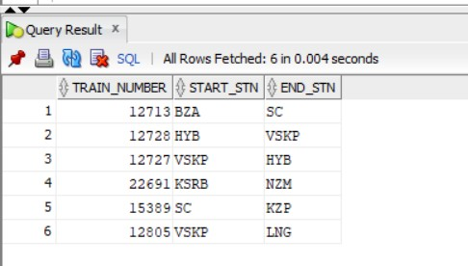
SQL QUERIES (Testing various requirements of data) :
1.Extract starting and ending point of each train SQL Query :
select *
from (select train_number,stn_code as start_stn from schedule where arr_time is null) natural join (select train_number,stn_code as end_Stn from schedule where dep_time is null);
OUTPUT :
2.Display train driver names of RAJDHANI train and his boarding station,leaving station.
SQL Query :
select emp_id,emp_name,start_stn_code,end_stn_code from current_workers natural join employee
where train_number=(select train_number from train where train_name='RAJADHANI') and designation='TD';
OUTPUT :

Slide 20
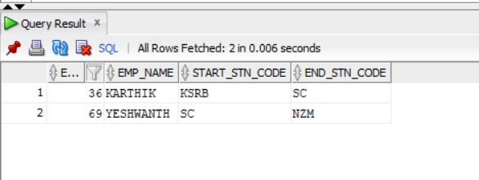
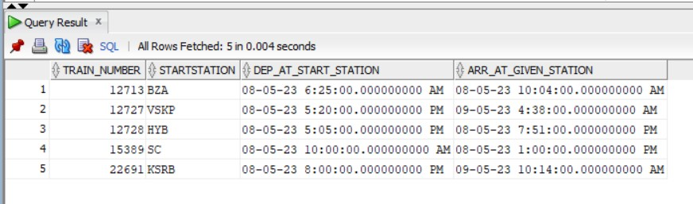
3.EXTRACT ALL THE TRAINS WHICH ARRIVE AT A GIVEN STATION ALONG WITH THEIR START STATION INFORMATION .
SQL Query :
SELECT A.TRAIN_NUMBER,B.STN_CODE AS STARTSTATION,B.DEP_TIME AS DEP_AT_START_STATION,A.ARR_TIME AS ARR_AT_GIVEN_STATION FROM WEEK_SCHEDULE A , SCHEDULE B
WHERE (A.stn_code=(select station_code from station where station_name='&A')) AND A.TRAIN_NUMBER=B.TRAIN_NUMBER AND B.ARR_TIME IS NULL;
OUTPUT :

Slide 21
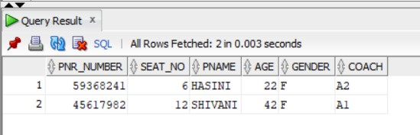
4.DISPLAY ALL PASSENGERS WHO BOOKED A TICKET FOR GIVEN INPUT TRAIN NAME ON A ON A PARTICULAR DATE
SQL Query :
SELECT B.*
FROM PNR A,PASSENGER B
WHERE A.PNR_NUMBER=B.PNR_NUMBER AND A.TRAIN_NUMBER=(SELECT TRAIN_NUMBER FROM TRAIN WHERE TRAIN_NAME='&A') AND A.JDATE='&B';
Output :
5.EXTRACT ALL TRAINS INFO WHICH RUN ON MONDAY AND SUNDAY
SQL Query :
SELECT TRAIN_NUMBER,TRAIN_NAME FROM TRAIN
WHERE RUNNING_DAYS LIKE '1 1';

Slide 22
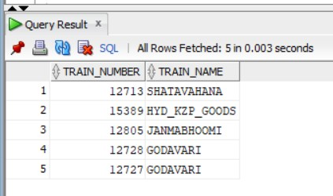
6.Find the cost of ticket by taking PNR number as input
SQL Query :
SELECT DISTANCE*COST*COUNT AS TOTAL_COST FROM
(SELECT (MAX(DIST_COVERED)-MIN(DIST_COVERED)) AS DISTANCE
FROM PNR A,PASSENGER B,TRAIN C,TRAIN_DETAILS D,TRAIN_TYPE E,SCHEDULE F
WHERE A.PNR_NUMBER=&P AND A.PNR_NUMBER=B.PNR_NUMBER AND A.TRAIN_NUMBER=C.TRAIN_NUMBER AND C.TRAIN_NAME=E.TRAIN_NAME AND D.TRAIN_TYPE=E.TYPE AND A.TRAIN_NUMBER=F.TRAIN_NUMBER AND (A.START_CODE=F.STN_CODE OR A.END_CODE=F.STN_CODE))
,
(SELECT DISTINCT(CASE
WHEN A.JCLASS='SL' THEN D.SL_COST_KM WHEN A.JCLASS='AC' THEN D.AC_COST_KM WHEN A.JCLASS='2S' THEN D.GEN_COST_KM END
) AS COST
FROM PNR A,PASSENGER B,TRAIN C,TRAIN_DETAILS D,TRAIN_TYPE E,SCHEDULE F
WHERE A.PNR_NUMBER=&P AND A.PNR_NUMBER=B.PNR_NUMBER AND A.TRAIN_NUMBER=C.TRAIN_NUMBER AND C.TRAIN_NAME=E.TRAIN_NAME AND D.TRAIN_TYPE=E.TYPE AND A.TRAIN_NUMBER=F.TRAIN_NUMBER AND (A.START_CODE=F.STN_CODE OR A.END_CODE=F.STN_CODE))

Slide 23
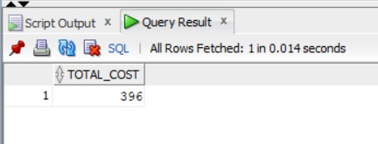
,
(SELECT (COUNT(*)/2) AS COUNT
FROM PNR A,PASSENGER B,TRAIN C,TRAIN_DETAILS D,TRAIN_TYPE E,SCHEDULE F
WHERE A.PNR_NUMBER=&P AND A.PNR_NUMBER=B.PNR_NUMBER AND A.TRAIN_NUMBER=C.TRAIN_NUMBER AND C.TRAIN_NAME=E.TRAIN_NAME AND D.TRAIN_TYPE=E.TYPE AND A.TRAIN_NUMBER=F.TRAIN_NUMBER AND (A.START_CODE=F.STN_CODE OR A.END_CODE=F.STN_CODE));
7.DISPLAY THE TRAIN NUMBERS OF ALL TRAINS THAT CROSS TWO GIVEN STATIONS IN THEIR PATH OF JOURNEY.
SQL Query :
(select train_number AS A from schedule
where stn_code=(select station_code from station where station_name='&A')) INTERSECT
(SELECT TRAIN_NUMBER AS B FROM SCHEDULE
WHERE STN_CODE=(SELECT STATION_CODE FROM STATION WHERE STATION_NAME='&B'));
OUTPUT:

Slide 24
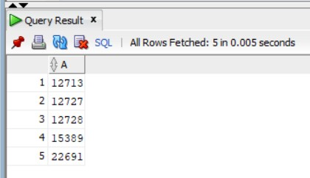
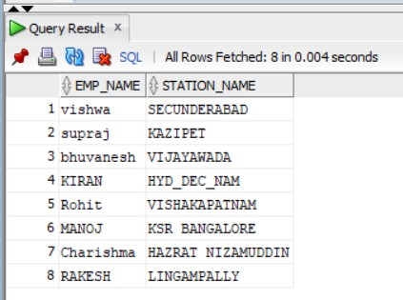
8.Write the details of all the station master and name of the station they handle
SQL QUERY:
SELECT B.EMP_NAME,C.STATION_NAME
FROM STATION_WORKERS A,EMPLOYEE B,STATION C
WHERE A.EMP_ID=B.EMP_ID AND B.DESIGNATION='SM' AND B.STATION_CODE=C.STATION_CODE;
OUTPUT:

Slide 25
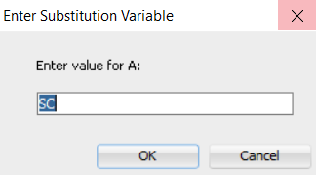
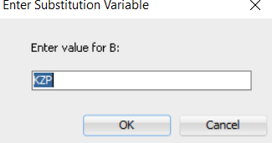
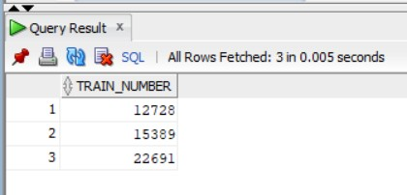
9.DISPLAY ALL TRAIN NUMBERS WHICH ARE PASSING THROUGH 2 GIVEN STATIONS IN THAT ORDER.
SQL QUERY:
SELECT TRAIN_NUMBER
FROM (select train_number,arr_time as A from schedule
where stn_code='&A') C natural join (select train_number,arr_time as B
from schedule
where stn_code='&B') D
WHERE (A IS NULL) OR (A < B);
INPUT:
OUTPUT:

Slide 26
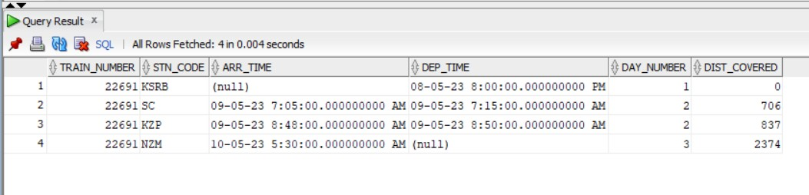
10. WRITE THE DETAILED SCHEDULE OF THE TRAIN WITH TRAIN NUMBER TAKEN AS INPUT.
SQL QUERY:
SELECT *
FROM SCHEDULE
WHERE TRAIN_NUMBER=&T ORDER BY DIST_COVERED;
OUTPUT:

