Slide 1
A SINGLE LETTER UPPER BOUND TO THE MISMATCH CAPACITY
BY 1)MANAS SACHIN DESHMUKH(2022102040)
2)PRAKHAR RAJ(2022102066)

Slide 2
BEFORE GOING AHEAD WHAT EXACTLY IS A DISCRETE MEMORYLESS CHANNEL?
A communication channel for which the statistical properties of the output signal at a time t are determined only by the input signal transmitted at this moment t of time and not at all on the past or future inputs is called a Discrete Memoryless Channel(DMC)
A discrete channel refers to a communication channel that can transmit information in a distinct and separate manner

Slide 3
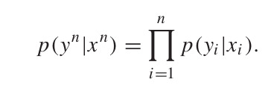
FORMULA OR MATHEMATICAL CONDITION FOR A CHANNEL TO BE DMC

Slide 4
Objective of the research paper
The traditional notion of channel capacity assumes perfect decoding, where the receiver can decode the transmitted message without any errors.
However, in practical scenarios, decoding errors can occur due to various factors such as noise, interference, or channel impairments.
The mismatch capacity accounts for these decoding errors and represents the maximum rate at which information can be reliably transmitted
It helps in improving system design and performance under mismatched conditions.

Slide 5

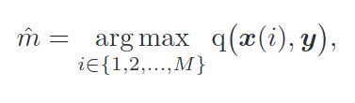
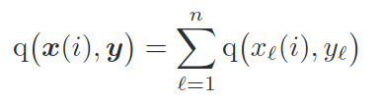
Optimizing best results from decoder by associating capacity with the particular channel
In certain situations, where the decoder is unaware of the channel law, or
is unable to compute it, it is not possible to use ML decoding and instead,
the decoder produces the message estimate as
where q :
Here q is a decoding metric
From XxY->R
The average and maximal error probabilities of codebook Cn under q-decoding are respectively denoted by Pe^{q} (Cn) and Pe^{q},max(Cn). The mismatch capacity Cq(W) or Cq(W) is defined as supremum of all achievable rates with q-decoding.

Slide 6
KEY INSIGHT
The key insight is that the bound is expressed as the mutual information of an auxiliary channel such that if a maximum-likelihood decoding error occurs on the auxiliary channel (obtained through the channel transformation), it implies that a mismatched-decoding error would occur on the original channel. This relationship between decoding errors is essential for deriving the upper bound.
The derived single-letter upper bound offers strict improvements over the traditional matched capacity in cases where the actual mismatched-decoding capacity is unknown.

Slide 7
WHAT EXACTLY IS CAPACITY OF A CHANNEL?
The maximum rate at which data can be correctly communicated over a channel in presence of noise and distortion is known as its channel capacity.
FOR A DISCRETE MEMORYLESS CHANNEL IT IS DEFINED AS PROBABILITY DISTRIBUTION Px FOR WHICH MUTUAL INFORMATION I(X;Y) IS MAXIMUM

Slide 8

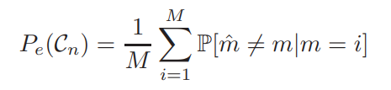

PROBABILITY OF ERROR
The probability of error is directly related to the achievable rates and the capacity of the channel. As the probability of error decreases, the achievable rate approaches the capacity of the channel and vice versa.
If there are M possible transmitted
symbols, the average error probability
can be expressed as:
The average error probability represents the probability of the estimate ( ) being incorrect, given the
true transmitted symbol (m = i).
This probability is calculated by summing the probabilities of all incorrect estimates over the total number
of possible estimates.

Slide 9
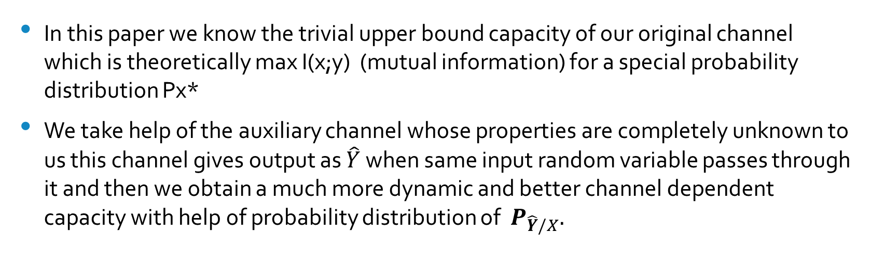
INTRODUCTION OF THE AUXILIARY CHANNEL and the main idea
In this paper we know the trivial upper bound capacity of our original channel which is theoretically max I(x;y) (mutual information) for a special probability distribution Px*
We take help of the auxiliary channel whose properties are completely unknown to us this channel gives output as $\hat{Y}$ when same input random variable passes through it and then we obtain a much more dynamic and better channel dependent capacity with help of probability distribution of $P_{\hat{Y}/X}.$

Slide 10
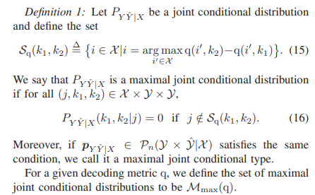
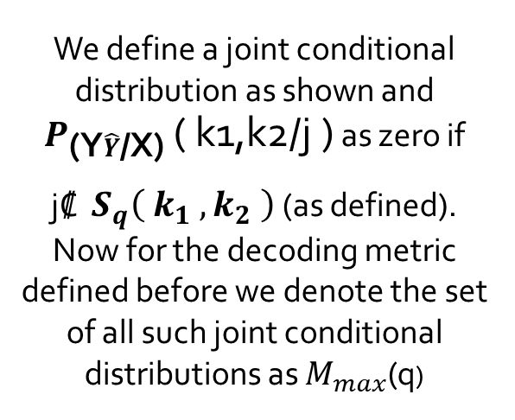
PROBABILITY DISTRIBUTION DEFINITION AND IMPLICATIONS :-
We define a joint conditional distribution as shown and $P_{\text{(}\text{Y}\hat{Y}\text{/}\text{X}\text{)}}$ ( k1,k2/j ) as zero if
j₡ $S_{q}\left( k_{1} , k_{2} \right)$(as defined). Now for the decoding metric defined before we denote the set of all such joint conditional distributions as $M_{max}$(q)

Slide 11
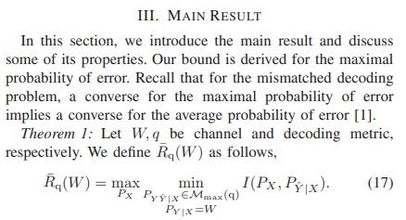
THE MAIN RESULT OF THE PAPER:-
Here for a channel W and decoding metric q we define capacity rate as some function of mutual information of probability distributions of random variables X and Y^/X then we find all minimas such that P(Y|X) is from channel W and P(YY^|X) belongs to the mentioned joint conditional distribution
Then we find such* a probability distribution Px such that we obtain the maximum of all those minimums.

Slide 12
EXAMPLE:-
BINARY INPUT BINARY OUTPUT CHANNEL

Slide 13
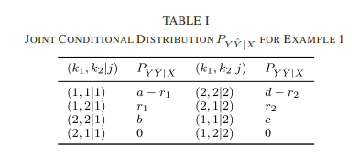
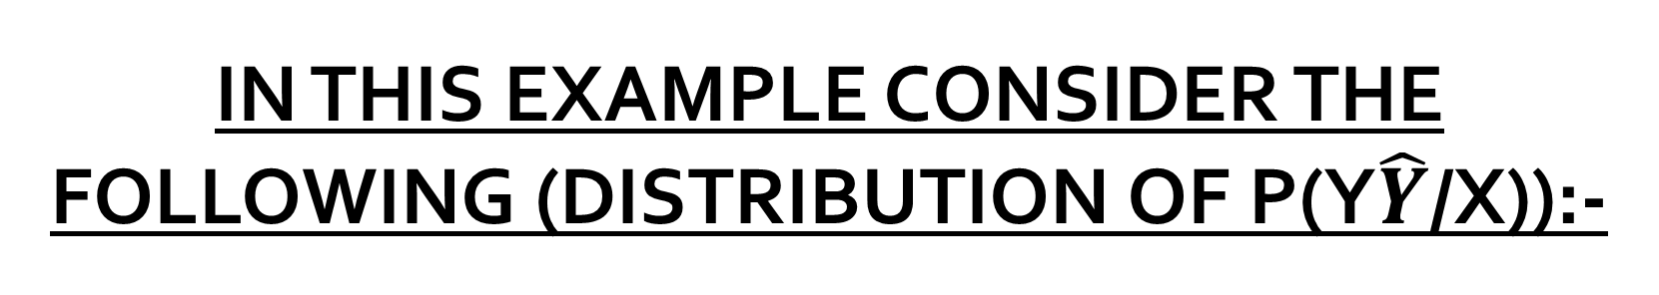
IN THIS EXAMPLE CONSIDER THE FOLLOWING (DISTRIBUTION OF P(Y$\hat{Y}$/X)):-

Slide 14

CONSIDER W AS CHANNEL MATRIX[FIXED] AND Q AS DECODING MATRIX BITS FOR BINARY INPUT BINARY OUTPUT CHANNEL

Slide 15

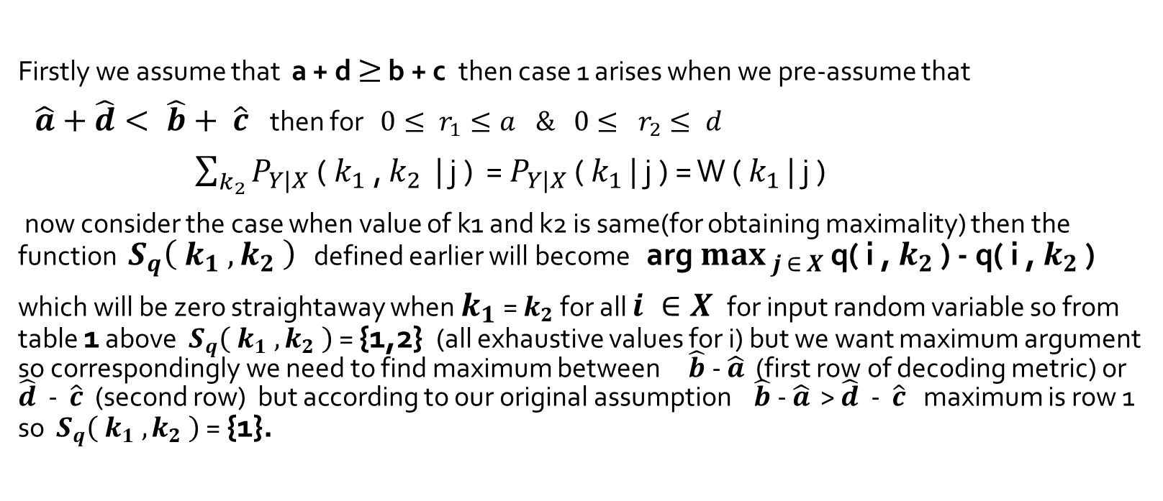
EXPLANATION FOR THE EXAMPLE:-
Firstly we assume that a + d $≥$ b + c then case 1 arises when we pre-assume that
$\hat{a}+\hat{d}< \hat{b}+ \hat{c}$ then for $0≤ r_{1}≤a \& 0≤ r_{2}≤ d$
$\sum_{k_{2}}{P_{Y|X}\text{ (} k_{1}\text{ , }k_{2}\text{ | }\text{j}\text{ )}}$ = $P_{Y|X}$ ( $k_{1}$ | j ) = W ( $k_{1}$ | j )
now consider the case when value of k1 and k2 is same(for obtaining maximality) then the function $S_{q}\left( k_{1} , k_{2} \right)$ defined earlier will become arg $\max_{ j ∈ X}{\text{q}\text{( }\text{i} \text{,} k_{2} \text{)} \text{−} \text{q}\text{( }\text{i} \text{,} k_{2} \text{)} }$
which will be zero straightaway when $k_{1}$ = $k_{2}$ for all $i ∈X$ for input random variable so from table 1 above $S_{q}\left( k_{1} , k_{2} \right)$ = {1,2} (all exhaustive values for i) but we want maximum argument so correspondingly we need to find maximum between $\hat{b}$- $\hat{a}$ (first row of decoding metric) or $\hat{d}$ - $\hat{c}$ (second row) but according to our original assumption $\hat{b}$- $\hat{a}$ > $\hat{d}$ - $\hat{c}$ maximum is row 1 so $S_{q}\left( k_{1} , k_{2} \right)$ = {1}.

Slide 16


EXPLANATION CONTINUED:-
Now we find matrix for $P_{\hat{Y}|X}$ by eliminating y by summing $P_{\hat{Y}|X}$for a fixed value of $\hat{Y}$ and X and summing over all possible values of Y we get:-

Slide 17


CONCLUSION AND FINAL STATEMENT:- 1)P(0|0)=a+c/2 2)P(0|1)=a+c/2 3)P(1|0)=P(1|1)=b+d/2(capacity can be found)

Slide 18

SIMILAR ANALYSIS CAN BE PERFORMED FOR THE OTHER CASE THAT IS $\hat{a}+\hat{d}< \hat{b}+ \hat{c}$ :-
Therefore, our upper-bound also matches the achievable rate and by the main result also easily we can get a much dynamic and system dependent better upper bound on capacity
THEREFORE OUR GOAL HAS BEEN ACHIEVED!!

Slide 19
THANK YOU FOR LISTENING ATTENTIVELY!!

