Slide 1

Mamindla pooja AICTE : STU63c917c1441421674123201
College name:Balaji Institute of Technology & Science
Department: computer science(IOT)
Year: 3 rd YEAR

Slide 2
PROJECT TITLE : WEATHER FORECAST
Problem Statement :
Current weather apps often provide inaccurate or generic forecasts, failing to account for specific locations and user preferences.
Inaccurate forecasts lead to frustration and disrupted plans
Generic forecasts lack personalized insights and recommendations
Existing apps often have cluttered interfaces and confusing data

Slide 3
AGENDA
Project Overview
End Users
Solution and Value Proposition
Customization and Modelling
Results

Slide 4
PROJECT OVERVIEW
Our Weather App aims to provide accurate and personalized weather forecasts, addressing the limitations of existing apps.
Utilize advanced weather APIs and machine learning algorithms
Incorporate user input and preferences for tailored forecasts
Intuitive and user-friendly interface

Slide 5
WHO ARE THE END USERS of this project?
Our target audience includes:
Individuals seeking accurate and reliable weather forecasts
Outdoor enthusiasts (e.g., hikers, cyclists, athletes)
Commuters and travelers
Weather-sensitive industries (e.g., agriculture, construction)

Slide 6
YOUR SOLUTION AND ITS VALUE PROPOSITION
Our Weather App offers:
Hyperlocal weather forecasts (accurate to within 1 km)
Personalized forecasts based on user input and preferences
Real-time weather alerts and notifications
Integration with popular calendar and mapping apps
Value Proposition: Stay ahead of the weather with our accurate and personalized forecasts, ensuring a more productive and enjoyable day.

Slide 7
How did you customize the project and make it your own
To create a tailored experience, we:
Utilize user input (e.g., location, preferences) to train machine learning models
Integrate with wearables and IoT devices for additional data
Employ data analytics to refine forecast accuracy

Slide 8
MODELLING
Our machine learning model incorporates various weather parameters, including:
Temperature
Humidity
Wind speed
Atmospheric pressure

Slide 9
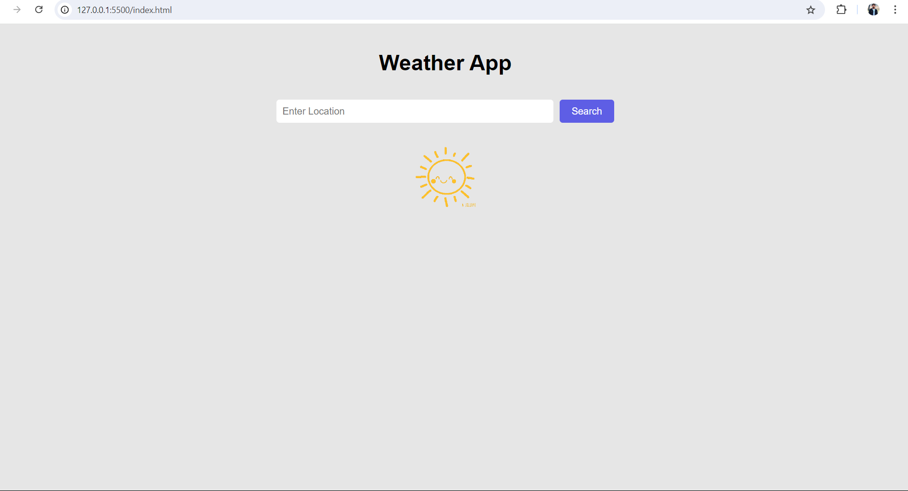
Results

Slide 10
links
https://github.com/2003poojamamindla24/webcloning.git
Bootstrap · The most popular HTML, CSS, and JS library in the world. (getbootstrap.com)

