Slide 1
Business Ownership Policies Broker Portal
Project Presentation

Slide 2
Objective and Scope
Objective: Build a digital portal for brokers to create, manage, and submit business insurance quotes.
Scope:
- Broker-focused BOP portal
- Simplifies quote lifecycle
- Enhances user engagement and earnings

Slide 3
Technical & Code Architecture
Frontend: Angular
Backend: ASP.NET Web API
Authentication: JWT (JSON Web Token)
Email: EmailJS integration
PDF Generation: Quote PDF download
Dynamic Forms: Autofill from uploaded PDF

Slide 4
Functional & Technical Features
- Secure Login/Registration with JWT
- Dashboard with quote stats and earnings
- Quote creation with premium calculation
- Upload PDF for form autofill
- Dynamic T&C preview
- Email notifications (EmailJS)
- Quote upgrade suggestions with benefits

Slide 5
Functional Details & Assumptions
Quote Rating: Based on business data and policy type
Assumptions:
- Admin panel is internal use only
- No claim management
- Brokers only; no direct customers

Slide 6
Innovation & Creativity
- Auto-filled quote forms via PDF upload
- Upgrade suggestion system (Normal → Gold → Premium)
- Notification system post-quote
- Earnings Tracker (2% commission)
- Interactive and modern UI/UX

Slide 7
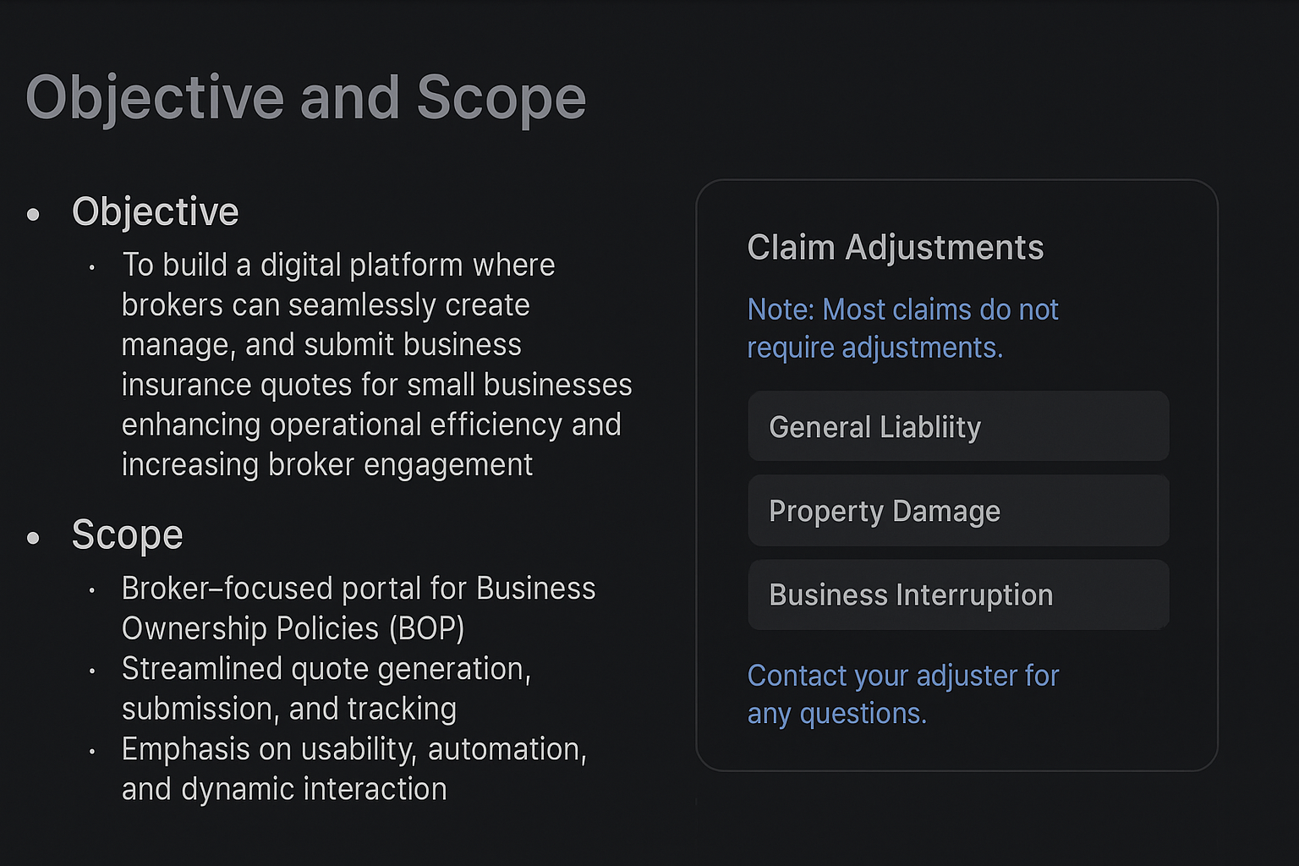
Objective and Scope (Visual)

