Slide 1
Runners IoT
Project Graphics & Benchmarks
By Michael Kelly 20041540

Slide 2





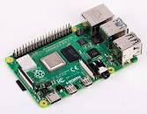


Pictorial Diagram
If the speed has reached over 12 km/h activate a action by sending email and twitter
Current speed and previous locations are tracked on website using different widgets
Data collected by Blynk is sent to RPI
RPI uses mqtt to publish data to Wia
Location and speed sent to Blynk app

Slide 3
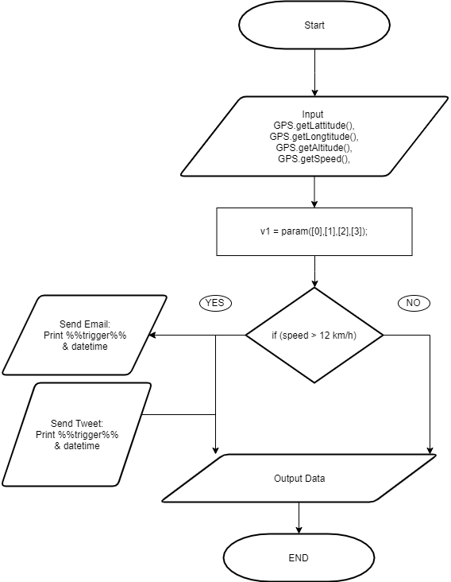
Flow Chart algorithm/logic

Slide 4
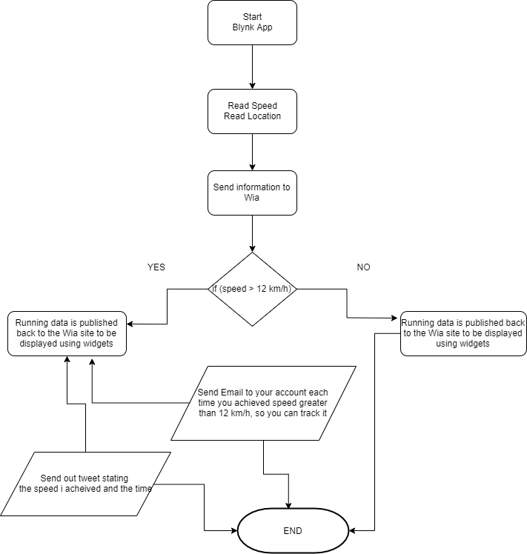
Informational Flow Chart

