Slide 1
Unveiling Emotional Insights: A Guide to Sentiment Analysis

Slide 2


Welcome to Unveiling Emotional Insights, a guide to
. Explore
the power of data in understanding human emotions and behaviors. Discover how sentiment analysis can revolutionize decision-making and customer experience.

Slide 3



Understanding Emotions
Delve into the complexity of human emotions and the role of
in deciphering them. Gain insights into the nuances of emotional expression
and the impact on decision-making and relationships.

Slide 4


Explore the diverse methods and tools for , including natural language processing, machine learning, and social media monitoring. Uncover the potential of these techniques in understanding public opinion and consumer sentiment.

Slide 5


Applications in Business
Discover how can drive business strategies, from brand reputation management to product development.
Learn how organizations leverage emotional insights to enhance customer satisfaction and loyalty.

Slide 6
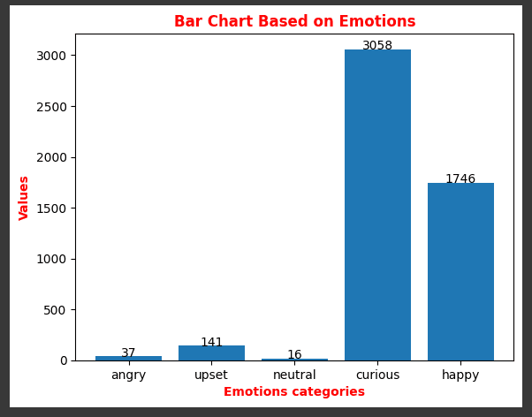

Slide 7
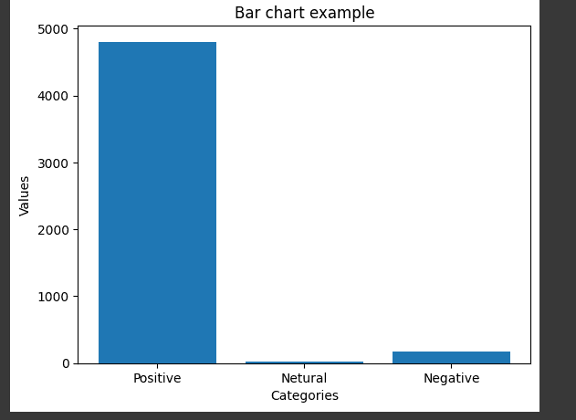

Slide 8


Examine the ethical implications of , including privacy concerns and potential biases. Understand the responsibility of utilizing emotional data ethically and transparently in decision-making processes.

Slide 9


Conclusion
Reﬂect on the transformative potential of
in understanding and responding to human emotions. Embrace the opportunities and challenges in leveraging emotional insights for informed decision-making and meaningful interactions.

Slide 10
Thanks!

