Slide 1
Predicting Eligibility for NSAP: using Machine Learning
CAPSTONE PROJECT
Presented By:
Aryan Choudhary: Jaipur Engineering College and Research Centre : Branch =Artificial Intelligence and Data Science

Slide 2
OUTLINE
Problem Statement
Proposed System/Solution
System Development Approach
Algorithm & Deployment
Result Conclusion
Future Scope
References

Slide 3
Problem Statement
Traditional manual processes for NSAP eligibility are inefficient and error-prone, causing:
Significant delays in aid distribution to vulnerable citizens.
Increased potential for human error and misallocations.
Lack of transparency and accountability.
High administrative burden on government resources.
This creates a critical need for a modernized, accurate, and efficient system to ensure timely and equitable distribution of vital social assistance.

Slide 4
Proposed Solution
The proposed system aims to address the challenge of manually determining NSAP eligibility by providing an efficient, accurate, and automated prediction model. This involves leveraging data analytics and machine learning techniques to predict the most suitable NSAP scheme for applicants. The solution will consist of the following components:
Data Collection:
Gather historical demographic and socio-economic data relevant to NSAP eligibility from sources like the AI Kosh dataset.
Collect features such as financial year, state/district codes, total beneficiaries, gender distribution, caste categories (SC, ST, OBC, General), and mobile/Aadhaar linkage.
Data Preprocessing:
Clean and preprocess the collected data to handle missing values, outliers, and inconsistencies.
Perform feature engineering to extract relevant features that might impact NSAP scheme eligibility.
Machine Learning Algorithm:
Implement a multiclass classification machine learning model (automatically selected by IBM Watsonx.ai's AutoAI).
Train the model to predict the specific schemeo (NSAP scheme category) based on historical applicant data.
Incorporate automated algorithm selection, feature engineering, and hyperparameter optimization via AutoAI for improved prediction accuracy.
Deployment:
Deploy the trained model as a RESTful API endpoint on IBM Cloud using Watsonx.ai.
Develop a user-friendly interface or client-side script that provides real-time predictions for new applicant data.
Ensure the solution is deployable on a scalable and reliable platform, considering factors like server infrastructure, response time, and user accessibility.
Evaluation:
Assess the model's performance using appropriate metrics such as Accuracy, Precision, Recall, and F1-Score.
Fine-tune the model based on feedback and continuous monitoring of prediction accuracy.
Result:
The system outputs the predicted NSAP scheme for an applicant with a corresponding confidence score.
Provides a clear, data-driven recommendation for scheme allocation, demonstrating efficiency and precision.

Slide 5
System Approach
This section outlines the overall strategy and methodology for developing and implementing the NSAP Eligibility Prediction Model, ensuring a robust and efficient system. Here's a suggested structure for this section:
System Requirements
Data Inputs: Access to comprehensive historical NSAP applicant data, including demographic (e.g., age, gender, caste), socio-economic (e.g., beneficiaries, financial year), and existing scheme (schemeo) information.
Cloud Platform: A reliable cloud environment capable of hosting machine learning services and deployments (IBM Cloud).
Machine Learning Capabilities: Tools for automated data preprocessing, model training, evaluation, and deployment (IBM Watsonx.ai, AutoAI).
Scalability: Ability to handle increasing volumes of applicant data and prediction requests.
Real-time Inference: Capability for immediate predictions on new data.
Security & Compliance: Adherence to data privacy and security standards relevant to government welfare data.
Library Required to Build the Model
Python: The primary programming language for any custom scripting or interaction with APIs.
ibm_watsonx_ai SDK: For programmatic interaction with Watsonx.ai services, if needed for client-side scripts or specific integrations.
requests: For making HTTP calls to the deployed model's API endpoint.
json: For handling data serialization (input payload and output parsing).
os, dotenv: For securely managing environment variables (e.g., API keys) when interacting with IBM Cloud.

Slide 6
Algorithm & Deployment
Algorithm Selection:
Our model utilizes multiclass classification algorithms, automatically identified and optimized by IBM Watsonx.ai's AutoAI.
AutoAI intelligently explored and ranked various high-performing algorithms (e.g., Decision Trees, Random Forests, LGBM Classifier, Logistic Regression) to ensure the best fit for predicting discrete NSAP scheme categories based on applicant data.
Data Input:
The algorithm uses historical NSAP applicant data from sources like the AI Kosh dataset.
Key input features include demographic information (e.g., totalmale, totalfemale, totalsc, totalst, totalgen, totalobc, totalaadhr, totalmobil), geographic details (statename, districtname), and financial year (finyear).
Training Process:
The algorithm is trained using this historical data within IBM Watsonx.ai's AutoAI environment.
AutoAI automates the entire training pipeline, including data preprocessing, feature engineering, intelligent algorithm selection, and hyperparameter tuning, ensuring the model learns complex patterns for accurate eligibility prediction.
Prediction Process:
The trained model makes predictions by receiving new applicant demographic and socio-economic data as input.
It then processes this real-time data to output a predicted schemeo (NSAP scheme category) along with a confidence score, enabling immediate and accurate eligibility assessment.
Deployment : Making the Model Accessible
Online API Endpoint: The best-performing model pipeline was seamlessly deployed as a RESTful API endpoint on IBM Cloud via Watsonx.ai.
Real-time Inference: This deployment enables real-time predictions, allowing external systems or applications to send new applicant data and receive instant eligibility results.
Scalability: The deployed model is designed to handle a high volume of concurrent prediction requests, ensuring scalability for large-scale governmental use.

Slide 7
Result
Overall Model Accuracy:
Our NSAP Eligibility Prediction Model achieved a high overall accuracy of 98.1% on the test dataset.
This metric signifies the proportion of correctly predicted eligibility outcomes across all NSAP schemes.
Key Performance Metrics (Multiclass Classification):
Beyond overall accuracy, AutoAI evaluated the model using critical metrics relevant to multiclass classification:
Precision: Indicates the proportion of positive identifications that were actually correct for each scheme.
Recall: Measures the proportion of actual positives that were correctly identified.
F1-Score: The harmonic mean of Precision and Recall, providing a balanced measure of the model's accuracy.
These metrics confirm the model's robust ability to distinguish between different NSAP scheme categories.
Effectiveness in Scheme Allocation:
The model demonstrates high effectiveness in accurately assigning applicants to the most suitable NSAP scheme, minimizing misclassification errors.
This directly translates to fairer and more efficient allocation of welfare benefits, reducing the burden on administrative processes.

Slide 8
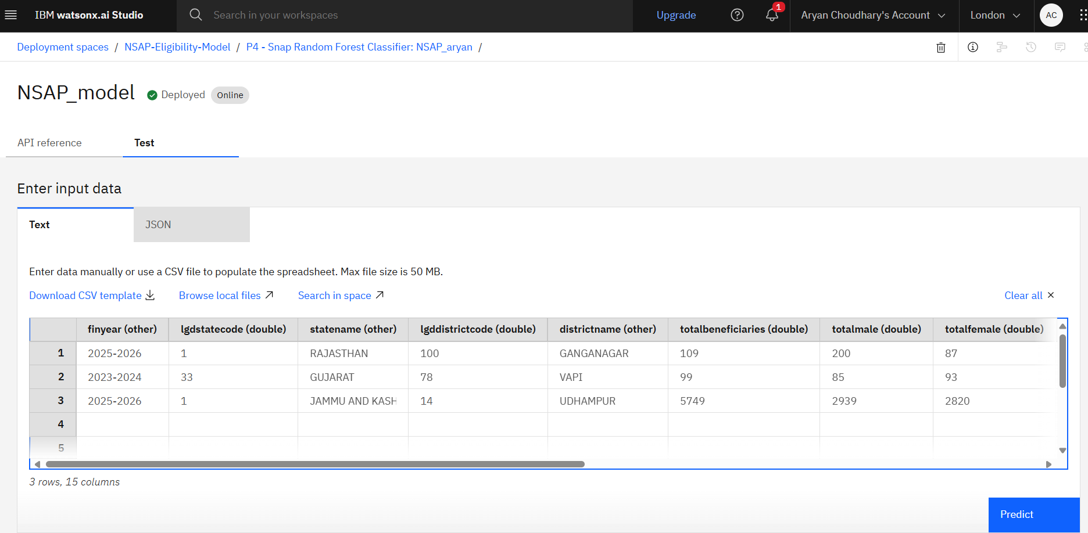
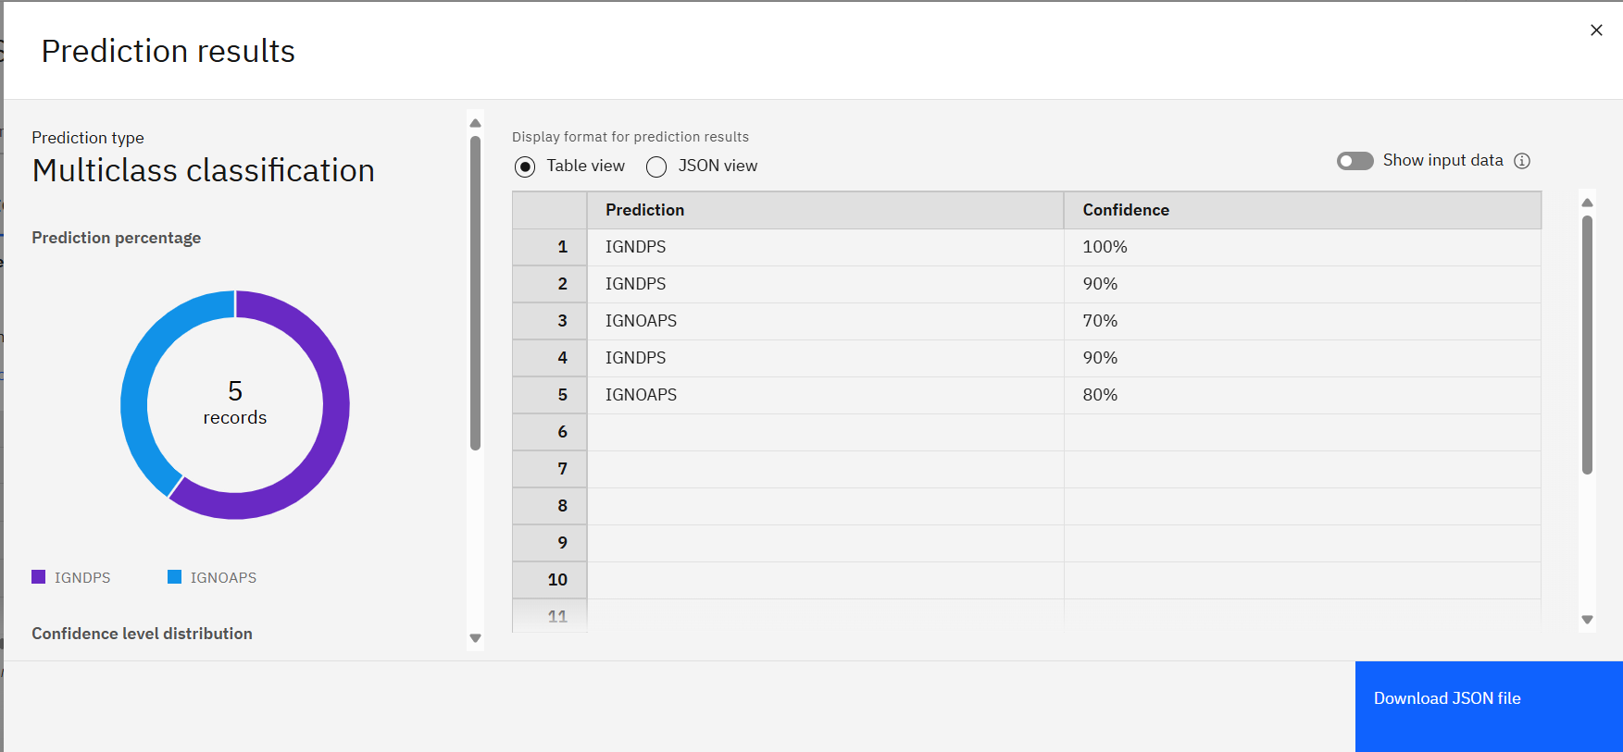

Slide 9
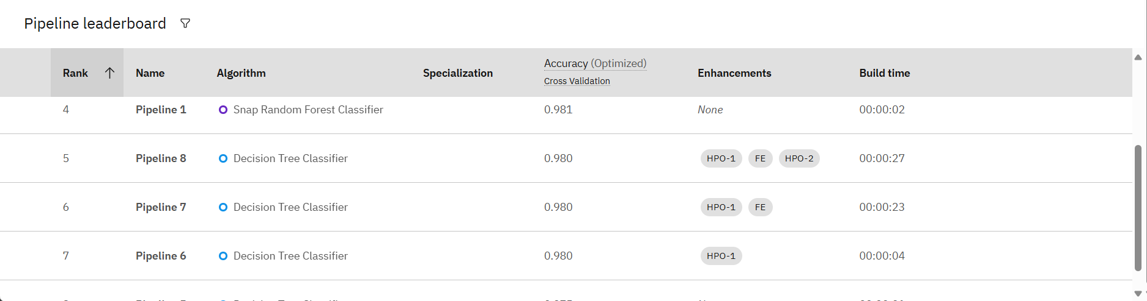

Slide 10
Conclusion
This project culminates in the successful development of an AI-powered NSAP Eligibility Prediction Model, demonstrating a significant advancement in social welfare administration.
Effective Process Building: We have successfully established a robust and efficient process for leveraging machine learning to automate complex eligibility determinations, proving the power of data-driven approaches.
High Accuracy and Operational Improvement: The model exhibits high accuracy in predicting appropriate NSAP schemes, directly translating to enhanced efficiency, minimized errors, and accelerated aid distribution compared to manual systems.
Significant Potential for Impact and Growth: This solution carries immense potential for real-world impact, ensuring timely and accurate delivery of benefits to India's vulnerable populations. Its foundation allows for continuous improvement and expansion to other social schemes.
Leveraging Data for Social Good: The project underscores the critical importance of readily available and structured government data (like that from AI Kosh) as a fundamental resource for building impactful AI solutions that drive positive societal change in both urban and rural areas.

Slide 11
Future scope
Our NSAP Eligibility Prediction Model lays a strong foundation, with significant potential for future enhancements and broader application to maximize its social impact.
Seamless Integration with Government Portals:
Integrate the model's API directly with existing or new government online application portals.
This enables real-time eligibility checks and automated scheme recommendations at the point of application submission, greatly enhancing user experience and administrative efficiency.
Enhancing Trust with Explainable AI (XAI):
Implement Explainable AI (XAI) techniques to provide clear, human-understandable reasoning behind the model's predictions.
This fosters greater transparency and trust among applicants and administrators, allowing for auditing and verification of decisions.
Multilingual Interface for Broader Accessibility:
Develop a multilingual user interface, potentially leveraging services like IBM Granite for translation capabilities.
This will allow applicants from diverse linguistic backgrounds across India to input data and receive predictions in their preferred regional language, ensuring wider accessibility and inclusion.
Continuous Learning and Model Updates:
Establish a robust feedback loop for continuous model improvement.
Periodically retrain and update the model using new applicant data, verified outcomes, and any revised NSAP scheme criteria, ensuring ongoing accuracy and relevance.
Broader Social Program Applicability:
Extend this successful predictive framework to other government social welfare or subsidy schemes within India (e.g., health, education, housing subsidies).
Leverage similar data-driven approaches to optimize resource distribution across various sectors, contributing to a more comprehensive and efficient digital welfare system.

Slide 12
References
National Social Assistance Programme (NSAP) Dataset:
AI Kosh, IndiaAI: https://aikosh.indiaai.gov.in/web/datasets/details/district%20wise%20pension%20data%20under%20the%20national%20social%20assistance%20programme_nsap_1.html
IBM Cloud & Watsonx.ai Documentation:
Official documentation for IBM Watsonx.ai, particularly sections related to AutoAI and Model Deployment.
General IBM Cloud documentation for platform services and infrastructure.

Slide 13
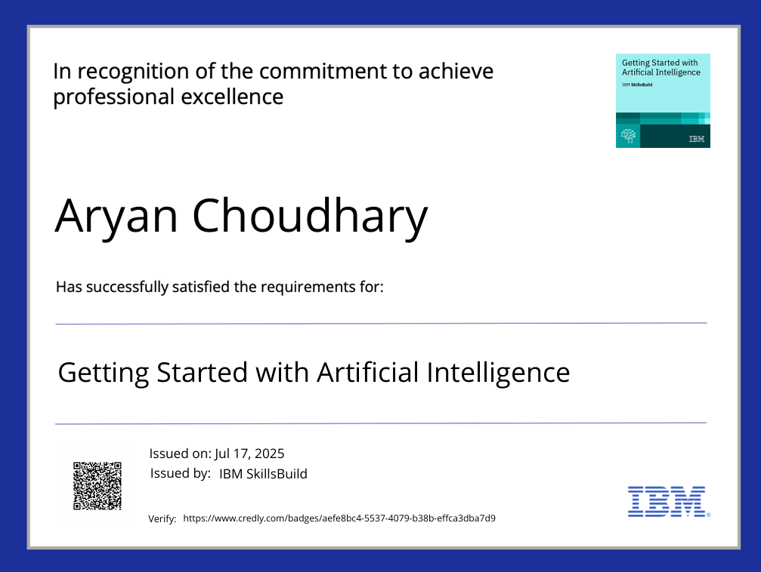
IBM Certifications
Screenshot/ credly certificate( getting started with AI)

Slide 14
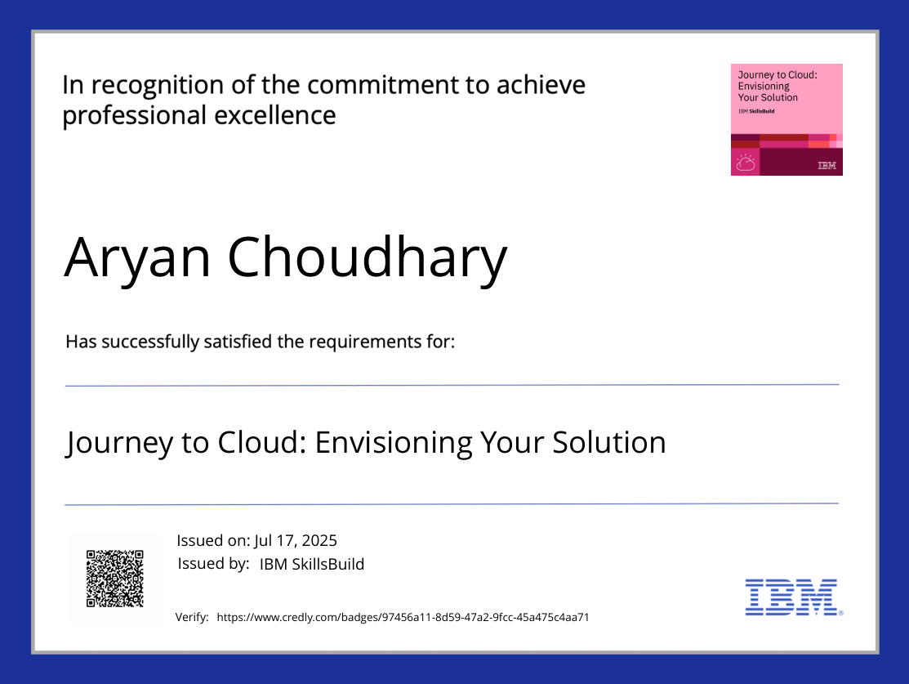
IBM Certifications
Screenshot/ credly certificate( Journey to Cloud)

Slide 15
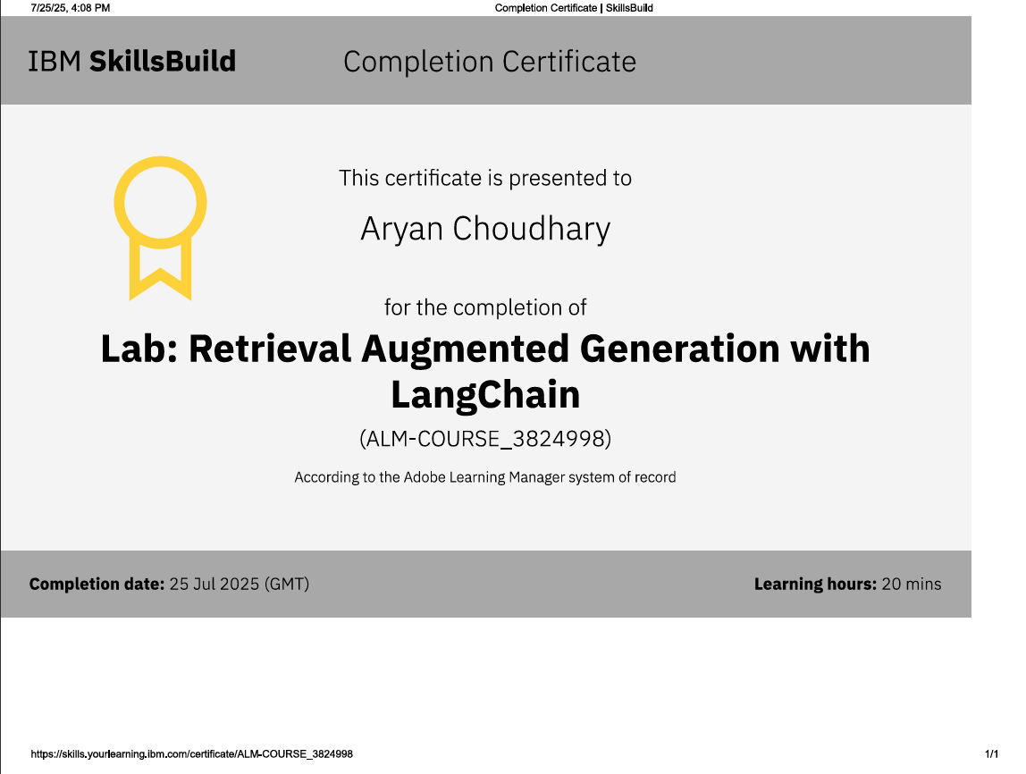
IBM Certifications
Screenshot/ credly certificate( RAG Lab)

Slide 16
THANK YOU

