Slide 1
Quest 4: Secure E-Votes
By Joshua Arrevillaga, Michael Barany, Samuel Kraft

Slide 2
Project Description
Secure E-Voting with NFC and IR Communication: Implement a voting system where you cast a vote using fobs, they communicate via IR and NFC
Distributed Network with Leader Election: Develop a system of identical fobs via WI-FI. Elect a leader in case the current one fails
Real time vote logging and confirmation: Setup a central database using TingoDB to log each votes metadata, {id, color, time-stamp}. Confirmation message is sent back to the fobs
Web interface for polling results: Create a UI that displays real time votes and allows for database management, i.e. resetting the database

Slide 3
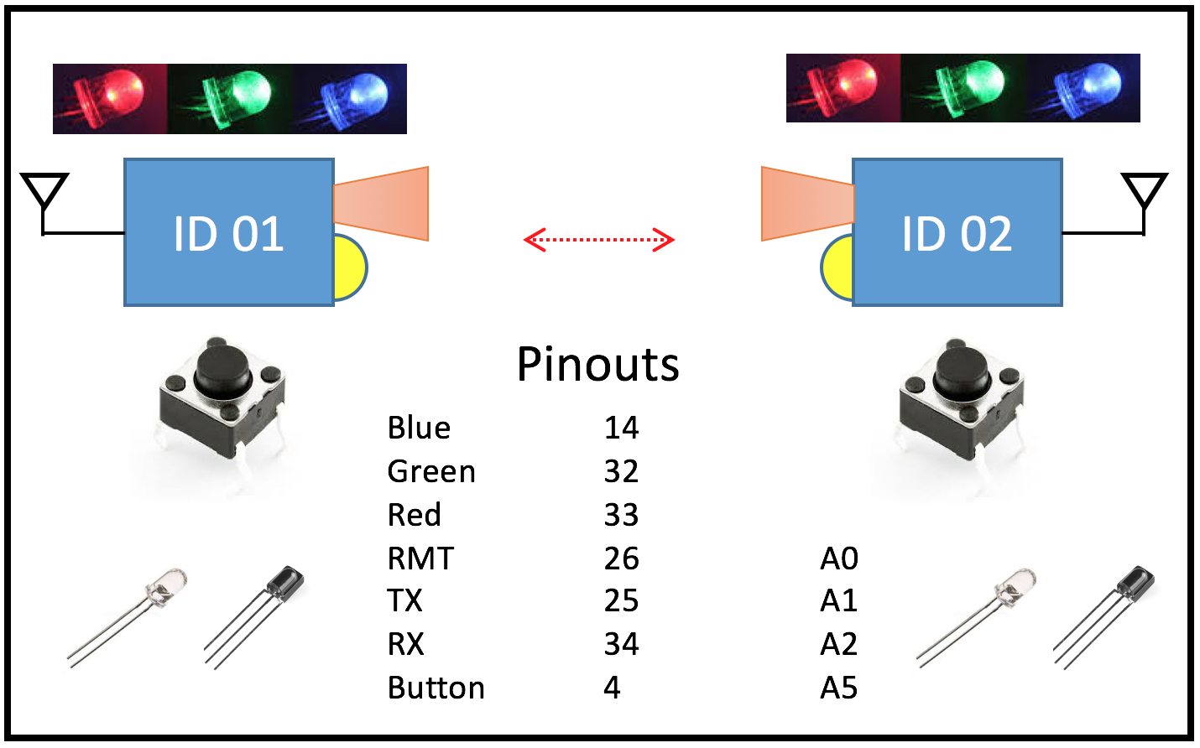
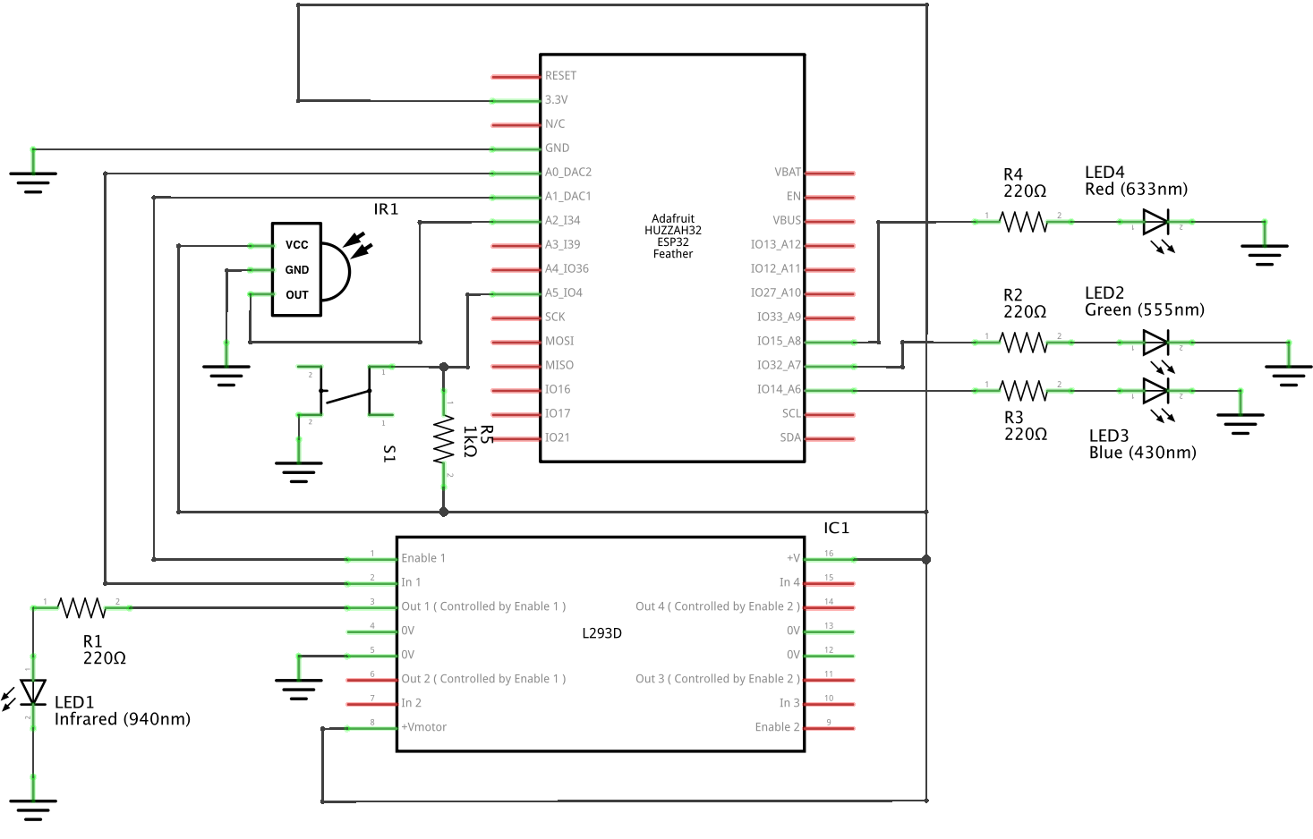
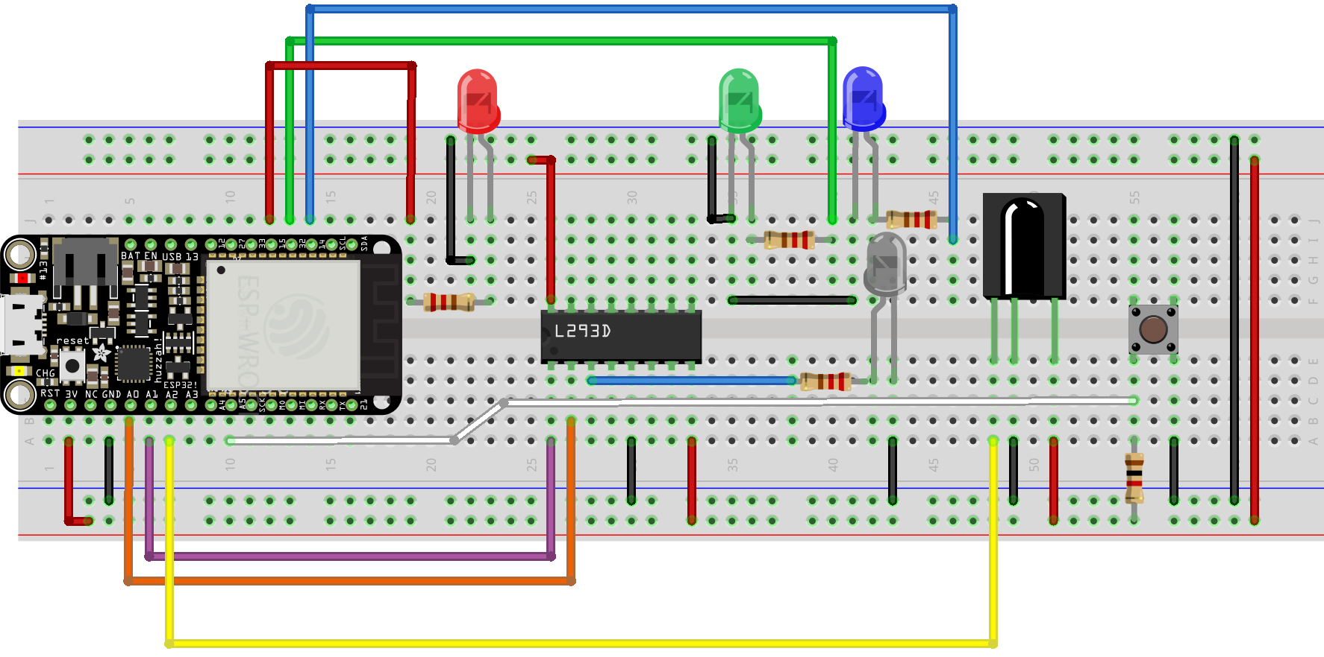
Circuit Diagrams

Slide 4
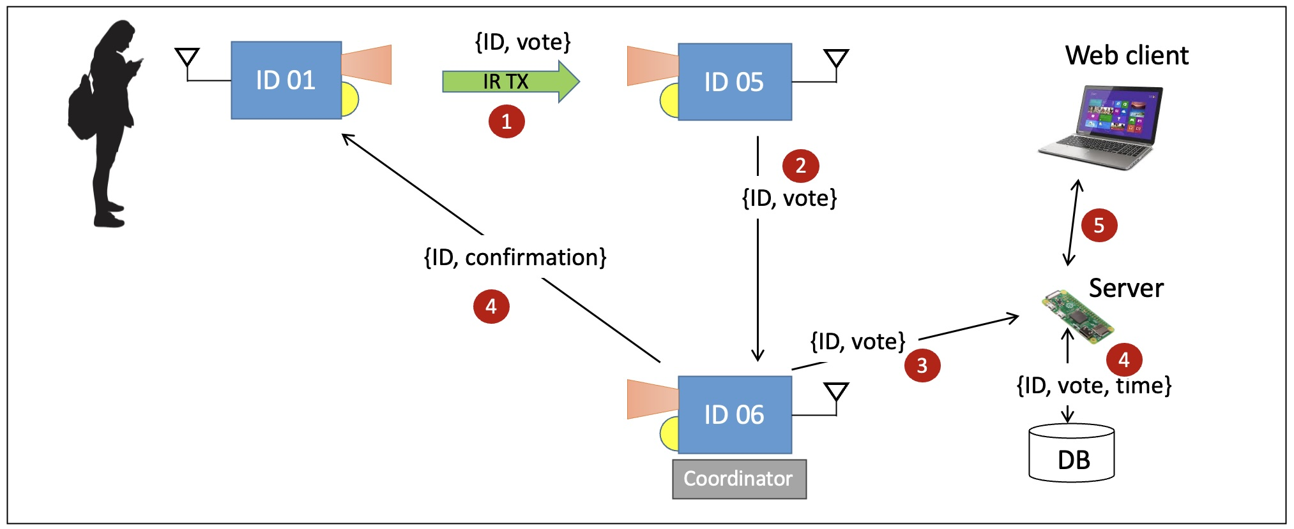
Code Logic (Fobs.c)
State Machines for Role Management: Implements state machines to manage fob's roles—uncertain, leader, or follower. Uses a leader election algorithm and heartbeat messages to select and monitor Coordinator, ensuring operation even if Coordinator fails.
IR Communication for Vote Transmission: Utilizes IR communication to simulate NFC, allowing secure vote transmission when button is pressed. Includes checksum verification for data integrity before forwarding votes to Coordinator over Wi-Fi.
User Interaction with LEDs and Button Input: Provides user interface through a button to initiate voting and LEDs to indicate the device's state—Red for uncertain, Blue for leader, and Green for follower—offering real-time feedback and diagnostics.

Slide 5
Code Logic (server.js/main.js)
Main.js
UDP Server Receiving and Storing Votes in a Database: Implements a UDP server that listens for incoming vote data from ESP32 devices, parses the messages to extract voter IDs and votes, and stores them in a Tingodb database for persistent storage and retrieval.
Provides API Endpoints for Vote Data Retrieval and Reset: Sets up Express routes (/api/votes and /api/reset) to allow the front-end to fetch current vote counts and reset the database, enabling dynamic interaction and management of vote data through the web interface.
Server.js
Express Server Serving Static Files with Socket.IO Integration: Establishes an Express server to serve the front-end application and uses Socket.IO for real-time communication, enabling the server to push updates to connected clients.
Emits Current Vote Counts to Connected Clients: On client connections, sends the current voteCounts to the clients via Socket.IO, ensuring that users receive up-to-date voting information upon accessing the web interface.

Slide 6
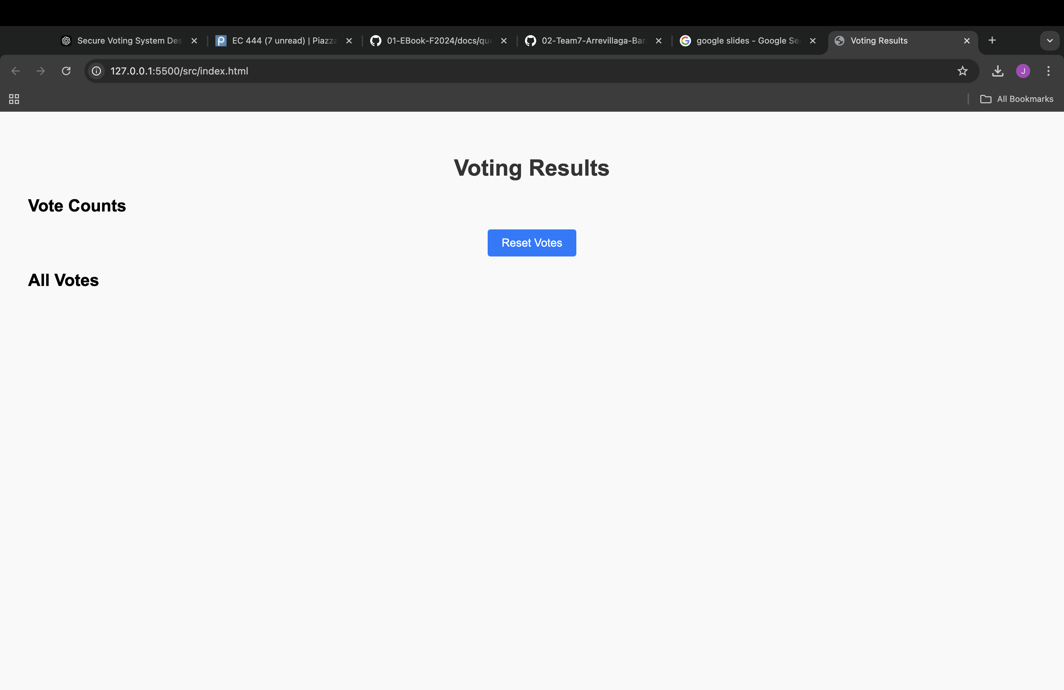
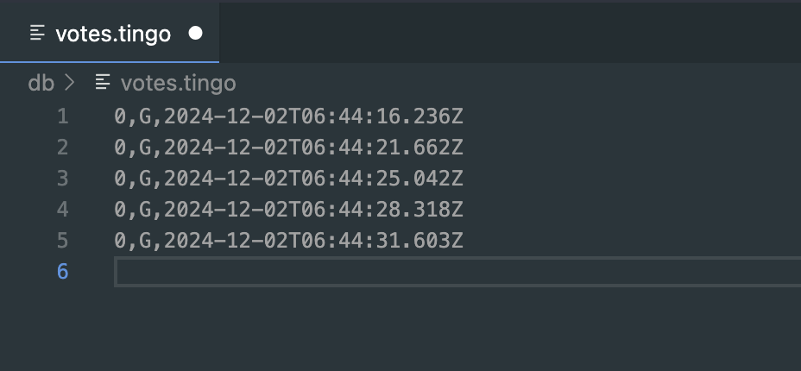
Ui/Database

Slide 7
Reflections
Plan our timeline better with respects to other class workloads
Use our resources better, asking professor and TAs for help when needed and properly go over documentation
Finish skills on time

