Slide 1
Epsilon Conductor
Causal marketing decisioning — spend only where it changes the outcome.
We don't predict who will buy. We prove whose decision marketing actually changed.
Epsilon Hackathon · Theme 02: seamless journeys, clear measures of success

Slide 2
THE PROBLEM
Most marketing pays for sales it already had
▪ Conventional targeting ranks customers by propensity — who is likely to buy.
▪ But most high-propensity buyers would have bought anyway — the discount is wasted margin.
▪ Worse: some customers convert LESS when contacted — and nobody measures it.
▪ No system answers the only question that matters: where does spend change the decision?
Epsilon Conductor
2

Slide 3
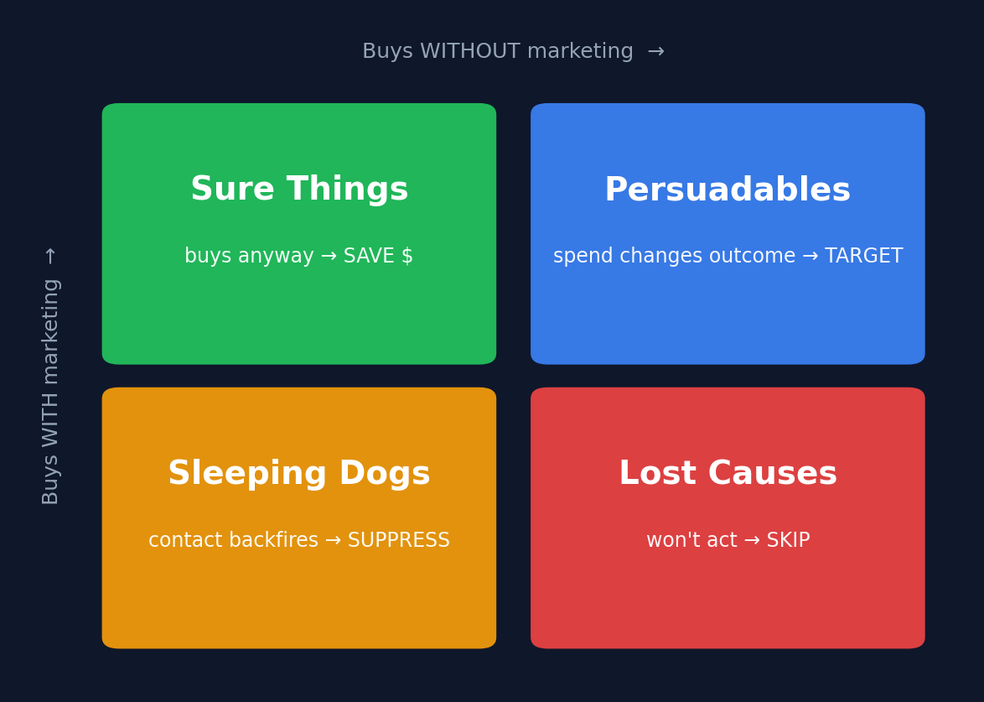
THE INSIGHT
Four buckets, one question
▪ Persuadables — spend here.
▪ Sure Things — buy anyway, save the budget.
▪ Sleeping Dogs — contact backfires, stay silent.
▪ Lost Causes — won't act, skip.
Only the Persuadables are worth a dollar — typically a small slice of the base.
Epsilon Conductor
3

Slide 4
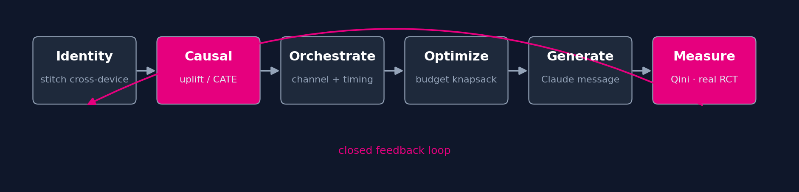
HOW IT WORKS
A closed decisioning loop
Identity → causal uplift → channel orchestration → budget allocation → generative message → causal measurement — feeding back into the next decision.
Epsilon Conductor
4

Slide 5
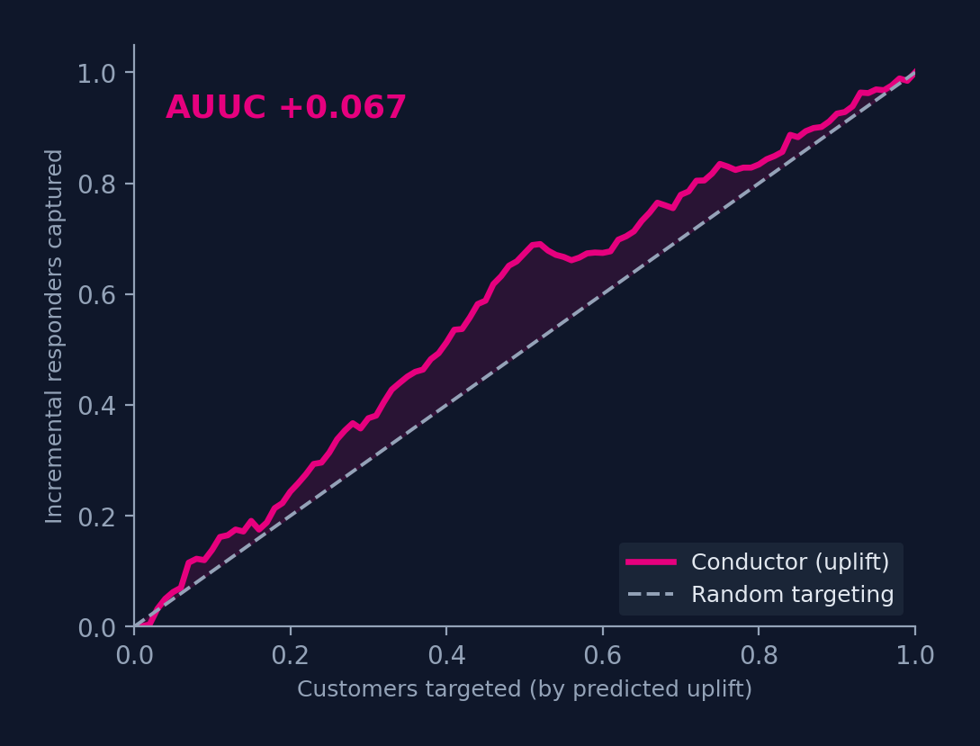
THE CAUSAL ENGINE
We model uplift, not propensity
▪ EconML X-Learner estimates each customer's incremental effect (CATE).
▪ Trained on the Hillstrom RCT — 64,000 real, randomized customers.
▪ Validated with Qini / AUUC — the right metric for incrementality, not accuracy.
▪ Negative-uplift customers fall out automatically as Sleeping Dogs.
Epsilon Conductor
5

Slide 6
THE PRODUCT
Live, per-shopper decisioning
▪ S-Learner scores live behaviour (9 signals) in real time.
▪ Per-product intent across the whole consideration set.
▪ Cross-device identity — cart & points follow the shopper.
▪ Next-best-action: right channel, right time — or deliberate silence.
🖼 Paste screenshot: Console — live shopper view (/console · two-world economics + per-product cards)
Epsilon Conductor
6

Slide 7
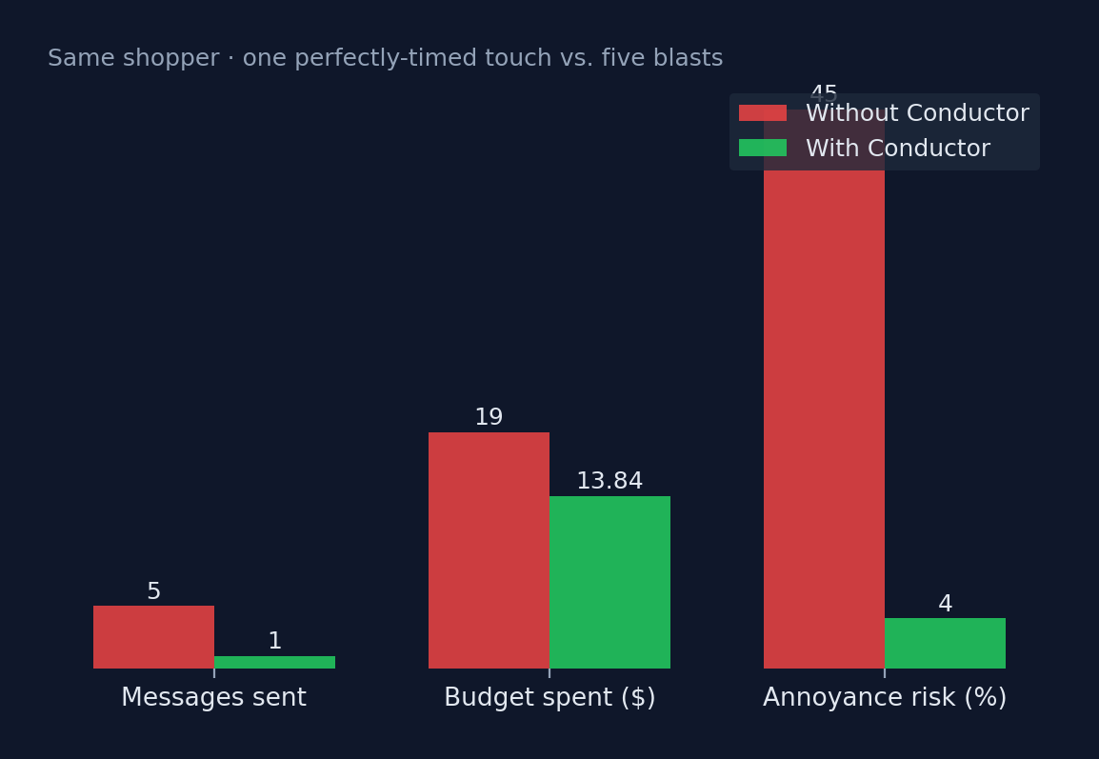
ECONOMICS
Restraint, measured in dollars
▪ Revenue GENERATED — incremental sales from Persuadables.
▪ Budget SAVED — not discounting Sure Things who pay full price.
▪ Revenue PROTECTED — not annoying Sleeping Dogs.
▪ Minimum Effective Dose — the smallest discount that still converts.
Epsilon Conductor
7

Slide 8
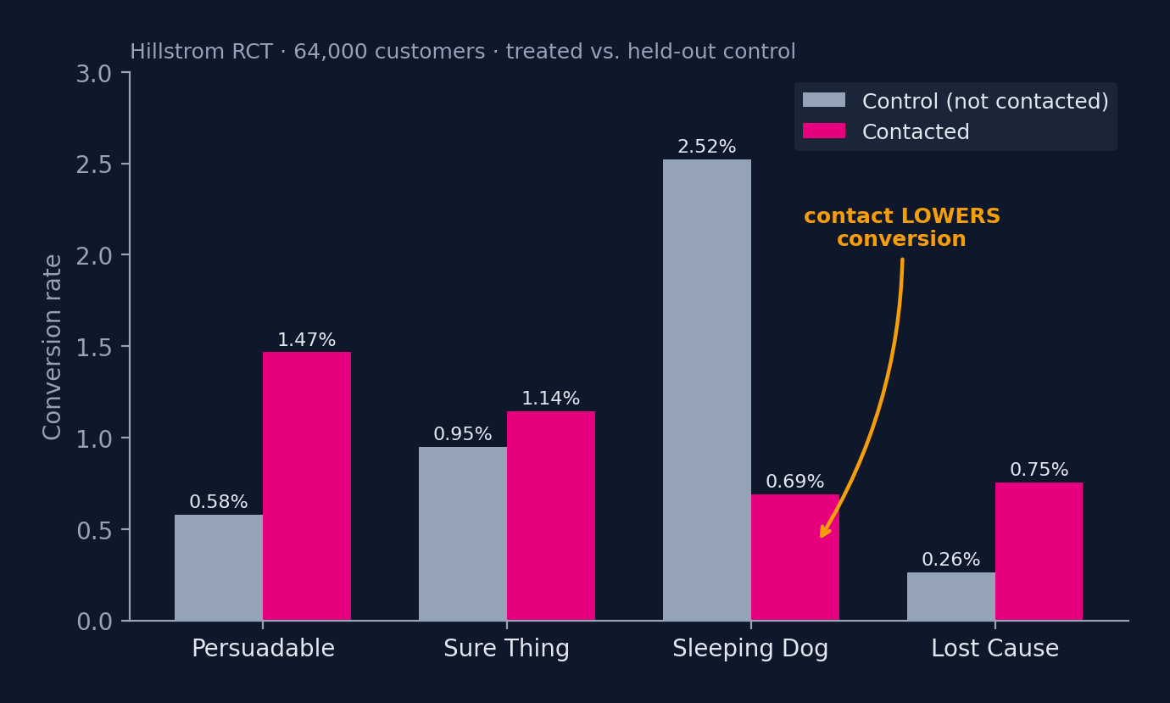
THE PROOF
Proof on a real experiment — measured, not modelled
▪ Persuadables convert ~2.5× higher when contacted.
▪ Sure Things barely move — discounting them is waste.
▪ Sleeping Dogs: contact CUT conversion by 1.83 points.
That is the spend every propensity model makes blind — and we can prove it on a real RCT.
Epsilon Conductor
8

Slide 9
DIFFERENTIATION
What's actually new
 | Conventional martech | Epsilon Conductor
Target signal | Propensity — who'll buy | Uplift / CATE — whose mind we change
Live scoring | Rules or stale score | S-Learner on live behaviour
Channel | Same blast | Thompson bandit + timing policy
Budget | Top-N by score | 0/1 knapsack, marginal-ROI knee
Discount | Blanket 20% | Minimum effective dose
Success metric | Clicks / conversions | Qini + real RCT proof
Restraint | Not modelled | Generated · Saved · Protected ($)
Epsilon Conductor
9

Slide 10
WE DID THE HOMEWORK
Built on Epsilon's own playbook
▪ Dell “Unfrozen”: split dormant customers into Nappers & Dormants — and chose to let some go.
▪ That restraint drove ~6% more revenue and ~8% higher margin. Letting go IS the thesis.
▪ Walgreens: a decade of per-person, cross-channel journeys.
▪ Conductor is the causal layer on top of CORE ID + PeopleCloud — every touch made provably worth it.
Epsilon Conductor
10

Slide 11
UNDER THE HOOD
Technology
Causal ML EconML X-Learner · S-Learner · scikit-learn
Orchestration Thompson-sampling contextual bandit
Optimization PuLP 0/1 knapsack · marginal-ROI knee
Data / proof Hillstrom RCT · Qini / AUUC
Backend FastAPI · real-time SSE
Frontend Next.js · Recharts
Generative Claude — per-decision explanations
Epsilon Conductor
11

Slide 12
We don't just market smarter.
We prove it.
Seamless across every channel and device · every decision explainable · every dollar tied to a measured outcome.
Thank you.

