Slide 1

SMART INDIA HACKATHON 2026
KAVACH
Sovereign Agentic AI Workbench for Confidential Industrial Work
Problem Statement ID: SIH26117
Theme: Smart Automation
PS Category: Software
Organization: Mangalore Refinery & Petrochemicals Ltd. (MRPL)
Team ID: [TEAM ID]
Team Name: [TEAM NAME]
"Claude/Codex-grade intelligence. Zero data leaves the fence."

Slide 2
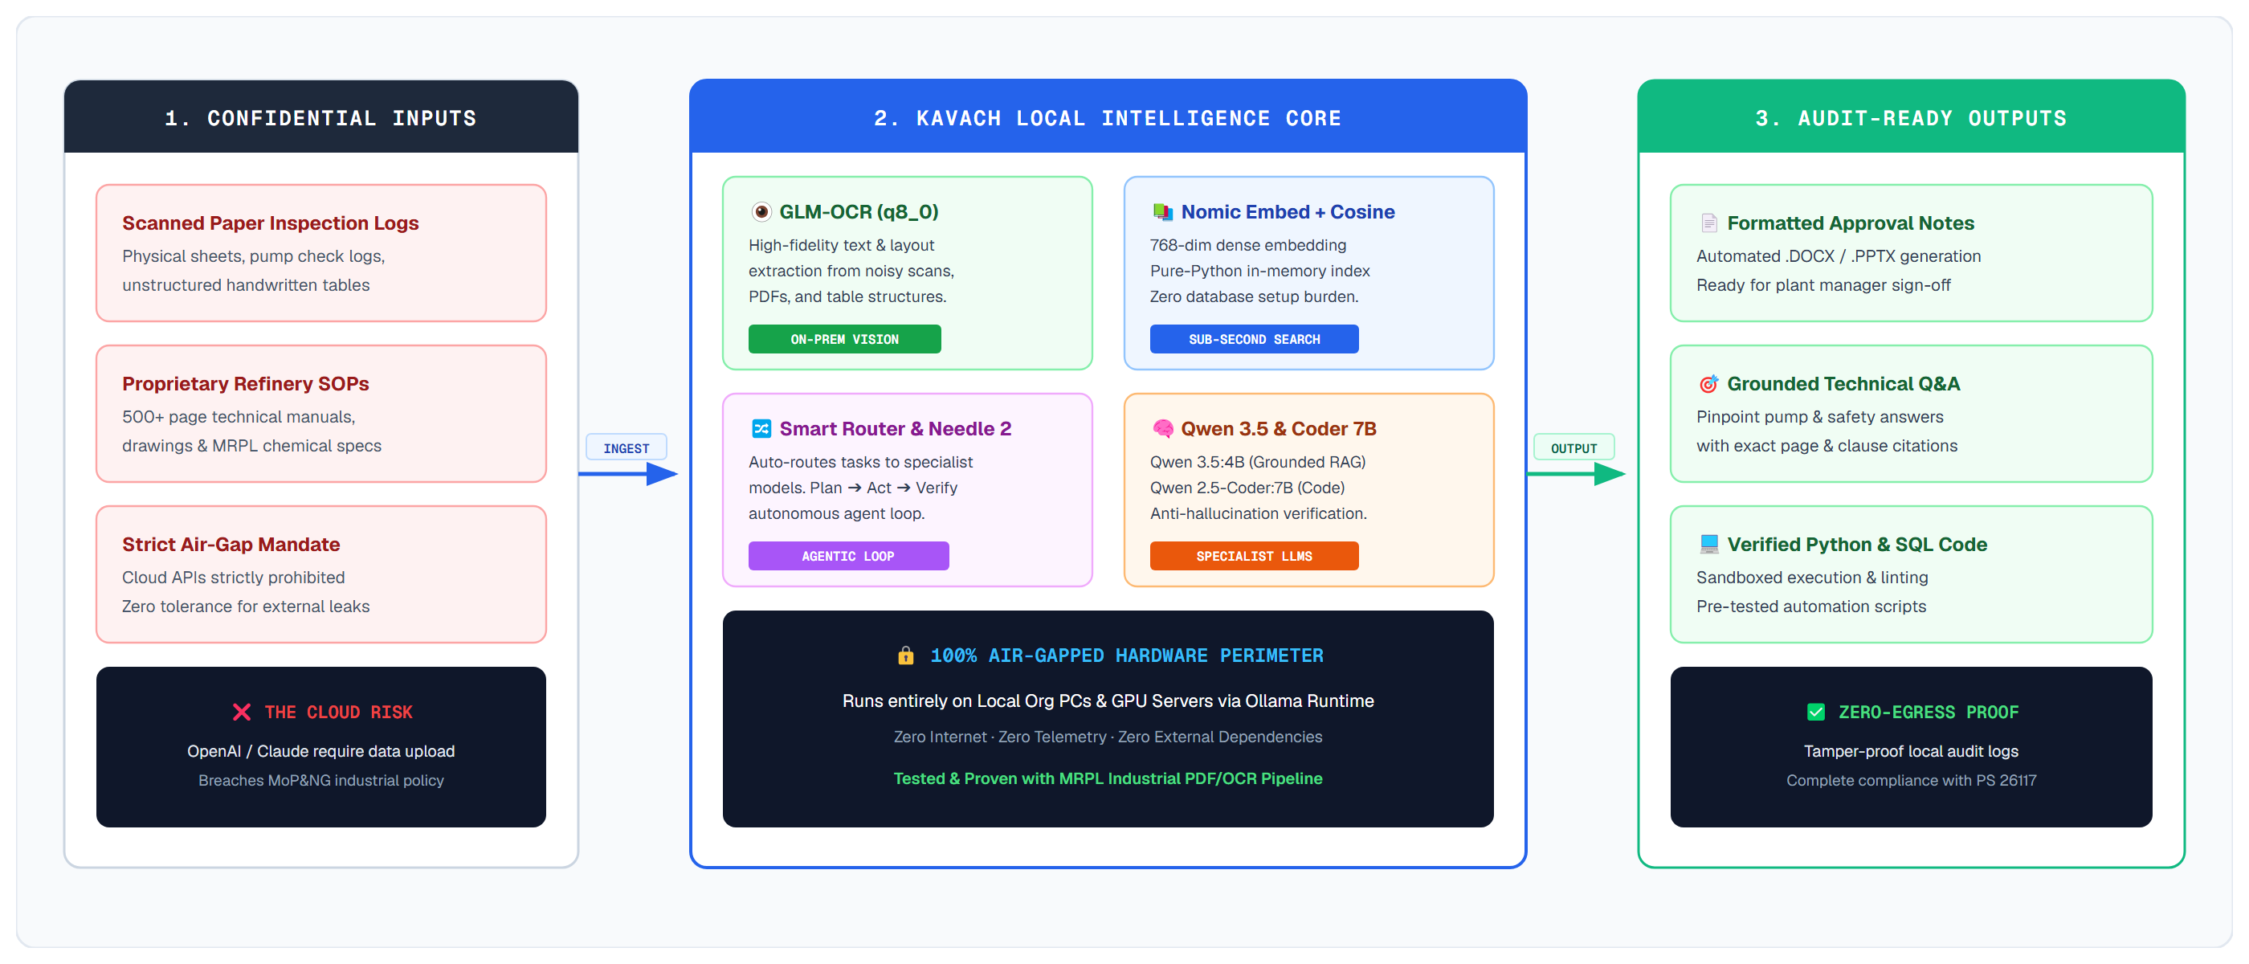
PROPOSED SOLUTION: KAVACH SOVEREIGN WORKBENCH
From Confidential Industrial Data to Verified Deliverable — 100% On-Premise
Your Team Name

Slide 3
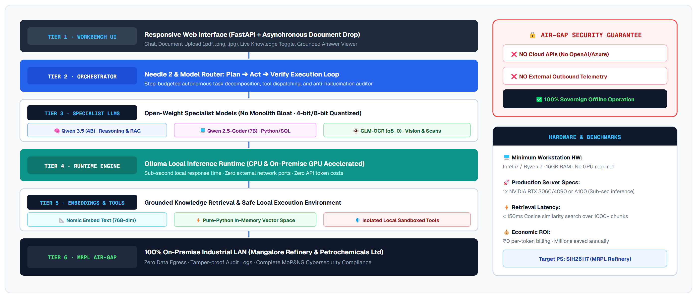
TECHNICAL APPROACH: AIR-GAPPED SYSTEM ARCHITECTURE
End-to-End Multimodal Layer Stack with Zero External Data Egress
Your Team Name

Slide 4
FEASIBILITY, RISK MITIGATION & SCALABILITY ROADMAP
Practical On-Premise Deployment Validated for Industrial Infrastructure
Your Team Name
⚙️ Technical Feasibility
• Open-weight models deployable locally today via Ollama runtime.
• Runs efficiently on standard workstations (Intel i7/i9, 16-32GB RAM).
• In-memory cosine vector store eliminates database setup burden.
🚀 Deployment Feasibility
• Standalone MVP operable on single industrial PC or GPU workstation.
• Seamlessly scales to multi-GPU server clusters without code change.
• 100% offline installation; air-gapped LAN deployment ready.
🛡️ Operational Feasibility & Risk Strategy
• Risk: CPU latency ➔ Mitigation: 4-bit/8-bit quantization (Q8_0/Q4_K_M).
• Risk: Document noise ➔ Mitigation: GLM-OCR structured text filtering.
• Risk: Hallucination ➔ Mitigation: Strict grounded prompt with source citations.
📈 Scalability & Future Growth
• Modular model swapping: upgrade to 14B/32B models as hardware scales.
• Extendable tool catalogue: add Python sandbox, SQL connectors, CAD viewers.
• Enterprise scale: Single PC ➔ On-Prem Server ➔ Multi-User Refinery Cluster.
DEPLOYMENT MATURITY TIMELINE:
[MVP PHASE: Single Workstation / Local PC] ➔ [PRODUCTION PHASE: On-Premise GPU Server] ➔ [ENTERPRISE: Multi-User Air-Gapped Cluster]

Slide 5
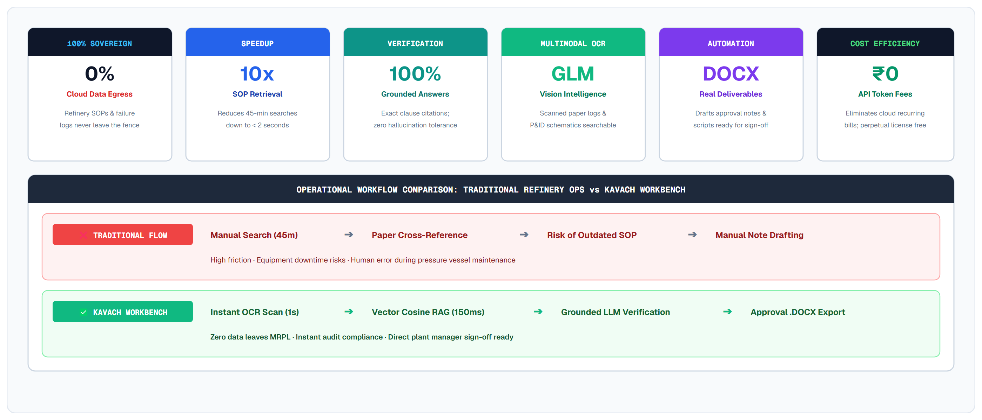
IMPACT, BENEFICIARIES & VALUE FOR MRPL REFINERY
Tangible Operational, Safety & Economic Gains Across Industrial Operations
Your Team Name

Slide 6
RESEARCH, DIFFERENTIATION MATRIX & REFERENCES
Academic Foundations, Model Benchmarks & Competitive Differentiators
Your Team Name
Open-Weight LLMs
Local Inference
Agent Orchestration
Grounded RAG
Multimodal Vision
GLM-OCR Engine
Sandboxed Tools
Real Deliverables
COMPETITIVE DIFFERENTIATION: KAVACH vs. GENERIC CLOUD COPILOTS
• 100% On-Premise Execution: [KAVACH: YES (Local HW)] vs [Cloud Copilots: NO (Remote Data Egress)]
• Strict Air-Gapped Network Operation: [KAVACH: YES (No Internet Needed)] vs [Cloud Copilots: NO (Always Online)]
• Multi-Model Dynamic Task Routing: [KAVACH: YES (Specialist Coder/OCR)] vs [Cloud Copilots: NO (Single Monolith)]
• Scanned Document & Image OCR: [KAVACH: YES (Integrated GLM-OCR)] vs [Cloud Copilots: ⚠️ Limited/Paid Cloud Addon]
• Verified Real File Deliverables: [KAVACH: YES (DOCX, PPTX, XLSX, Code)] vs [Cloud Copilots: ❌ Chatbot Text Only]
• Network Audit & Zero-Egress Proof: [KAVACH: YES (Tamper-Proof Logs)] vs [Cloud Copilots: ❌ Third-Party Blackbox]
KEY RESEARCH & BENCHMARK REFERENCES:
• Qwen 3.5 & Qwen 2.5-Coder: Open-Weight Large Language Models for Reasoning & Code (Alibaba Cloud Research, 2024-2025)
• GLM-OCR: Generalized Multimodal Model for Visual Document Understanding and Text Extraction (Zhipu AI, 2025)
• Nomic Embed Text: High-Dimensional Contextual Vector Representations for Dense Retrieval (Nussbaum et al., 2024)
• Retrieval-Augmented Generation for Knowledge-Intensive NLP Tasks (Lewis et al., NeurIPS Research Standards)
• Mangalore Refinery and Petrochemicals Limited (MRPL) — PS 26117 On-Premise Industrial AI Workbench Requirements

