Slide 1
Event Control Room
SUBMITTED BY
HP
Harikrishna Panchal
A unified multi-event check-in, kit distribution & payment verification platform, built on Nextcloud
B332,70022200505
NN
Naman Naik
B355,70022200547
KS
Kanishk Sahay
B360,70022200556

Slide 2
Agenda
ROADMAP
1
Introduction & Problem Statement
6
Data Model on Nextcloud
2
Objectives
7
Role-Based Access Control
3
Proposed Solution & Key Features
8
Application Walkthrough
4
System Architecture
9
Security & Reliability
5
Technology Stack
10
Conclusion & Future Scope

Slide 3
The Problem with Running Campus Events
INTRODUCTION
College fests like Desi Kalakar run on spreadsheets, WhatsApp forwards and a volunteer's memory. Registrations, kit stock, and UPI payment screenshots live in different places, so the desk on event day cannot answer a simple question in real time: has this person paid, and have they collected their kit?
WHY IT MATTERS
Long check-in queues on event day
Duplicate / fraudulent kit claims
Unverifiable cash & UPI collections
No visibility for organisers across events
No single source of truth
Excel sheets, forms and payment proofs drift out of sync between volunteers.
No real-time desk view
Check-in and kit handout can't be verified against payment status on the spot.
Every event rebuilds the wheel
Each fest hacks together a new sheet, a new form, a new ad-hoc process.

Slide 4
Objectives
GOALS
1
2
3
Single live dashboard
Multi-event, multi-role
Zero extra database
Give organisers one real-time view of registrations, check-ins, kits and payments per event.
Let one deployment run many fests, each with its own admins and volunteers.
Use Nextcloud itself — files, WebDAV and users — as the only datastore.
4
5
6
Self-serve registration
Trustworthy state
Walk-in friendly
Let organisers build and publish a custom public form per event in minutes.
Prevent lost updates when many volunteers check people in at once.
Support on-the-spot registration and cash collection at the desk.

Slide 5
Key Features
PROPOSED SOLUTION
Multi-event workspace
Live Control Room dashboard
Check-in desk
Create unlimited events from one login; switch between them from an event picker.
Registrations, check-ins, kit stock and revenue update in real time.
Search by name, phone or email and mark attendance in one tap.
Kit manager
Payment verification
Issue tracking
Configure kit types & prices per event; track distribution against stock.
Mark UPI/cash payments verified, pending or flagged with proof uploads.
Auto-flags ambiguous kit selections and lets admins resolve manual issues.
Reports & smart insights
Form builder
Role-based team
Auto-generated participation, attendance and revenue summaries.
Build a custom public registration form and share it as a link — no login needed.
Per-event Admin / Volunteer roles backed by Nextcloud groups.

Slide 6
System Architecture
ARCHITECTURE
Four containers on Docker Compose. Nextcloud is the only datastore — no separate application database.
DOCKER COMPOSE
Browser
Volunteer / Admin
web
React + nginx :8081
backend
Node / Express API
nextcloud
WebDAV + OCS API
WHY NO DB?
MariaDB
metadata store
Redis
cache / locking
Every event, registration and state record is a JSON file in Nextcloud, guarded by ETag optimistic locking.
BACKEND RESPONSIBILITIES
JWT auth & role checks
CSV / XLSX import
Issue detection
File uploads (proofs)
Presentation
API
Identity & storage
Supporting services

Slide 7
Technology Stack
TECHNOLOGY
Frontend
Backend
Datastore
React 18, Vite, lucide-react icons — single-page app driven entirely by /api/*
Node.js, Express, JWT auth, Multer file uploads
Nextcloud (WebDAV + OCS API) — files & users, no separate DB for app data
Infrastructure
Data import
Testing
Docker Compose: MariaDB + Redis (for Nextcloud), 4 services total
CSV / XLSX parsing for bulk registration sheets
Node test runner — backend/test/*.test.js for API & forms

Slide 8
Nextcloud as the Only Datastore
DATA MODEL
The backend's service account owns one folder tree. Every entity is a JSON file; no application database exists.
📁
/EventManagement/events.json
index of all events
OPTIMISTIC CONCURRENCY
Many volunteers can check people in at the same instant. Every state write uses WebDAV's ETag as an If-Match header — a classic read–modify–write loop:
📁
/<slug>/config.json
name, branding, kit types
📁
/<slug>/registrations/<regId>.json
one file per registration
1
GET state/<regId>.json + its ETag
📁
/<slug>/state/<regId>.json
check-in / kit / payment state — ETag-locked
2
Apply the change in memory
📁
/<slug>/uploads/<regId>/<file>
3
PUT back with If-Match: <ETag>
payment proof screenshots
📁
/<slug>/imports/<timestamp>-<file>
4
On 412 Conflict, retry with backoff (up to 6x)
original CSV / XLSX uploads
Result: no lost updates, even with a full volunteer desk hammering the same registration.

Slide 9
Role-Based Access Control
SECURITY MODEL
Access is decided by Nextcloud group membership, not by file sharing — two groups are created per event.
event-creators group → can create new events
Nextcloud User
signs in once
event-<slug>-admins
full control of one event
event-<slug>-volunteers
desk operations on one event
ADMIN CAN
VOLUNTEER CAN
Edit event config & kit types
Manage team (add/remove admins & volunteers)
Build, edit and close public forms
Import registrations, reset event state
Search & check in participants
Hand out kits, add walk-in registrations
Verify / flag payments and raise issues
View live dashboard & reports (read-only admin pages)

Slide 10
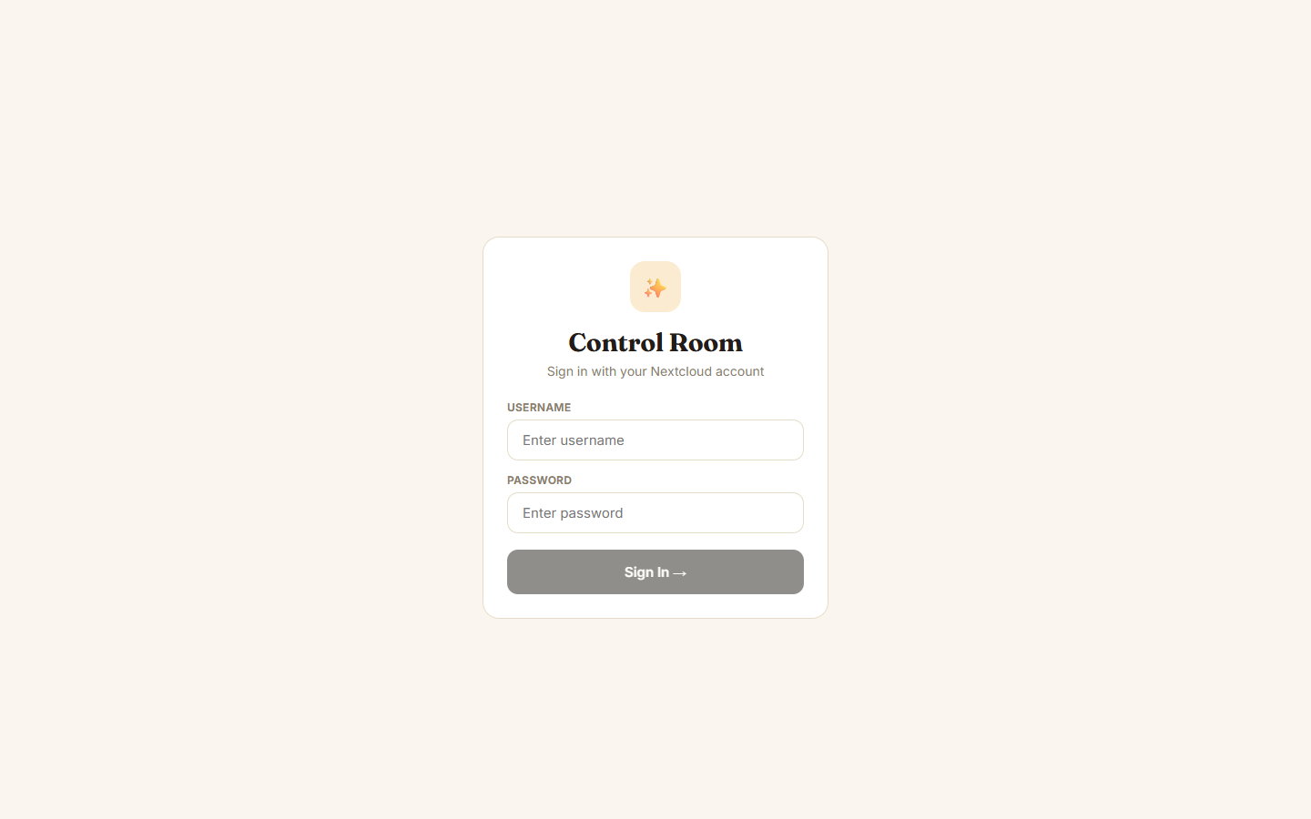
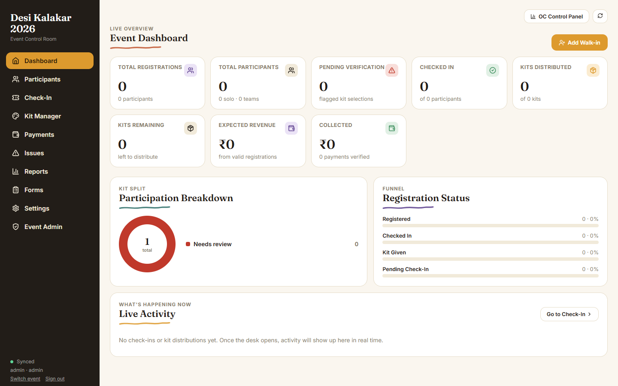
Sign In & Event Workspace
Nextcloud-backed sign-in
Pick or create an event

Slide 11
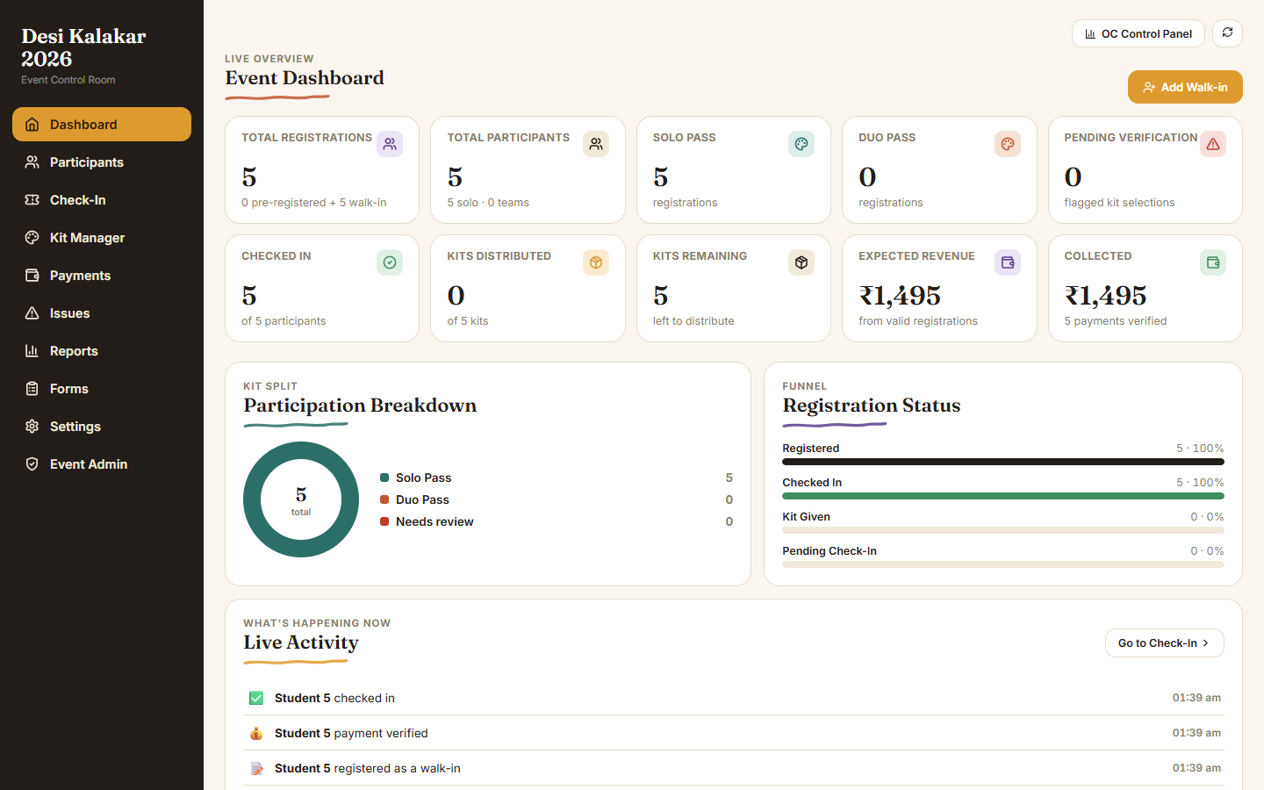
Live Control Room Dashboard
Registrations, check-ins, kits and revenue — updated live

Slide 12
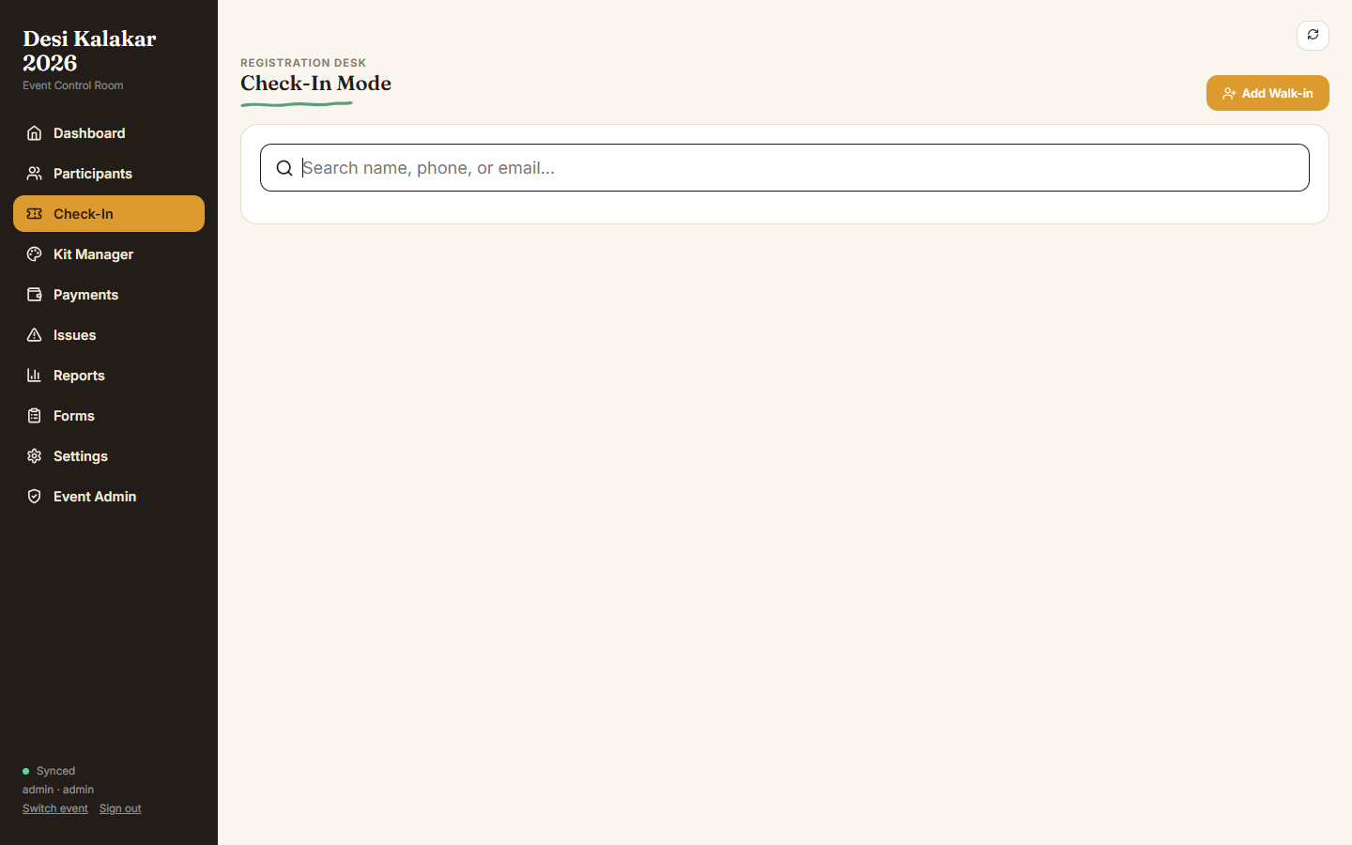
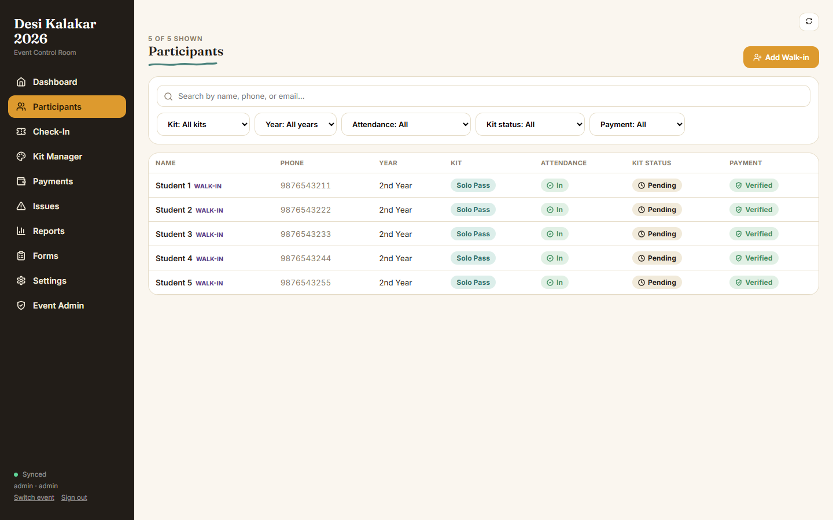
Check-In Desk & Participant Directory
Search by name, phone or email
Filterable participant list with status

Slide 13
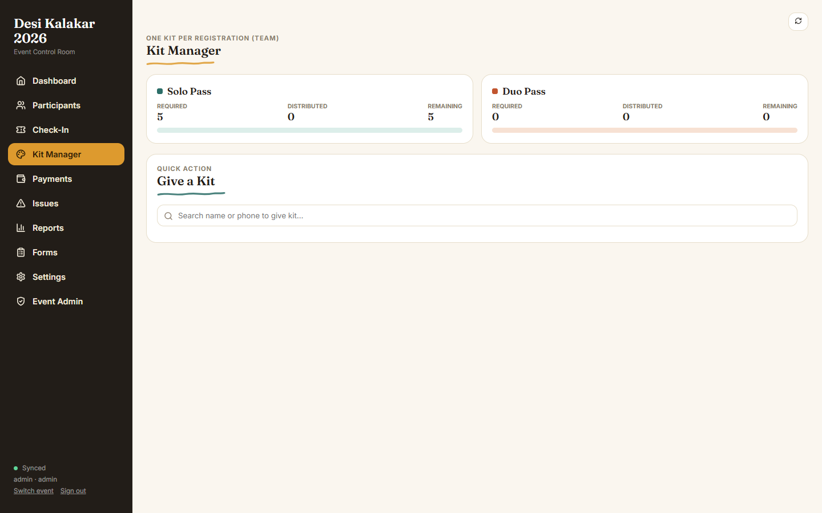
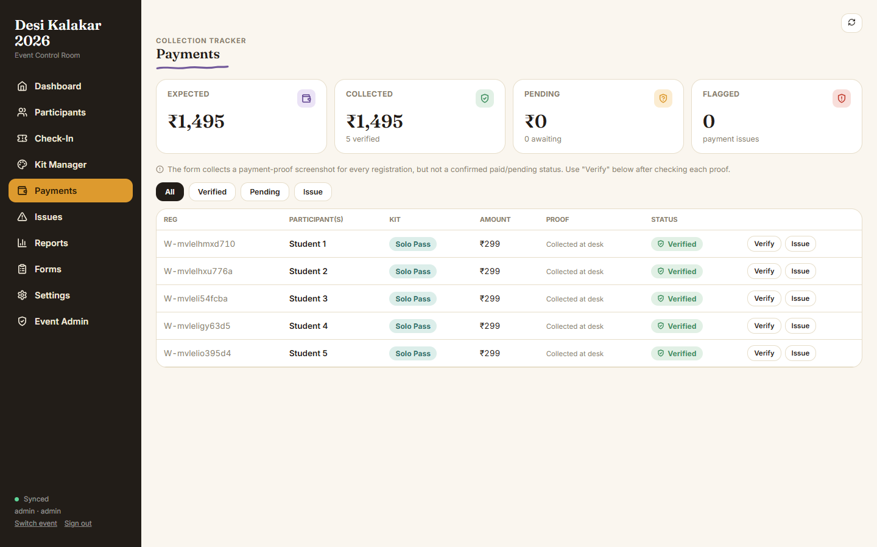
Kit Manager & Payment Verification
Configure kit types, price & color per event
Verify, flag or hold UPI / cash payments

Slide 14
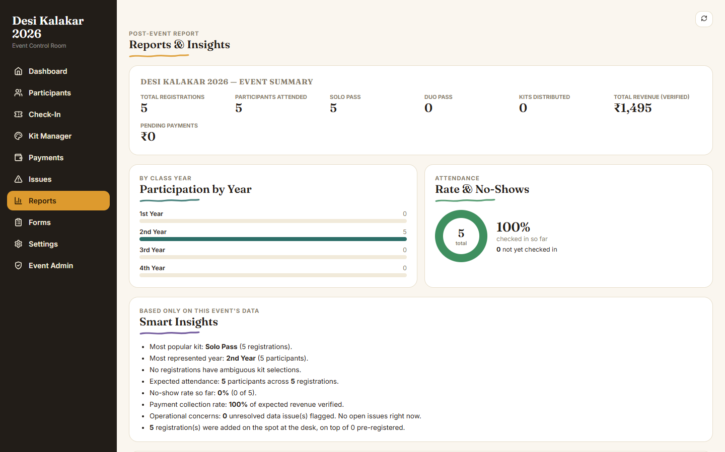
Reports & Smart Insights
Auto-generated post-event summary & insights

Slide 15
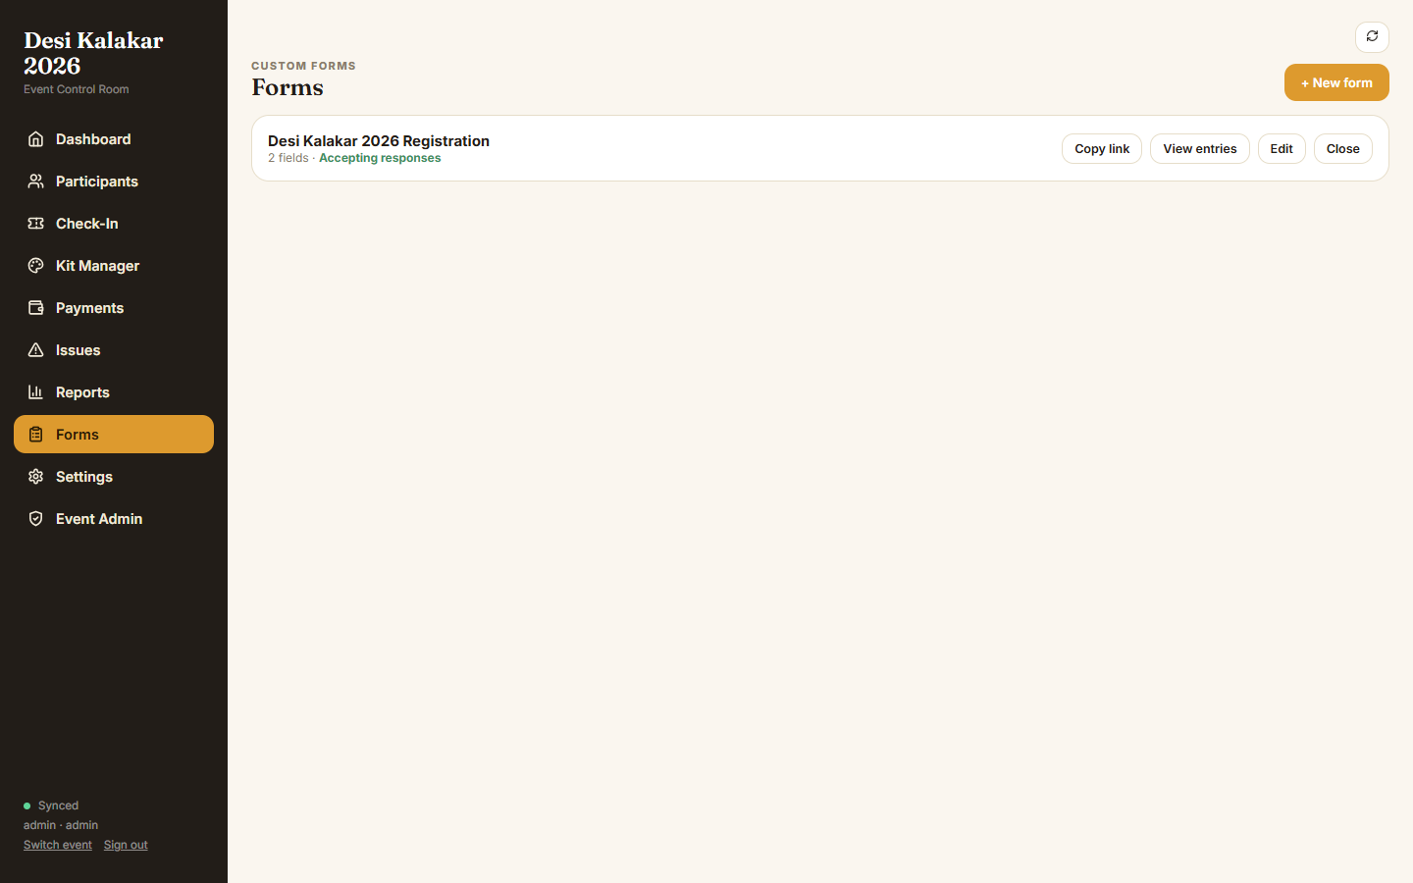
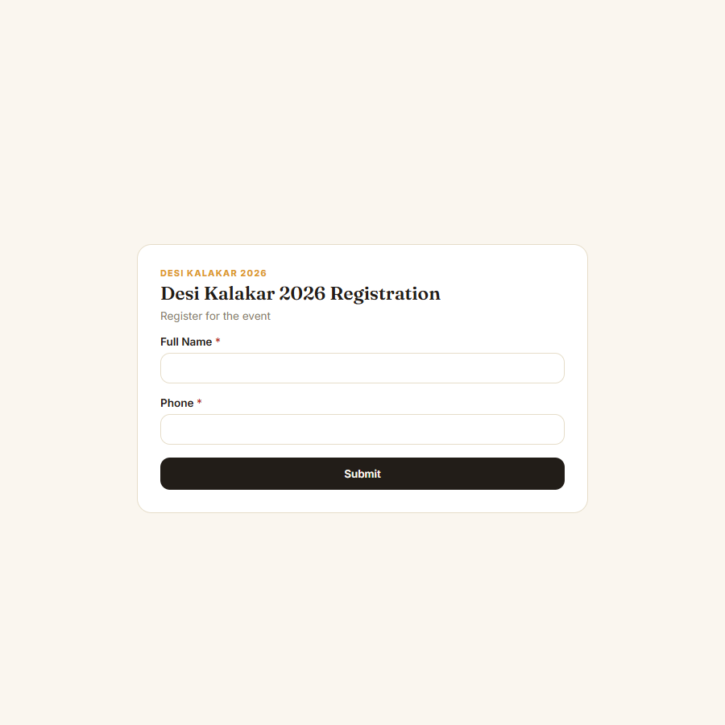
Form Builder & Public Registration Link
Admins build & publish forms per event
Students fill the public link — no login needed

Slide 16
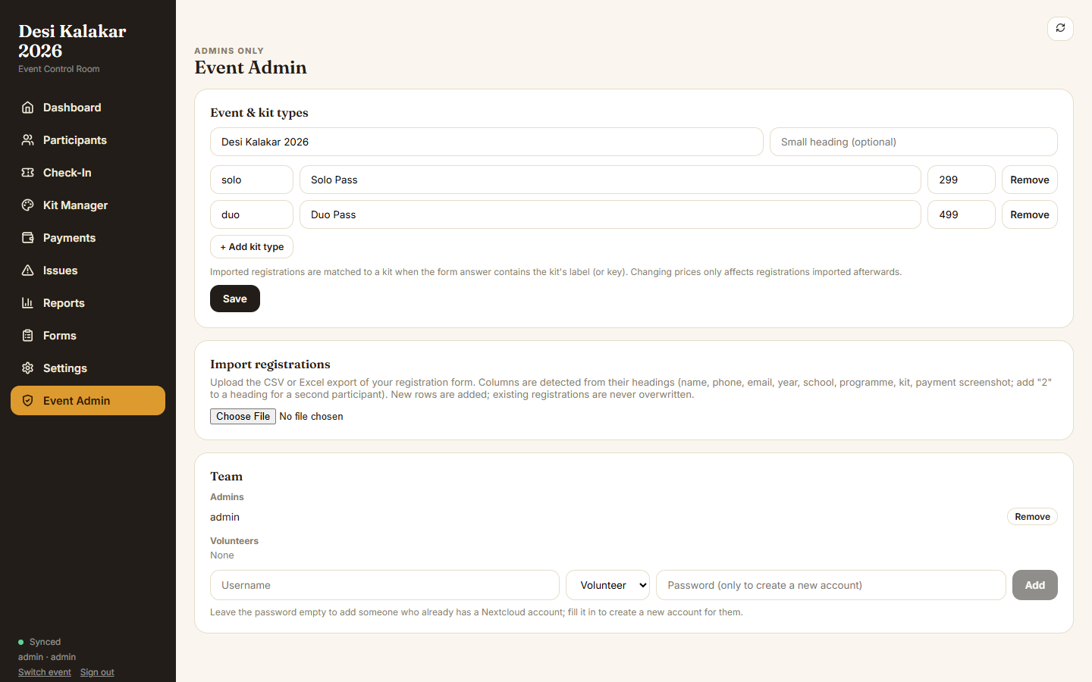
Event Admin: Kit Types & Team
Kit configuration, CSV import and team management in one page

Slide 17
Built to Survive Event Day
SECURITY & RELIABILITY
✓
✓
✓
JWT-based sessions
Optimistic locking
Scoped roles
12-hour signed tokens; every request re-checks Nextcloud group membership (30s cache).
ETag / If-Match on every state write — no lost check-ins under concurrent load.
Admin vs Volunteer enforced per-event on every route via eventAccess() middleware.
✓
✓
✓
Input validation
Safe bulk import
Automated tests
Slugs, kit keys, phone numbers and form answers are all validated server-side.
CSV / XLSX import never overwrites existing registrations; duplicates are skipped.
Node test suite covers auth, roles, check-in flow and the public forms API.

Slide 18
Conclusion & Future Scope
LOOKING AHEAD
CONCLUSION
FUTURE SCOPE
Event Control Room replaces scattered spreadsheets and chat threads with one live, role-aware dashboard. By building entirely on Nextcloud's own files and identity system, it stays infrastructure-light — four Docker containers, zero extra database — while safely supporting many simultaneous events and volunteers.
QR-code based check-in and kit handout
Native UPI payment-gateway integration (auto-verification)
Push / SMS notifications to participants
Public analytics page per event for sponsors
Offline-first desk mode for poor-connectivity venues
Faster check-in queues on event day
Verifiable payments, fewer disputes
One platform reused fest after fest

Slide 19
Thank You

