Slide 1
EARLY DISEASE PREDICTION SYSTEM
Risk Before Symptoms
Diabetes · Heart Disease — with honest uncertainty, an independent second opinion, and a preventive plan
Riyansh Choudhary
Pranav Singh Puri
Kartikya Yadav
Rudra
Sushant Jaiswal
SAP ID 500122039
SAP ID 500122453
SAP ID 500122804
SAP ID 500124508
SAP ID 500123999
Mentor: Imran Khan
Live: healthpredictor092005.streamlit.app Code: github.com/2005Maverick/early-disease-prediction-

Slide 2
Problem Statement & Our Solution
!
The Problem
✓
Our Solution
Diabetes and heart disease develop silently for years — but early lifestyle intervention cuts diabetes incidence by 58% (DPP trial).
Typical ML prototypes output a single risk number with no statement of confidence — the user cannot tell 84% they should trust from 84% they should not.
Most projects report accuracy on data the model partially saw, and silently feed the Pima dataset’s impossible zeros in as real measurements.
An Uncertainty Engine — 200 bootstrap-trained models produce a risk distribution per patient, whose spread is honest confidence.
Patients Like You — a model-free 50-nearest-neighbour second opinion; agreement between independent methods builds trust.
Every metric strictly out-of-fold; the alert threshold derived from a stated clinical rule (recall ≥ 85%).
Explanations and a guideline-based preventive plan turn the score into action.

Slide 3
Literature Review
Four strands of prior work shaped the design.
1
Grinsztajn, Oyallon & Varoquaux (2022, NeurIPS)
Why tree-based models still outperform deep learning on typical tabular data — justifies gradient boosting as our base learner at 768 / 303 patients.
2
Efron (1979) · Breiman (1996)
The bootstrap and bagging — training many models on resamples. We keep the averaged prediction for accuracy and expose the full spread as per-patient uncertainty.
3
Cover & Hart (1967)
Nearest-neighbour pattern classification — the oldest idea in the field becomes our model-free second opinion and a case-based explanation clinicians find natural.
4
Diabetes Prevention Program (2002, NEJM)
Lifestyle intervention cut type-2 diabetes incidence by 58% — the clinical evidence that early, actionable prediction is worth building.

Slide 4
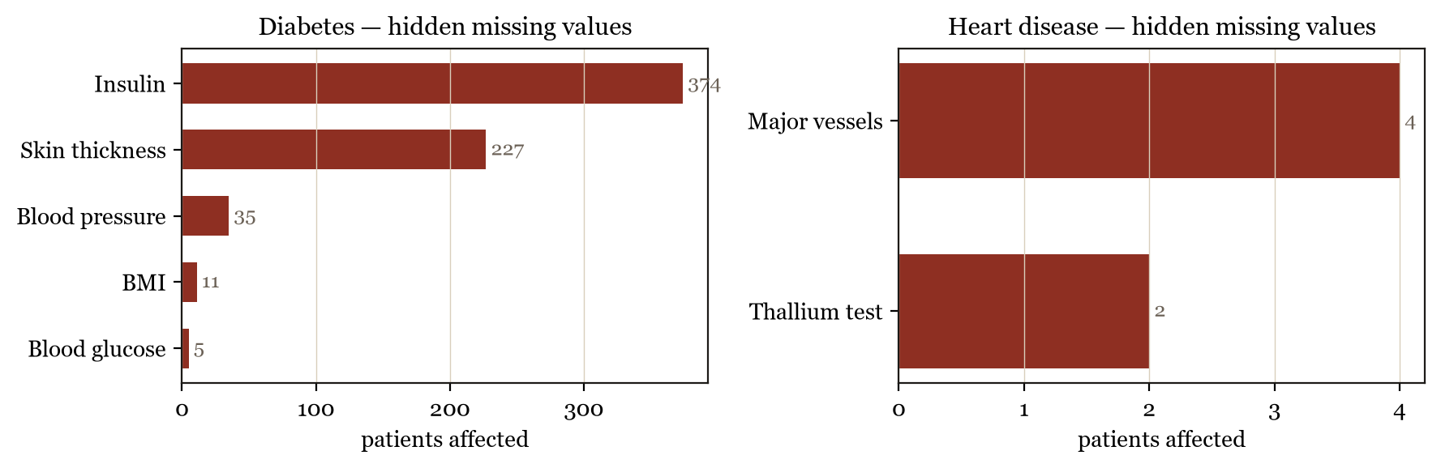
The Data
Two classical clinical study datasets — and the trap most projects fall into.
Diabetes
Heart disease
374 / 768
Pima study — NIDDK
Cleveland Clinic — UCI
768 patients, 8 features
glucose, BMI, insulin, age, family history…
34.9% developed the disease
303 patients, 13 features
cholesterol, max heart rate, ST depression…
45.9% diagnosed with disease
Pima patients with a physiologically impossible ZERO recorded for insulin — hidden missing data most projects feed to the model as real.

Slide 5
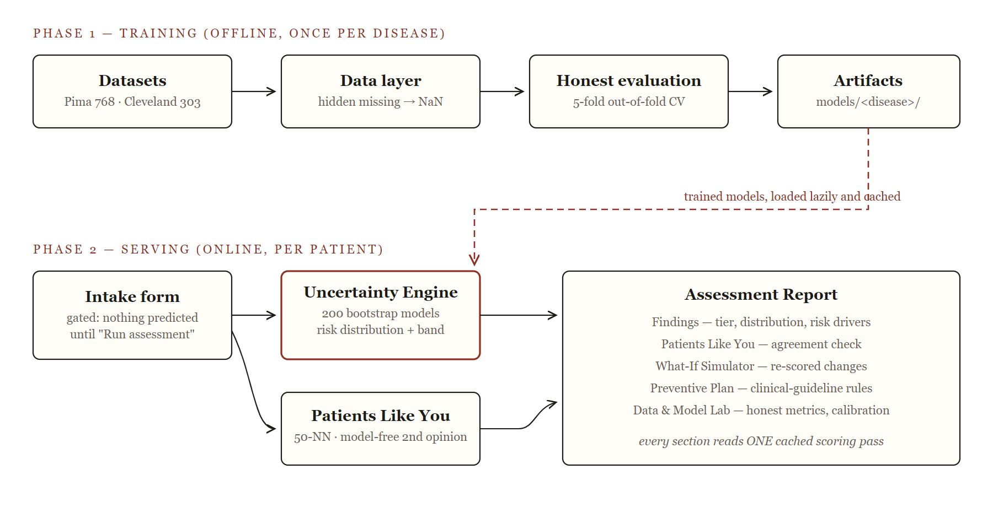
System Architecture
Train once offline; serve per patient online. Nothing is predicted until the user asks.

Slide 6
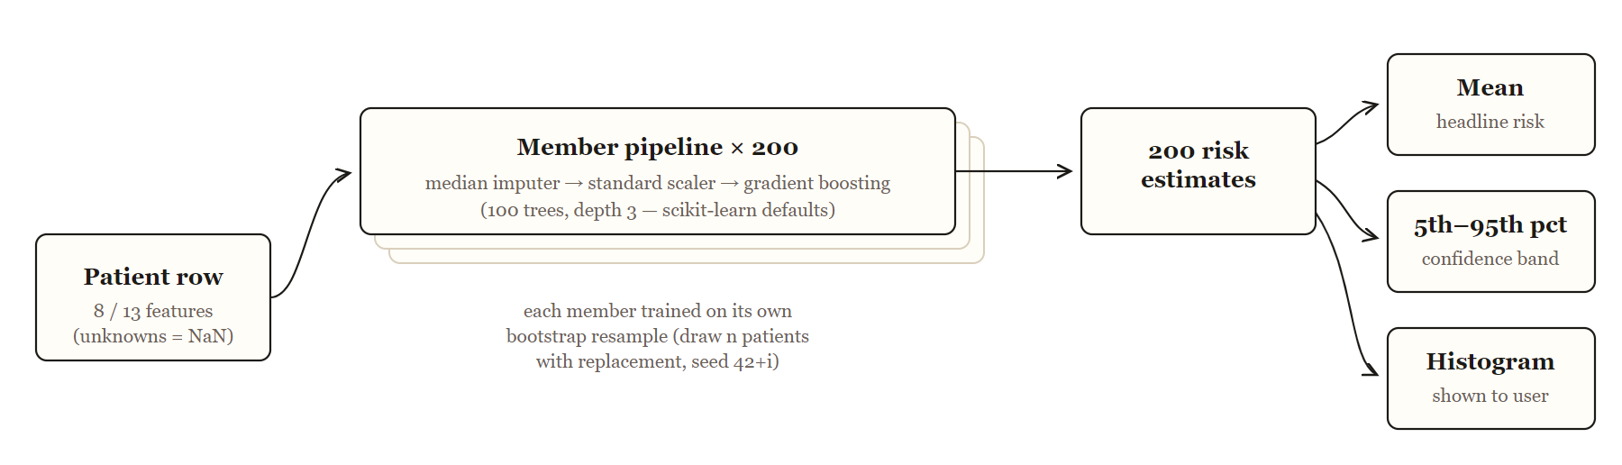
Deep Dive I — The Uncertainty Engine
Configuration
Members: 200 pipelines
Each: impute → scale → boosting
Trees: 100 per member, depth 3
Training: bootstrap resamples
Seeds: 42 – 241
Hyperparameters: library defaults
Why chosen. Gradient-boosted trees are the strongest learners at this data scale; bootstrapping 200 of them turns one opinion into a distribution. Deliberately untuned — with ~600 training rows per fold, aggressive tuning fits noise, so evaluation integrity was prioritised over a possible extra AUC point.
“We ask 200 slightly different models and plot all their answers.”

Slide 7
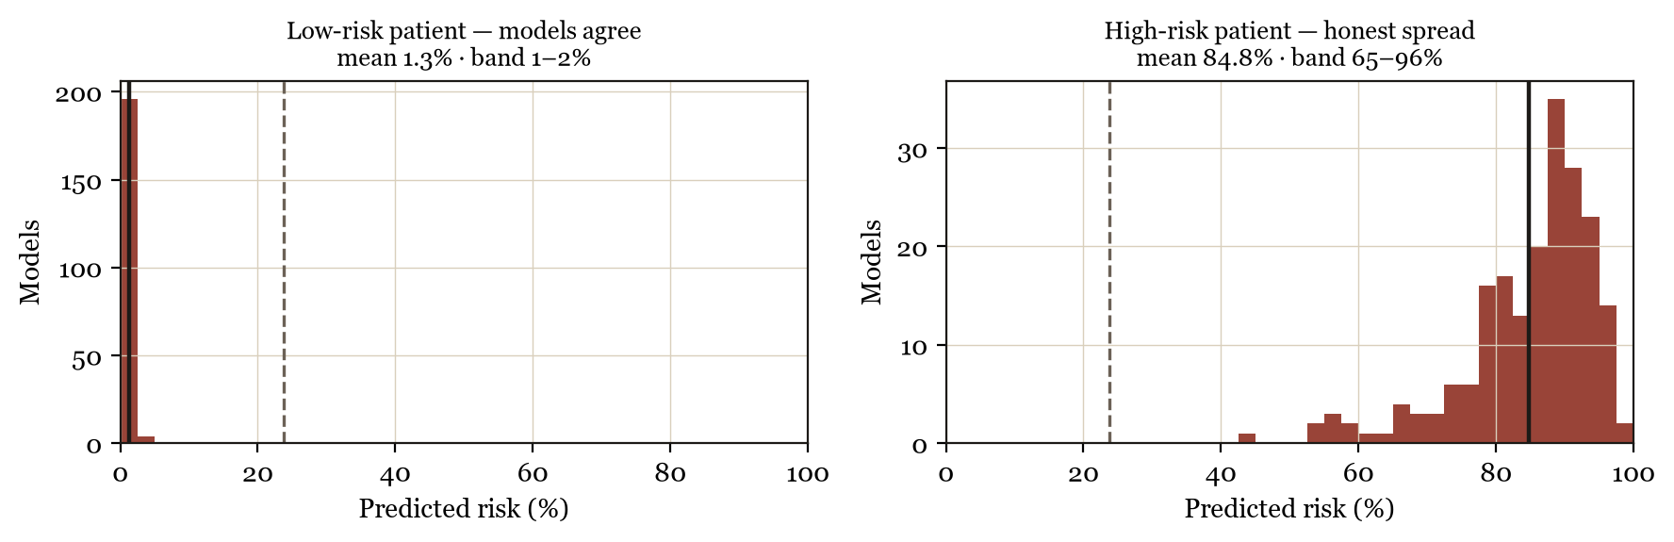
Deep Dive II — A Distribution, Not a Number
1–2%
65–96%
90%
band width when the 200 models agree
(clear low-risk patient)
band width for an ambiguous patient —
the system says so, visibly
confidence band shown with every
single assessment

Slide 8
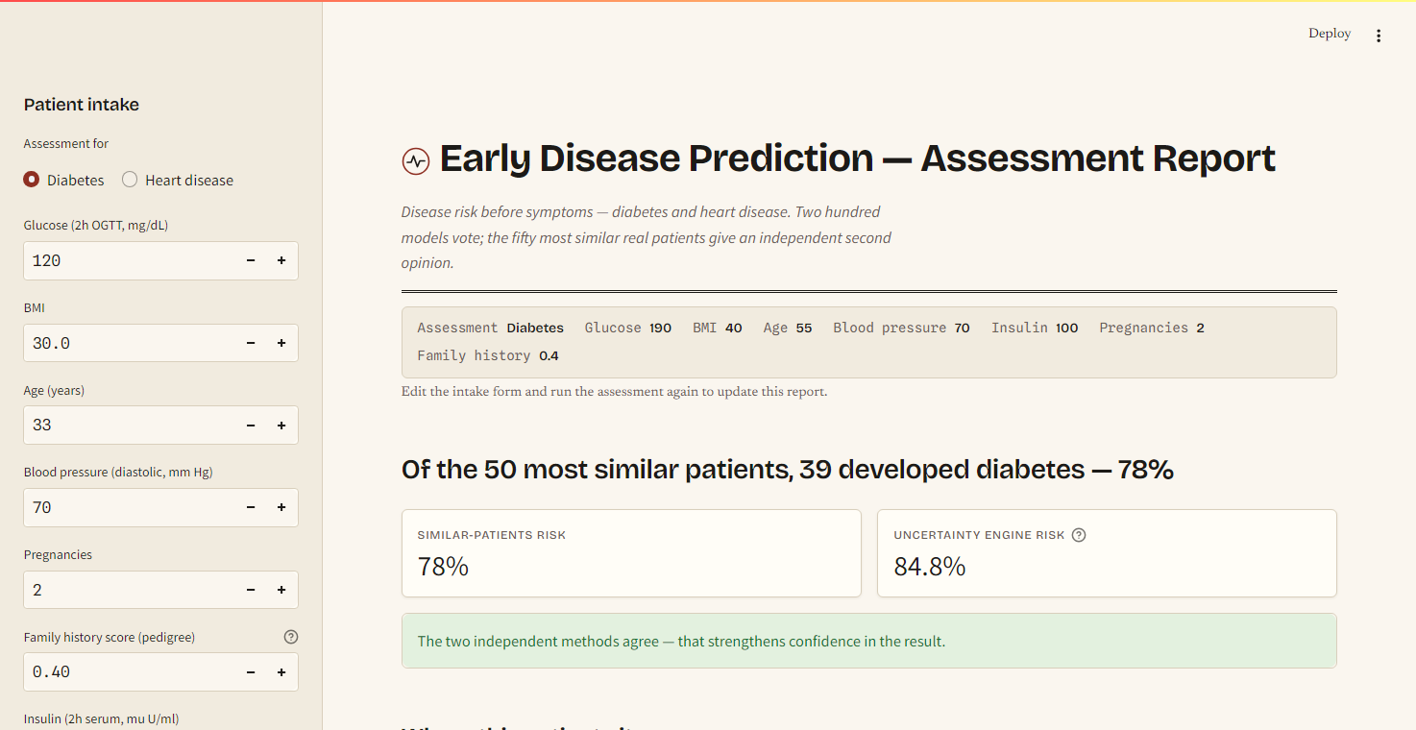
Deep Dive III — Patients Like You
No model at all.
Standardize every feature, find the 50 most similar patients in the study, report how many actually developed the disease.
Because it shares no machinery with the ensemble, agreement is real evidence — and disagreement flags an unusual patient, exactly when caution is right. The interface states which case applies.
Example: 84.8% (ensemble) vs 78% (similar patients) — methods agree.

Slide 9
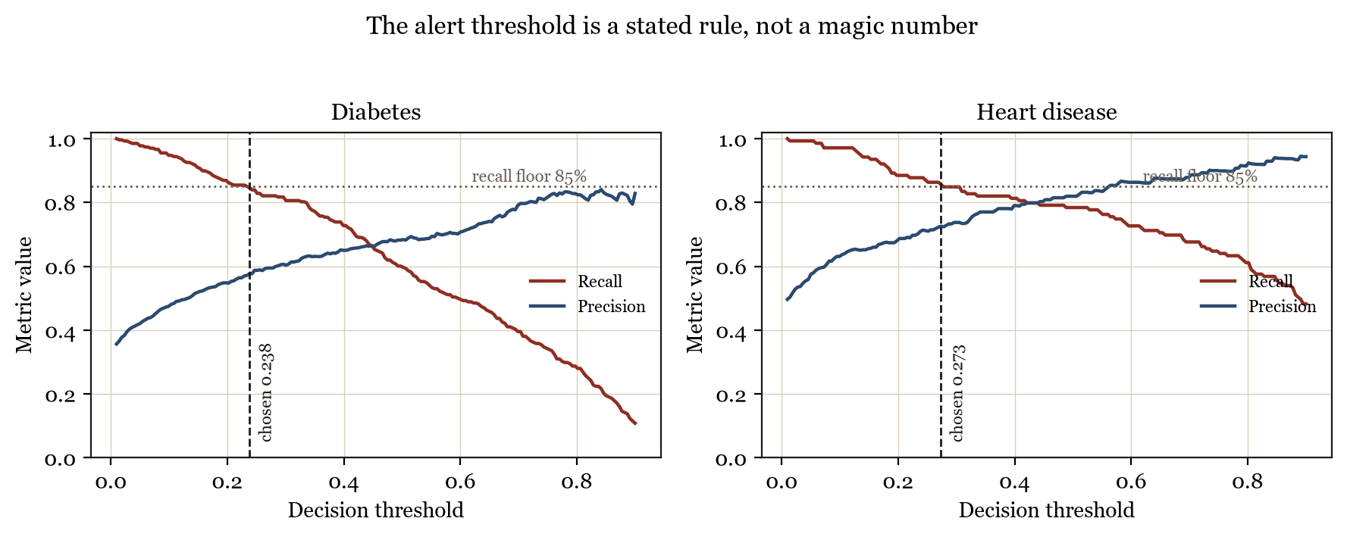
Deep Dive IV — The Alert Threshold Is a Stated Rule
Rule: among all thresholds with out-of-fold recall ≥ 85% — never miss more than 15% of true future patients — choose the one with the best precision. Result: alert at 23.8% (diabetes) and 27.3% (heart disease). The rule and its consequence are shown inside the application.

Slide 10
Results I — Model Benchmark
Four models, identical folds, every number out-of-fold. ROC AUC shown; full table in the report.
85%+
recall on both diseases —
by construction, not by luck
90.0
heart-disease ROC AUC of the
deployed ensemble
Honest note: on the smaller Cleveland data, simpler baselines edge ahead by ~1 AUC point. The ensemble still wins deployment — it is the only model that also outputs trustworthy uncertainty (next slide).

Slide 11
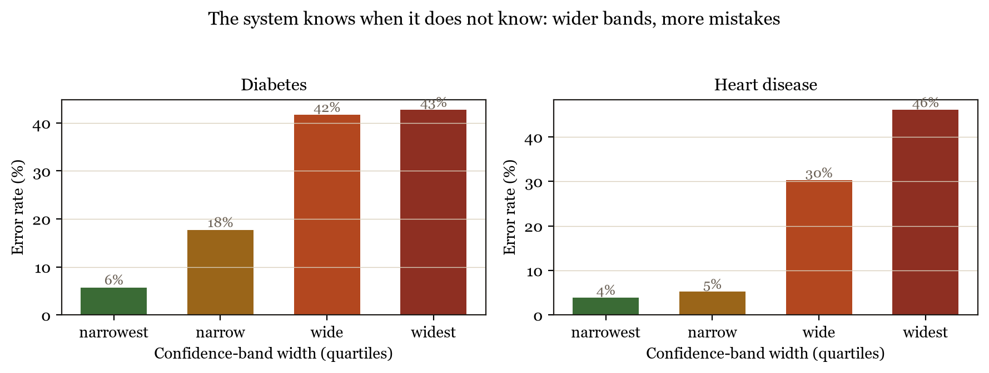
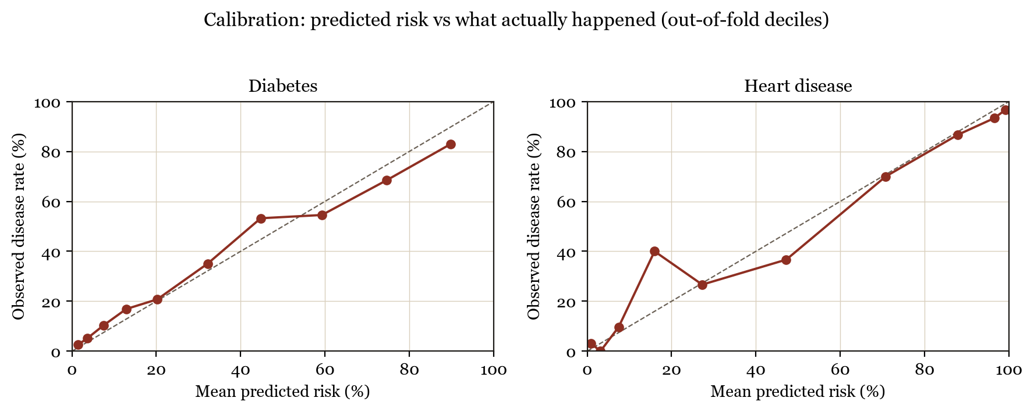
Results II — The System Knows When It Does Not Know
6% → 43%
error rate, narrowest to widest
confidence bands (diabetes)
4% → 46%
the same effect on
heart disease
Calibrated too: patients told “about 30% risk” develop the disease about 30% of the time (bottom).

Slide 12
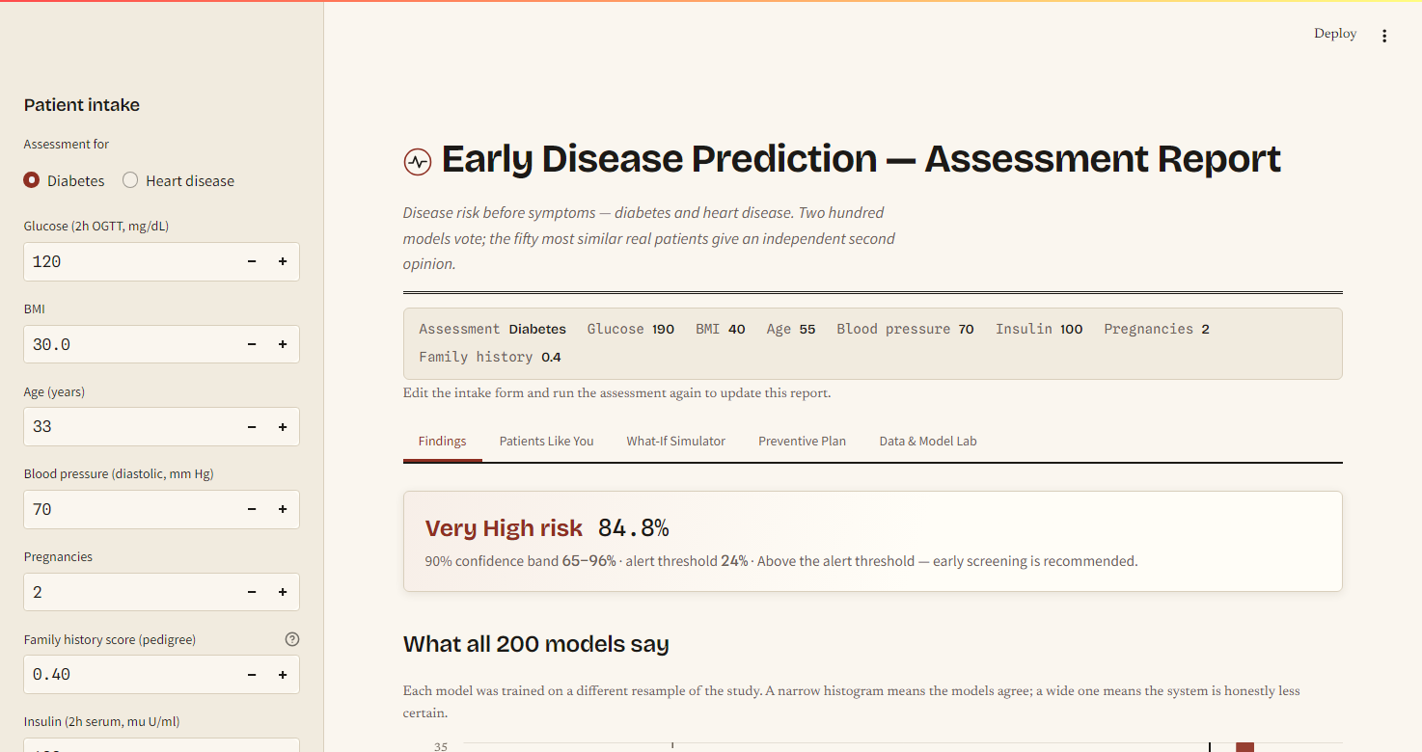
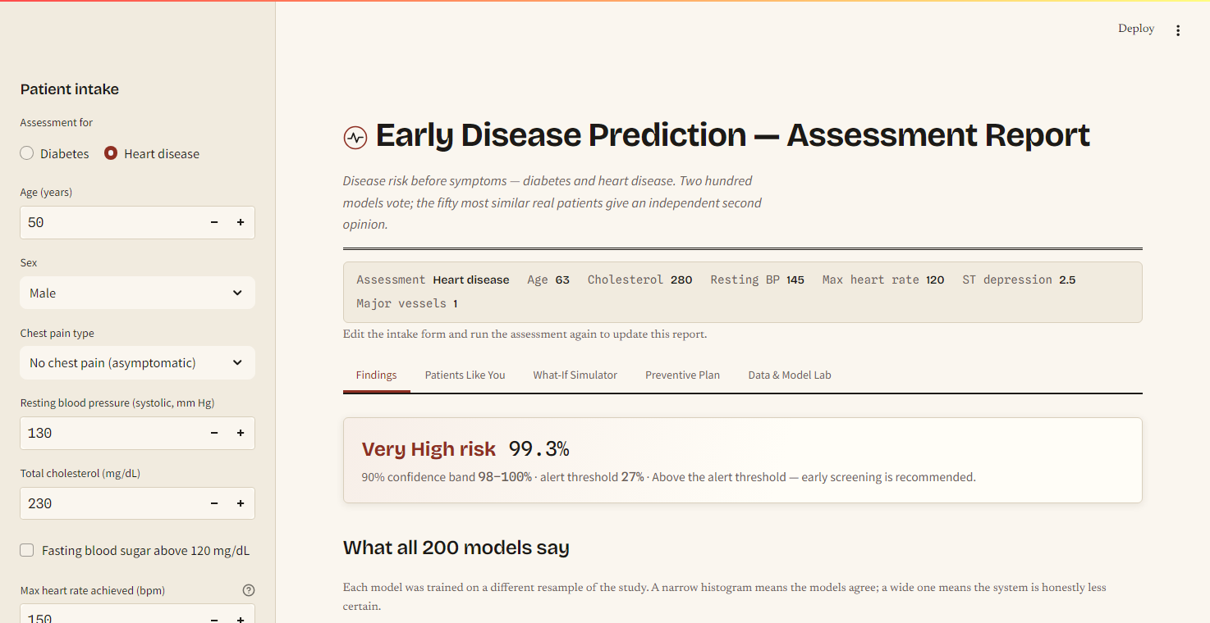
The Live Dashboard
Deployed and public — a gated flow: intake form → Run assessment → report. No phantom predictions.
One engine, two diseases — same interface serving the diabetes (left) and heart-disease (right) models.
healthpredictor092005.streamlit.app

Slide 13
SWOT Analysis
Strengths
Weaknesses
Every metric out-of-fold; probabilities calibrated
Uncertainty demonstrably informative (6% → 43% error)
Two independent methods cross-check each other
Deployed, tested (15 tests), reproducible figures
Small, decades-old cohorts (768 / 303 patients)
No external validation on a modern population
Bootstrap bands capture sampling uncertainty only
What-if is model response, not causal effect
Opportunities
Threats
Third disease = one config file + retrain (registry design)
Conformal prediction for formal coverage guarantees
External validation on modern cohorts (e.g. NHANES)
Longitudinal mode: track risk across assessments
Not clinically validated — must not drive real decisions
Cohort bias limits transfer across populations
Users may over-trust a polished interface — mitigated by visible uncertainty and in-product disclaimers

Slide 14
References
[1] L. Breiman, “Bagging predictors,” Machine Learning, 24(2), 1996.
[2] J. H. Friedman, “Greedy function approximation: a gradient boosting machine,” Annals of Statistics, 29(5), 2001.
[3] L. Grinsztajn, E. Oyallon, G. Varoquaux, “Why do tree-based models still outperform deep learning on typical tabular data?,” NeurIPS, 2022.
[4] B. Efron, “Bootstrap methods: another look at the jackknife,” Annals of Statistics, 7(1), 1979.
[5] T. Cover, P. Hart, “Nearest neighbor pattern classification,” IEEE Trans. Information Theory, 13(1), 1967.
[6] J. W. Smith et al., “Using the ADAP learning algorithm to forecast the onset of diabetes mellitus,” Proc. SCAMC, 1988.
[7] R. Detrano et al., “International application of a new probability algorithm for the diagnosis of coronary artery disease,” Am. J. Cardiology, 64(5), 1989.
[8] Diabetes Prevention Program Research Group, “Reduction in the incidence of type 2 diabetes…,” NEJM, 346(6), 2002.
[9] A. Niculescu-Mizil, R. Caruana, “Predicting good probabilities with supervised learning,” ICML, 2005.
[10] F. Pedregosa et al., “Scikit-learn: machine learning in Python,” JMLR, 12, 2011.

Slide 15
Thank You
Questions & Discussion
Early Disease Prediction System · Diabetes & Heart Disease · 200 models, honest uncertainty
Try it live: healthpredictor092005.streamlit.app

