Slide 1
🌾 AgriML
AI-Powered Fertilizer Recommendation System
Machine Learning • Climate-Aware • Sustainable Farming
Client-Side • Browser-Based • Zero Server Dependencies

Slide 2
The Problem
Why do farmers need intelligent fertilizer recommendations?
⚠️ Over-fertilization wastes money and pollutes groundwater
⚠️ Under-fertilization leads to poor crop yields and food insecurity
⚠️ Nutrient imbalance locks out uptake — too much of one nutrient blocks others
⚠️ Climate variability (rain, heat) changes optimal application timing & quantity
⚠️ Manual soil testing is expensive and infrequent for small-hold farmers
⚠️ No easy access to agronomist expertise in rural India
30%
of global fertilizer is wasted
₹8,000 Cr
annual loss to Indian farmers
10 Crops
supported by AgriML
7 Fertilizer
types covered in the model

Slide 3
Our Solution: AgriML
An end-to-end ML pipeline running entirely in the browser
🧪
⚙️
📊
🌦️
Data Input
ML Engine
Optimization
Climate Aware
Soil NPK, pH, moisture, temperature, rainfall, humidity, crop type
Random Forest Classifier + Gradient Boosting Regressor
Quantity, cost, and environmental impact scoring
7-day forecast adjusts timing and quantity recommendations
→ Input Soil Data ⟶ ML Models Predict ⟶ Optimize Quantity & Cost ⟶ Climate-Adjusted Output

Slide 4
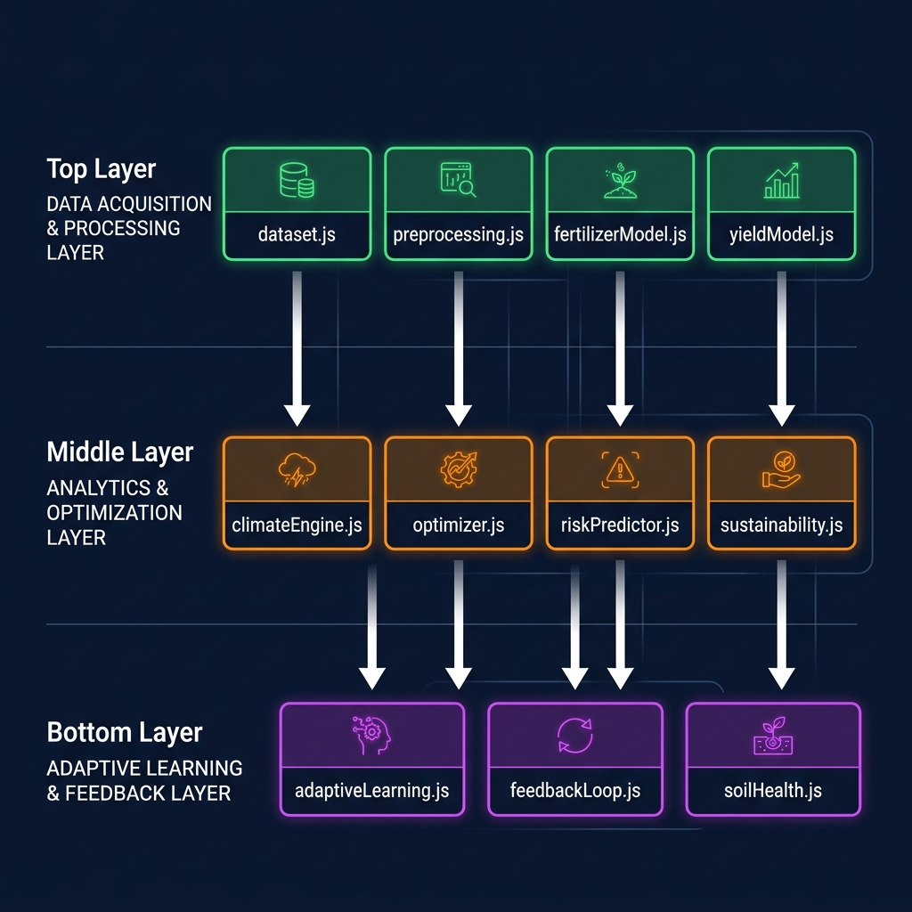
System Architecture
12 interconnected modules — 100% client-side JavaScript
Data Layer
▸ dataset.js — 2,000 synthetic training samples
▸ preprocessing.js — imputation + normalization
▸ fertilizerModel.js — Random Forest (15 trees)
▸ yieldModel.js — Gradient Boosting (50 stumps)
Analysis Layer
▸ climateEngine.js — 7-day weather forecast
▸ optimizer.js — qty, cost & env scoring
▸ riskPredictor.js — 7 risk categories
▸ sustainability.js — 6-component index
Learning Layer
▸ adaptiveLearning.js — correction factors
▸ feedbackLoop.js — farmer feedback
▸ soilHealth.js — degradation tracker

Slide 5
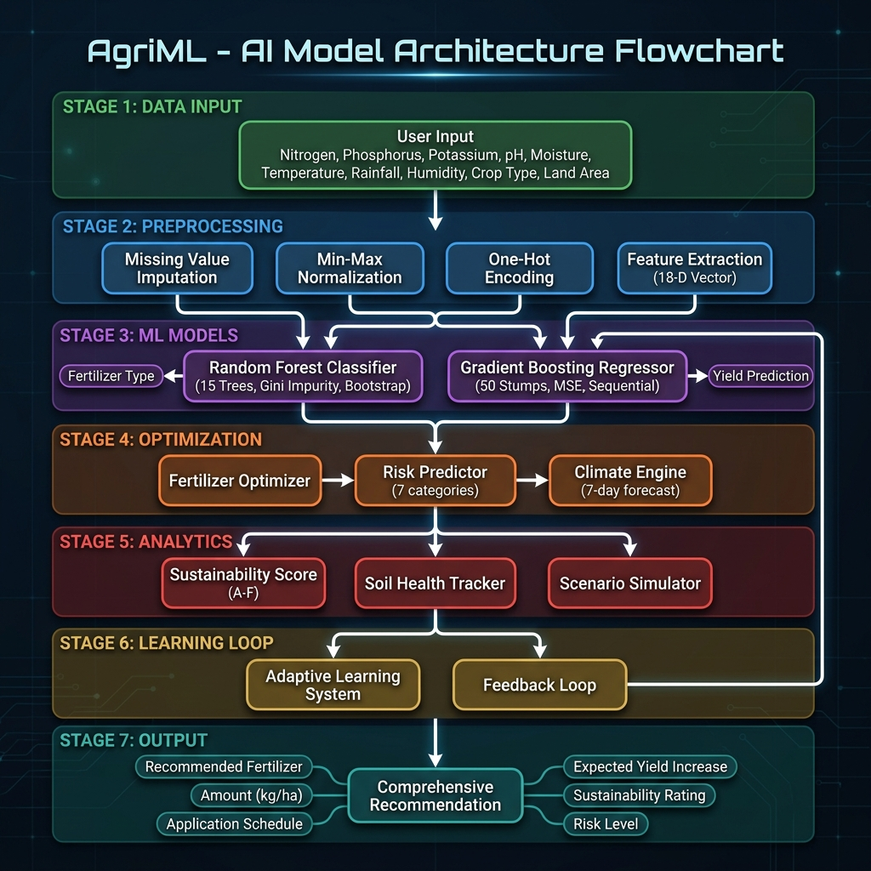
Model Architecture Flowchart
Complete 7-stage ML pipeline from data input to recommendation output

Slide 6
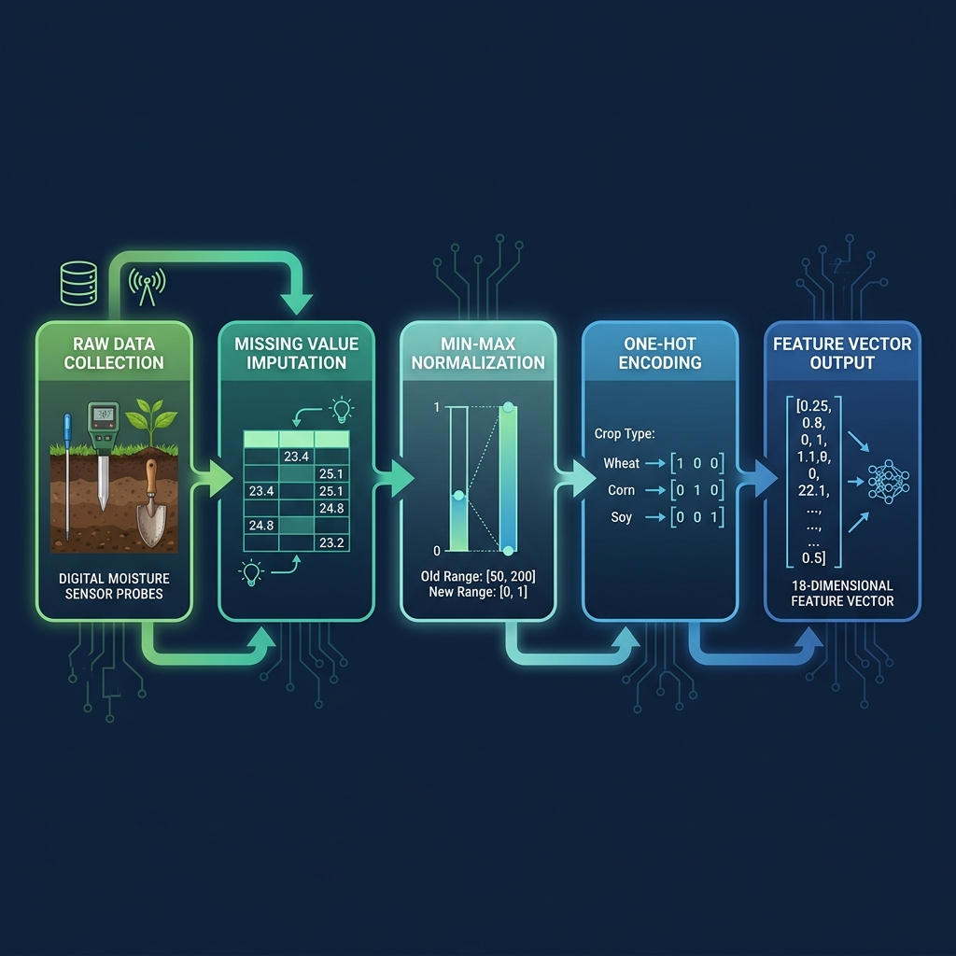
Data Pipeline & Preprocessing
From raw sensor data to model-ready features
1️⃣ Synthetic Data
2️⃣ Imputation
3️⃣ Normalization
4️⃣ One-Hot Encode
5️⃣ Feature Vector
2,000 samples 10 crops × 7 fertilizers
Mean/Mode fill missing values
Min-Max scaling to [0, 1] range
10 binary features for crop type
18-D combined feature array → model

Slide 7
Input Features
8 numeric features + 1 categorical feature (crop type)
Feature | Type | Unit | Range | Description
Nitrogen (N) | Numeric | kg/ha | 0–200 | Available nitrogen in soil
Phosphorus (P) | Numeric | kg/ha | 0–150 | Available phosphorus in soil
Potassium (K) | Numeric | kg/ha | 0–120 | Available potassium in soil
pH | Numeric | — | 3.0–10.0 | Soil acidity / alkalinity
Moisture | Numeric | % | 5–100 | Soil moisture percentage
Temperature | Numeric | °C | -5–50 | Ambient temperature
Rainfall | Numeric | mm | 0–450 | Monthly rainfall
Humidity | Numeric | % | 10–100 | Air humidity percent
Crop | Categorical | — | 10 types | Rice, Wheat, Maize, Cotton, …

Slide 8
Supported Crop Profiles
Optimal ranges for each crop used during training and optimization
Crop | N (kg/ha) | P (kg/ha) | K (kg/ha) | pH | Temp (°C) | Yield (t/ha)
Rice | 60–120 | 30–60 | 30–60 | 5.5–7.0 | 22–35 | 3.0–8.0
Wheat | 80–140 | 40–70 | 20–50 | 6.0–7.5 | 12–25 | 2.5–6.5
Maize | 80–160 | 30–60 | 20–50 | 5.8–7.0 | 18–32 | 3.0–9.0
Cotton | 60–120 | 20–50 | 20–40 | 6.0–7.5 | 20–35 | 1.5–4.0
Sugarcane | 100–200 | 40–80 | 40–80 | 5.5–7.5 | 22–36 | 50–120
Soybean | 20–50 | 40–70 | 20–50 | 6.0–7.0 | 20–30 | 1.5–4.0
Potato | 80–150 | 50–90 | 60–100 | 5.0–6.5 | 15–25 | 15–40
Tomato | 60–130 | 40–80 | 50–90 | 5.5–7.0 | 18–30 | 20–60
Groundnut | 10–30 | 30–60 | 20–40 | 5.5–7.0 | 22–33 | 1.0–3.5
Barley | 60–110 | 30–55 | 20–45 | 6.0–8.0 | 10–22 | 2.0–5.5

Slide 9
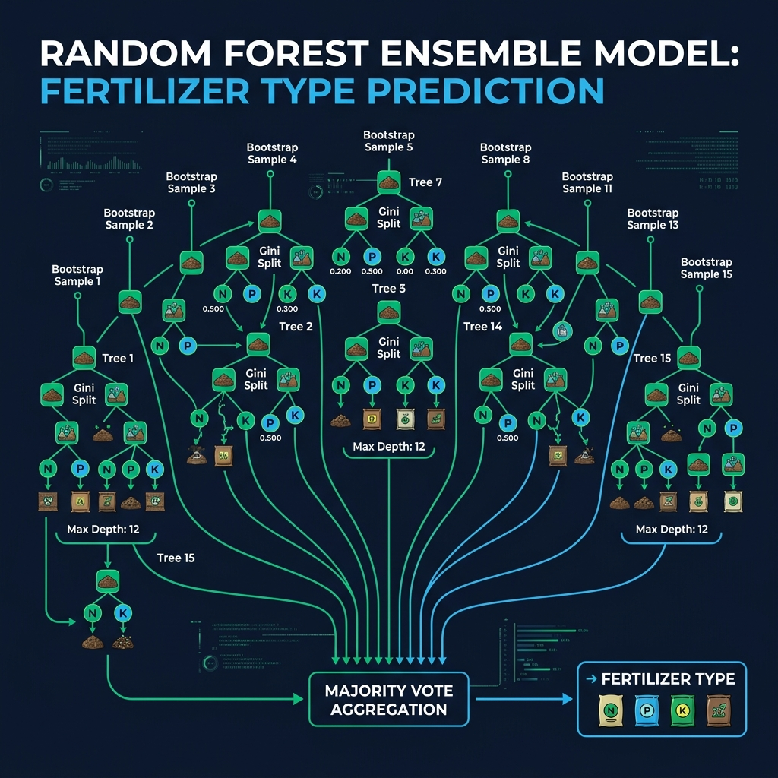
Model 1: Random Forest Classifier
Fertilizer type recommendation using ensemble of 15 decision trees
How It Works
→ Bootstrap Sampling — each tree gets a random sample (with replacement)
→ Random Feature Subset — 60% features per split for diversity
→ Gini Impurity — measures split quality at each node
→ Majority Vote — final prediction aggregates all 15 trees
→ Confidence Score — % of trees agreeing on the top class
→ Class Probabilities — derived from aggregated leaf node counts

Slide 10
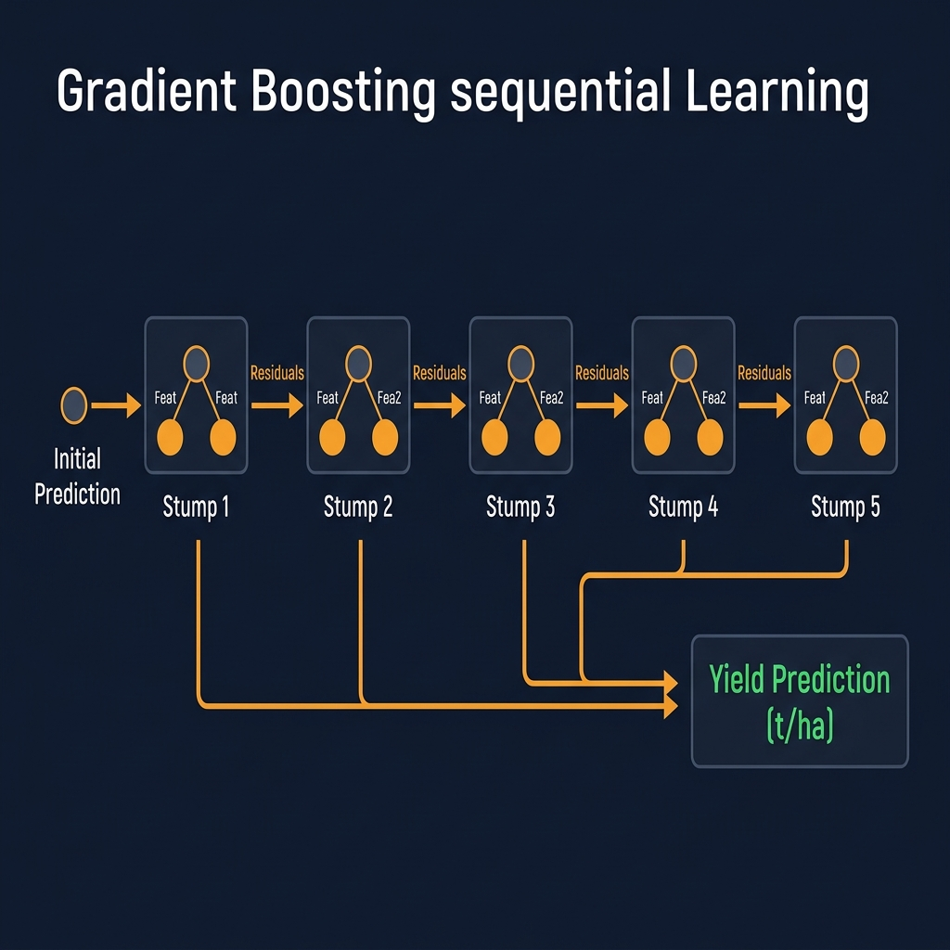
Model 2: Gradient Boosting Regressor
Yield prediction using 50 sequential decision stumps
Algorithm Steps
→ Initialize prediction with mean of all target yields
→ For each of 50 estimators:
→ a) Compute residuals (actual – current prediction)
→ b) Fit a decision stump (depth 4) on residuals
→ c) Update predictions += learning_rate × stump output
→ Confidence = 1 – (RMSE / target std deviation)
→ Output: yield (t/ha), confidence, RMSE

Slide 11
Fertilizer Types & Nutrient Content
7 fertilizer types with nutrient composition and cost data
Fertilizer | N (%) | P (%) | K (%) | Cost (₹/kg) | Best For
Urea | 46 | 0 | 0 | 8 | High N deficiency
DAP | 18 | 46 | 0 | 28 | N + P deficiency
NPK 10-26-26 | 10 | 26 | 26 | 22 | P + K deficiency
NPK 20-20-20 | 20 | 20 | 20 | 25 | Balanced needs
MOP | 0 | 0 | 60 | 18 | High K deficiency
SSP | 0 | 16 | 0 | 10 | Phosphorus deficiency
Amm. Sulphate | 21 | 0 | 0 | 12 | Acidic soils

Slide 12
Fertilizer Selection Logic
Rule-based training label assignment before Random Forest training
N < 50 AND P < 35 AND K < 30?
YES
NO
✅ NPK 20-20-20 (Balanced Deficiency)
N < 50 AND P < 35?
YES
NO
✅ DAP (N + P)
Only N < 50?
YES
NO
✅ Urea (N only)
K<30→MOP | P<35→SSP pH<5.5→Am.Sul | →NPK10-26-26
🔵 Decision node (rule check) ✅ Green = Leaf node (fertilizer assigned) 🟠 Orange = Multiple outcomes

Slide 13
Optimization Layer
Calculating optimal quantity, cost, and environmental score
💊 Quantity Optimization
💰 Cost Estimation
🌍 Environmental Impact Score
• Compute N, P, K deficits vs crop profile
• Quantity = max deficit / nutrient % × 100
• Capped at 20–500 kg/hectare
• Scales by user's land area
• Cost = quantity × cost-per-kg
• Per-hectare and total cost
• 7 fertilizers with real market rates
• Supports ₹ INR currency
• Over-application penalty (+15)
• High rainfall leaching risk (+20)
• Soil acidification risk (+15)
• High moisture runoff risk (+10)
• Quantity-proportional impact (+0-40)

Slide 14
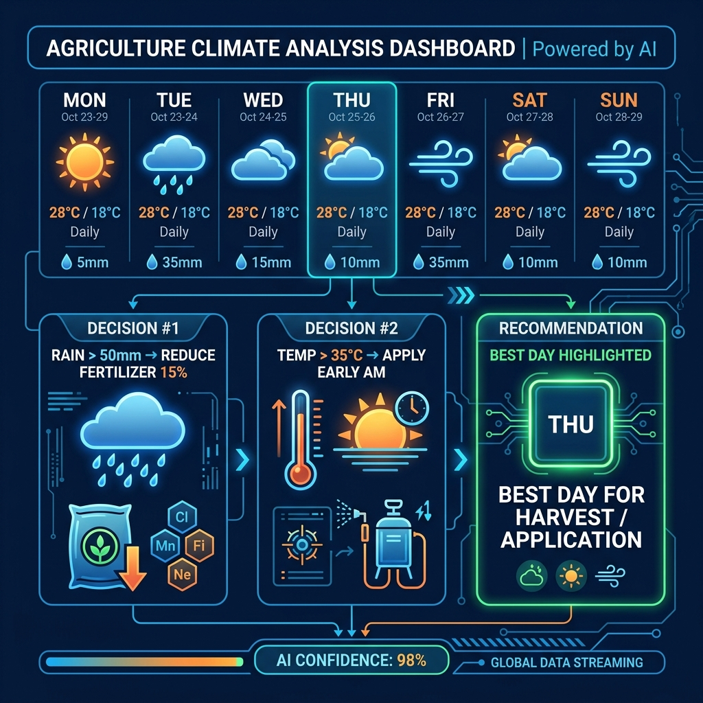
Climate-Aware Decision Engine
7-day weather forecast modifies fertilizer recommendations in real-time
Climate Logic
🌦️ Generates 7-day weather forecast (temp, rain, humidity, wind)
🌦️ Analyzes next 5 days for application window
🌦️ Heavy rain (>50mm) → reduce quantity 15%, delay
🌦️ Moderate rain (>25mm) → reduce 8%, split doses
🌦️ High temp (>35°C) → apply early morning
🌦️ High humidity (>80%) → monitor fungal risk
🌦️ Best Application Day — lowest risk window scored

Slide 15
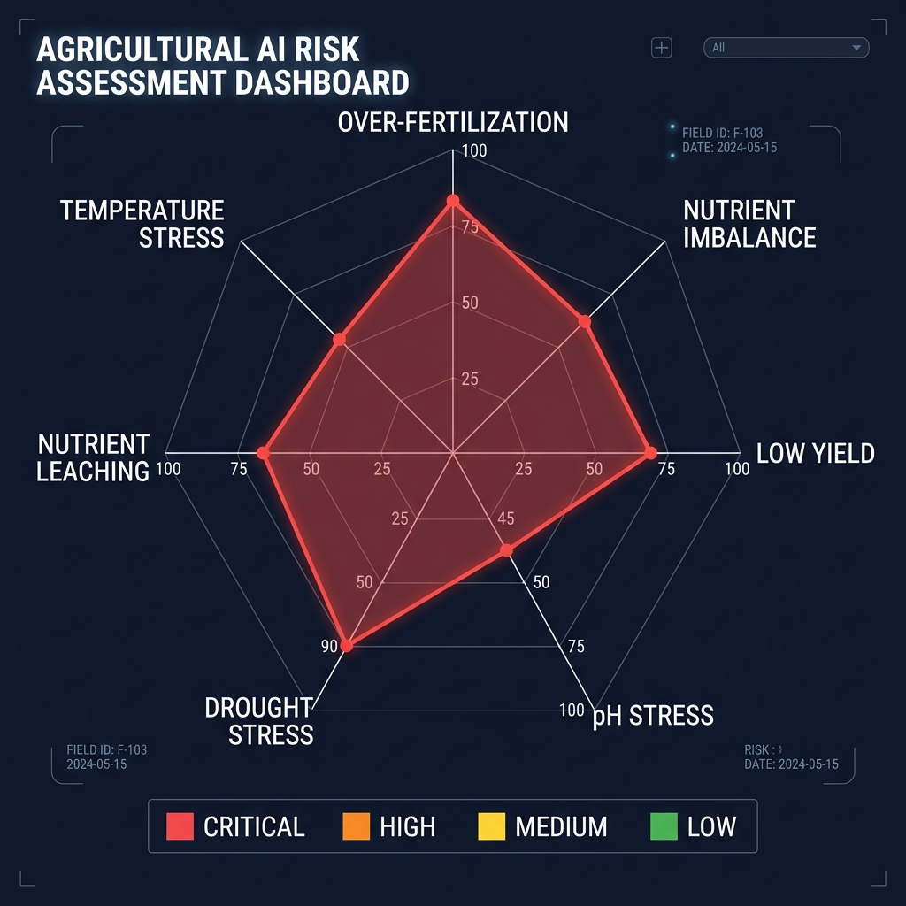
Risk Prediction Module
7 risk categories with severity, probability, and actionable recommendations
Risk Category | Trigger Condition | Severity
Over-Fertilization | NPK excess > 20 kg/ha | High/Med
Nutrient Imbalance | N:P:K ratio gap > 0.6 | High/Med
Low Yield | Predicted < 60% of avg | High/Med
pH Stress | pH outside optimal ±1 | High/Med
Drought Stress | Moisture < 25%, Rain < 30 | High/Med
Nutrient Leaching | Rain > 200mm, Qty > 100 | High/Med
Temperature Stress | Temp outside optimal ±5°C | Medium

Slide 16
Sustainability Index
6-component weighted scoring system with grades A–F
🌿
⚖️
🌍
💧
🌾
♻️
Fertilizer Efficiency
Soil Balance
Environmental Score
Water Impact
Soil Health Trend
Carbon Footprint
Weight: 20%
Weight: 15%
Weight: 20%
Weight: 15%
Weight: 15%
Weight: 15%
100 − qty/5
100 − total deficit
100 − env impact
Rain + moisture + qty penalties
From degradation tracker
100 − (qty × 0.5)/2.5
Grades: A (≥80) Excellent | B (≥65) Good | C (≥50) Fair | D (≥35) Poor | F (<35) Critical

Slide 17
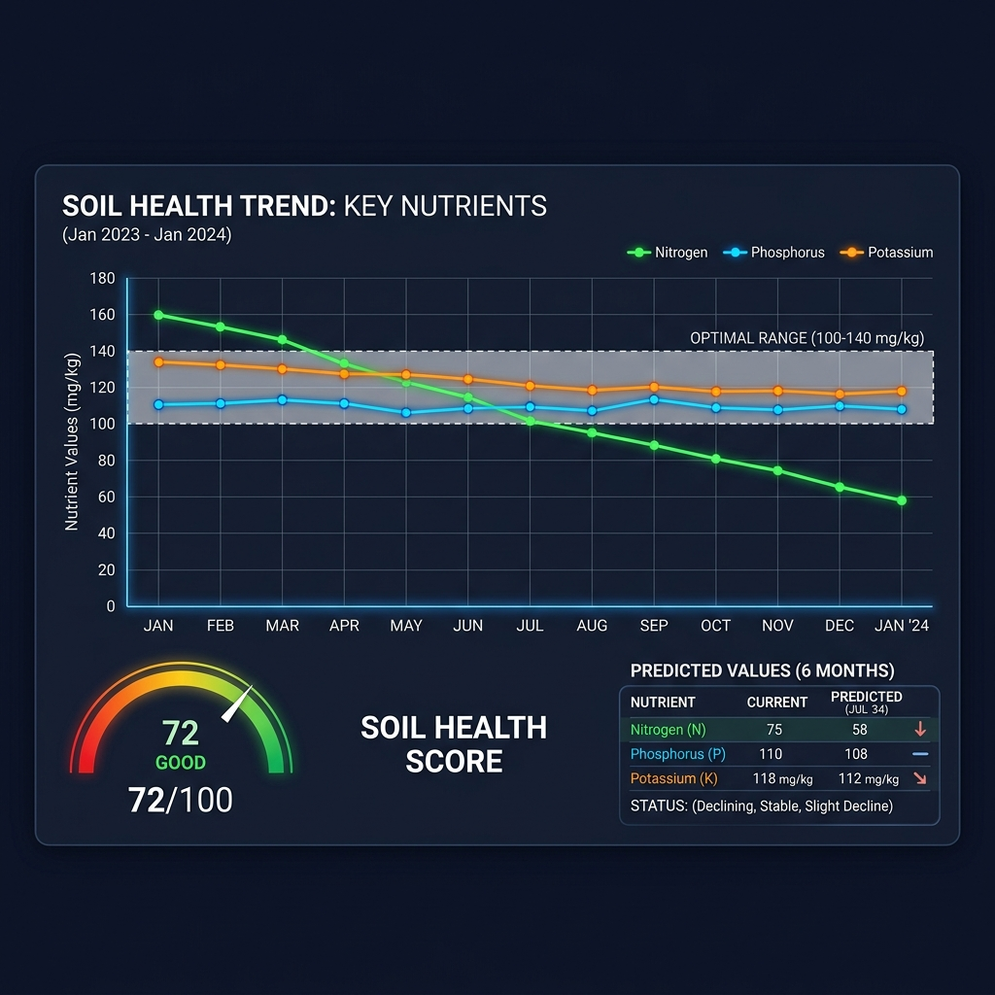
Soil Health Degradation Tracker
Linear trend projection to predict nutrient decline over time
How It Works
📈 Records soil N, P, K, pH, moisture for each analysis
📈 Builds time-series history (up to 100 entries)
📈 Linear regression on nutrient values over time
📈 Predicts values 6+ months into the future
📈 Classifies trend: Declining / Stable / Improving
📈 Health score (0–100) from nutrient proximity to optimal
📈 Generates urgency-based recommendations

Slide 18
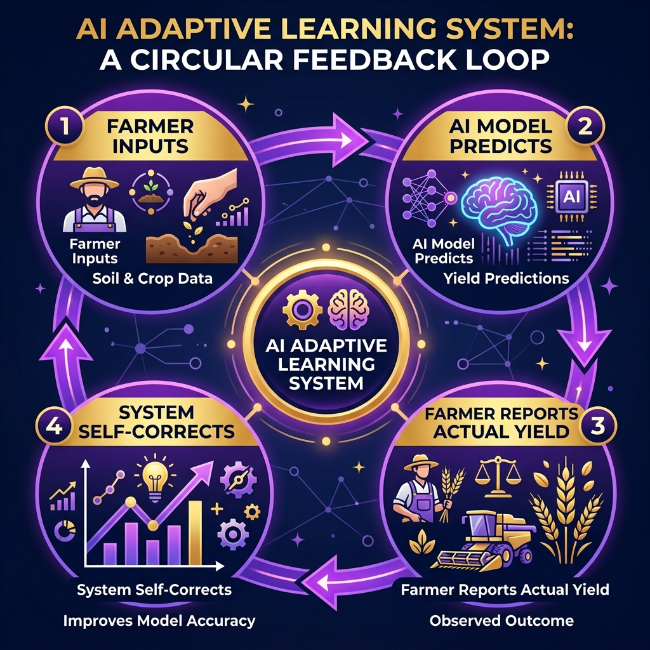
Adaptive Learning & Feedback Loop
Continuous improvement through farmer feedback
Adaptive Learning System
🧠 Records every recommendation (input + predicted output)
🧠 Computes correction factor: actual / predicted yield
🧠 Blends: 70% model + 30% learned correction
🧠 Blend weight grows with more farmer feedback (max 30%)
🧠 Tracks accuracy: within 20% error = 'correct'
🧠 Builds personal crop profiles over time

Slide 19
Scenario Simulator (What-If Analysis)
Explore impact of different conditions on yield, cost, and sustainability
Scenario | Modifications | Use Case
📉 Reduce Fert 30% | N, P, K × 0.7 | Cost saving analysis
📈 Increase Fert 30% | N, P, K × 1.3 | Yield maximization
🏜️ Drought | Rain=20mm, Moisture=20% | Drought preparedness
🌧️ Heavy Rainfall | Rain=350mm, Moisture=85% | Flood risk planning
🌡️ Heat Wave | Temp=42°C, Humidity=30% | Extreme heat response
✨ Optimal Conditions | All params at ideal values | Best-case benchmarking
Each scenario computes: Δ Yield (t/ha), Δ Cost (₹), Δ Environmental Impact, and generates a natural-language recommendation comparing base vs. scenario.

Slide 20
Explainability & Smart Alerts
Every recommendation comes with human-readable reasoning
Model Explainability
Smart Alert System
💡 Feature Importance via correlation-based analysis
💡 Top-3 influencing features shown per recommendation
💡 Nutrient-specific explanations (e.g., 'Low N → use N-rich')
💡 Environmental context notes (rainfall, temperature)
💡 Yield context: above/below average for crop type
💡 Sustainability badges earned (🏆 Efficient, 🌿 Low Impact, …)
Level | Trigger | Message
🔴 Critical | pH < 4.5 | Apply lime before fertilizing
🔴 Critical | Moisture < 20% | Irrigate before application
🟡 Warning | pH < 5.5 | Acidic soil reduces uptake
🟡 Warning | pH > 8.5 | Apply gypsum or sulfur
🟡 Warning | N < 20 | Yellowing leaves likely
🟡 Warning | Temp > 40°C | Apply early AM / evening
🟢 Info | Low deficits | Minimal fertilization needed

Slide 21
Technology Stack & Key Metrics
Technology Stack
Key Metrics
⚡ Frontend: Vanilla JavaScript (ES6 Modules)
⚡ Styling: CSS3 with Glassmorphism design
⚡ Build: Vite for bundling and dev server
⚡ ML: Custom Random Forest + Gradient Boosting (no libs)
⚡ Storage: localStorage for adaptive learning + history
⚡ Charts: Custom SVG / Canvas charting
⚡ Deployment: Static hosting (Vercel / Netlify)
⚡ Zero server dependencies — runs 100% in browser
Metric | Value
Training Samples | 2,000 synthetic
Feature Dimensions | 18 (8 numeric + 10 encoded)
Supported Crops | 10
Fertilizer Classes | 7
RF Trees | 15
GB Estimators | 50
Risk Categories | 7
Sustainability Components | 6
Code Modules | 12

Slide 22
Future Roadmap
Planned enhancements for the next phase
Phase 1
Phase 2
Phase 3
Phase 4
Real Weather API Integration
Satellite Imagery (NDVI)
Backend + Auth
Mobile App (React Native)
Connect to IMD / OpenWeather for live forecast data
Use NDVI from Sentinel-2 for crop health monitoring
Node.js/Firebase backend for data persistence
Offline-capable mobile app for rural farmers

Slide 23
Thank You!
AgriML — Empowering Farmers with AI
Questions & Discussion
🌾 Smart Fertilizer • 📊 Yield Prediction • 🌦️ Climate Aware • ♻️ Sustainable

