Slide 1

Tour De France Bike Shop
Reuben Hernandez
Project 0

Slide 2
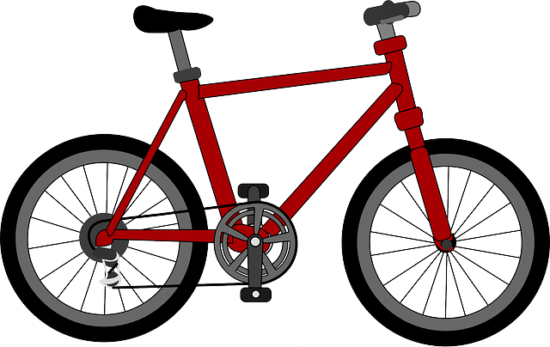
Overview
Tour de France Bike Shop has an online presence now!
An interface for customers and employees
Customers who come in for repairs can track the progress and more!
Employees have admin privileges to manage customer data

Slide 3
User Stories
1. As a customer, I should be able to view my bike repair status.
2. As a customer, I should be able to register my bike(s).
3. As a customer, I should be able to view and pay my bill.
4. As a customer, I should be able to purchase additional products.
5. As an employee, I should be able to update repair status.
6. As an employee, I should be able to set the bill balance for the customer.
7. As an employee, I should be able to update customers’ bill balance status.
8. As an employee, I should be able to edit/add product details.

Slide 4
Features
Login
Determine interface based on user role (customer or employee)
Validation
User input is validated (proper format and if input exist in DB)
Customer user stories implementations
Register bike, pay bills, etc.
Employee user stories implementations
Add products, set bill balance, etc.
Logging
Logs user login/logout and SQL errors

Slide 5
Design Patterns
Factory
Used to generate menus for different user types
DAO (Data Access Object)
Used to define classes that make database calls

Slide 6
DEMO TIME

