Slide 1
Introduction
Who am I
Casey Shimata
IOS Swift, Flutter Dart, Xamarin C#, Python, MEAN
App Name
A Divine H2O Event Manager
Link to Presentation: https://drive.google.com/drive/folders/1Xh2Y3WUkubes9Sn_Y7p1nta_YXfMax-W?usp=sharing

Slide 2
Overview
App summary
Tech Used in App
Visual of Database Structure (ERD)
App Features List
App Demo
Future Sprint Considerations

Slide 3
App Summary
The Problem
coordinating:
volunteer schedules
event supplies
event communication
The Solution
a cross platform app that:
allows admin to manage events
allows volunteers to join events
allows admin to manage supplies
allows volunteers to set schedules
provides conversation about events

Slide 4
Tech Used in App
Java
Maven
Postgresql
J.D.B.C.
Junit
log4j
Servlets
jsp
JCA (crypto)
Notes:
Java Cryptography Architecture: a java api for security implementation

Slide 5
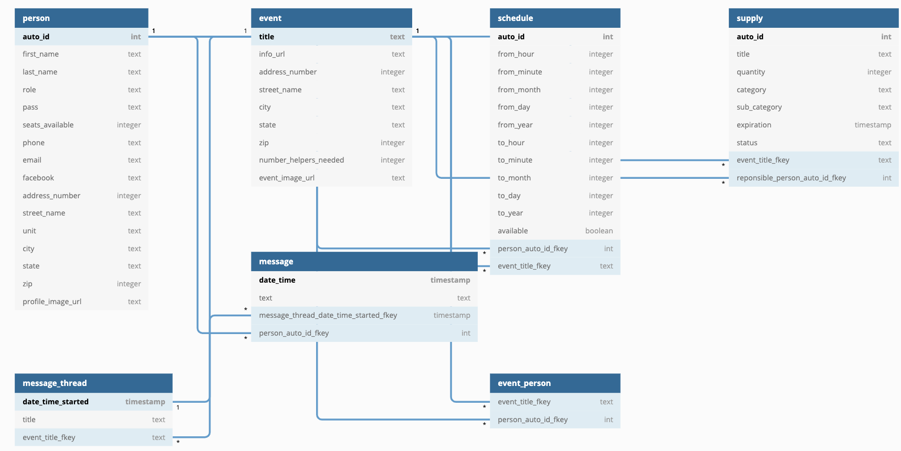
Visual of Database Structure

Slide 6
P0 App Features List
Login (validation)
View All Events
Delete Event
View Event
Edit Event
View Self
test
encrypt
decrypt
login valid
addEvent
Notes:
login:
read user where phone
return encrypted pass
decrypt if match {query person, set it to session, redirect
view All Events:
read list of events
set the events to session

Slide 7
App Demo
Project Source code: https://github.com/200601-USF-Pega/ShimataCRepo
Project Zip File: https://drive.google.com/drive/folders/1Xh2Y3WUkubes9Sn_Y7p1nta_YXfMax-W?usp=sharing
GO TO DEMO ->

Slide 8
Future Sprint Considerations
Implement Schedules:
person schedules does not overlap event schedule
Register Person:
so volunteers can sign up rather than admin doing the work
Implement Event MessageThread:
so people can begin talking about other event details

