Slide 1

Eventivity An Adaptive Event Platform
Dean Sinnott – BSc Applied Computing
Final Year Project Demo 2025
Notes:
Hi, I’m Dean Sinnott. My final year project is called Eventivity, an adaptive event platform built as a progressive web app. I’ll walk you through the concept, the technologies used, what I built, and what I learned.

Slide 2

Core Concept
Adaptive progressive web application
A central hub for event information
Reusable across multiple events
Dynamic theming
Notes:
The core idea behind Eventivity is reusability. Instead of building a new app for every event, Eventivity adapts its theme and content dynamically. The structure stays the same, but the branding and data change per event. It’s installable, works offline, and keeps users in a consistent but customised environment. This concept supports both users and organisers by reducing app development time and making the platform feel familiar but fresh.

Slide 3

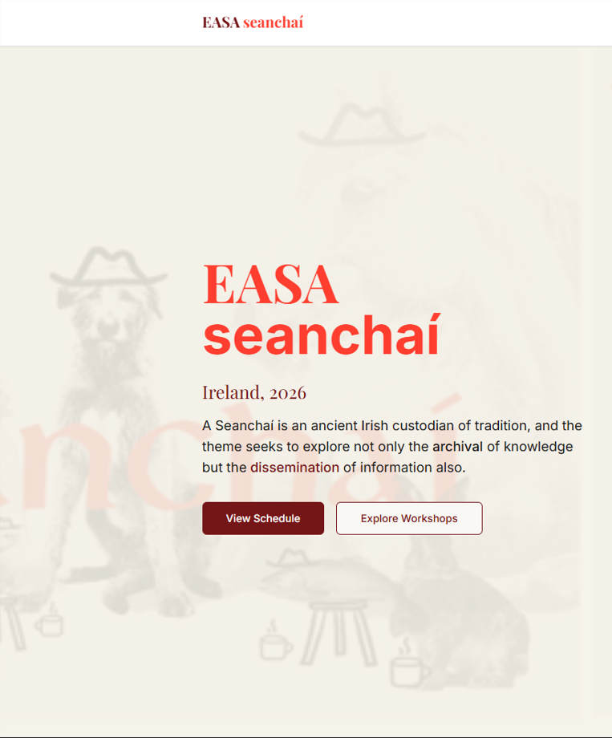
Motivation
Inspired by a real-world event, EASA Waterford in 2026
Aim to support local events with a modern, intuitive and scalable platform
Chance to collaborate closely with the organiser
Build something reusable and meaningful beyond college
Opportunity to apply cloud skills from the Cloud Computing stream
Notes:
The idea came from a real event my friend is organising in 2026, called EASA. I knew I wanted to build something that could help support that kind of local, large-scale event. We had worked together on creative projects before, and I thought it would be a good chance to build something useful with potential beyond college. Since I’m in the Cloud Computing stream, I also wanted a chance to apply those skills in a real project, not just in labs or tutorials.

Slide 4

Idea Development
First idea
Started as a single-event app
Semester 1 review
Supervisors recommended expanding the scope, to introduce a level of complexity.
Brainstorming
How should I expand my idea ?
Introduce complex features?
Multiple events ?
Multi-Event Platform
Shifted towards reusable structure and dynamic theming
Project deliverable
Notes:
I started with a basic idea: just one app for one event. That would’ve worked, but after some early feedback from my supervisor, I realised there was an opportunity to make it more useful. That’s when I decided to focus on building something reusable — where the structure stays the same, but each event gets its own theme, data, and identity. That decision shaped a lot of my thinking around simplicity and reusability, both in design and development

Slide 5
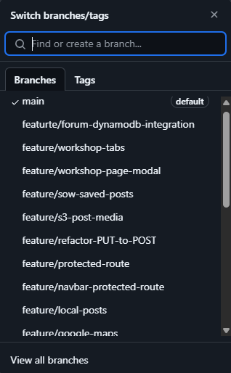
Development Approach
Incremental, feature-by-feature development
Used GitHub branches to isolate work
Logged bugs and tasks using GitHub Issues
CI/CD handled through AWS Amplify
Notes:
I used a flexible, iterative approach. I built one feature at a time and tested as I went.
Each feature had its own GitHub branch, and I tracked bugs or small tasks using GitHub Issues.
Every time I pushed to the main branch, AWS Amplify rebuilt and deployed the app automatically.
This made testing new features feel more real and helped me stay organised.

Slide 6
Technologies used
Frontend
Backend
Additional tools
React
Vite
Tailwind CSS
AWS Cognito
AWS S3
AWS Lambda
DynamoDB
API Gateway
AWS Amplify
Google Maps API
vite-plugin-pwa
GitHub
Postman

Slide 7
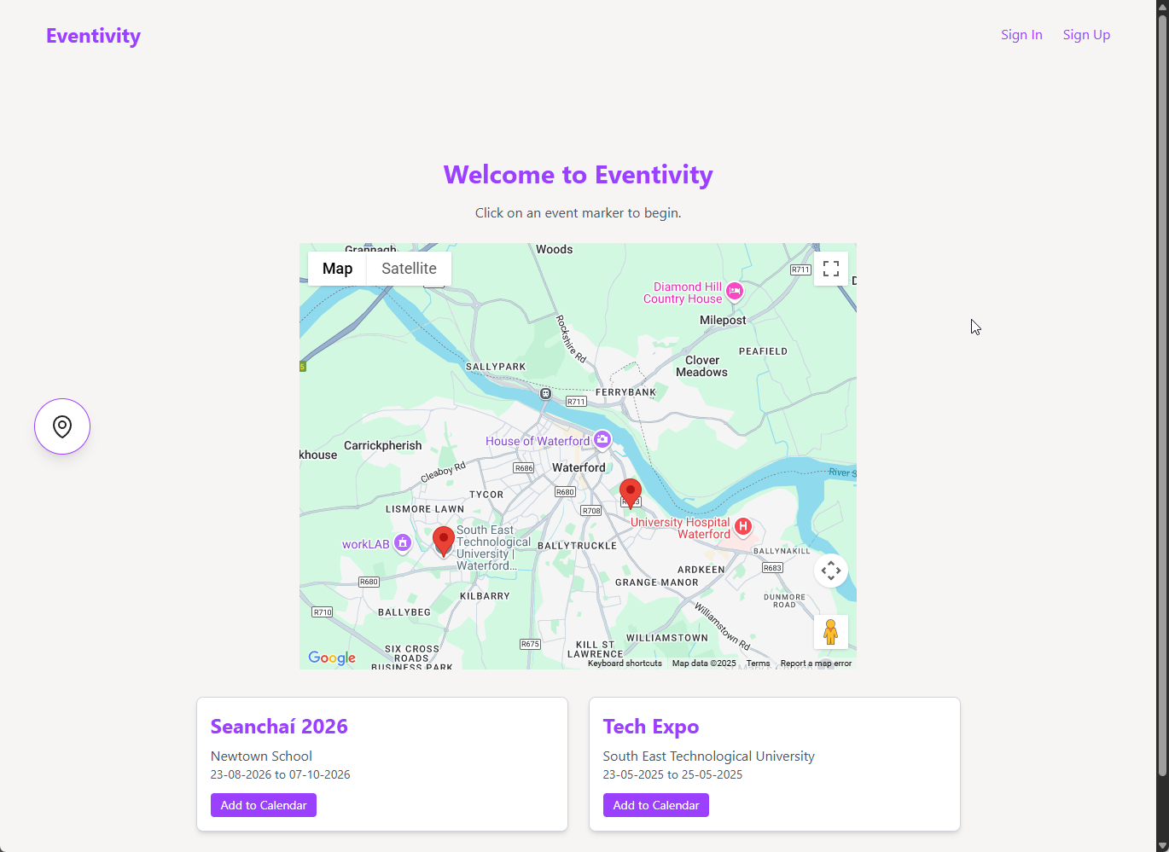
Features Implemented
✅ Sign Up, Sign In, Confirm Account (AWS Cognito)
✅ Forum Posts with Media (DynamoDB + S3)
✅ Dynamic Event Theming
✅ Workshop Cards + Detail Modals
✅ Event Map with Clickable Markers (Google Maps)
✅ Offline Access + Installable PWA (vite-plugin-pwa)
Notes:
Here’s what I was able to build and test successfully. Users can register and sign in securely using Cognito. They can create forum posts, with support for images and video. The app’s theme changes based on the selected event, and all core pages use a shared component structure. I also added workshop scheduling, modals with detail tabs, and QR code links for navigation. Finally, I implemented offline access and installability using service workers — important for visitors with limited mobile data

Slide 8
Future Improvements
Load events and schedules dynamically from DynamoDB
Push notifications for updates/ reminders
Improved mobile layout
QR code generation and navigation to specific workshop pages
Expand the Calander page to include a list of events and workshops saved by the user.
Notes:
While the current version works as a skeleton, there’s still a lot I want to build
First, I want to load events dynamically from the database so organisers can create or update events without touching the code.
I also plan to make the “My Calendar” page persistent and let users sync with tools like Google Calendar. Push notifications, an admin dashboard, and improvements to mobile layout and media handling are all on my roadmap. These aren’t just ideas — they’re the next logical steps based on how I structured the app.

Slide 9

Challenges – Defining the Scope
Balancing ambition with available time
Learning new AWS services and development tools
Building core functionality before extra features
Adapting expectations while maintaining quality
Notes:
Like many final year projects, this started off bigger than it needed to be. I had to scale back and focus on building a solid foundation first. Tools like Cognito and IAM had steep learning curves, and I spent time troubleshooting permission issues and user flows. Rather than rushing to include every idea, I made the decision to develop a functional skeleton — something stable I could build on later. This helped me learn to prioritise and make realistic technical decisions under pressure.

Slide 10



Thank You
Dean Sinnott
20067691@mail.wit.ie
https://main.d2c6n3hjfqezye.amplifyapp.com/
https://github.com/20067691/eventivity_fyp.git

