Slide 1

Introduction to
Artificial Intelligence
(503043)
MIDTERM PRESENTATION
Group: 08
Instructor:
Nguyễn Thành An, MSc.

Slide 2
Team Members & Contribution Rates
 | Student ID | Full Name | Academic Email | Assigned Responsibilities | Completion
1 | 524H0121 | Lê Phú | 524h0102@student.tdtu.edu.vn | Algorithm Core & Strategy (req 2,5,7) | 34%
2 | 524H0095 | Vũ Giang Huy | 524h0095@student.tdtu.edu.vn | Modeling & Experiments(req 1,3,4) | 33%
3 | 524H0102 | Lê Hoàng Minh Khôi | 524h0102@student.tdtu.edu.vn | Competitive Engine, GUI & Presentation (req 6,8, task2) | 33%

Slide 3
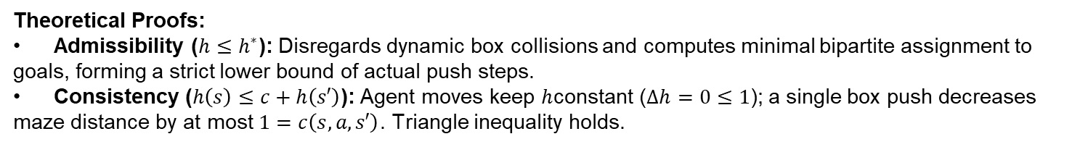
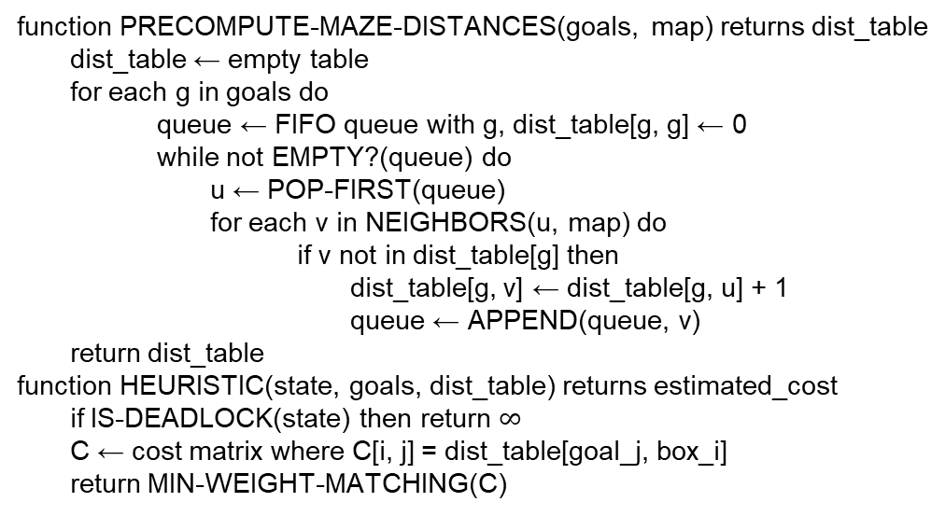
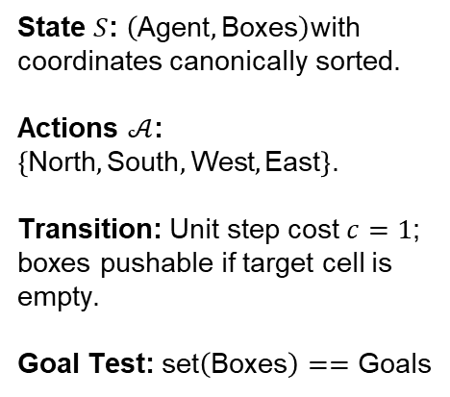
Single-Agent Search & Non-Manhattan Heuristic
State $S$: $\left(\text{Agent},\text{Boxes}\right)$with coordinates canonically sorted.
Actions $𝒜$: $\left\{\text{North},\text{South},\text{West},\text{East}\right\}$.
Transition: Unit step cost $c=1$; boxes pushable if target cell is empty.
Goal Test: $\text{set}\left(\text{Boxes}\right)==\text{Goals}$
function PRECOMPUTE-MAZE-DISTANCES(goals, map) returns dist_table
dist_table ← empty table
for each g in goals do
queue ← FIFO queue with g, dist_table[g, g] ← 0
while not EMPTY?(queue) do
u ← POP-FIRST(queue)
for each v in NEIGHBORS(u, map) do
if v not in dist_table[g] then
dist_table[g, v] ← dist_table[g, u] + 1
queue ← APPEND(queue, v)
return dist_table
function HEURISTIC(state, goals, dist_table) returns estimated_cost
if IS-DEADLOCK(state) then return $∞$
C ← cost matrix where C[i, j] = dist_table[goal_j, box_i]
return MIN-WEIGHT-MATCHING(C)
Theoretical Proofs:
Admissibility ($h≤h^{∗}$): Disregards dynamic box collisions and computes minimal bipartite assignment to goals, forming a strict lower bound of actual push steps.
Consistency ($h\left(s\right)≤c+h\left(s′\right)$): Agent moves keep $h$constant ($Δh=0≤1$); a single box push decreases maze distance by at most $1=c\left(s,a,s′\right)$. Triangle inequality holds.

Slide 4
A*Graph Search with Deadlock Pruning
function A-STAR-SEARCH(problem, h) returns a solution, or failure
node ← a node with STATE = problem.INITIAL-STATE, PATH-COST = 0
frontier ← a priority queue ordered by f(n) = PATH-COST + h(n.STATE)
frontier ← INSERT(node, frontier)
explored ← an empty set
loop do
if EMPTY?(frontier) then return failure
node ← POP(frontier)
if problem.GOAL-TEST(node.STATE) then return SOLUTION(node)
add node.STATE to explored
for each action in problem.ACTIONS(node.STATE) do
child ← CHILD-NODE(problem, node, action)
if IS-DEADLOCK(child.STATE) then continue if child.STATE is not in explored or frontier then
frontier ← INSERT(child, frontier)
else if child.STATE is in frontier with higher PATH-COST then
replace that frontier node with child
Key Implementation Highlights:
Graph-Search Integrity: Uses explored set and frontier lookup to avoid redundant cyclical explorations.
Static Pruning: IS-DEADLOCK eliminates non-goal corner and wall entrapments prior to frontier insertion, saving significant memory.

Slide 5
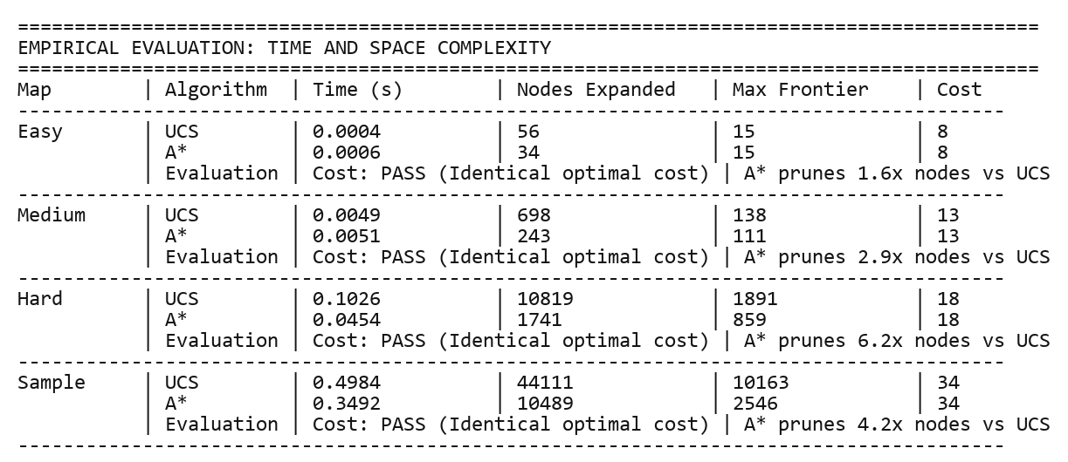
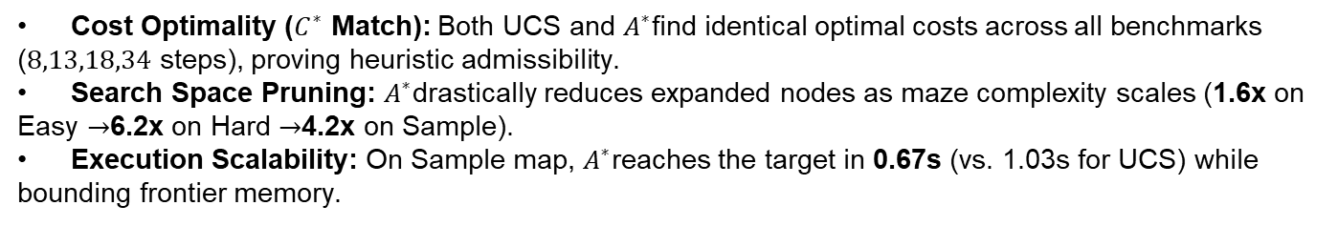
Empirical Evaluation: UCS vs. A*Search
Cost Optimality ($C^{∗}$ Match): Both UCS and $A^{∗}$find identical optimal costs across all benchmarks ($8,13,18,34$ steps), proving heuristic admissibility.
Search Space Pruning: $A^{∗}$drastically reduces expanded nodes as maze complexity scales (1.6x on Easy $→$6.2x on Hard $→$4.2x on Sample).
Execution Scalability: On Sample map, $A^{∗}$reaches the target in 0.67s (vs. 1.03s for UCS) while bounding frontier memory.

Slide 6
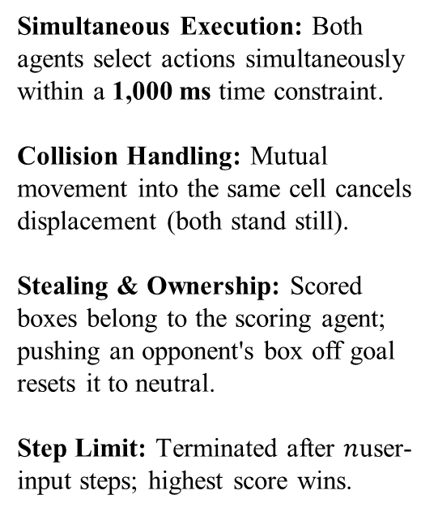
Competitive Two-Agent Engine & Decision Strategy
Simultaneous Execution: Both agents select actions simultaneously within a 1,000 ms time constraint.
Collision Handling: Mutual movement into the same cell cancels displacement (both stand still).
Stealing & Ownership: Scored boxes belong to the scoring agent; pushing an opponent's box off goal resets it to neutral.
Step Limit: Terminated after $n$user-input steps; highest score wins.
function COMPETITIVE-AGENT(state) returns an action
start_time ← CURRENT-TIME()
if OPPONENT-BOX-ON-GOAL?(state) then
path ← BFS-PATH(my_pos, steal_push_pos, obstacles)
if path is not empty then return FIRST(path)
if UNPLACED-BOXES?(state) then
(box, goal) ← FIND-BEST-PAIR(unplaced_boxes, free_goals)
path ← BFS-PATH(my_pos, push_pos, obstacles)
if path is not empty then return FIRST(path)
if (CURRENT-TIME() - start_time) < 0.8s then
return ALPHA-BETA-SEARCH(state, depth = 2)
return "Stay"

Slide 7
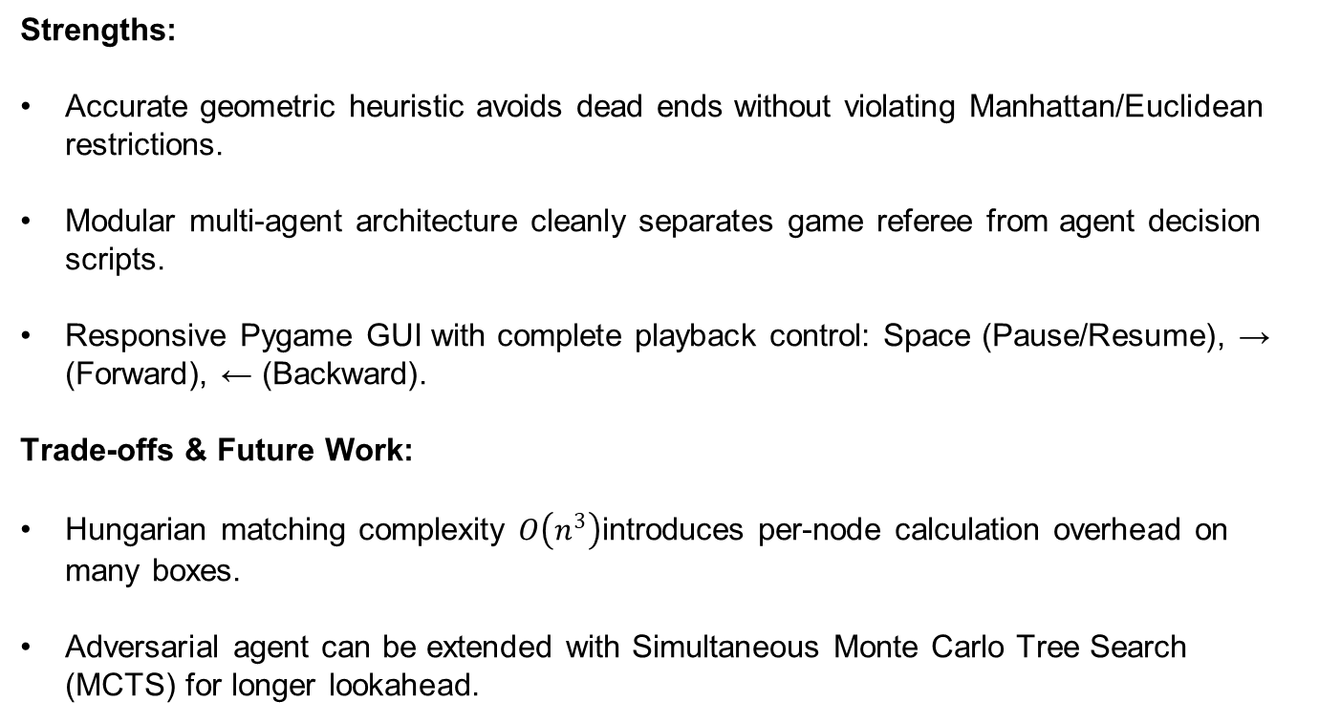
System Evaluation
Strengths:
  Accurate geometric heuristic avoids dead ends without violating Manhattan/Euclidean restrictions.
  Modular multi-agent architecture cleanly separates game referee from agent decision scripts.
  Responsive Pygame GUI with complete playback control: Space (Pause/Resume), → (Forward), ← (Backward).
Trade-offs & Future Work:
  Hungarian matching complexity $O\left(n^{3}\right)$introduces per-node calculation overhead on many boxes.
  Adversarial agent can be extended with Simultaneous Monte Carlo Tree Search (MCTS) for longer lookahead.

