Slide 1
PROJECT 2
Model B6 Investigation
& Evidence-Grounded Agents
模型訓練、控制實驗與證據導向 AI Agent
MODEL B6 / AGNO / DIAGNOSTICS
巫承志 / 113033225 / 動機28
FINAL REPORT · 2026.10.09
Notes:
Model B6 Investigation
& Evidence-Grounded Agents
Evidence:
Repository HEAD e1a1bc5c75a085e1b39629986b98302f1842fe4b, audit 2026-10-09
Quantitative full precision and report provenance: evidence/Project2-Final-Report-evidence-coverage.json

Slide 2
COURSE REQUIREMENT
Project 2 成果與目前驗證狀態
課程要求 | 實作與證據 | 目前狀態
Step 5 訓練 | 60 epochs；final / best artifacts | CONFIRMED 訓練完成
Step 6 驗證 | USA / Taiwan × final / best | CONFIRMED 技術流程完成
Agno / agent.py | 隔離環境、adapter、Baseline live | CONFIRMED 完整回答紀錄
5-Level / Do New | framework review、Evidence Agent | CONFIRMED 原始 Do New live
額外 v2：Vision live 已驗收；Diagnosis / Unified 為 LIVE VERIFICATION PENDING。駕駛品質為 NOT VERIFIED。
PROJECT 2 / E01 E03 E04 E09
02
Notes:
Project 2 成果與目前驗證狀態
Evidence: docs/PROJECT2.md §§5–27; private course summaries verified against local original slides 3–11 and Agent assignment
projects/project2/agent/artifacts/do-new-v2/step5/runs/p25-baseline-20261005/run.json; docs/PROJECT2_AUDIT.md §15
projects/project2/agent/artifacts/do-new-v2/step6/report.json; {usa,taiwan}/{final,best}/manifest.json; production frame PNGs; projects/project2/modelb6/step6.py
docs/PROJECT2_AUDIT.md §§27,32; projects/project2/agent/FRAMEWORK_REVIEW.md; professor_baseline.py; evidence_agent.py
Repository HEAD e1a1bc5c75a085e1b39629986b98302f1842fe4b, audit 2026-10-09
額外 v2：Vision live 已驗收；Diagnosis / Unified 為 LIVE VERIFICATION PENDING。駕駛品質為 NOT VERIFIED。
Quantitative full precision and report provenance: evidence/Project2-Final-Report-evidence-coverage.json

Slide 3
CONTRIBUTION / INVESTIGATION MAP
學生貢獻與模型調查主線
課程核心
工程改善
原創調查
訓練、四組驗證、Agent 與 Do New
資料配對、隔離環境與產物驗證
控制實驗、根因範圍與修復決策
模型調查如何一步步縮小問題？
01 幾何異常
→
02 排除部分解釋
→
03 控制介入
→
04 檢驗修復
→
05 依門檻決策
raw output
已出現鋸齒
已測前處理一致；
投影與參考吻合
換影像回應極弱；
state policy 效應大
Depthwise／mixed-state
短訓練對照
候選均未通過；
不升級長訓練
14–15 頁
15–16 頁
17–23 頁
24–27 頁
28 頁
CONFIRMED｜這是可追溯的調查與決策過程；唯一成因、有效修復與駕駛品質仍未驗證。
PROJECT 2
03
Notes:
學生貢獻的三個層次
Evidence: docs/PROJECT2.md §§5–27; private course summaries verified against local original slides 3–11 and Agent assignment
projects/project2/modelb6/corrections.py; step5_data.py; step5.py; docker/Dockerfile.modelb6; docker-compose.yaml; docs/PROJECT2_AUDIT.md §§12–15
projects/project2/agent/artifacts/do-new-v2/p27-sensitivity/results.json; projects/project2/modelb6/step7_sensitivity.py; docs/PROJECT2_AUDIT.md §18
projects/project2/agent/artifacts/do-new-v2/p28-encoder-audit/{results,reference_controls}.json; step8_encoder_audit.py; docs/PROJECT2_AUDIT.md §19
projects/project2/agent/artifacts/do-new-v2/p29-gradient-audit/{summary,interpretation}.json; step9_gradient_audit.py; docs/PROJECT2_AUDIT.md §20
projects/project2/agent/artifacts/do-new-v2/p210-gradient-controls/summary.json; step10_gradient_controls.py; docs/PROJECT2_AUDIT.md §§21,23
docs/PROJECT2_AUDIT.md §§29–32; projects/project2/agent/{vision_agent,diagnosis_agent,v2_evidence,v2_tests,prepare_v2}.py; DO_NEW_V2.md
Repository HEAD e1a1bc5c75a085e1b39629986b98302f1842fe4b, audit 2026-10-09
Quantitative full precision and report provenance: evidence/Project2-Final-Report-evidence-coverage.json
v2 integration: see evidence/Project2-Final-Report-v2-evidence-coverage.json. Corrected state recheck supersedes old interpretation. Teacher previous state is past information. Frozen-Best mixed-state conclusion is limited to tested formulation. Original course/Agent claims remain historical.
Presentation content review: Map preserves scope: course core vs engineering improvements vs student investigations. Same existing G/S/M sources; stage order summarizes the established evidence, not proof of a unique causal chain. Dates unchanged.

Slide 4
SYSTEM ARCHITECTURE
兩條工作流共享同一份實驗證據
P1 inherited
OpenPilot / dataB6 / dataC
read-only inherited inputs
Model B6
Evidence
AI Agent
TensorFlow 2.13.1
Python 3.8 Docker
JSON / manifests
production PNGs
Agno 3.1.1
Python 3.11 venv
模型產物進入唯讀 Agent 工具，Agent 不修改模型。
Project 1 環境只作既有基礎；本報告貢獻限於 Project 2。來源唯讀，derived / output 分離。
PROJECT 2 / E02 E03 E04 E10
04
Notes:
兩條工作流共享同一份實驗證據
Evidence: projects/project2/modelb6/corrections.py; step5_data.py; step5.py; docker/Dockerfile.modelb6; docker-compose.yaml; docs/PROJECT2_AUDIT.md §§12–15
projects/project2/agent/artifacts/do-new-v2/step5/runs/p25-baseline-20261005/run.json; docs/PROJECT2_AUDIT.md §15
projects/project2/agent/artifacts/do-new-v2/step6/report.json; {usa,taiwan}/{final,best}/manifest.json; production frame PNGs; projects/project2/modelb6/step6.py
docs/PROJECT2_AUDIT.md §§29–32; projects/project2/agent/{vision_agent,diagnosis_agent,v2_evidence,v2_tests,prepare_v2}.py; DO_NEW_V2.md
Repository HEAD e1a1bc5c75a085e1b39629986b98302f1842fe4b, audit 2026-10-09
Project 1 環境只作既有基礎；本報告貢獻限於 Project 2。來源唯讀，derived / output 分離。
Quantitative full precision and report provenance: evidence/Project2-Final-Report-evidence-coverage.json

Slide 5
PART A · MODEL B6
Model B6 的四輸入與分支
Image pair
Image encoder
Direct heads
12 ×128 ×256
1024 embedding
meta / desire_pred / pose
image embedding
Desire / traffic
Recurrent gate
Output / next state
8 / 2 values
previous state:512
path / lane / lead …
Image：(1,12,128,256)；desire：8；traffic：2；state：512。輸出共 2383 值，分為 12 sections。
meta / desire_pred / pose 直接讀取 image embedding；path / lane / lead 等經 recurrent 分支。
PROJECT 2 / E02 E05
05
Notes:
Model B6 的四輸入與分支
Evidence: projects/project2/modelb6/corrections.py; step5_data.py; step5.py; docker/Dockerfile.modelb6; docker-compose.yaml; docs/PROJECT2_AUDIT.md §§12–15
projects/project2/agent/artifacts/do-new-v2/p27-sensitivity/results.json; projects/project2/modelb6/step7_sensitivity.py; docs/PROJECT2_AUDIT.md §18
Repository HEAD e1a1bc5c75a085e1b39629986b98302f1842fe4b, audit 2026-10-09
Image：(1,12,128,256)；desire：8；traffic：2；state：512。輸出共 2383 值，分為 12 sections。
meta / desire_pred / pose 直接讀取 image embedding；path / lane / lead 等經 recurrent 分支。
Quantitative full precision and report provenance: evidence/Project2-Final-Report-evidence-coverage.json

Slide 6
STEP 5 · INPUT / TARGET
訓練資料與 teacher forcing
來源／split | teacher target rows | 角色
USA --33 | 1198 | training
USA --37 | 1199 | training
USA --32 | 1199 | validation
supercombo079.keras | 2383 values / row | teacher targets
影像 pair (i,i+1) 對應 teacher row i；input state 使用前一列 512-value latent，序列起點為 zero。教師輸出提供訓練目標，並非獨立人工 ground truth。
PROJECT 2 / E01 E02 E03
06
Notes:
訓練資料與 teacher forcing
Evidence: docs/PROJECT2.md §§5–27; private course summaries verified against local original slides 3–11 and Agent assignment
projects/project2/modelb6/corrections.py; step5_data.py; step5.py; docker/Dockerfile.modelb6; docker-compose.yaml; docs/PROJECT2_AUDIT.md §§12–15
projects/project2/agent/artifacts/do-new-v2/step5/runs/p25-baseline-20261005/run.json; docs/PROJECT2_AUDIT.md §15
Repository HEAD e1a1bc5c75a085e1b39629986b98302f1842fe4b, audit 2026-10-09
影像 pair (i,i+1) 對應 teacher row i；input state 使用前一列 512-value latent，序列起點為 zero。教師輸出提供訓練目標，並非獨立人工 ground truth。
Quantitative full precision and report provenance: evidence/Project2-Final-Report-evidence-coverage.json

Slide 7
ENGINEERING IMPROVEMENT
資料與 checkpoint 的修正層
Problem
reference generator 的檔案／row 配對風險，跨 recording state 未重置。
Investigation
核對每個 sequence 的 teacher file、image pair 與 row index；測試真實序列切換。
Solution
same-sequence / same-row 配對，序列起點 zero state；fresh start 與顯式 resume 分開。
Verification
7 correction + 13 production fixtures 的歷史 PASS；599 batches dry run 包含 --33 到 --37。
Best checkpoint 依 val_loss 選擇
保留教授 model、output slices 與 custom loss；修正放在 student-owned wrapper。
PROJECT 2 / E02
07
Notes:
資料與 checkpoint 的修正層
Evidence: projects/project2/modelb6/corrections.py; step5_data.py; step5.py; docker/Dockerfile.modelb6; docker-compose.yaml; docs/PROJECT2_AUDIT.md §§12–15
Repository HEAD e1a1bc5c75a085e1b39629986b98302f1842fe4b, audit 2026-10-09
保留教授 model、output slices 與 custom loss；修正放在 student-owned wrapper。
Quantitative full precision and report provenance: evidence/Project2-Final-Report-evidence-coverage.json

Slide 8
ENGINEERING IMPROVEMENT
正式訓練前的執行 gate
Preflight
Labels
Probe
Train
Reload
mount / split / hashes
shape / finite / SHA-256
5557 / 5558 + boundary
new unique run ID
fresh process
任何來源或產物身分不一致，流程停止。
資料與教授 source 保持唯讀。derived 以 staging、atomic publish、completion marker 發布；run 拒絕覆蓋既有結果。Resume 是新訓練片段，未還原 optimizer / scheduler。
PROJECT 2 / E02 E03
08
Notes:
正式訓練前的執行 gate
Evidence: projects/project2/modelb6/corrections.py; step5_data.py; step5.py; docker/Dockerfile.modelb6; docker-compose.yaml; docs/PROJECT2_AUDIT.md §§12–15
projects/project2/agent/artifacts/do-new-v2/step5/runs/p25-baseline-20261005/run.json; docs/PROJECT2_AUDIT.md §15
Repository HEAD e1a1bc5c75a085e1b39629986b98302f1842fe4b, audit 2026-10-09
資料與教授 source 保持唯讀。derived 以 staging、atomic publish、completion marker 發布；run 拒絕覆蓋既有結果。Resume 是新訓練片段，未還原 optimizer / scheduler。
Quantitative full precision and report provenance: evidence/Project2-Final-Report-evidence-coverage.json

Slide 9
STEP 5 · CONFIRMED
60 epochs 的正式 baseline 訓練
60
1200 / 600
train / validation steps
13,039,435
model parameters
completed epochs
289.480 s
training-entry elapsed time
Run：p25-baseline-20261005。Batch 2；每 epoch 20 / 10 steps；Adam；cosine 1e-3 至 5e-4。
custom loss：0.3 path + 0.3 left lane + 0.3 right lane + 0.1 full output。訓練完成尚不構成品質驗證。
PROJECT 2 / E03
09
Notes:
60 epochs 的正式 baseline 訓練
Evidence: projects/project2/agent/artifacts/do-new-v2/step5/runs/p25-baseline-20261005/run.json; docs/PROJECT2_AUDIT.md §15
Repository HEAD e1a1bc5c75a085e1b39629986b98302f1842fe4b, audit 2026-10-09
Run：p25-baseline-20261005。Batch 2；每 epoch 20 / 10 steps；Adam；cosine 1e-3 至 5e-4。
custom loss：0.3 path + 0.3 left lane + 0.3 right lane + 0.1 full output。訓練完成尚不構成品質驗證。
Quantitative full precision and report provenance: evidence/Project2-Final-Report-evidence-coverage.json

Slide 10
TRAINING EVIDENCE
Validation loss 的波動與 final / best 差距
Best val_loss = 0.5254096388816833（epoch 25）
Final val_loss = 71.71458435058594；final training loss = 3.204094648361206。
評估 A｜訓練歷史：每 epoch 10 validation steps × batch 2；windows 隨 epoch 改變。
使用前一列 teacher state 與 custom loss；epoch 平均用於選 Best，不等同第 11／32 頁評估。
LIKELY / SUGGESTED｜波動支持訓練不穩定；單一 validation sequence 未確認 overfitting。
PROJECT 2 / E03
10
Notes:
Validation loss 的波動與 final / best 差距
Evidence: projects/project2/agent/artifacts/do-new-v2/step5/runs/p25-baseline-20261005/run.json; docs/PROJECT2_AUDIT.md §15
Repository HEAD e1a1bc5c75a085e1b39629986b98302f1842fe4b, audit 2026-10-09
Best val_loss = 0.5254096388816833（epoch 25）
Final val_loss = 71.71458435058594；final training loss = 3.204094648361206。
LIKELY / SUGGESTED：波動與後期惡化符合不穩定／可能 overfitting；單一 validation sequence 無法確立原因。
Quantitative full precision and report provenance: evidence/Project2-Final-Report-evidence-coverage.json
Editable chart values (log10 where axis states so): [{"name":"Training loss","values":[79.2671279907227,10.3434906005859,5.25730133056641,5.67512893676758,4.55456495285034,3.41660690307617,1.06380009651184,0.61636745929718,0.571145534515381,0.332301318645477,0.216690585017204,0.173467025160789,0.234954997897148,0.668510496616364,0.198955625295639,0.313675791025162,1.89712297916412,2.56526231765747,5.50966024398804,4.0572566986084,1.17045474052429,1.86815798282623,2.53271675109863,0.745613396167755,0.254729926586151,0.287915617227554,0.229591995477676,0.188643604516983,0.895666599273682,13.3488254547119,43.0628089904785,4.56117486953735,2.98299312591553,0.80575293302536,0.267726749181747,0.228140383958817,0.191802650690079,0.176673173904419,0.396675527095795,0.257970035076141,0.200353071093559,0.450728178024292,1.04208433628082,0.375451564788818,0.16901233792305,0.478464305400848,1.06707000732422,1.51393580436707,3.73368954658508,4.85878133773804,1.61861670017242,0.470589250326157,0.248334854841232,0.374931693077087,1.14045035839081,0.456695020198822,1.15052342414856,2.16016459465027,1.36217904090881,3.20409464836121],"smooth":false,"line":{"fill":"#0369A1","width":2.5},"marker":{"symbol":"none"}},{"name":"Validation loss","values":[42.2973327636719,30.0927848815918,10.6103229522705,5.49363279342651,4.66823482513428,3.81652402877808,5.86505746841431,5.48772382736206,7.82135915756226,6.17100715637207,2.19848108291626,4.13026809692383,1.86925828456879,12.9960346221924,18.4481010437012,27.2939338684082,142.914993286133,254.925003051758,146.196014404297,143.111297607422,66.1919403076172,5.02396106719971,2.76473951339722,0.63464879989624,0.525409638881683,0.833008587360382,0.555522203445435,0.747852861881256,11.6544275283813,60.5683708190918,14.5459032058716,4.09415721893311,3.1076455116272,15.1290187835693,31.7361946105957,24.9084968566895,27.9974422454834,26.2766914367676,4.60584115982056,0.760581195354462,1.3142192363739,13.3708753585815,28.5981254577637,33.2993507385254,24.9935150146484,22.5156726837158,40.6671600341797,82.8778533935547,7.44476222991943,2.78384828567505,4.21088171005249,1.78833615779877,3.595370054245,23.571756362915,15.3817920684814,42.2455825805664,90.26806640625,66.6814956665039,43.4502449035645,71.7145843505859],"smooth":false,"line":{"fill":"#6D28D9","width":3},"marker":{"symbol":"none"}}]
Loss comparison clarification: A is the historical epoch-aggregated custom validation loss, 10 steps x batch2, changing validation windows, previous teacher state. It is not the fixed120 aggregate on slide11 or median18 gradient diagnostic on slide32. Historical values and chart/workbook bytes preserved. Source: Step5 run p25-baseline-20261005 and original evidence coverage E03.

Slide 11
STEP 5 · CHECKPOINT COMPARISON
固定評估下，Final 明顯差於 Best
BEST · EPOCH 25
FINAL · EPOCH 60
12.2088
79.1267
B6BW.hdf5
B6.keras
評估 B｜固定 120 筆 held-out rows，使用相同 teacher-state 條件
本頁是固定資料的平均 custom loss，用來公平比較原始 Best／Final checkpoints。
第 10 頁為變動 windows 的 epoch 平均；第 32 頁為另一組 18 筆診斷 loss 的中位數。
三者樣本與統計方式不同，不能直接互比數值；本頁 CONFIRMED：Final 較差。
原訓練不穩定為 LIKELY / SUGGESTED，不能據此確認 overfitting。
PROJECT 2 / E03 E11 G01
11
Notes:
Original checkpoint identities: Final B6.keras 157259010 bytes, SHA256 7b3e95e913a4f6a04827ba8ab11739c320c8b0f4be94f2cb8ec0e916dd39bd03. Best B6BW.hdf5 157495320 bytes SHA256 97452bae969c8fc1b107bf2ad2679949b218fe94df7b8be2cb8e56a92148d21a. Original artifacts retained.
v2 claim: Original Best fixed loss 12.208786964416504 vs Final 79.12674713134766
CONFIRMED
Sources:
/Users/2006wu/Desktop/Project2-B6-State-Divergence-Investigation/b6-state-divergence-20261009-01/13-state-loss-audit/fixed-validation-loss-decomposition.json
/Users/2006wu/Desktop/Project2-B6-Geometry-Investigation/b6-geometry-20261009-01/07-loss-gradient/validation120.json

Slide 12
STEP 6 · TECHNICAL VERIFICATION
Step 6 的可檢查推論管線
Decode
YUV pair
4 inputs
Outputs
Visual
sequential frame count
professor transform
own state feedback
2383 raw values
JSON + 4-panel PNG
USA / Taiwan 使用各自的課程投影設定。
USA right offset -0.5（slide）取代 active parser -0.1；Taiwan path / lane calibration 分別處理。
數值修正：stable softplus 避免有限 logits 導致 exp overflow。Step 6 traffic [0,0] 與 training [1,0] 差異保留在解釋中。
PROJECT 2 / E04
12
Notes:
Step 6 的可檢查推論管線
Evidence: projects/project2/agent/artifacts/do-new-v2/step6/report.json; {usa,taiwan}/{final,best}/manifest.json; production frame PNGs; projects/project2/modelb6/step6.py
Repository HEAD e1a1bc5c75a085e1b39629986b98302f1842fe4b, audit 2026-10-09
USA right offset -0.5（slide）取代 active parser -0.1；Taiwan path / lane calibration 分別處理。
數值修正：stable softplus 避免有限 logits 導致 exp overflow。Step 6 traffic [0,0] 與 training [1,0] 差異保留在解釋中。
Quantitative full precision and report provenance: evidence/Project2-Final-Report-evidence-coverage.json

Slide 13
STEP 6 · CONFIRMED
四組完整影片技術驗證
Domain / model | Predictions | 近端 path 變化均值 m | width ≤0 frames
USA final | 1199 | 1.0903 | 1006
USA best | 1199 | 0.00460 | 0
Taiwan final | 1201 | 0.9993 | 943
Taiwan best | 1201 | 0.00460 | 0
Raw (predictions,2383) 四組皆 finite。Path 變化保留歷史 near-path 範圍（索引 4:40）；width 採固定前 40 點計數（Taiwan Final 943）。描述性計數不代表 accuracy，USA --37 為 train-seen。
PROJECT 2 / E04
13
Notes:
四組完整影片技術驗證
Evidence: projects/project2/agent/artifacts/do-new-v2/step6/report.json; {usa,taiwan}/{final,best}/manifest.json; production frame PNGs; projects/project2/modelb6/step6.py
Repository HEAD e1a1bc5c75a085e1b39629986b98302f1842fe4b, audit 2026-10-09
Raw shape 為 (predictions,2383)，四組皆 finite。Path 指歷史 near-path 索引 4:40（36 個 samples）；lane width ≤0 是診斷閾值。數值為描述性 measures，沒有 ground-truth accuracy。USA --37 是 train-seen。
Quantitative full precision and report provenance: evidence/Project2-Final-Report-evidence-coverage.json
v2 integration: see evidence/Project2-Final-Report-v2-evidence-coverage.json. Corrected state recheck supersedes old interpretation. Teacher previous state is past information. Frozen-Best mixed-state conclusion is limited to tested formulation. Original course/Agent claims remain historical.
2026-10-13 metric scope correction: near-path temporal values use step6.py summarize indices4:40, not first20. Numeric values unchanged.

Slide 14
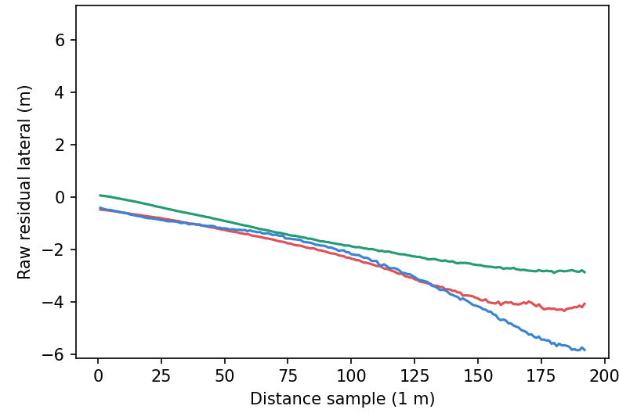
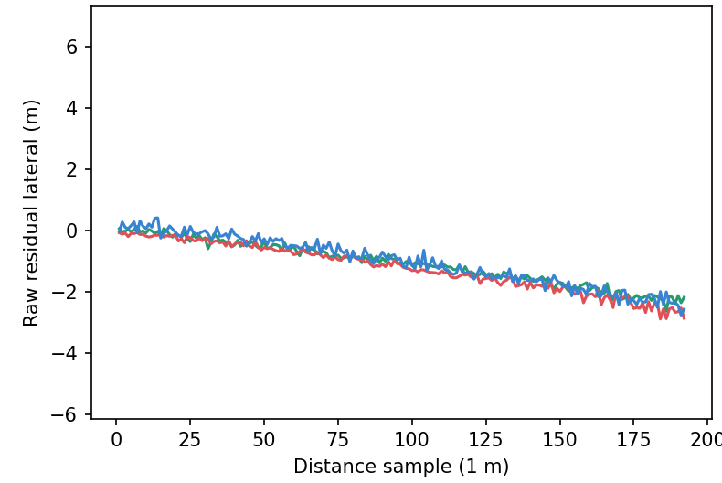
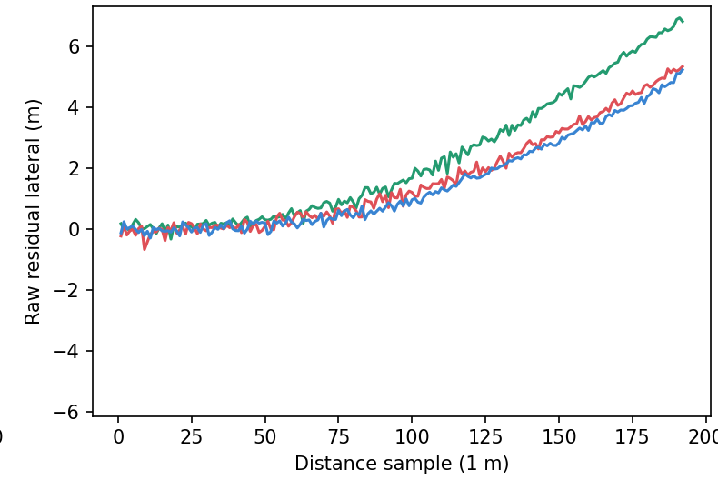
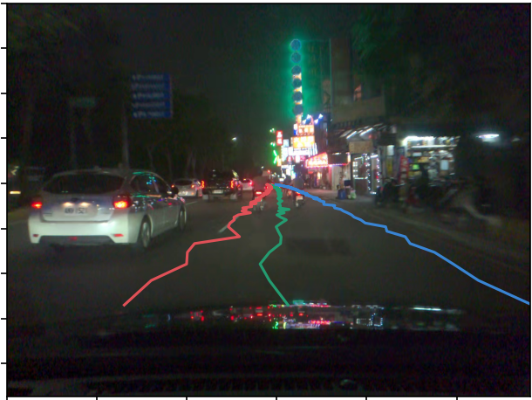
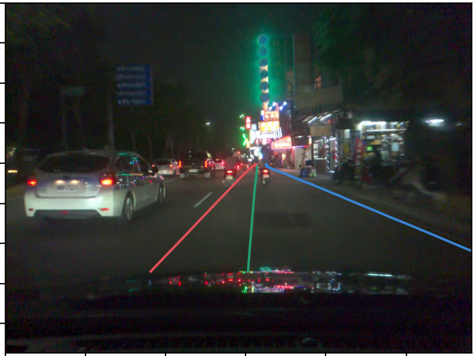

GEOMETRY · SAME-FRAME CONTROL
Student 的原始曲線在投影前已出現鋸齒
TEACHER · supercombo079
B6 BEST
B6 FINAL
各圖 Y 軸沿用原始尺度：此頁比較曲線形狀，不直接比較幅度。橫軸為距離取樣，單位 m。
如何閱讀這組對照？
同一 Taiwan frame 601，共享 teacher 前一時刻 state、traffic=[1,0]。
原始 path／lane 曲線已不平滑；camera overlay 是下游顯示結果。
PROJECT 2
14
Notes:
Actual Figure-A Taiwan frame601. Shared teacher previous state, traffic[1,0], same image/preprocess/parser/calibration/projection. Top row camera overlays; bottom original raw residual curves all192 points, no redraw. Original top-down row remains in source. Raw axes differ by role as original; focus is curve morphology, not comparable vertical scale.
v2 claim: Matched same-frame student raw geometry is jagged before visualization
CONFIRMED
Shared teacher-state/traffic[1,0], not the full-clip free-running counter condition. No driving accuracy inference.
Sources:
/Users/2006wu/Desktop/Project2-B6-Geometry-Investigation/b6-geometry-20261009-01/02-teacher-vs-best-vs-final/Figure-A-taiwan-frame-601.png
/Users/2006wu/Desktop/Project2-B6-Geometry-Investigation/b6-geometry-20261009-01/report/B6-Geometry-Investigation-Report.md

Slide 15
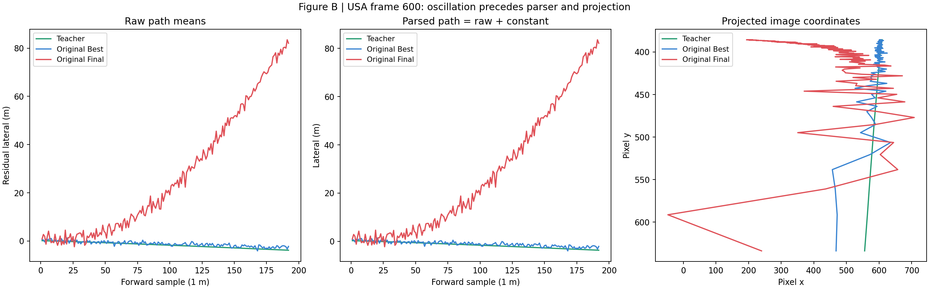
GEOMETRY · RAW → PARSED → PROJECTED
Raw、Parsed、Projected：異常在顯示前就存在
Raw output
Parsed output
Projected pixels
Final 紅線已呈鋸齒與偏移。
加上 parser 偏移後仍保留異常。
投影把異常曲線轉為像素座標。
已測投影與參考最大差異 1.14e−13 px；支持異常在上游，未證明所有 calibration 都正確。
PROJECT 2
15
Notes:
Figure-B USA frame600 contains original own-feedback trajectories. The original raw, parsed and projected plots are embedded without prediction redraw.
v2 claim: Projection maximum difference 1.1368683772161603e-13 px; abnormality upstream of visualization
CONFIRMED
Only tested inputs and settings.
Sources:
/Users/2006wu/Desktop/Project2-B6-Geometry-Investigation/b6-geometry-20261009-01/04-parser-calibration/projection-check.json
/Users/2006wu/Desktop/Project2-B6-Geometry-Investigation/b6-geometry-20261009-01/03-raw-parsed-projected/Figure-B-usa.png

Slide 16
SUPPORTING EVIDENCE · INPUT CONTROL
前處理檢查：真實輸入確實不同
19.0024388631
native pixel MAE · USA quarter vs Taiwan quarter
不同影像輸入
cross-domain matching samples MAE 9.312–19.002 pixel levels
train / inference 一致
3 組 USA decoded pair 與 yuv.h5 完全相同，difference = 0
native YUV scale
train / inference 都未除以 255；訓練首 batch range 35–204
重複 identical input 的輸出 bitwise identical。這些檢查排除已檢查 samples 的近似影像／scale mismatch 解釋，未證明所有 preprocessing 都理想。
PROJECT 2 / E05 E06
16
Notes:
前處理檢查：真實輸入確實不同
Evidence: projects/project2/agent/artifacts/do-new-v2/p27-sensitivity/results.json; projects/project2/modelb6/step7_sensitivity.py; docs/PROJECT2_AUDIT.md §18
projects/project2/agent/artifacts/do-new-v2/p28-encoder-audit/{results,reference_controls}.json; step8_encoder_audit.py; docs/PROJECT2_AUDIT.md §19
Repository HEAD e1a1bc5c75a085e1b39629986b98302f1842fe4b, audit 2026-10-09
重複 identical input 的輸出 bitwise identical。這些檢查排除已檢查 samples 的近似影像／scale mismatch 解釋，未證明所有 preprocessing 都理想。
Quantitative full precision and report provenance: evidence/Project2-Final-Report-evidence-coverage.json
v2 integration: see evidence/Project2-Final-Report-v2-evidence-coverage.json. Corrected state recheck supersedes old interpretation. Teacher previous state is past information. Frozen-Best mixed-state conclusion is limited to tested formulation. Original course/Agent claims remain historical.

Slide 17
SUPPORTING EVIDENCE · IMAGE / STATE
換影像後輸出幾乎不變，換 state 的影響較大
讀圖：MAE 是平均絕對差；這裡越大，表示介入讓輸出改變越多。
縱軸為 log10(MAE)，負值不代表負誤差。−7 約等於 1e−7。
已測 image swap n=5、prior state n=4／cell；固定其他 inputs／weights。
Final USA 的 state 介入 MAE=1.868；Best USA=2.046。結論限於已測 inputs，未建立全域 image independence。
PROJECT 2
17
Notes:
Previous state 的效應明顯較大
Evidence: projects/project2/agent/artifacts/do-new-v2/p27-sensitivity/results.json; projects/project2/modelb6/step7_sensitivity.py; docs/PROJECT2_AUDIT.md §18
Repository HEAD e1a1bc5c75a085e1b39629986b98302f1842fe4b, audit 2026-10-09
Prior state intervention n=4 / cell；Final USA mean full MAE = 1.8681882426295509；Best USA = 2.0459331007376322。
同一 12-pair window：feedback vs reset 的 mean full MAE 為 1.165 final / 3.033 best（排除首筆）。Direct meta / desire_pred / pose 的 state-intervention difference 恰為 0，符合分支架構。
Quantitative full precision and report provenance: evidence/Project2-Final-Report-evidence-coverage.json
Editable chart values (log10 where axis states so): [{"name":"Real cross-domain image swap · n=5","values":[-7.01294592991918,-7.01294592991918,-6.49208767428734,-6.49208767428734],"fill":"#0369A1"},{"name":"Prior-eight-pair state · n=4","values":[0.271420634536657,0.271420736277078,0.310891428762506,0.310891373208704],"fill":"#6D28D9"}]
v2 integration: see evidence/Project2-Final-Report-v2-evidence-coverage.json. Corrected state recheck supersedes old interpretation. Teacher previous state is past information. Frozen-Best mixed-state conclusion is limited to tested formulation. Original course/Agent claims remain historical.

Slide 18
SUPPORTING EVIDENCE · ENCODER
影像差異沿 Encoder 深度整體衰減
讀圖：activation MAE 比較兩張影像在同一層的回應；越低，兩者越接近。
縱軸為 log10(activation MAE)。整體下降，表示可區分影像的差異逐步縮小。
同一 USA-quarter／Taiwan-quarter real swap；不同層的尺度也可能不同。
Final flatten MAE=1.076e−7；平均 activation magnitude≈2.824。這是已測對照，並非所有影像或唯一成因。
PROJECT 2
18
Notes:
Encoder 內部的影像差異逐層衰減
Evidence: projects/project2/agent/artifacts/do-new-v2/p28-encoder-audit/{results,reference_controls}.json; step8_encoder_audit.py; docs/PROJECT2_AUDIT.md §19
Repository HEAD e1a1bc5c75a085e1b39629986b98302f1842fe4b, audit 2026-10-09
同一 USA-quarter / Taiwan-quarter real swap。Chart 為各 endpoint activation MAE 的 log10，原值保留於 chart data / notes。Final flatten MAE = 1.076e-7，mean activation magnitude ≈2.824。
Quantitative full precision and report provenance: evidence/Project2-Final-Report-evidence-coverage.json
Editable chart values (log10 where axis states so): [{"name":"final","values":[0.886826770629735,-2.46278854688493,-3.71055511573455,-5.06631172623293,-6.49087413281208,-7.70410558044111,-7.53987800578645,-6.96808294141619],"line":{"fill":"#6D28D9","width":3}},{"name":"best","values":[0.886321728441356,-2.45949929939064,-3.70589370473297,-5.06938149622843,-6.41533749349368,-7.63344555243375,-7.4977556824263,-6.88905831076222],"line":{"fill":"#0369A1","width":3}},{"name":"Fresh 2801","values":[0.854499107352221,-2.20353938780689,-3.43973410138933,-4.85771873798868,-6.37659730153999,-7.94137871470682,-8.36217462719817,-8.19637822100147],"line":{"fill":"#64748B","width":3}}]
Original activation MAE values before log10 transform (same USA-quarter vs Taiwan-quarter image pair):
{
"final": [
{
"layer": "stem_activation",
"mae": 7.705960359791511
},
{
"layer": "block3c_add",
"mae": 0.003445176317072196
},
{
"layer": "block4d_add",
"mae": 0.00019473538981690746
},
{
"layer": "block5d_add",
"mae": 0.000008583971632939817
},
{
"layer": "block6e_add",
"mae": 3.229429939193114e-7
},
{
"layer": "block7b_add",
"mae": 1.97648908149197e-8
},
{
"layer": "top_activation",
"mae": 2.8848417473041496e-8
},
{
"layer": "flatten",
"mae": 1.0762596502900124e-7
}
],
"best": [
{
"layer": "stem_activation",
"mae": 7.697004286873069
},
{
"layer": "block3c_add",
"mae": 0.0034713683589278808
},
{
"layer": "block4d_add",
"mae": 0.00019683679964931468
},
{
"layer": "block5d_add",
"mae": 0.000008523510564373282
},
{
"layer": "block6e_add",
"mae": 3.842930289885352e-7
},
{
"layer": "block7b_add",
"mae": 2.325704041471578e-8
},
{
"layer": "top_activation",
"mae": 3.178661762087193e-8
},
{
"layer": "flatten",
"mae": 1.291045919060707e-7
}
],
"fresh_reference": [
{
"layer": "stem_activation",
"mae": 7.153179238111761
},
{
"layer": "block3c_add",
"mae": 0.00625836101907636
},
{
"layer": "block4d_add",
"mae": 0.0003633004188905139
},
{
"layer": "block5d_add",
"mae": 0.000013876542240356949
},
{
"layer": "block6e_add",
"mae": 4.20148384954972e-7
},
{
"layer": "block7b_add",
"mae": 1.1445144634099822e-8
},
{
"layer": "top_activation",
"mae": 4.343355453457391e-9
},
{
"layer": "flatten",
"mae": 6.362411859948264e-9
}
]
}
v2 integration: see evidence/Project2-Final-Report-v2-evidence-coverage.json. Corrected state recheck supersedes old interpretation. Teacher previous state is past information. Frozen-Best mixed-state conclusion is limited to tested formulation. Original course/Agent claims remain historical.

Slide 19
SUPPORTING EVIDENCE · SUPERVISED GRADIENT
局部 loss gradient：影像方向極弱，state 較大
讀圖：gradient RMS 表示此處 loss 對輸入微小變動的局部敏感度。
縱軸為 log10(RMS)，低柱表示梯度更小；RMS 有助比較不同大小的 tensors。
18 samples 的 original-condition median；原 custom loss 與 targets 保留。
Final image/state RMS=9.775e−15／0.1907；Best=2.580e−15／0.2903。Tiny nonzero 並非 numerical zero；局部梯度不等於全域因果。
PROJECT 2
19
Notes:
Image input 的局部 loss gradient 極小
Evidence: projects/project2/agent/artifacts/do-new-v2/p29-gradient-audit/{summary,interpretation}.json; step9_gradient_audit.py; docs/PROJECT2_AUDIT.md §20
Repository HEAD e1a1bc5c75a085e1b39629986b98302f1842fe4b, audit 2026-10-09
18 samples、original condition 的 median。Final image RMS = 9.774764271e-15；state RMS = 0.1906711418。
Best image RMS = 2.579593744e-15；state RMS = 0.2902863671。RMS 用於不同 tensor size 的比較；tiny nonzero gradient 不是 numerical zero。局部 derivative 並非全域 causal attribution。
Quantitative full precision and report provenance: evidence/Project2-Final-Report-evidence-coverage.json
Editable chart values (log10 where axis states so): [{"name":"Median gradient RMS","values":[-14.0098937072767,-0.719715032842279,-14.5884486849326,-0.537173359660331],"fill":"#6D28D9"}]
v2 integration: see evidence/Project2-Final-Report-v2-evidence-coverage.json. Corrected state recheck supersedes old interpretation. Teacher previous state is past information. Frozen-Best mixed-state conclusion is limited to tested formulation. Original course/Agent claims remain historical.

Slide 20
SUPPORTING EVIDENCE · FRESH CONTROLS
Fresh controls：訓練前就有嚴重梯度衰減
讀圖：log10(top RMS／stem RMS) 越大，反向傳至 stem 的衰減越嚴重。
三個 fresh seeds、54 records、0 optimizer steps，同一 18 cached samples。
三組約 9.30–9.40 orders；計算使用 ratios of medians，不是平均逐筆比值。
支持衰減在訓練前已存在；fresh controls 不是歷史初始權重，也未單獨隔離 initializer 為唯一原因。
PROJECT 2
20
Notes:
Fresh controls：衰減在訓練前已存在
Evidence: projects/project2/agent/artifacts/do-new-v2/p210-gradient-controls/summary.json; step10_gradient_controls.py; docs/PROJECT2_AUDIT.md §§21,23
Repository HEAD e1a1bc5c75a085e1b39629986b98302f1842fe4b, audit 2026-10-09
同一 18 cached samples、原 loss / targets / native inputs / teacher state。Top / stem gradient RMS 的 ratios of medians 轉為 log10 orders。
Fresh seeds 3101 / 3102 / 3103 分別 9.4032603088 / 9.3036137983 / 9.3215033007 orders；不等同 historical P2.5 initialization，也未單獨隔離 initializer。
Quantitative full precision and report provenance: evidence/Project2-Final-Report-evidence-coverage.json
Editable chart values (log10 where axis states so): [{"name":"Top / stem orders","values":[9.40326030880665,9.30361379827038,9.32150330067632],"fill":"#6D28D9"}]
v2 integration: see evidence/Project2-Final-Report-v2-evidence-coverage.json. Corrected state recheck supersedes old interpretation. Teacher previous state is past information. Frozen-Best mixed-state conclusion is limited to tested formulation. Original course/Agent claims remain historical.

Slide 21
STATE · DISTRIBUTION MISMATCH
訓練與自由運行使用不同的 state 來源
TRAINING
Teacher s[t−1]
Student + image pair
FREE RUNNING
Student s[t−1]
Student + image pair
回饋自己的 512-value next state
Teacher s[t−1] 是過去資訊，並非 future leakage。來源分布差異可能影響循環軌跡（LIKELY / SUGGESTED）；是否為唯一可訓練根因仍 NOT VERIFIED。
PROJECT 2 / S01 M01
21
Notes:
512-state output slice [1871:2383]. Actual current teacher target has state supervised inside .1 MSE all2383; no BPTT. This diagram expresses actual data flow, not a proven unique cause.
v2 claim: Training uses teacher previous state; free running uses own previous state
CONFIRMED
Sources:
/Users/2006wu/Desktop/Project2-B6-State-Divergence-Investigation/b6-state-divergence-20261009-01/report/B6-State-Divergence-Investigation-Report.md
/Users/2006wu/Desktop/Project2-B6-Mixed-State-Training/b6-mixed-state-20261009-01/report/B6-Mixed-State-Training-Investigation-Report.md

Slide 22
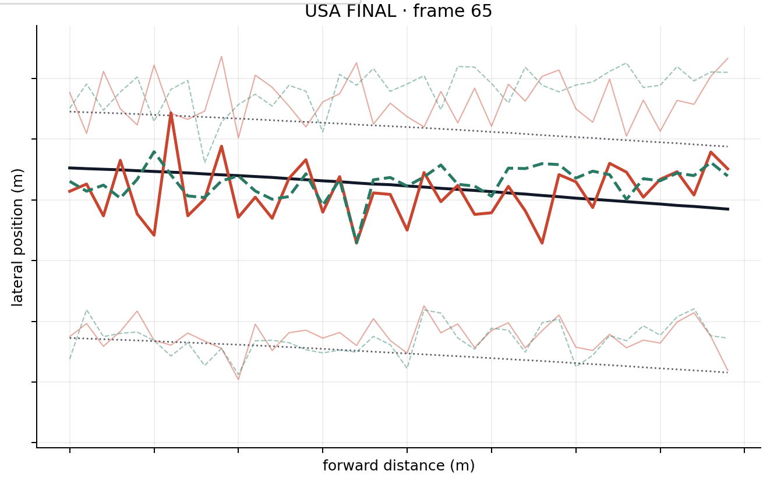
STATE · CONTROLLED FULL-SEQUENCE EVIDENCE
State policy 明顯改變整段幾何行為
USA Final · frame 65
整段 width ≤0 frames
USA · 1199 frames
1006
0
Taiwan · 1201 frames
943
0
free-running
teacher-state
Teacher 黑 / free-run 紅 / teacher-state 綠虛線
CONFIRMED：state policy 的影響很大，但 teacher injection 並非通用解法。兩段影片、固定 traffic=[0,0]；零失敗計數不代表平滑、準確或可安全駕駛。
PROJECT 2 / S02
22
Notes:
Same-frame evidence is USA Final frame65. The colored curves come from original source figure, teacher black, student free red, teacher-state dashed green. The full-sequence metrics are independently shown on right. Traffic[0,0], desire0. Width counter uses fixed first40. Teacher forcing starts atzero and uses teacher previousstate thereafter.
v2 claim: Original Final width failures USA1006/1199 Taiwan943/1201; teacher-forced zero both
CONFIRMED
Full-sequence first40 counters; exact long-run counts can be numerically sensitive.
Sources:
/Users/2006wu/Desktop/Project2-B6-State-Divergence-Investigation/b6-state-divergence-20261009-01/04-state-vs-geometry/usa-final-rollout-summary.json
/Users/2006wu/Desktop/Project2-B6-State-Divergence-Investigation/b6-state-divergence-20261009-01/04-state-vs-geometry/taiwan-final-rollout-summary.json
/Users/2006wu/Desktop/Project2-B6-State-Divergence-Investigation/b6-state-divergence-20261009-01/recheck-20261009/Recheck-Report.md

Slide 23
STATE · CORRECTED COUNTEREXAMPLE
單次 teacher-state 注入取決於時機
Taiwan Final · 整段非正 lane width frames
943
1006
+63 frames
無注入
frame 1 注入後
Frame 135 注入：改善僅維持一段時間
135
注入
接下來 100 frames
width / path-out = 0
282
path-out 再現
352
width ≤0 再現
CONFIRMED：單一「正確」state 無法保證穩定恢復。上列 timeline 為 Taiwan；USA 的 path-out / width 再現分別在 245 / 313。
PROJECT 2 / S03
23
Notes:
Taiwan Final single injectionframe1 width count943→1006 (+63). For injectionframe135 next100frame width/pathout bothzero, but Taiwan pathout returns282,width352. USA analogous returns245/313. Full sequences and batch-size caveats in recheck. This is temporal dependence, not a scalarRMS-only explanation.
v2 claim: Taiwan injection adverse943→1006; frame135 temporary, pathout282 width352
CONFIRMED
Every tested single-injection branch eventually fails again. Teacher previousstate is causal past information.
Sources:
/Users/2006wu/Desktop/Project2-B6-State-Divergence-Investigation/b6-state-divergence-20261009-01/recheck-20261009/all-injection-outcomes.json
/Users/2006wu/Desktop/Project2-B6-State-Divergence-Investigation/b6-state-divergence-20261009-01/recheck-20261009/Recheck-Report.md

Slide 24
CONTROLLED FIX 1 · DO NOT PROMOTE
Depthwise 候選：哪些門檻通過、哪些未通過
匹配 8 epochs ×20 steps ×batch 2；只改 depthwise 初始化，固定 120 筆 validation。
升級必要條件／指標 | Default → Variant | 結果
Total loss 更低 | 12.2589 →12.2391 | 通過（−0.16%）
Path／lane MSE 更低 | 23.9895／23.4174 →23.9954／23.4308 | 未通過
空間二階差分更低（較平滑） | 0.4223 →0.4909 | 未通過
車道交錯計數不退化 | 已測片段：0 →0 | 通過
Image-swap path 回應增加 | 1.47e−7 →4.06e−8 | 未通過
必要條件須全部滿足；僅降低 total loss 不足以升級至 60 epochs。
CONFIRMED｜兩個短訓練都已完成；候選沒有建立有效幾何修復，未執行長訓練。
PROJECT 2
24
Notes:
Independent matched initialization experiment, not mixed-state E0. Same freshseed4201 architecture/data/optimizer/loss. Variant only depthwise scaling. Both bestepoch7 of8, fixed120 validation. Raw values stored in decisionJSON.
v2 claim: Depthwise matched8epoch negative result, loss −0.1609%, no60epochpromotion
CONFIRMED
Sources:
/Users/2006wu/Desktop/Project2-B6-Geometry-Investigation/b6-geometry-20261009-01/09-controlled-fixes/short-training-decision.json

Slide 25
CONTROLLED FIX 2 · FROZEN-BEST DESIGN
Mixed-state：只改前一時刻 state 的來源
Teacher s[t−1]
逐列選擇來源
相同 Student
q = 0 /25 /50%
不混平均向量
teacher target
保持不變
Frozen Best s[t−1]
各 recording 從起點循環產生 cache
E0 0% E1 25% E2 50%
8 epochs ×20 steps ×batch 2；相同初始化、資料、Adam 與 loss
Teacher 為過去 state。只測 frozen original-Best 分布，未使用 evolving candidate cache、BPTT 或 adaptive scheduled sampling。USA --37 為 train-seen，Taiwan 為 OOD。
PROJECT 2 / M01
25
Notes:
Bernoulli row-level selection, not averaging teacher/student vectors. Frozen originalBest cached separately per recording, causally aligned previousrow; original teacher currenttargets unchanged. NoBPTT. Actual selected82/320 and162/320. Same rowplan two20rowwindowsperepoch; not historical60epochtrajectory.
v2 claim: E0q0 E1q.25 E2q.5 same8x20x2 seed4201 Adam loss data; frozenBest previousstate cache
CONFIRMED
Sources:
/Users/2006wu/Desktop/Project2-B6-Mixed-State-Training/b6-mixed-state-20261009-01/02-design/mixed-state-design.md
/Users/2006wu/Desktop/Project2-B6-Mixed-State-Training/b6-mixed-state-20261009-01/report/B6-Mixed-State-Training-Investigation-Report.md

Slide 26
CONTROLLED FIX 2 · MATCHED E0 / E1 / E2
Mixed-state 候選未通過預先定義的升級門檻
完整序列／固定評估 | E0 · 0% | E1 · 25% | E2 · 50%
Fixed val loss | 14.4614 | 16.3557 | 17.5898
USA path-out／1199 | 0 | 14 | 412
Taiwan path-out／1201 | 2 | 164 | 731
USA free-run state RMS | 8.237 | 16.280 | 13.075
Taiwan free-run state RMS | 8.259 | 16.286 | 13.066
原訂必要門檻：兩個 domain 都須符合，才可升級長訓練。
幾何：失敗不增加；每域一項非零計數降 ≥20%。
State：RMS 降 ≥10%；temporal change 不增 >10%。
模仿：path／lane 誤差不增 >10%；不只看 total loss。
影像：有效回應不降 >20%；finite／reload／重複驗證須過。
零基準限制：E0 USA 的兩項失敗計數皆為 0，無法達成「非零計數降 ≥20%」。
PLANNED｜零計數先檢查不退化；改善須另設指標，不能事後宣稱已通過原門檻。
E1／E2 的 path-out 與 state RMS 仍退化，因此本次 DO NOT PROMOTE。
Path-out 是預測曲線超出預測 lanes，並非實車偏離；結論限於本次設計。
PROJECT 2
26
Notes:
Full precision source values in09-free-running-evaluation summaries and08-fixed-validation; table uses roundeddisplay. StateRMS=current512studentstate vs teachercurrentstate. Pathout counts first40, outputgeometry not vehicledeparture. Allwidthcounts0. E0 already has almostnofailures so not attribute old-vs-new gains to mixing.
v2 claim: E0E1E2 fixedloss14.4614/16.3557/17.5898 USApathout0/14/412 Taiwan2/164/731 RMS8.237/16.280/13.075 and8.259/16.286/13.066
CONFIRMED
Sources:
/Users/2006wu/Desktop/Project2-B6-Mixed-State-Training/b6-mixed-state-20261009-01/09-free-running-evaluation/E0-summary.json
/Users/2006wu/Desktop/Project2-B6-Mixed-State-Training/b6-mixed-state-20261009-01/09-free-running-evaluation/E1-summary.json
/Users/2006wu/Desktop/Project2-B6-Mixed-State-Training/b6-mixed-state-20261009-01/09-free-running-evaluation/E2-summary.json
/Users/2006wu/Desktop/Project2-B6-Mixed-State-Training/b6-mixed-state-20261009-01/report/B6-Mixed-State-Training-Investigation-Report.md
/Users/2006wu/Desktop/Project2-B6-Mixed-State-Training/b6-mixed-state-20261009-01/12-promotion-decision/decision.json

Slide 27
CONTROLLED FIX 2 · POINTWISE VS TRAJECTORY
單點誤差改善，不代表循環軌跡更穩定
E2 USA，相對 E0：同一組評估，同時觀察兩種不同指標。
−12.8%
約 22×
Path MAE 改善
每 frame path 變化增大
0.4702 →0.4102 m
0.01330 →0.29306 m
每次預測與 teacher 的距離較近。
相鄰預測變動更大，循環穩定性較差。
決策：仍須同時通過幾何、state、temporal 與模仿門檻；此候選不升級。
E2 Taiwan path MAE 未改善；結論只適用本次 frozen-Best formulation，未排除未測的其他方法。
PROJECT 2
27
Notes:
USA E2 vsE0: pathMAE.4701591228→.4102017058m =−12.753%, temporalchange.01329675265→.29306456957m/pair =22.0403×. PointwiseMAE teacher-validcapped40; temporalfirst40. TaiwanMAE.47804583→.49290171worse, E1temporal improvesbutstate/geometry/aggregateimitationgatesfail. Scope limited frozenBestformulation.
v2 claim: E2USApathMAEimproves12.8% temporalpathchange~22x whilefreegeometryregresses
CONFIRMED
Only tested frozen-Best formulation; not allmixedstateorsequenceawaretraining.
Sources:
/Users/2006wu/Desktop/Project2-B6-Mixed-State-Training/b6-mixed-state-20261009-01/09-free-running-evaluation/E0-summary.json
/Users/2006wu/Desktop/Project2-B6-Mixed-State-Training/b6-mixed-state-20261009-01/09-free-running-evaluation/E1-summary.json
/Users/2006wu/Desktop/Project2-B6-Mixed-State-Training/b6-mixed-state-20261009-01/09-free-running-evaluation/E2-summary.json
/Users/2006wu/Desktop/Project2-B6-Mixed-State-Training/b6-mixed-state-20261009-01/12-promotion-decision/conclusion.json

Slide 28
MODEL B6 · EVIDENCE-BOUNDED CONCLUSION
根因範圍已縮小，有效修復仍待建立
CONFIRMED
01
幾何異常出現在 raw output，早於 parser / projection
02
影像介入回應極弱，state policy 明顯改變循環幾何
03
固定評估 Final 較 Best 差，未確認單一退化成因
04
兩個修復假設經短訓練檢驗，皆未通過升級門檻
LIKELY / SUGGESTED
循環不穩定與微弱 visual correction 可能共同影響恢復
VALIDATION BOUNDARY
唯一可訓練根因、有效修復、駕駛品質：NOT VERIFIED
PROJECT 2 / G01–04 S01–03 M01–03
28
Notes:
CONFIRMED findings apply to tested models/sequences/conditions. LIKELY/SUGGESTED weakvisualcorrection plus recurrentfeedback maycontribute; exacttrainablerootcause and universalexposurebias notverified. Two repairhypotheses refersdepthwise andfrozenBestmixedstatefamily (E1/E2), not exactlytwoindividualruns.
v2 claim: Geometry/state mechanism narrowed; two testedrepairhypothesesrejected
CONFIRMED
Sources:
/Users/2006wu/Desktop/Project2-B6-Geometry-Investigation/b6-geometry-20261009-01/report/B6-Geometry-Investigation-Report.md
/Users/2006wu/Desktop/Project2-B6-State-Divergence-Investigation/b6-state-divergence-20261009-01/recheck-20261009/Recheck-Report.md
/Users/2006wu/Desktop/Project2-B6-Mixed-State-Training/b6-mixed-state-20261009-01/12-promotion-decision/conclusion.json
v2 claim: Recurrentinstability andweakvisualcorrection possible mechanism
LIKELY / SUGGESTED
Unique trainable rootcause, universalexposurebias, effective repair, drivingquality, safety andautonomousperformance NOT VERIFIED.
Sources:
/Users/2006wu/Desktop/Project2-B6-State-Divergence-Investigation/b6-state-divergence-20261009-01/report/B6-State-Divergence-Investigation-Report.md

Slide 29
PART B · AI AGENT
Agent 基線在獨立 Python 環境執行
Runtime
Python 3.11.4 / Agno 3.1.1 / Google GenAI 2.28.0
Reference
6 constructors；只有 reasoning travel prompt 為 active request
Observed live
2026-10-08：think / analyze calls、完整 structured answer、返回 shell
CONFIRMED：audit 記錄完整 user-submitted baseline receipt。旅行細節只是示範回答，未驗證或預訂。Student default model ID 為 gemini-3.8-flash，可由 GEMINI_MODEL_ID 覆寫；此為目前 source 設定。
PROJECT 2 / E09 E10
29
Notes:
Agent 基線在獨立 Python 環境執行
Evidence: docs/PROJECT2_AUDIT.md §§27,32; projects/project2/agent/FRAMEWORK_REVIEW.md; professor_baseline.py; evidence_agent.py
docs/PROJECT2_AUDIT.md §§29–32; projects/project2/agent/{vision_agent,diagnosis_agent,v2_evidence,v2_tests,prepare_v2}.py; DO_NEW_V2.md
Repository HEAD e1a1bc5c75a085e1b39629986b98302f1842fe4b, audit 2026-10-09
CONFIRMED：audit 記錄完整 user-submitted baseline receipt。旅行細節只是示範回答，未驗證或預訂。Student default model ID 為 gemini-3.8-flash，可由 GEMINI_MODEL_ID 覆寫；此為目前 source 設定。
Quantitative full precision and report provenance: evidence/Project2-Final-Report-evidence-coverage.json

Slide 30
ENGINEERING IMPROVEMENT
以 adapter 處理 Agno API 相容性
Professor reference
Student adapter
agent_id / add_datetime_to_instructions
舊 YFinance keyword / show_tool_calls
id / add_datetime_to_context
enable_* finance keywords / 移除 display flag
AST 讀取 constructor 與 active prompt，避免 import 時執行 top-level API calls。
確認 6 Agent constructors、1 active request；不直接改寫教授檔案。Baseline offline tests 檢查實際 construction / registered tools。相容 adapter 不改變 Agent architecture level。
PROJECT 2 / E09 E12
30
Notes:
以 adapter 處理 Agno API 相容性
Evidence: docs/PROJECT2_AUDIT.md §§27,32; projects/project2/agent/FRAMEWORK_REVIEW.md; professor_baseline.py; evidence_agent.py
projects/project2/agent/professor_baseline.py; baseline_tests.py; git e1a1bc5 diff
Repository HEAD e1a1bc5c75a085e1b39629986b98302f1842fe4b, audit 2026-10-09
確認 6 Agent constructors、1 active request；不直接改寫教授檔案。Baseline offline tests 檢查實際 construction / registered tools。相容 adapter 不改變 Agent architecture level。
Quantitative full precision and report provenance: evidence/Project2-Final-Report-evidence-coverage.json

Slide 31
COURSE REQUIREMENT
5-Level review 與實作的架構定位
1
Tools + instructions
Level 1
2
Knowledge + session memory
3
Long-term memory + reasoning
主要架構定位
reasoning / evidence tools
4
Multi-agent teams
5
Persistent agentic workflows
LIKELY / SUGGESTED：依 assigned framework 與實際配置分析。ReasoningTools 本身不建立 Level 3；多個 examples 不構成 Team。沒有 persistent memory、retrieval index、delegation 或 background job architecture。
PROJECT 2 / E09
31
Notes:
5-Level review 與實作的架構定位
Evidence: docs/PROJECT2_AUDIT.md §§27,32; projects/project2/agent/FRAMEWORK_REVIEW.md; professor_baseline.py; evidence_agent.py
Repository HEAD e1a1bc5c75a085e1b39629986b98302f1842fe4b, audit 2026-10-09
LIKELY / SUGGESTED：依 assigned framework 與實際配置分析。ReasoningTools 本身不建立 Level 3；多個 examples 不構成 Team。沒有 persistent memory、retrieval index、delegation 或 background job architecture。
Quantitative full precision and report provenance: evidence/Project2-Final-Report-evidence-coverage.json

Slide 32
ORIGINAL EXTENSION · HISTORICAL LIVE EVIDENCE
原始 Do New：真實工具數值與已驗收回答
實際任務：比較 final／best gradients，並區分技術完成與駕駛品質。
summarize_p2_evidence() →144 records／18 samples →Gemini 完整回答
評估 C｜USA train／validation／Taiwan 各 6 筆；原始 teacher-state 條件，custom loss。
下表 loss 為 18 筆中位數，用於梯度診斷；非第 10 頁 epoch 平均或第 11 頁固定 120 筆平均。
回答中核對的數值（overall median） | Final | Best
Diagnostic loss · median 18 | 30.7705 | 29.9163
Image gradient RMS | 9.7748e−15 | 2.5796e−15
State gradient RMS | 0.1907 | 0.2903
Image／state ratio | 6.7352e−14 | 2.2175e−14
已驗收回覆重點（依 audit §27 摘要，非逐字重製）
回答使用上述八個匹配數值，並指出駕駛品質尚未驗證。
人工審核也修正其「near machine precision zero」措辭：極小非零梯度不等於零。
PROJECT 2
32
Notes:
原始 Do New：用 experiment facts 支持回答
Evidence: docs/PROJECT2_AUDIT.md §§27,32; projects/project2/agent/FRAMEWORK_REVIEW.md; professor_baseline.py; evidence_agent.py
Repository HEAD e1a1bc5c75a085e1b39629986b98302f1842fe4b, audit 2026-10-09
CONFIRMED：audit §27 記錄 user receipt 驗收；來源數據仍可檢查。Live integration 成功不保證每句科學解釋正確，當時的機制解釋限制保留。
Quantitative full precision and report provenance: evidence/Project2-Final-Report-evidence-coverage.json
Presentation content review: Actual prompt fromgit e1a1bc5 evidence_agent.py main. Table eight values fromdocs/PROJECT2_AUDIT.md§27 matched live submitted receipt SHA256bf8b431759149d4e6003ed437438e6e6700e6596c2b01036d67723af53255c7e. Diagnosticlossmedians notStep5epochloss. Only reported phrase near machine precision zero is quoted; other answer content explicitly audit summary, not fabricated transcript. v1source/tests/exportscript removed during cleanup, retrievable inGit e1a1bc5; current workingdirectory has v2, notfreshv1acceptance.
C is original-condition median across18 individual samples:6 USA train(--37),6 USA validation(--32),6 Taiwan diagnostic extension. Desirezeros,traffic[1,0], previous teacher state; original custom loss, no optimizer updates. 144 trials include4 conditions x2 checkpoints x18samples, but displayed loss is original-condition only, not the median over all144. Taiwan targets are diagnostic teacher targets, not historical training or human ground truth. Sources: PROJECT2_AUDIT.md section20 and27. A/B/C protocol distinction added; existing accepted-answer summary remains nonverbatim.

Slide 33
ORIGINAL EXTENSION · BEFORE / AFTER
教授 baseline 與我的 Do New 新增能力
比較面向 | 教授 baseline | 我的 Evidence／Vision 延伸
輸入與任務 | 目前啟用：旅行規劃問題 | ModelB6 實驗結果與驗證影像
工具與證據 | ReasoningTools；未接本地實驗 | 證據讀取、來源／hash／完成狀態驗證
結果呈現 | 文字／表格規劃回答 | 匹配數值＋定性影像報告與限制
驗收範圍 | 完整 baseline 回答已記錄 | Evidence v1、Vision 單張 live 已驗收
額外 v2 的三種模式
Diagnosis
Vision
Unified
八個數值工具；live 待驗收
實際 PNG bytes；單張已驗收
圖片＋數值工具；live 待驗收
PROJECT 2
33
Notes:
Do New v2：數值、影像與整合三種模式
Evidence: docs/PROJECT2_AUDIT.md §§29–32; projects/project2/agent/{vision_agent,diagnosis_agent,v2_evidence,v2_tests,prepare_v2}.py; DO_NEW_V2.md
Repository HEAD e1a1bc5c75a085e1b39629986b98302f1842fe4b, audit 2026-10-09
Diagnosis：讀取多實驗數值；Vision：實際 approved PNG bytes + structured report；Unified：兩者共同解釋。
沒有多 Agent delegation，也沒有新增 training / inference experiments。Canonical export 是既有 production evidence 的唯讀副本。
Quantitative full precision and report provenance: evidence/Project2-Final-Report-evidence-coverage.json
Presentation content review: Baseline currentactive agno2 travel/ReasoningTools. Professor reference includes other separate inactive examples (search/image/etc), so this table compares active baseline and our course-specific evidence integration; does notclaim professor source hasno image example. All extensions singleagent tools/instructions Level1 architecture, notTeam orpersistentmemory. v2onlyread-onlyexisting evidence, no newinference/training. Original current sourceandhistoricalacceptance status separated.

Slide 34
DO NEW V2 · IMPLEMENTATION
八個工具與可追溯 evidence export
get_training_evidence
Step 5 histories / final-best
get_verification_evidence
Step 6 four-cell matrix
get_sensitivity_evidence
P2.7 interventions
get_encoder_evidence
P2.8 layer trace + controls
get_gradient_evidence
P2.9 supervised loss
get_fresh_gradient_evidence
P2.10 fresh seeds
compare_domains
paired domain / checkpoint facts
check_diagnostic_claim
bounded claim catalogue
26 canonical files：10 evidence JSON、4 cell manifests、12 PNGs。本次全部 byte count / SHA-256 匹配 export manifest。路徑 allowlist、拒絕 symlink／escape、完成狀態與 finite 檢查限制工具輸入。
PROJECT 2 / E10 E11
34
Notes:
八個工具與可追溯 evidence export
Evidence: docs/PROJECT2_AUDIT.md §§29–32; projects/project2/agent/{vision_agent,diagnosis_agent,v2_evidence,v2_tests,prepare_v2}.py; DO_NEW_V2.md
build/audit-data.json; private read-only Docker inspection receipt
Repository HEAD e1a1bc5c75a085e1b39629986b98302f1842fe4b, audit 2026-10-09
26 canonical files：10 evidence JSON、4 cell manifests、12 PNGs。本次全部 byte count / SHA-256 匹配 export manifest。路徑 allowlist、拒絕 symlink／escape、完成狀態與 finite 檢查限制工具輸入。
Quantitative full precision and report provenance: evidence/Project2-Final-Report-evidence-coverage.json

Slide 35
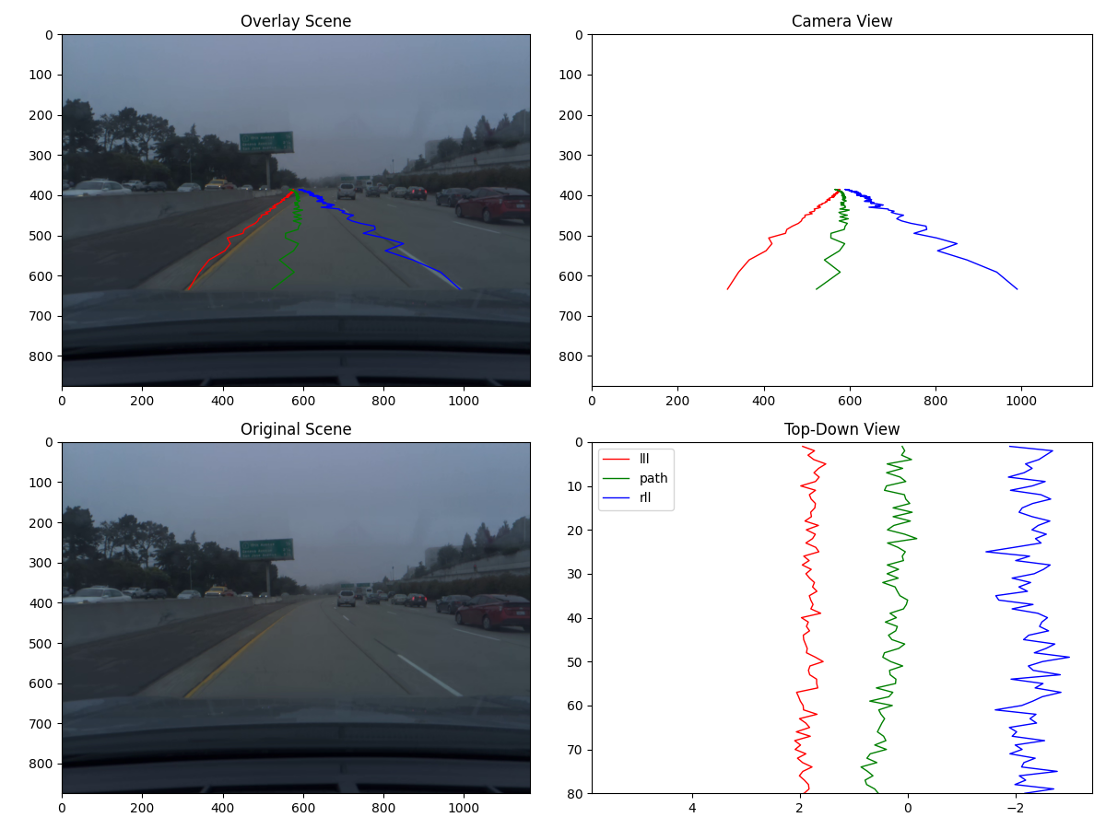
DO NEW V2 · SINGLE-IMAGE LIVE EVIDENCE
Vision live：從實際圖片得到哪些觀察
已驗收回覆重點
依 audit §30 整理；非原始逐字輸出。
場景
陰天、多車道公路；可見車流與左側邊界。
Path／lanes
綠 path、紅／藍 lanes 呈空間鋸齒，與圖中相符。
Lead
沒有可辨識的 lead-specific overlay，回答為 unknown。
限制
單張支持空間觀察；時間不穩定、accuracy／safety 未驗證。
USA／final／frame 1；實際 PNG bytes、image hash 與完整 structured report 已核對。
PROJECT 2
35
Notes:
Vision live：實際影像與定性報告
Evidence: docs/PROJECT2_AUDIT.md §§29–32; projects/project2/agent/{vision_agent,diagnosis_agent,v2_evidence,v2_tests,prepare_v2}.py; DO_NEW_V2.md
Repository HEAD e1a1bc5c75a085e1b39629986b98302f1842fe4b, audit 2026-10-09
CONFIRMED：user receipt 經原 image / hash / report 核對，audit §30。Single still image 只支持空間觀察；無法證明 temporal zigzag、quantitative accuracy 或 safety。Offline mode report=null，gemini_executed=false。
Quantitative full precision and report provenance: evidence/Project2-Final-Report-evidence-coverage.json
Presentation content review: Actual unchanged canonicalUSAfinalframe1, SHA2568c54890341c34a1a7dee89ef4b402513a2c8d922de778d62c63b9e613686e7f7. Audit§30 live receipt complete/imagegroundedreport. Four visible observations are faithful paraphrase from inspected audit; no transcript or providerreasoning invented. No newAPIcall. Thisoneimage doesnotconfirm temporalinstability, quantitativegroundtruth orcausality. offline report=null remains noGemini observation.

Slide 36
CURRENT VALIDATION STATUS
Diagnosis / Unified：provider 限制與驗收進展
Diagnosis
八種證據工具已實際呼叫。
完整答案前遇到 429。
IMPLEMENTED / OFFLINE VERIFIED
LIVE VERIFICATION PENDING
Unified · Taiwan / best
Taiwan / best PNG bytes 已送出。
Gemini 回傳 503，尚無回答。
IMPLEMENTED / OFFLINE VERIFIED
LIVE VERIFICATION PENDING
2026-10-13：Diagnosis 429 為每分鐘 input-token 額度；Unified 503 為高需求。
目前停止重試，保留 live PENDING；外部阻擋不代表功能已通過或失敗。
PROJECT 2 / E10 L01 L02
36
Notes:
Diagnosis / Unified 的 live 驗收仍待完成
Evidence: docs/PROJECT2_AUDIT.md §§29–32; projects/project2/agent/{vision_agent,diagnosis_agent,v2_evidence,v2_tests,prepare_v2}.py; DO_NEW_V2.md
Repository HEAD e1a1bc5c75a085e1b39629986b98302f1842fe4b, audit 2026-10-09
NOT VERIFIED：尚無完成的 live report。Quota exhaustion 是外部阻擋紀錄，未證明功能失敗。先前 503 也保留在歷史。
PLANNED：配額恢復後重試，依 completed response 與人工 evidence review 驗收；更新本頁 status 區即可。
Quantitative full precision and report provenance: evidence/Project2-Final-Report-evidence-coverage.json
2026-10-13 live evidence agent-live-20261012-01: Diagnosis actual eight tools and matching canonical payloads, fifth provider call429 per-minute input-token limit250000, no final answer. Unified canonical Taiwan/best/frame1 actual inline PNG784912bytes,1200x900,SHA2562a46e36a96b78ed0ff6edd9e9f256240cca06fd1f0b405ecc95d4122bf849a5d; firstcall503, no tools/answer. BothPENDING; userdeferredretry. Sources: Project2-Agent-Live-Verification/agent-live-20261012-01/report/acceptance.json and mode attempt01/provider-calls.json.

Slide 37
VERIFICATION MATRIX · HISTORICAL / CURRENT
歷史 live 成果與目前可執行版本分開驗證
項目 | 已驗證成果／限制 | 目前工作目錄
Model B6 | 技術流程完成；driving quality 未驗證 | 原模型與調查證據保留
Baseline Agent | 完整 live 回答：audit receipt | baseline／adapter 保留
Evidence v1 | 歷史 live 通過；八個數值匹配 | 已清理；Git e1a1bc5 可追溯
v2 Vision | USA／final 單張 live 通過 | Vision runner 保留
v2 Diagnosis／Unified | live PENDING；完整答案未完成 | 已實作／離線驗證；目前擱置
目前保留的 Agent 離線測試：44／44 通過
歷史 suite：55／55（20 existing＋35 v2），紀錄 2026-10-06。
v1 專用測試已移除；測試數不同反映範圍變更，不能當成功能退化。
PROJECT 2
37
Notes:
Offline、live 與 driving quality 分層
Evidence: projects/project2/agent/artifacts/do-new-v2/step6/report.json; {usa,taiwan}/{final,best}/manifest.json; production frame PNGs; projects/project2/modelb6/step6.py
docs/PROJECT2_AUDIT.md §§27,32; projects/project2/agent/FRAMEWORK_REVIEW.md; professor_baseline.py; evidence_agent.py
docs/PROJECT2_AUDIT.md §§29–32; projects/project2/agent/{vision_agent,diagnosis_agent,v2_evidence,v2_tests,prepare_v2}.py; DO_NEW_V2.md
Repository HEAD e1a1bc5c75a085e1b39629986b98302f1842fe4b, audit 2026-10-09
Agent 歷史 offline suite：55/55（20 existing +35 v2），最新紀錄 2026-10-06。Offline checks、live acceptance 與駕駛品質各自驗證，不能互相取代。
Quantitative full precision and report provenance: evidence/Project2-Final-Report-evidence-coverage.json
v2 integration: see evidence/Project2-Final-Report-v2-evidence-coverage.json. Corrected state recheck supersedes old interpretation. Teacher previous state is past information. Frozen-Best mixed-state conclusion is limited to tested formulation. Original course/Agent claims remain historical.
Presentation content review: Current unittestdiscovery current-agent-tests.log:44 tests PASS withoutAPIcalls. Historical55 count includes nowremovedv1only11tests. Current44=6baseline+3modelselection+35v2. All currentsourcefileslisted inAgentREADME; removed evidence_agent.py/do_new_tests.py/prepare_demo.py stayinGite1a1bc5. All existingvisible datespreserved, including2026-10-06; coverand36 untouched. No newliveacceptance.

Slide 38
PROJECT 2 · GRADING SUMMARY
Project 2 的成果與三項具體發現
課程成果｜60 epochs、四組技術驗證、Agno baseline 與 framework review；
Do New：Evidence v1 歷史 live、Vision 單張 live 已驗收。
01
CHECKPOINT COMPARISON
固定 120 筆評估：Best loss 12.2088，Final 79.1267。
增加訓練 epochs 沒有保證更好；此比較未確認 overfitting。
02
IMAGE / STATE INVESTIGATION
已測 raw 曲線在投影前已有異常；換影像回應極弱，state policy 影響明顯。
支持縮小調查範圍；仍未建立唯一成因或全域 image independence。
03
CONTROLLED REPAIR DECISIONS
Depthwise 與 frozen-Best mixed-state 短訓練候選未通過升級門檻。
本次不升級 60 epochs；loss 改善不足以證明幾何與循環穩定性改善。
NOT VERIFIED｜駕駛品質、唯一 causal mechanism、有效 model repair；Diagnosis／Unified live。
PLANNED｜Project 3 ACT 依後續課程要求規劃，不計入本報告成果。
PROJECT 2
38
Notes:
Project 2 建立的工程成果
Evidence: projects/project2/agent/artifacts/do-new-v2/step5/runs/p25-baseline-20261005/run.json; docs/PROJECT2_AUDIT.md §15
projects/project2/agent/artifacts/do-new-v2/step6/report.json; {usa,taiwan}/{final,best}/manifest.json; production frame PNGs; projects/project2/modelb6/step6.py
projects/project2/agent/artifacts/do-new-v2/p27-sensitivity/results.json; projects/project2/modelb6/step7_sensitivity.py; docs/PROJECT2_AUDIT.md §18
projects/project2/agent/artifacts/do-new-v2/p28-encoder-audit/{results,reference_controls}.json; step8_encoder_audit.py; docs/PROJECT2_AUDIT.md §19
projects/project2/agent/artifacts/do-new-v2/p29-gradient-audit/{summary,interpretation}.json; step9_gradient_audit.py; docs/PROJECT2_AUDIT.md §20
projects/project2/agent/artifacts/do-new-v2/p210-gradient-controls/summary.json; step10_gradient_controls.py; docs/PROJECT2_AUDIT.md §§21,23
docs/PROJECT2_AUDIT.md §§27,32; projects/project2/agent/FRAMEWORK_REVIEW.md; professor_baseline.py; evidence_agent.py
docs/PROJECT2_AUDIT.md §§29–32; projects/project2/agent/{vision_agent,diagnosis_agent,v2_evidence,v2_tests,prepare_v2}.py; DO_NEW_V2.md
Repository HEAD e1a1bc5c75a085e1b39629986b98302f1842fe4b, audit 2026-10-09
VALIDATION BOUNDARY · NOT VERIFIED
Driving quality；Diagnosis / Unified final live acceptance；唯一 causal mechanism 與有效 model repair。
Quantitative full precision and report provenance: evidence/Project2-Final-Report-evidence-coverage.json
v2 integration: see evidence/Project2-Final-Report-v2-evidence-coverage.json. Corrected state recheck supersedes old interpretation. Teacher previous state is past information. Frozen-Best mixed-state conclusion is limited to tested formulation. Original course/Agent claims remain historical.
Concrete concluding findings replace generic work inventory. Evidence: fixed120 validation source(G01); raw geometry(G02/G03), image/state intervention(E05/S02), depthwise(G04) and frozen-Best mixed-state(M02/M03) decisions. Preserve confirmed tested findings separately from not verified mechanism, repair and driving quality. Original course-core and live evidence coverage preserved; Project3 remains planned.

