Slide 1
Core Curriculum
2-16-2026

Slide 2
Proper data
Valid
Reliable
Sufficient

Slide 3
Valid data
Internal validity
  Data is accurate and true
  Study design effectively collects outcome data
External validity: results apply to the broader population
  a representative sample size
  clear inclusion/exclusion criteria
  multi-center trials
Validated instruments
  New
  adapted

Slide 4
FREE Resource!
Assistance with survey and questionnaire design from the Institute for Social Research
Click here for more information and to submit a request

Slide 5
Existing Instrument
Pilot test
https://bookdown.org/alex_leith/mc451/selecting-and-adapting-research-scales.html

Slide 6
Proper Analysis Example
Scenario: A randomized trial with 150 patients assigned equally to Drug A and Drug B, with clear inclusion/exclusion criteria, and standardized measurement of blood pressure.
Action: Statistical comparison is suitable; sample size is reasonable, methods are valid.

Slide 7
Improper Analysis Example
Scenario: Comparing outcomes from a handful of case reports (e.g., 2 with Drug A, 1 with Drug B), using a t-test.
Action: This is inappropriate; data are insufficient and not systematically collected.

Slide 8
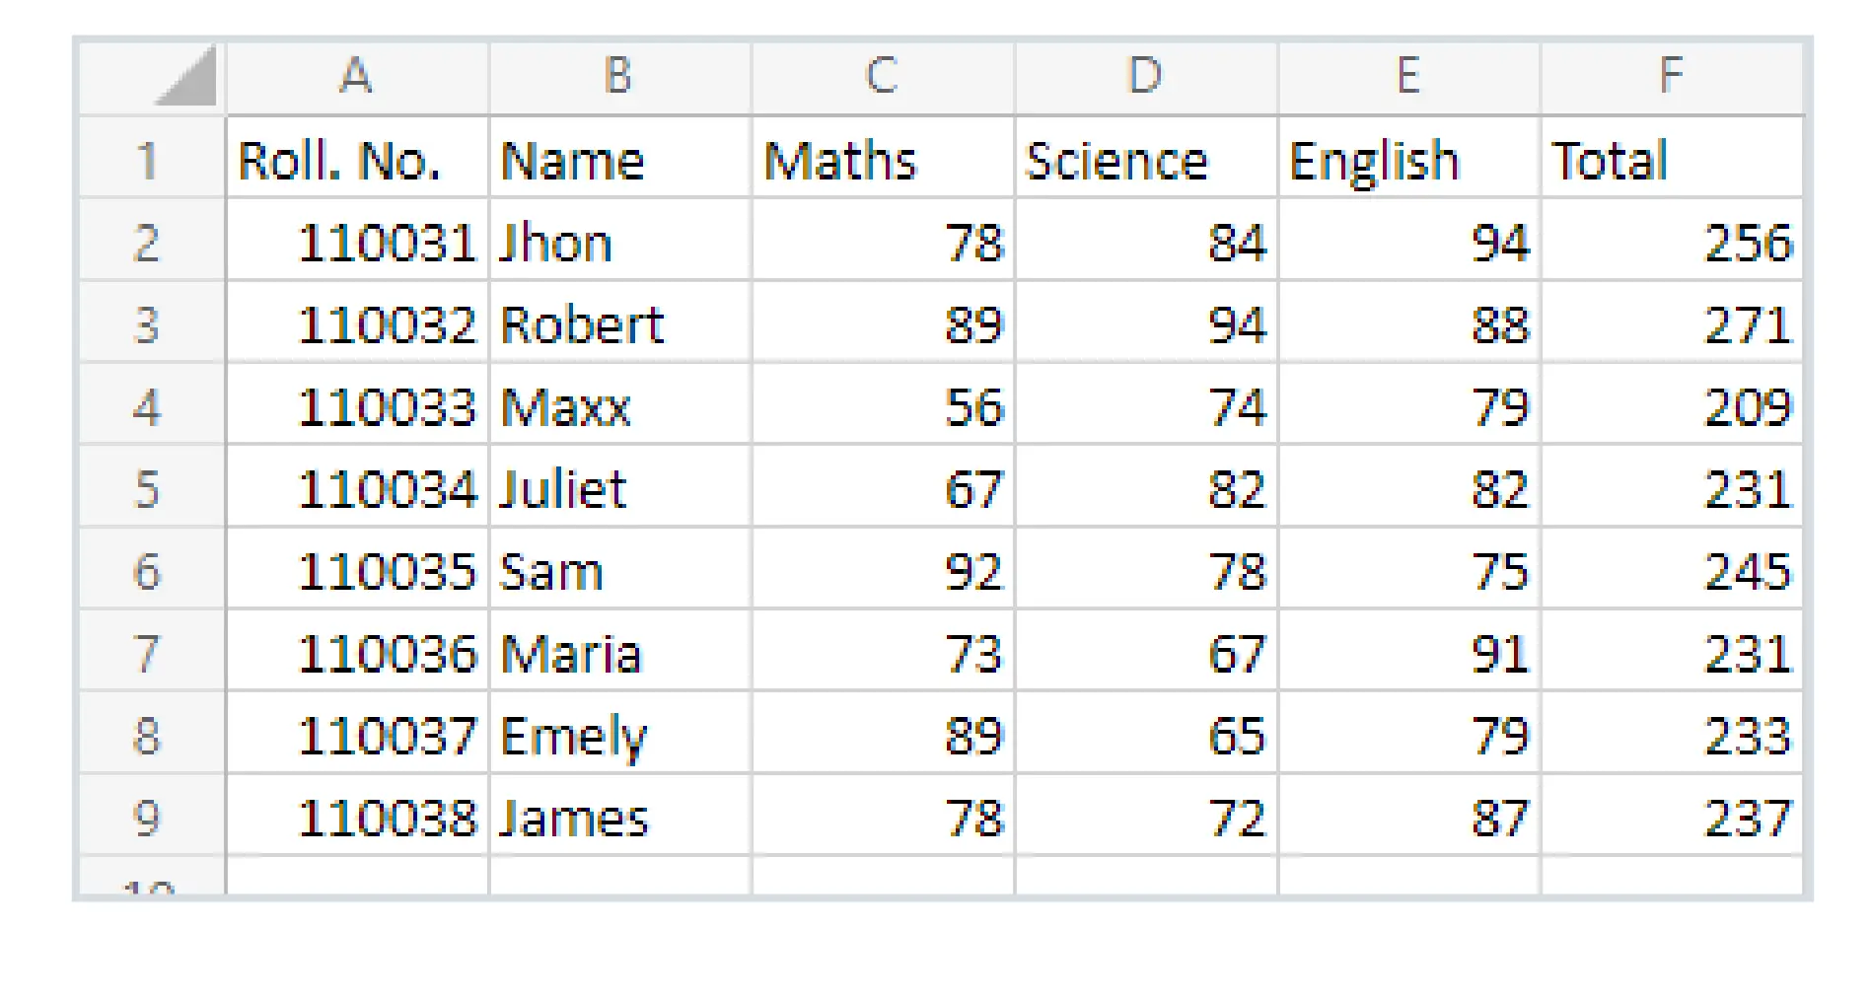
Proper dataset format

Slide 9
Proper statistical methods
Statistical methods should match
data type (e.g., categorical, continuous)
study design (e.g., descriptive, randomized trial, prediction modeling).

Slide 10
Data type
Categorical
Continuous

Slide 11
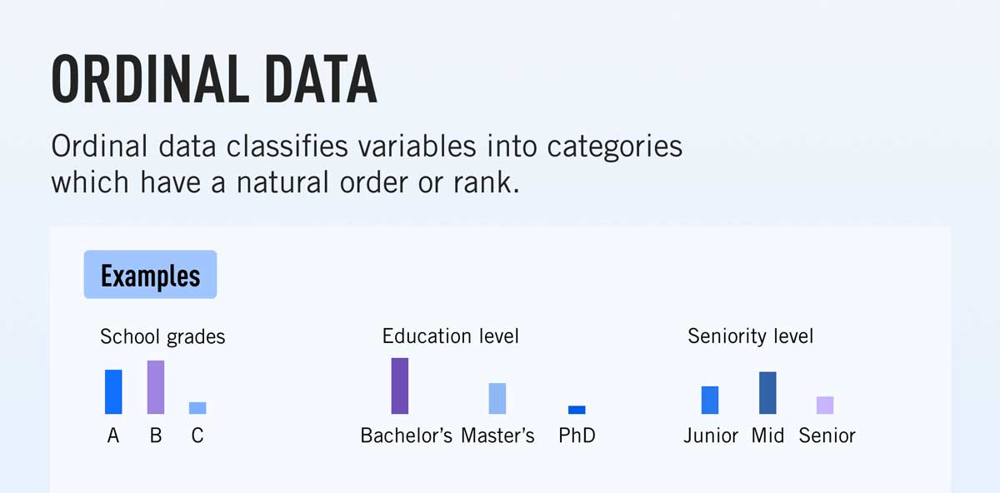

Slide 12
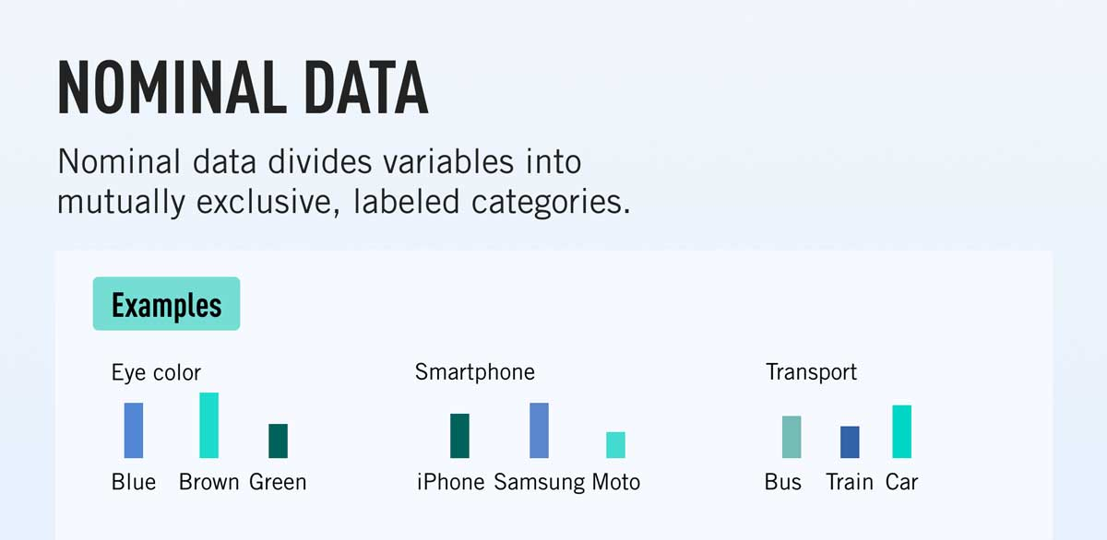

Slide 13
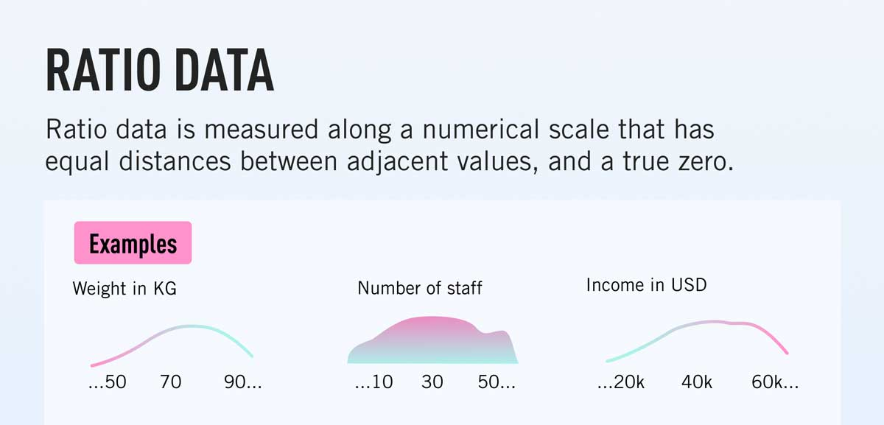

Slide 14
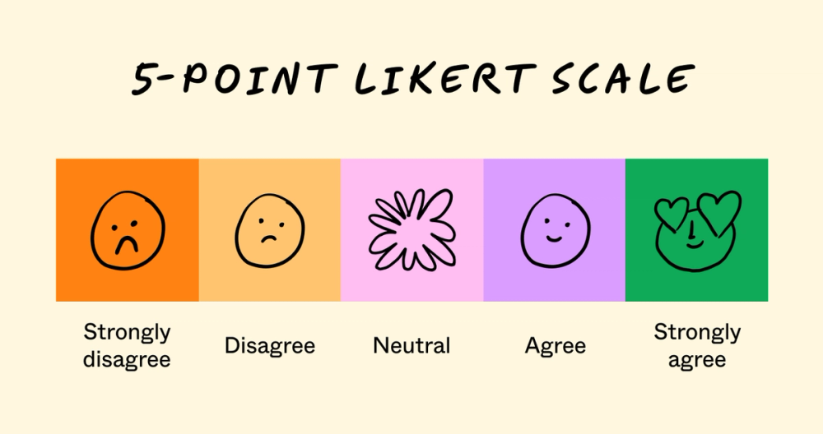
Likert-type data: ordinal data

Slide 15
Proper Analysis Example
Scenario: Comparing mean cholesterol levels (continuous data) between two independent groups with an independent samples t-test.
Action: Test matches data type and structure.

Slide 16
Improper Analysis Example
Scenario: Using a chi-square test to compare means of cholesterol (continuous data).
Action: Wrong test for the data type.

Slide 17
Proper assumptions
Many tests have assumptions: normality, independence, etc.
If assumptions aren’t checked or aren’t met, results can be misleading.

Slide 18
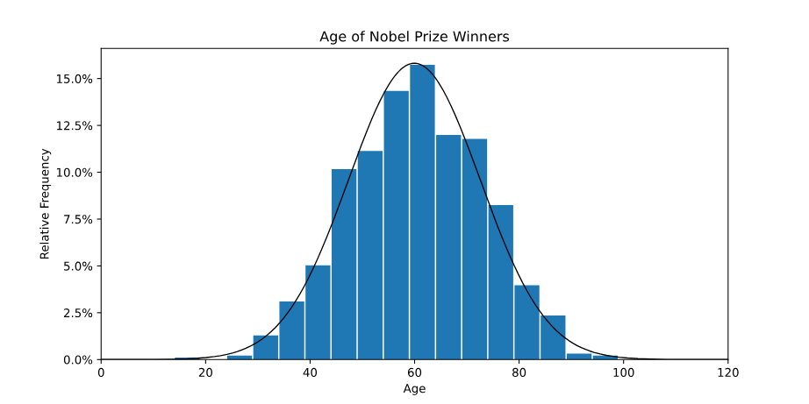

Slide 19
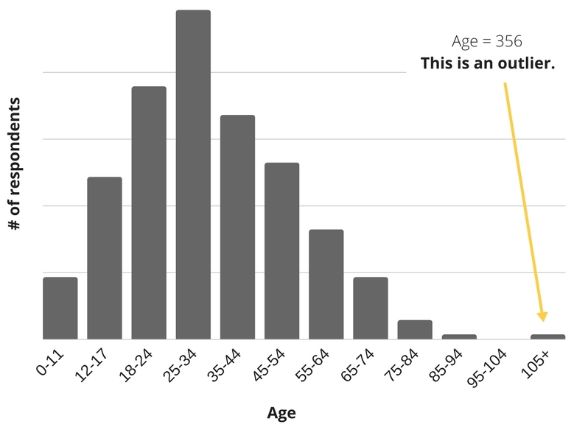

Slide 20
Normality test
Shapiro Wilk test
  swilk age
P<0.05
Normal distribution is not assumed
Median(IQR)
P≥0.05
Normal distribution is assumed
Mean(SD)

Slide 21
Mean vs median
Both measure central tendency
Median: reduce noise
Example:
Age 20, 30, 35, 36, 38, 39, 80
Mean: 39.7
Median: 36

Slide 22
Statistical test
Independent data
Median(IQR)
Wilcoxon rank sum test
Mean(SD)
Independent samples t-test

Slide 23
Variables | Normal distribution
Age | Yes | Mean(sd)
BMI | Yes | Mean(sd)
Length of stay | Yes | Mean(sd)

Slide 24
Variables | Normal distribution
Age | Yes | Mean(sd)
BMI | Yes | Mean(sd)
Length of stay | No | Median(IQR)

Slide 25
Variables | Normal distribution
Age | Yes | Median(IQR)
BMI | Yes | Median(IQR)
Length of stay | No | Median(IQR)

Slide 26
Proper Analysis Example
Scenario: Authors perform a Shapiro-Wilk test for normality before using a t-test. If assumptions fail, they use the Wilcoxon rank sum test.
Action: Appropriate checking and adaptation to statistical requirements.

Slide 27
Improper Analysis Example
Scenario: Authors blindly use t-tests on strongly skewed data without checking normality, ignoring outliers.
Action: Results may not be valid or generalizable.

Slide 28
True significant difference
Significant differences may arise if groups differ in baseline characteristics (“confounding”). It’s crucial to examine and adjust for comparability.

Slide 29
Proper Analysis Example
Scenario: Before comparing treatment outcomes, authors present a table of baseline variables (age, sex, comorbidities) and use regression or propensity score methods to adjust for differences.
Action: Ensures groups are comparable—reducing bias.

Slide 30
Improper Analysis Example
Scenario: Authors report Drug A is better, but the group receiving Drug A is 10 years younger and healthier (no adjustment).
Action: Significant difference likely due to group differences, not treatment effect.

Slide 31
Real-life example
Uncontrolled Demographic Factors: The MRFIT study, which found low cholesterol was associated with higher death rates, but failed to control for heavy alcohol consumption, which caused both low cholesterol and accidental deaths.

Slide 32
Proper use of statistical techniques
Incorrect technique choice or execution—e.g., failure to account for small sample size or paired data.

Slide 33
Variables | Hypertension Yes n=79 | Hypertension No n=46
BMI
Under weight | 2 (2.5%) | 1 (2.2%)
Normal | 66 (83.5%) | 27 (58.7%)
Obesity | 8 (10.1%) | 12 (26.1%)
Morbid obesity | 3 (3.8%) | 6 (13.0%)
37.5% cells have a count less than 5

Slide 34
Chi-square test VS Fisher’s exact test
<20%
  Chi-square test or Fisher’s exact test
>= 20% and <= 50%
  Fisher’s exact test
>50%
  Neither

Slide 35
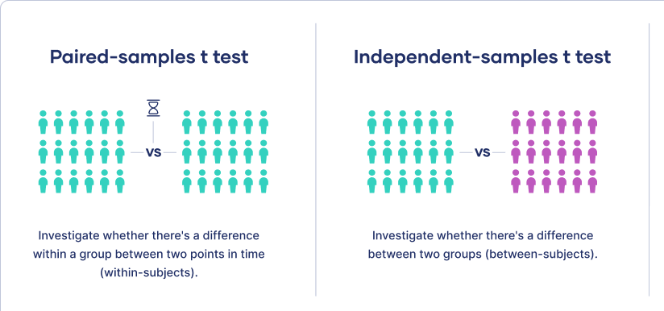
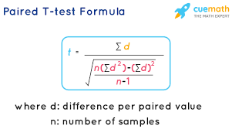
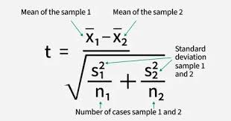

Slide 36
Statistical test
Paired continuous data
Median(IQR)
Wilcoxon signed rank test
Mean(SD)
paired t-test

Slide 37
Statistical test
Paired categorical data
n(%)
McNemar’s test

Slide 38
Likert-type data
Descriptive statistics for individual item
  ***Categorical, number (percentage)
  **”Continuous”, median
    ranked categories rather than precise, equal intervals.
  *”Continuous”, mean, not recommended

Slide 39
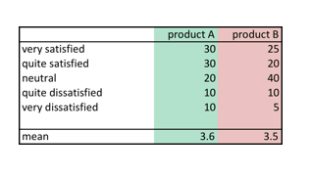

Slide 40
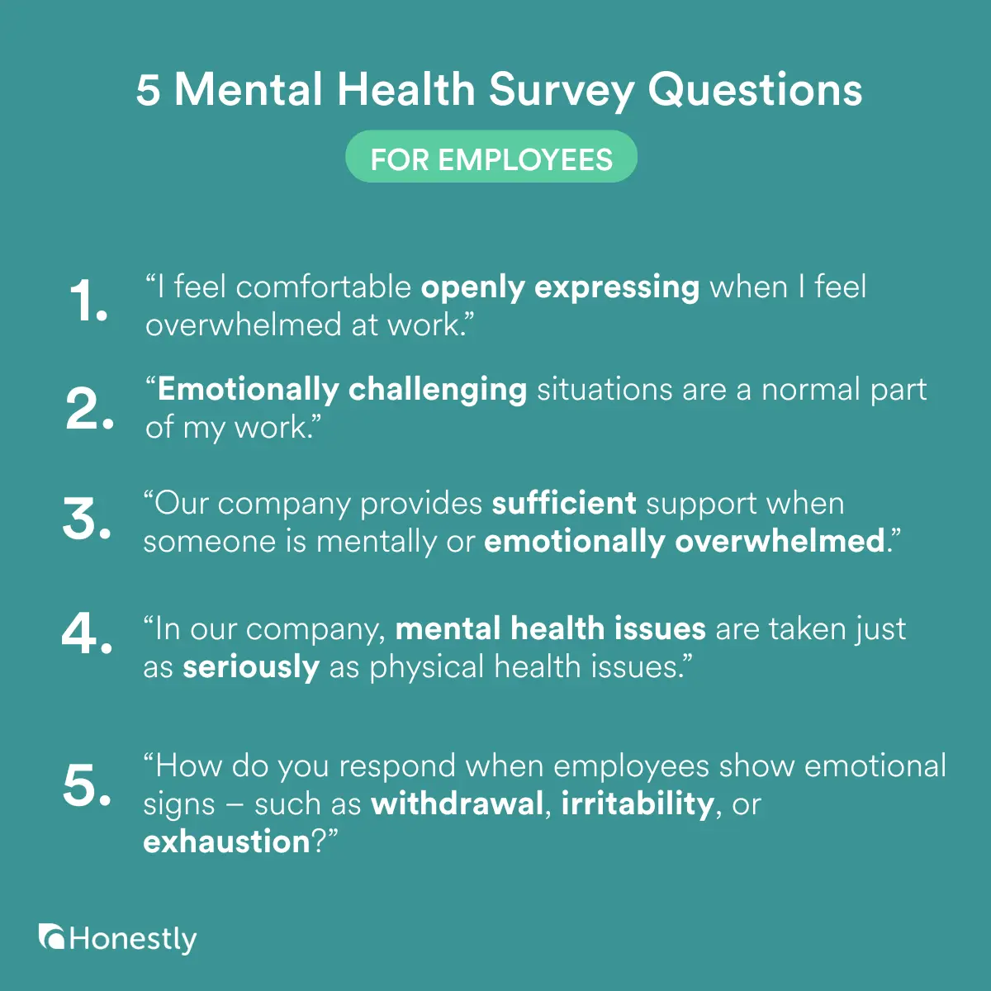

Slide 41
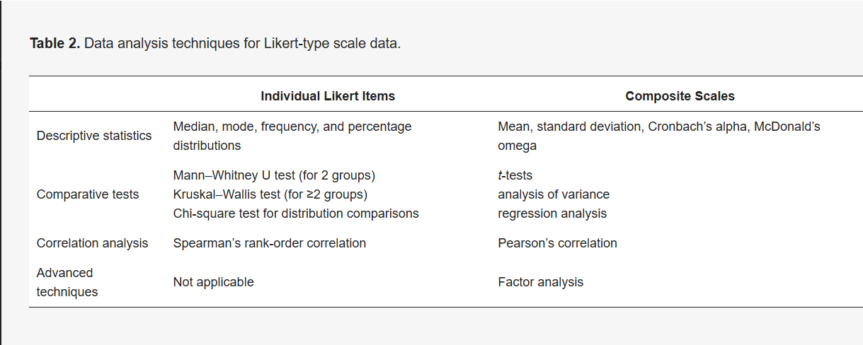
https://www.mdpi.com/2673-8392/5/1/18

Slide 42
Proper Analysis Example
Scenario: Authors use paired analyses for before-and-after measurements.
Action: Matches test to design.

Slide 43
Improper Analysis Example
Scenario: Authors use an unpaired t-test on paired data.
Action: Techniques don’t match data.

Slide 44
Properly report the type of test used/ significance level
A transparent report names statistical tests used and defines the significance threshold (e.g., p<0.05), so readers interpret results confidently.

Slide 45
Proper Analysis Example
Scenario: “We used the Wilcoxon rank sum test to compare median survival, with significance set at p<0.05.”
Action: Complete and clear, readers know the methods.

Slide 46
Improper Analysis Example
Scenario: “Survival was compared and found significant”—no test or threshold named.
Action: Lack of clarity; results are hard to interpret or reproduce.

Slide 47
Report sensitivity and specificity
Diagnostic performance requires both sensitivity (true positive rate) and specificity (true negative rate). Reporting only one is incomplete and potentially misleading.

Slide 48
Proper Analysis Example
Scenario: Authors report a new blood test has sensitivity 90% and specificity 85% for detecting heart attack.
Action: Both metrics included for full diagnostic value.

Slide 49
Improper Analysis Example
Scenario: “Our test caught 90% of heart attacks” (sensitivity), but specificity (false positive rate) is not reported.
Action: Without specificity, risk of many false positives is unknown.

Slide 50
Report missing data

Slide 51
Exercise

Slide 52
1. Comparing Mean Blood Pressure Between Two Groups
Scenario: You want to compare mean systolic blood pressure between patients treated with Drug A vs. Drug B.
Test:
A. Independent samples t-test
B. Wilcoxon rank sum test

Slide 53
2. Change in Pain Score Pre- vs. Post-Treatment
Scenario: Measuring pain scores (0–10) in the same patients before and after physical therapy.
Test:
A. Paired t-test
B. Wilcoxon signed rank test

Slide 54
3. Comparing Rate of Post-op Infection in Surgery Types
Scenario: Comparing infection rates (yes/no) after two types of surgical procedures.
Test:
A. Chi-square test for independence or Fisher’s exact test
B. Wilcoxon rank sum test

Slide 55
4. Association Between Smoking (Y/N) and COPD (Y/N)
Scenario: Examining the association between smoking status and COPD diagnosis in a cohort.
Test:
A. Chi-square test for independence
B. Fisher’s exact test

Slide 56
5. Correlation Between LDL and Triglycerides
Scenario: You hypothesize that higher LDL cholesterol is correlated with higher triglyceride levels.
  LDL cholesterol: continuous, normal distribution
  Triglyceride: continuous, not normal distribution
Test:
A. Pearson correlation
B. Spearman rank correlation

Slide 57
6. Comparing Median Survival Times
Scenario: Do two cancer treatment groups have different median survival times?
Test:
A. Wilcoxon rank sum test
B. Wilcoxon signed rank test

Slide 58
7. Prevalence of Complications Before and After Intervention
Scenario: Did a new protocol reduce the number of patients experiencing a complication (before/after intervention) in paired data?
Test:
A. McNemar’s test
B. Chi-square test

Slide 59
8. Generic Drug Compared to Brand
Scenario: Is a generic drug “not worse” than the brand in controlling blood glucose (HbA1c levels)?
Test:
A. Non-inferiority test (a one-sided t-test with pre-specified margin).
B. Independent samples t-test

Slide 60
9. Comparing clinical outcomes
Scenario: You want to compare clinical outcomes across two groups in an observational study, adjusting for baseline characteristics.
Case group n=48
Control group n=523
Method:
A. Propensity score matching
B. Nothing

Slide 61
10. Assessing Effect of Three Therapies on Depression Scores
Scenario: Three groups receive different psychotherapies, and you compare their post-treatment depression scores.
Test:
A. ANOVA (if data are normal); Kruskal-Wallis test (non-parametric).
B. Independent samples t-test or Wilcoxon rank sum test

Slide 62
11. Assessing Relationship Between Pain Improvement and Age
Scenario: Does greater age correlate with pain improvement (ranked outcome, not normally distributed)?
Test:
A. Spearman rank correlation
B. Pearson correlation

Slide 63
12. Comparing Proportions With Very Small Sample Sizes
Scenario: In a pilot study, you want to know if the rate of rare side effects differs between two drugs, with low event counts.
Test:
A. Fisher’s exact test
B. Chi-square test

Slide 64
Analysis of the results (1-5)
Were the data worthy of statistical analysis? If so, were the methods of analysis appropriate to the source and nature of the data?
Were the appropriate assumptions met for the statistical methods utilized?
Were there sufficient analyses to ascertain whether “significant difference” might, in fact, have been due to a lack of comparability of the groups: (i.e. age, sex, clinical characteristics etc.) ?
Was there an improper use of statistical techniques?
Was there mention of the type of test used or the significance level?
Was there use of measured sensitivity without specificity?

Slide 65
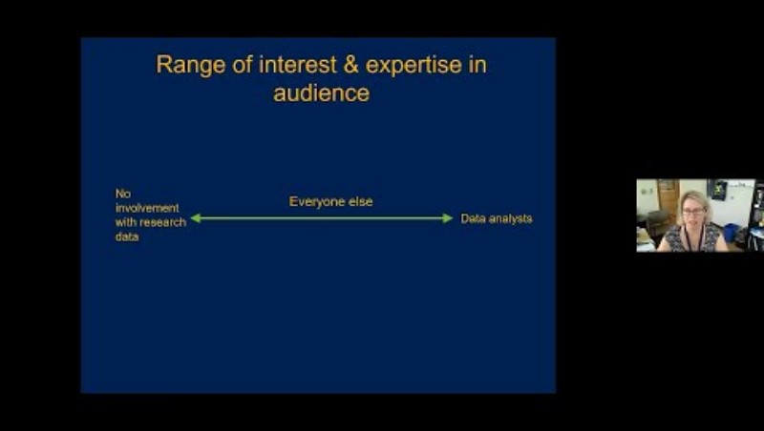

Slide 66
