Slide 1
Thromboembolism
PE
DVT

Slide 2
Pregnancy is a risk factor for thromboembolism
Accounting for 9.3% of maternal deaths in US
Physiological changes
Mechanical obstruction by the gravid uterus
Decreased mobility
Vascular injury

Slide 3
Other risk factors related to pregnancy
Advanced maternal age
Obesity
Cesarean delivery

Slide 4
preeclampsia
Hypertension arising after 20 weeks of gestation with new onset or worsening proteinuria or end-organ disease

Slide 5
Pathophysiologic association
Preeclampsia
Thromboembolism
Elevated risk for VTE in pregnancy and postpartum among those with preeclampsia.

Slide 6
Retrospective cohort study
The relationship between preterm preeclampsia and thromboembolic risk

Slide 7
Cohorts
No history of preeclampsia
preterm preeclampsia
Delivery at <= 36 weeks
term preeclampsia
Delivery at >= 37 weeks

Slide 8
outcome
Any thromboembolic event
Each type of thromboembolic event

Slide 9
National Inpatient Sample database
the largest publicly available all-payer inpatient healthcare database
contains data from around 7 million hospital stays each year
2017-2019
2.2 million
56,446 preterm preeclampsia
86,152 term preeclampsia

Slide 10
Variables of interest
Demographics
Age, race, BMI, tobacco use, insurance, income, hospital bed size, hospital teaching status, length of stay, cesarean delivery
Comorbidities: grand multiparity, diabetes mellitus, chronic hypertension, asthma, anemia, history of cesarean
Outcome
PE, DVT, cerebral thrombosis or TIA, other thrombosis

Slide 11
Univariate analysis
Categorical variable
Continuous variable (numeric, metric)

Slide 12
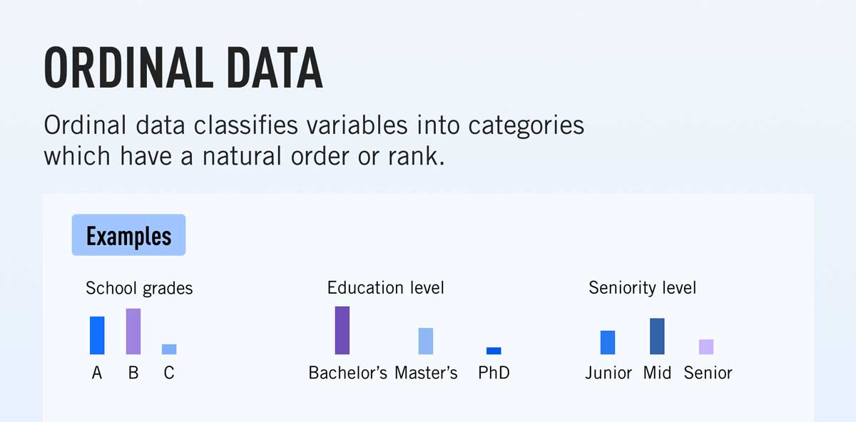

Slide 13
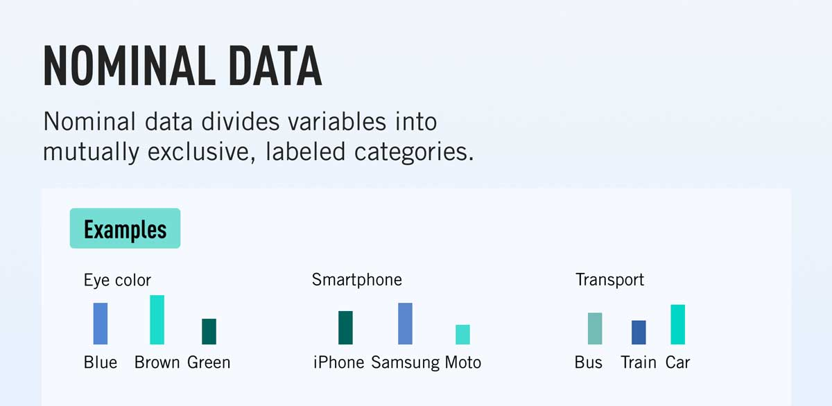

Slide 14
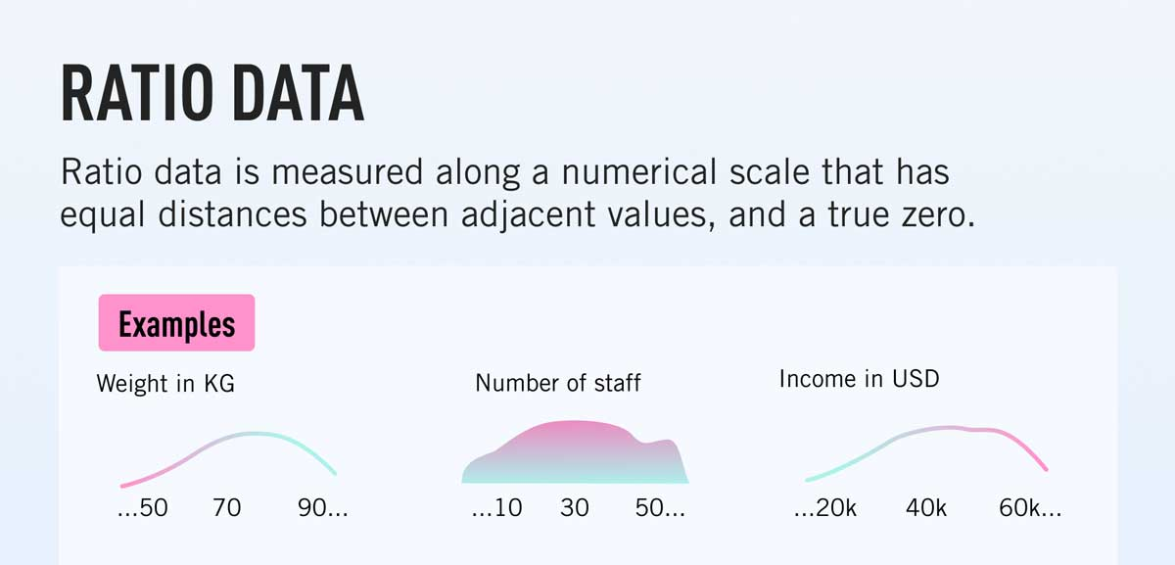

Slide 15
Demographics
Categorical
race, income, hospital bed size, hospital teaching status
Private insurance, tobacco use, grand multiparity, diabetes mellitus, chronic hypertension, asthma, anemia, history of cesarean, cesarean delivery
Continuous
Age, BMI, length of stay

Slide 16
Variables | Preterm preeclampsia n=56,446
Tobacco use | 3459 (6.1%)
Chronic hypertension | 8426 (14.9%)
History of cesarean | 11,434 (20.3%)

Slide 17
Variable | Preterm preeclampsia n=56,446
Race
Non-Hispanic White | 25,213 (46.2%)
Non-Hispanic Black | 13,627 (25.0%)
Hispanic | 10,587 (19.4%)
Asian or Pacific Island | 2310 (4.2%)
American Indian | 580 (1.0%)
Other | 2301 (4.2%)

Slide 18
Video
https://www.youtube.com/watch?v=K9teElePNkk
Descriptive statistics: 4:19-10:21

Slide 19
Mean vs median
Both measure central tendency
Median: reduce noise

Slide 20
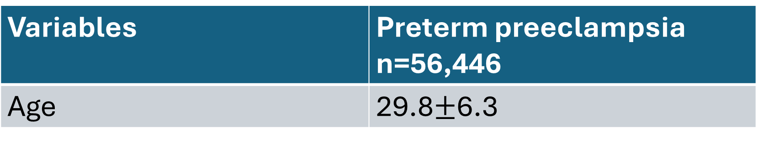
Variables | Preterm preeclampsia n=56,446
Age | 29.8$±$6.3

Slide 21
Variables | Preterm preeclampsia n=56,446
Age | 30.2 (23.8, 34.6)

Slide 22
Normality test
Shapiro Wilk test
swilk age
P<0.05
Normal distribution is not assumed
Median(IQR)
P≥0.05
Normal distribution is assumed
Mean(SD)

Slide 23
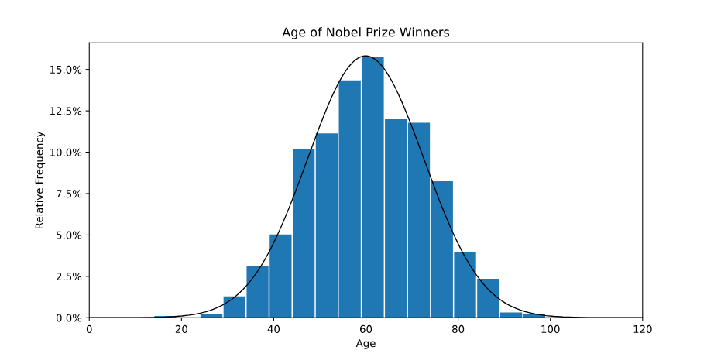

Slide 24
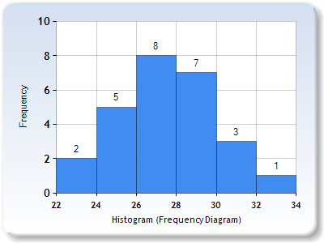

Slide 25
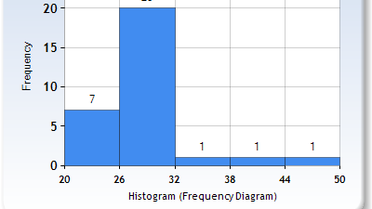

Slide 26
Variables | Normal distribution
Age | Yes | Mean(sd)
BMI | Yes | Mean(sd)
Length of stay | Yes | Mean(sd)

Slide 27
Variables | Normal distribution
Age | Yes | Mean(sd)
BMI | Yes | Mean(sd)
Length of stay | No | Median(IQR)

Slide 28
Variables | Normal distribution
Age | Yes | Median(IQR)
BMI | Yes | Median(IQR)
Length of stay | No | Median(IQR)

Slide 29
Variables | Preterm preeclampsia n=56,446
BMI | 32.2 (23.8, 38.6)

Slide 30
Variables | Preterm preeclampsia n=56,446
BMI
Under weight | 923 (1.6%)
Normal | 33,158 (58.7%)
Obesity | 14,923 (26.4%)
Morbid obesity | 7442 (13.2%)

Slide 31
Variables | Preterm preeclampsia n=56,446
Obesity | 14,923 (26.4%)
Morbid obesity | 7442 (13.2%)

Slide 32
Variables | No preeclampsia n=2,093,579 | Preterm preeclampsia n=56,446
BMI
Under weight | 25,123 (1.2%) | 923 (1.6%)
Normal | 1,760,101 (84.1%) | 33,158 (58.7%)
Obesity | 222,153 (10.6%) | 14,923 (26.4%)
Morbid obesity | 86,202 (4.1%) | 7442 (13.2%)

Slide 33
Chi-square test
P<0.05
Those with no history of preeclampsia were more likely to have normal weight.
Those with preterm preeclampsia were more likely to have obesity or morbid obesity.

Slide 34
Chi-square test
What if sample size is small
N=125

Slide 35
Variables | No preeclampsia n=79 | Preterm preeclampsia n=46
BMI
Under weight | 2 (2.5%) | 1 (2.2%)
Normal | 66 (83.5%) | 27 (58.7%)
Obesity | 8 (10.1%) | 12 (26.1%)
Morbid obesity | 3 (3.8%) | 6 (13.0%)
37.5% cells have a count less than 5

Slide 36
Chi-square test VS Fisher’s exact test
<20%
Chi-square test or Fisher’s exact test
>= 20% and <= 50%
Fisher’s exact test
>50%
Neither

Slide 37
Variables | No preeclampsia n=79 | Preterm preeclampsia n=46
BMI
Under weight | 2 (2.5%) | 1 (2.2%)
Normal | 66 (83.5%) | 27 (58.7%)
Obesity | 8 (10.1%) | 12 (26.1%)
Morbid obesity | 3 (3.8%) | 6 (13.0%)
37.5% cells have a count less than 5
Fisher’s exact test

Slide 38
Observed | No preeclampsia n=79 | Preterm preeclampsia n=46
BMI
Normal (<30) | 68 (86.1%) | 28 (60.9%)
Obesity (>=30, <40) | 8 (10.1%) | 12 (26.1%)
Morbid obesity (>=40) | 3 (3.8%) | 6 (13.0%)
16.7% cells have a count less than 5

Slide 39
Observed | No preeclampsia | Preterm preeclampsia
BMI |  |  | total
Normal (<30) | 68 (86.1%) | 28 (60.9%) | 96
Obesity (>=30, <40) | 8 (10.1%) | 12 (26.1%) | 20
Morbid obesity (>=40) | 3 (3.8%) | 6 (13.0%) | 9
total | 79 | 46

Slide 40
Expected Frequency=(Row Total/Grand Total)×(Column Total/Grand Total)×Grand Total=(Row Total×Column Total)/Grand Total

Slide 41
Expected | No preeclampsia | Preterm preeclampsia
BMI |  |  | total
Normal (<30) | 60.672 (76.8%) | 35.328 (76.8%) | 96
Obesity (>=30, <40) | 12.64 (16.0%) | 7.36 (16.0%) | 20
Morbid obesity (>=40) | 5.688 (7.2%) | 3.312 (7.2%) | 9
total | 79 | 46

Slide 42
Observed | No preeclampsia | Preterm preeclampsia
BMI
Normal | 68 (86.1%) | 28 (60.9%)
Obesity | 8 (10.1%) | 12 (26.1%)
Morbid obesity | 3 (3.8%) | 6 (13.0%)
If BMI and Preeclampsia are independent:
Expected | No preeclampsia | Preterm preeclampsia
BMI
Normal | 61 (76.8%) | 36 (76.8%)
Obesity | 13 (16.0%) | 7 (16.0%)
Morbid obesity | 6 (7.2%) | 3 (7.2%)

Slide 43
Variables | No preeclampsia n=79 | Preterm preeclampsia n=46
BMI
Normal (<30) | 68 (86.1%) | 28 (60.9%)
Obesity or morbid obesity (>=30) | 11 (13.9%) | 18 (39.1%)

Slide 44
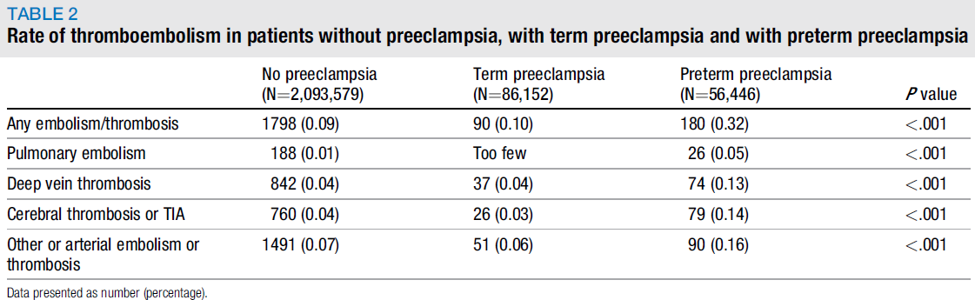

Slide 45
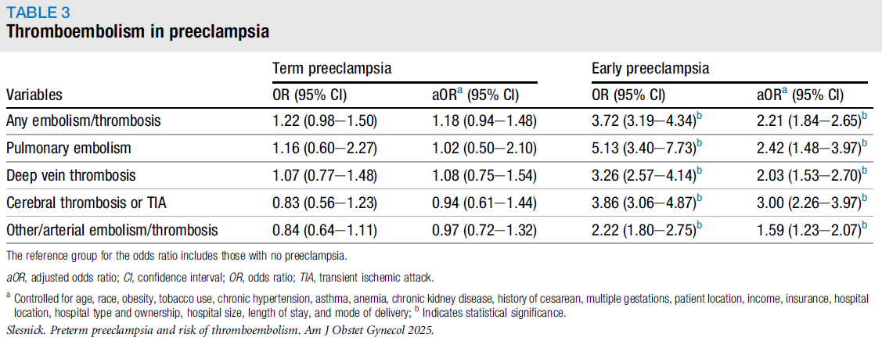
Controlled for age, race, obesity, tobacco use, chronic hypertension, asthma, anemia, chronic kidney disease, history of cesarean, multiple gestations, patient location, income, insurance, hospital location, hospital type and ownership, hospital size, length of stay, and mode of delivery

Slide 46
Oral contraceptive and thromboembolism
Case: with thromboembolism
Control: without thromboembolism
Exposure: oral contraceptive

Slide 47
Scenario 1
Case: n=200, 15% use oral contraceptive
Control: n=200, 10% use oral contraceptive
Significance level =0.05
Power calculation

Slide 48
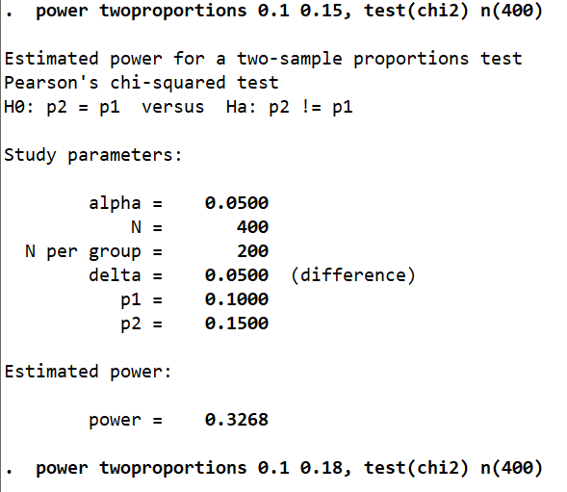

Slide 49
Scenario 2
Case: 15% use oral contraceptive
Control: 10% use oral contraceptive
Significance level =0.05
80% Power
Sample size

Slide 50
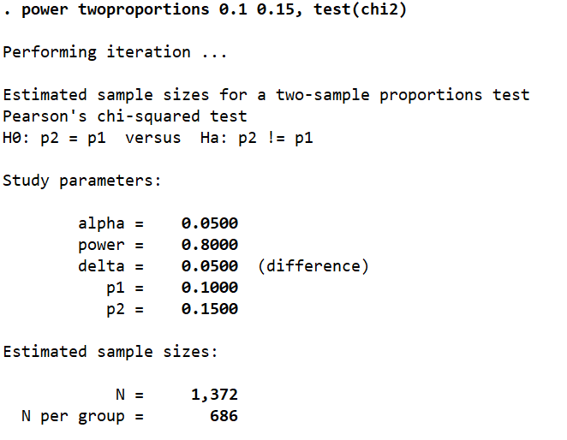

Slide 51
Postpartum depression and future pregnancy
Cohort 1: postpartum depression
Cohort 2: no postpartum depression

Slide 52
Scenario
PPD Cohort : 40%
Non-PPD Cohort: 60%
Significance level =0.05
80% Power

Slide 53
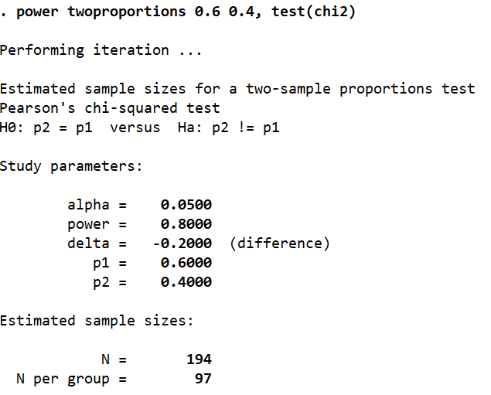

Slide 54
Ask UM-GPT
I want to do a power/sample size calculation in Stata (R):
……
……
Can you show me how to do it step by step?

Slide 55
Sampling and weighting
https://www.youtube.com/watch?v=DD5npelwh80
https://www.youtube.com/watch?v=dt0fQDabb4Y

Slide 56
Hypothetical Nationwide Cesarean Rate Survey - U.S. 2024

Slide 57
Hypothetical
Sample size: 4000 deliveries
35-40 hospitals or birth centers
March 1-10, 2024

Slide 58
Stratified multistage cluster sampling
Strata: Geographic regions, urban vs. rural areas, facility types. Clusters: Hospitals and birthing centers.
Stage 1: Selection of Primary Sampling Units (PSUs) Stratify by geographic regions. Select PSUs using probability proportional to size (PPS) sampling based on the number of births.
Stage 2: Within PSU Facilities Randomly select hospitals/birthing centers within each PSU.
Stage 3: Individual Births Random sample of births from selected facilities.

Slide 59
Stratified Multistage Cluster Sampling
Stratified Sampling: geographic regions, urban versus rural areas, and facility types
Cluster Sampling:

Slide 60
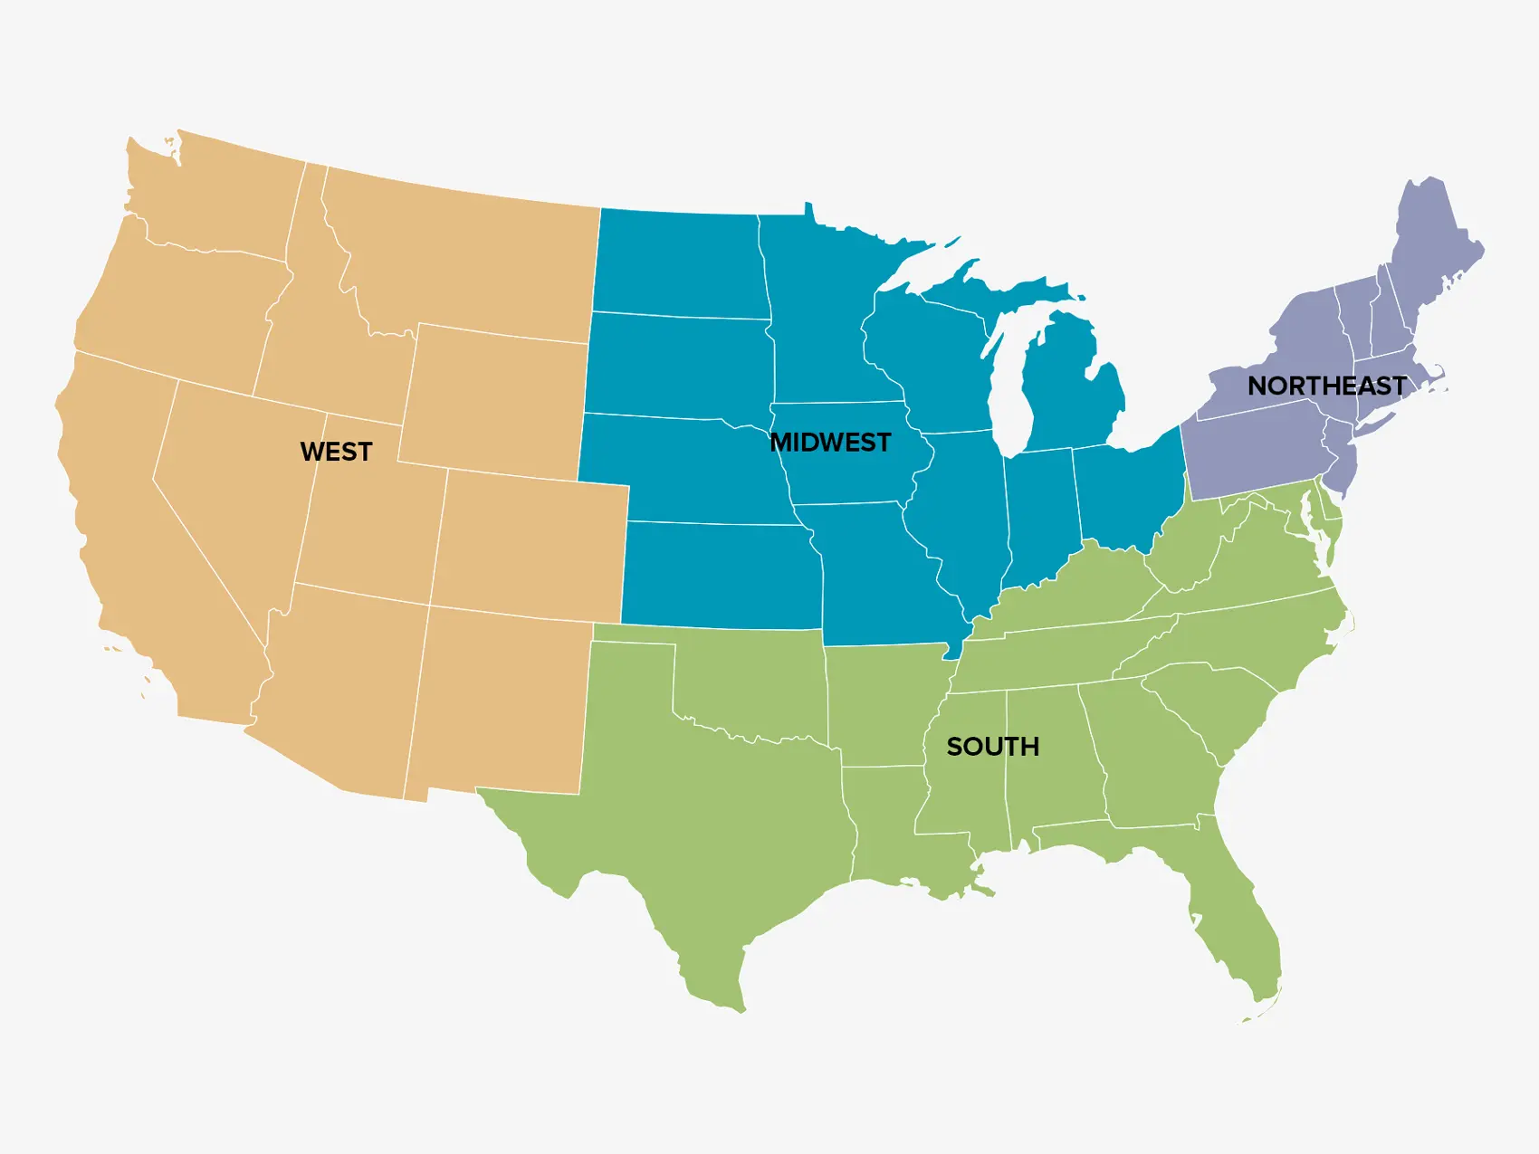

Slide 62
weighting
https://www.youtube.com/watch?v=SJRVxvdIc8s&t=613s

Slide 63
