Slide 1
Timesheet App
Ethan Larson & Dre Harm

Slide 2
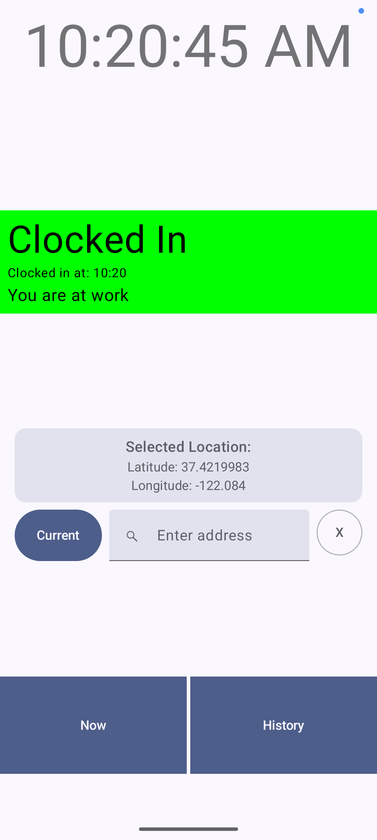
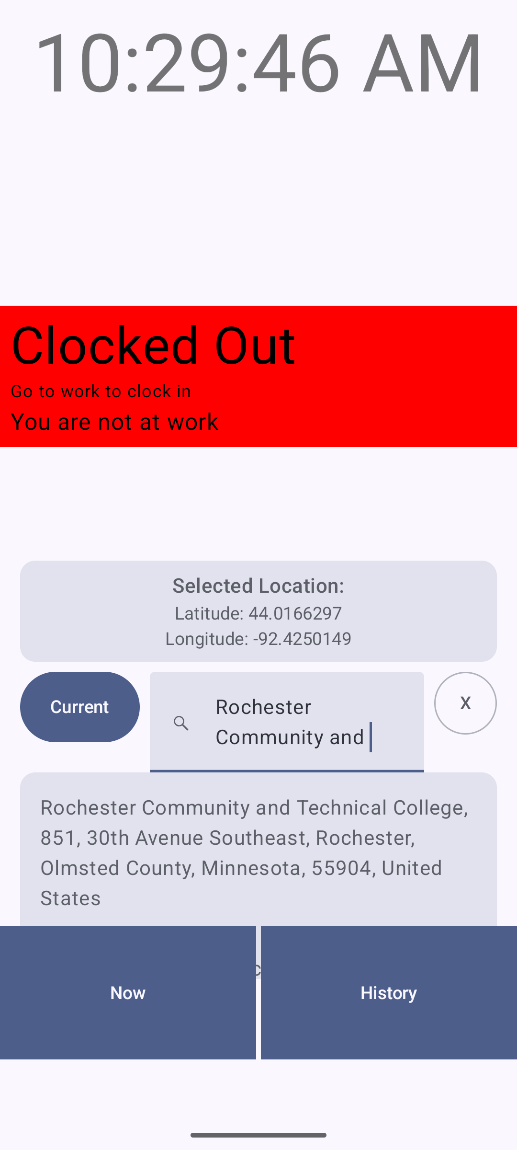
Now Screen
Current Location Address Lookup
Composables Used:
- DisplayTextClock()
- ClockInStatus()
- Column
- Row
-AddressSearch()
Card
Text
Lazy Column

Slide 3
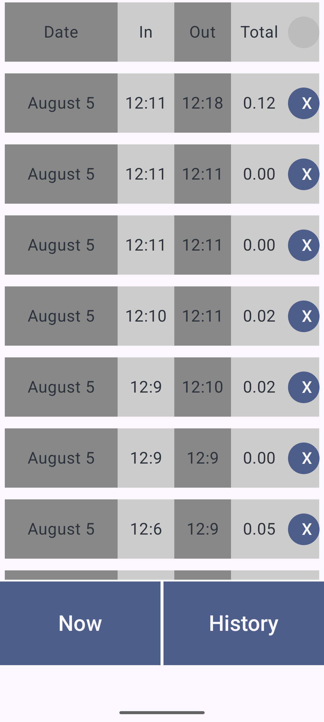
History Screen
Composables Used:
- LazyColumn()
- HistoryCard()
- Row
- Column
- Button

Slide 4
Societal Need Why We Chose It
Minimize Wage Theft (via company)
Ensures that the employee is paid for any overtime & stops off the clock work.
Stops wage fraud (via employee)
Gets rid of guesswork & stops employees from punching in before they're at work.
Our work schedule is very flexible
Everyday can be different
We submit our own times
There have been times when we forget
- Arrival time
- When we left
- Took breaks

Slide 5
Techniques From Class
MVVM
Hoisting
Lambdas as parameters

Slide 6
Thank You

