Slide 1
GRE强化写作
王屏非

Slide 2
第二章：Analyze an argument
第四节：Argument常见逻辑错误及模板

Slide 3
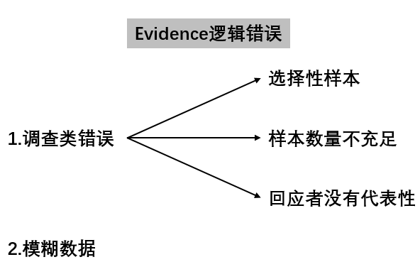

Slide 4
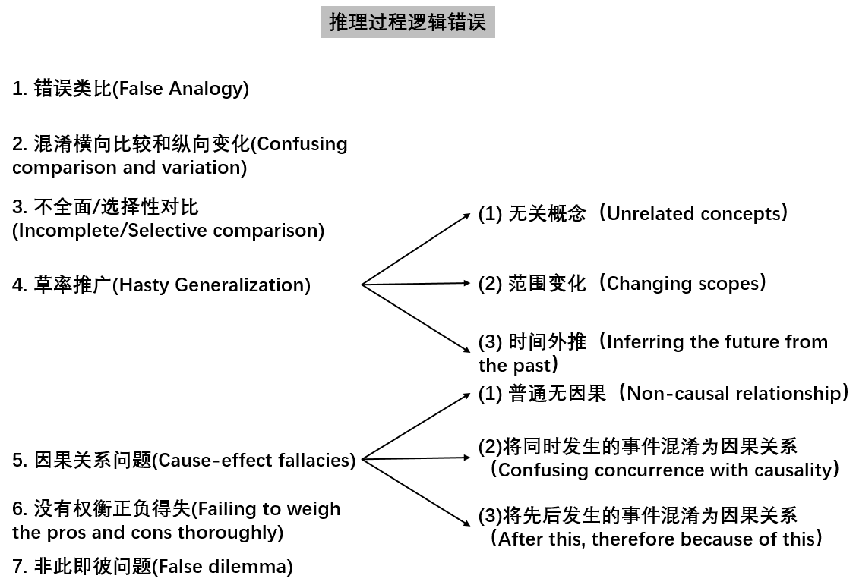

Slide 5
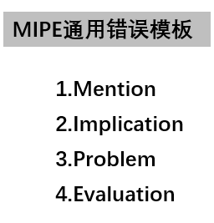

Slide 6
1.Evidence的逻辑错误
1 调查类错误

Slide 7
（1） 选择性样本

Slide 8
137 While the Department of Education in the state of Attra recommends that high school students be assigned homework every day, the data from a recent statewide survey of high school math and science teachers give us reason to question the usefulness of daily homework. In the district of Sanlee, 86 percent of the teachers reported assigning homework three to five times a week, whereas in the district of Marlee, less than 25 percent of the teachers reported assigning homework three to five times a week. Yet the students in Marlee earn better grades overall and are less likely to be required to repeat a year of school than are the students in Sanlee. Therefore, all teachers in our high schools should assign homework no more than twice a week.

Slide 9
English teacher
vocabulary, read passages, write essays
History teacher
figure, date, event

Slide 10
补充：可能性表达
It is likely/possible/probable/conceivable that …
There is a likelihood/ possibility/ probability that …
Another likelihood/ possibility/ probability is that …
Chances are high that…

Slide 11
补充：因果关系
A is caused by B.
A is due to/ owing to B.
A is attributed to/ attributable to B.
A is ascribed to B.
B causes A.
B leads to/ results in A.
B generates/ creates/ produces/ introduces A.
B is responsible for A.

Slide 12
Sample
The author implies that the teachers studied in the survey could present teachers in all the subjects, but the author considers only math and science teachers which are obviously selective sub-groups. Although they do constitute a significant part of all teacher groups, however, many teachers in other subjects are actually excluded from the survey. For example, an English teacher may require their students to memorize plenty of vocabularies, read passages and write essays, making more frequent assignments necessary. Another possibility is that in history class, many historical facts including figures, dates, events are needed to be understood thoroughly, which can only be achieved by sufficient exercise. To sum, without ruling out above possibilities, the author could not make any general conclusion about all teachers’ assignment advice merely on survey from math and science teachers.

Slide 13
微信公众号-ppt在线阅读
回复greppt 查看所有ppt
回复greppt5 查看本章节ppt

Slide 14
（2） 样本数量不充足

Slide 15
113 "Many other companies have recently stated that having their employees take the Easy Read Speed-Reading Course has greatly improved productivity. One graduate of the course was able to read a 500-page report in only two hours; another graduate rose from an assistant manager to vice president of the company in under a year. Obviously, the faster you can read, the more information you can absorb in a single workday. Moreover, Easy Read would cost Acme only $500 per employee—a small price to pay when you consider the benefits. Included in this fee is a three-week seminar in Spruce City and a lifelong subscription to the Easy Read newsletter. Clearly, to improve productivity, Acme should require all of our employees to take the Easy Read course."

Slide 16
500 pages in 2 hours
<-figures, graphics
<-by himself/elementary students
rapid promotion
<-hardworking, teamwork
<-family connection

Slide 17
Sample
The evidence cited by the author could hardly illustrate the assumption that Easy Read Speed-Reading Course was effective because the author provided only two samples of the overall graduates. In terms of the first graduate, reading a 500-page report in two hours may be due to the fact that the report was occupied mainly by figures and graphics. Besides, it could be written by himself or by elementary students with simple words and passage structure. With respect to the second graduate, the rapid promotion from assistant manager to vice president of the company could be attributed to his personal hardworking and teamwork spirit. It was also probable that family members helped me to achieve this goal using their connection. The two examples are too limited to be representative of overall graduates; As a result, we cannot accept the author’s implication that two graduates’ success resulted from attending Speed-Reading Course before more statistic data about the performance of other graduates are provided.

Slide 18
（3） 回应者没有代表性

Slide 19
43 "Two years ago, consultants predicted that West Egg's landfill, which is used for garbage disposal, would be completely filled within five years. During the past two years, however, the town's residents have been recycling twice as much material as they did in previous years. Next month the amount of recycled material—which includes paper, plastic, and metal—should further increase, since charges for pickup of other household garbage will double. Furthermore, over 90 percent of the respondents to a recent survey said that they would do more recycling in the future. Because of our town's strong commitment to recycling, the available space in our landfill should last for considerably longer than predicted."

Slide 20
respondents
<- environmental protection
<-extra costs
other who did not respond
majority

Slide 21
Sample
The author conducted a survey in West Egg about residents’ willingness to continue recycling. To make the survey convincing, the author should provide concrete evidence to demonstrate the respondent are representative. In most cases, this survey is not a mandatory investigation so that people who are interested in environmental protection or who care about the extra costs of pickup of household garbage might be generally more likely to respond to the survey than other people, reading these respondents not representative of the general group. Citizens in West Egg who did not respond may not care about environment and extra costs, and they may make up of the majority of the whole population. Without considering the attitudes of these people, the result of the survey in itself could not justifiably illustrate that the result of the survey is effective.

Slide 22
1.2 模糊数据

Slide 23
27 "Commuters complain that increased rush-hour traffic on Blue Highway between the suburbs and the city center has doubled their commuting time. The favored proposal of the motorists' lobby is to widen the highway, adding an additional lane of traffic. But last year's addition of a lane to the nearby Green Highway was followed by a worsening of traffic jams on it. A better alternative is to add a bicycle lane to Blue Highway. Many area residents are keen bicyclists. A bicycle lane would encourage them to use bicycles to commute, and so would reduce rush-hour traffic rather than fostering an increase."

Slide 24
给出many/ actual number
缺乏percentage/fraction
给出percentage/fraction
缺乏base amount

Slide 25
Sample
The information concerning what local residents like is not accurate enough to evaluate their actual preference. The author only informs us many area residents are keen bicyclists, but we do not know the actual number of these keen bicyclists. Besides, we should also know its fraction of the total local residents. For example, if the keen bicyclists are 100,000, this is a big metropolitan city, with a total population of 20,000,000. Therefore, these 100,000 bicyclists only make up of a small proportion of local residents. For lack of detailed information about the actual number of bicyclists and the its percentage of the whole group, we can hardly assess whether many residents like cycling and whether adding a bicycle lane to Blue Highway is appropriate or not.

Slide 26
2.推理过程的逻辑错误
2.1 错误类比(False Analogy)

Slide 27
97 "Over the past ten years, there has been a 20 percent decline in the size of the average audience at Classical Shakespeare Theatre productions. In spite of increased advertising, we are attracting fewer and fewer people to our shows, causing our profits to decrease significantly. We must take action to attract new audience members. The best way to do so is by instituting a 'Shakespeare in the Park' program this summer. Two years ago the nearby Avon Repertory Company started a 'Free Plays in the Park' program, and its profits have increased 10 percent since then. If we start a 'Shakespeare in the Park' program, we can predict that our profits will increase, too."

Slide 28
CST=ARC
X
reputation/history
actors, actresses’
experience
differences
marketing strategy
“Free”

Slide 29
Sample
In the argument, the author recommends CST to carry out the similar strategy as ARC, but we may ask whether the two theatres are similar enough at every aspect and indeed comparable. While it is true that they share some common grounds on their close location and similar business scope, many differences exist between them. For example, ARC may have a much longer performance history and has already accumulated prestigious reputation. In contrast, CST is likely to be a newly built theatre with poor fame. As a result, even they plan similar plays, only a few people will go. Besides, actors and actresses in ARC are all experienced in stage performance while the performers in CST are all fresh people. Before CST decides to copy ARC’s solution, the author should take these differences into account and make careful study on the comparability of the two.

Slide 30
2.2 混淆横向比较和纵向变化(Confusing comparison and variation)

Slide 31
自从用了某种X学习方法，考了班级第一
X学习方法真有用
90
X
80
60/70
other students

Slide 32
46 "Medical experts say that only one-quarter of Corpora's citizens meet the current standards for adequate physical fitness, even though twenty years ago, one-half of all of Corpora's citizens met the standards as then defined. But these experts are mistaken when they suggest that spending too much time using computers has caused a decline in fitness. Since overall fitness levels are highest in regions of Corpora where levels of computer ownership are also highest, it is clear that using computers has not made citizens less physically fit. Instead, as shown by this year's unusually low expenditures on fitness-related products and services, the recent decline in the economy is most likely the cause, and fitness levels will improve when the economy does."

Slide 33
Sample
The author provides the comparison between the region C with highest computer ownership as well as fitness level and other regions. Although the comparison could partly indicate the fitness level of this particular region is higher than other regions, , the variation of fitness level of C is actually more convincing and necessary to demonstrate expert’s conclusion that consuming too much time using computers can deteriorate one’s health. It is very likely that compared with C in the past, the fitness has dropped dramatically because of long time use of computers. Moreover, people in other regions may spend more time using computers, making their fitness even worse. Lacking variation of this region C, we could not assess if spending time using computers can undermine one’s fitness level.

Slide 34
2.3 不全面/选择性对比
(Incomplete/Selective comparison)

Slide 35
170 "The surface of a section of Route 101, paved just two years ago by Good Intentions Roadways, is now badly cracked with a number of dangerous potholes. In another part of the state, a section of Route 40, paved by Appian Roadways more than four years ago, is still in good condition. In a demonstration of their continuing commitment to quality, Appian Roadways recently purchased state-of-the-art paving machinery and hired a new quality-control manager. Therefore, I recommend hiring Appian Roadways to construct the access roads for all our new shopping malls. I predict that our Appian access roads will not have to be repaired for at least four years."

Slide 36
strength in use
Route 101
Route 40
car flow
weather/temperature

Slide 37
Sample
The author hastily implies that AR is superior to GIR in road construction, but the comparison between them is incomplete. The author only compares condition and using time of different two routes, Route 101 and Route 40. However, there are myriad of factors which would bring about totally different result for the comparison. To fully evaluate the quality of two companies, the author should provide more concrete evidence about other factors, which would influence the result while ignored by the author in the argument. For example, two routes might be different in strength in use, car flow, weather, and other geological conditions. If more heavy trucks go through Route 101, it is totally reasonable that the road damage is much more serious than Route 40. Therefore, it is not due to the building technique of GIT. Without any further consideration about these factors, the author could not convince us AR is better than GIR.

Slide 38
2.4 草率推广(Hasty Generalization)
(1) 无关概念（Unrelated concepts）

Slide 39
75 "The department of agriculture in Batavia reports that the number of dairy farms throughout the country is now 25 percent greater than it was 10 years ago. During this same time period, however, the price of milk at the local Excello Food Market has increased from $1.50 to over $3.00 per gallon. To prevent farmers from continuing to receive excessive profits on an apparently increased supply of milk, the Batavia government should begin to regulate retail milk prices. Such regulation is necessary to ensure fair prices for consumers.“

Slide 40
# of dairy farms↑=milk supply ↑
X
scale of each farm↓
export to other countries
other forms, cheese, yogurt

Slide 41
Sample
In illustrating the assumption that the more dairy farms will produce more milk, the author commits a fallacy of hasty generalization. The author mentions the amount of dairy farms is 25 percent greater than it was 10 years ago. However, the increased farms is not a good indication of the increased supply of milk. Probably, even though the number of farms is increasing, the scale of each dairy farm is becoming smaller; therefore, the total milk production is declining. Besides, some parts of the milk production can also be exported to other countries or manufactured into other dairy products such as yogurt and they did not put all the volume into the market. The author ought to make careful and clear differentiation between the amount of dairy farms and the amount of supply of milk before we could evaluate if the inference is justified.

Slide 42
(2) 范围变化（Changing scopes）

Slide 43
X city->whole country
Whole country->X city
(标志词)
nationwide
throughout the country

Slide 44
63 "Throughout the country last year, as more and more children below the age of nine participated in youth-league sports, over 40,000 of these young players suffered injuries. When interviewed for a recent study, youth-league soccer players in several major cities also reported psychological pressure exerted by coaches and parents to win games. Furthermore, education experts say that long practice sessions for these sports take away time that could be used for academic activities. Since the disadvantages outweigh any advantages, we in Parkville should discontinue organized athletic competition for children under nine."

Slide 45
country->Parkville
X
better protection gears
better training courts
more professional coaches

Slide 46
Sample
To thoroughly evaluate the argument, we may well ask whether the condition of the whole country could sufficiently illustrate the condition of Parkville. Although the author’s inference that children under nine will be injured might be true for some cities where the report was conducted, this is not true for Parkville. For example, parents in Parkville are much wealthier and can spend more money on buying more advanced protection equipment for their children. Besides, athletics court is equipped with better protecting facilities. The soccer court might be paved by real grass rather plastic grass. In addition, children in Parkville are trained by more professional coaches. Unless the author can demonstrate that the condition of Parkville is similar to the condition of the whole country, the conclusion cannot be reached based on nationwide average cases.

Slide 47
(3) 时间外推
（Inferring the future from the past）

Slide 48
66 "For many years all the stores in our chain have stocked a wide variety of both domestic and imported cheeses. Last year, however, all of the five best-selling cheeses at our newest store were domestic cheddar cheeses from Wisconsin. Furthermore, a recent survey by Cheeses of the World magazine indicates an increasing preference for domestic cheeses among its subscribers. Since our company can reduce expenses by limiting inventory, the best way to improve profits in all of our stores is to discontinue stocking many of our varieties of imported cheese and concentrate primarily on domestic cheeses."

Slide 49
last year domestic cheese
X
future domestic cheese
Imported cheese more ads in the future
economy is declining
local company go bankrupt

Slide 50
Sample
The author suggests that chain stores can improve profits through concentrating on domestic cheeses which was successful in the past year. A hidden assumption behind the argument is that all conditions and factors upon which the effectiveness of popularity of domestic cheeses depends have remained unchanged during the past. However, many factors could have changed. For instance, people’s preference will change from domestic chees to imported cheese due to growing advertisements of the imported cheese companies. Furthermore, it is likely that local economy may decline resulting in the bankruptcy of many domestic cheese company. Without taking into account all these changing factors, the author could not convince us that the concentrating on domestic cheeses in the future.

Slide 51
2.5 因果关系问题(Cause-effect fallacies)
(1) 普通无因果（Non-causal relationship）

Slide 52
55 "Although the sales of Whirlwind video games have declined over the past two years, a recent survey of video-game players suggests that this sales trend is about to be reversed. The survey asked video-game players what features they thought were most important in a video game. According to the survey, players prefer games that provide lifelike graphics, which require the most up-to-date computers. Whirlwind has just introduced several such games with an extensive advertising campaign directed at people ten to twenty-five years old, the age-group most likely to play video games. It follows, then, that the sales of Whirlwind video games are likely to increase dramatically in the next few months."

Slide 53
<- X lifelike graphics
video games↓
X
economic recession
policy
many bugs
expensive software

Slide 54
Sample
The author unfairly assumes that it is the lack of lifelike graphics in the video games that resulted in the decline of the sales of Whirlwind video games. But we find no concrete evidence to substantiate the inevitable relationship between them. Other reasons can also contribute to the decline. For example, the decline is due to the shrinking market environment. Government’s new policy to restrict the development of video games companies or parents urge their children to focus on study because of the fiercer studying environment. Besides, it is also likely that there are many bugs in the games such as game crash, leading to the poor satisfaction. In short, they author could not hastily conclude that the lack of lifelike graphics is the only possible reason for the dropping before taking above factors into account.

Slide 55
(2)将同时发生的事件混淆为因果关系 （Confusing concurrence with causality）

Slide 56
36 "An innovative treatment has come to our attention that promises to significantly reduce absenteeism in our schools and workplaces. A study reports that in nearby East Meria, where fish consumption is very high, people visit the doctor only once or twice per year for the treatment of colds. Clearly, eating a substantial amount of fish can prevent colds. Since colds represent the most frequently given reason for absences from school and work, we recommend the daily use of Ichthaid—a nutritional supplement derived from fish oil—as a good way to prevent colds and lower absenteeism."

Slide 57
fewer cold
<- fish consumption
X
regular exercise
better living
environment
less working stress

Slide 58
Sample
The author rests on an underlying assumption that it is the large consumption of fish that resulted in the low incident of colds in East Meria. The author only points out that the two events occurred during the same period. However, merely a coincidence of two events could not sufficiently demonstrate a causal relationship between them. Many other factors could also lead to the fewer people getting colds, which might include local residents have more nutritional and fresher vegetables and fruits. Besides, it is still likely that people pay more attention to daily exercise like jogging, swimming or their working stress is much lower than other cities, producing metal health. Without ruling out such factors, we could not be convinced that eating a large amount of fish is the actual cause of low rate of getting colds.

Slide 59
(3)将先后发生的事件混淆为因果关系
（After this, therefore because of this）

Slide 60
71 "Traffic here in Waymarsh is becoming a problem. Although just three years ago a state traffic survey showed that the typical driving commuter took 20 minutes to get to work, the commute now takes closer to 40 minutes, according to the survey just completed. Members of the town council already have suggested more road building to address the problem, but as well as being expensive, the new construction will surely disrupt some of our residential neighborhoods. It would be better to follow the example of the nearby city of Garville. Last year Garville implemented a policy that rewards people who share rides to work, giving them coupons for free gas. Pollution levels in Garville have dropped since the policy was implemented, and people from Garville tell me that commuting times have fallen considerably. There is no reason why a policy like Garville's shouldn't work equally well in Waymarsh."

Slide 61
pollution ↓
<- share rides/give free coupons
X
chemical enterprise moved
new energy automobiles
hybrid/pure electric

Slide 62
commuting time ↓
X
<- share rides/give free coupons
highway, subway finished
new guiding App, avoid
congestion

Slide 63
Sample
The author assumes that the policy that rewards people who shares rides to work and gives coupons is responsible for the drop of pollution levels and smoother traffic basing on the mere fact that the benefits occurred after the policy was implemented. However, the sequence of the two events does not sufficiently prove that the former caused the later one. Many other factors can make this happen. For example, chemical enterprises happened to move out of Garveille, greatly reducing pollution. Besides, the government might encourage to replace with electric vehicle. It is also possible that newly built highway or subway significantly reduced the congested traffic flow in the past. Without ruling out these possible scenarios, the author could not establish a causal relationship between the implementation of the policy and the drop of pollution levels and local traffic.

Slide 64
2.6 没有权衡正负得失
(Failing to weigh the pros and cons thoroughly)

Slide 65
75 "The department of agriculture in Batavia reports that the number of dairy farms throughout the country is now 25 percent greater than it was 10 years ago. During this same time period, however, the price of milk at the local Excello Food Market has increased from $1.50 to over $3.00 per gallon. To prevent farmers from continuing to receive excessive profits on an apparently increased supply of milk, the Batavia government should begin to regulate retail milk prices. Such regulation is necessary to ensure fair prices for consumers."

Slide 66
fair prices
dampen farmers’ initiatives
reduce scale(cows), invest in new business
milk supply↓
out of stock in the supermarket
higher price(only the rich can afford)

Slide 67
Sample
In claiming that the B government should begin to regulate retail milk pries, the author needs to do comprehensive research on both positive and negative effects of the proposal. Although the proposal could maintain the milk prices to a certain degree, this may actually bring about more harmful effects. It is entirely possible that this policy will dampen farmers’ initiative to run dairy farms. Therefore, they will start to greatly reduce the number of cows and utilize the saved funding to develop new business area. But the supply of milk will drop tremendously while citizens’ demand remain the same. This will make citizens pay more money to buy milk. Making only wealthy people can afford milk, and this will introduce more complicated social instability. Under such scenario, adopting the author’s proposal would harm, rather than benefit local residents.

Slide 68
2.7 非此即彼问题(False dilemma)

Slide 69
133 "Butter has now been replaced by margarine in Happy Pancake House restaurants throughout the southwestern United States. Only about 2 percent of customers have complained, indicating that an average of 98 people out of 100 are happy with the change. Furthermore, many servers have reported that a number of customers who ask for butter do not complain when they are given margarine instead. Clearly, either these customers cannot distinguish butter from margarine or they use the term 'butter' to refer to either butter or margarine. Thus, to avoid the expense of purchasing butter and to increase profitability, the Happy Pancake House should extend this cost-saving change to its restaurants in the southeast and northeast as well."

Slide 70
either
2%
or
98% happy
X
customers
didn’t complain
but unsatisfied
never come back
post comments
on twitter or Yelp

Slide 71
either
cannot distinguish
X
or
use “butter” to refer to either
butter or margarine
margarine much
cheaper
other possibilities
work in a rush, and
no time to argue

Slide 72
Sample
In explaining why the consumers who want butter do not complain, the author is presenting a false dilemma. The author simply assumes that the reason would be that either they cannot differentiate butter from margarine or that the word “butter” can refers to both butter and margarine. But the two explanations are not necessarily mutually exclusive. They are maybe other reasons they did not complain. For example, margarine costs much less than butter and local people want to save more money. Besides, it is also conceivable that most people entering the restaurant is in a rush. They do not want to argue with the restaurant so that they can go back to work as soon as possible. Before ruling out all the possibilities above, the author could not convince us that there are only two possible explanations for us to accept.

Slide 73
3.MIPE通用错误模板
M: Mention： _______________
The author_____________________________
_______________________________________that…
提及原文论据
indicates/reasons/infers/ states/
claims/ asserts/discloses/ points out/ expresses

Slide 74
I: Implication：_______________
The author _______________________ that …
The author falsely depends on gratuitous assumption that …
指出假设内容
assumes/implies/presumes
groundless/false/unwarranted

Slide 75
3 P: Problem：______________________
However, no evidence is stated in the argument to support this assumption.
However, nor does the author cite any evidence to support this assumption.
However, this assumption is never supported with any data.
However, the author fails to cite any evidence to support this assumption.
指出逻辑错误

Slide 76
4 E: Evaluation：______________________
For example, it is entirely likely that …
For instance, another possibility is that …
给出其他解释
It is possible/probable/likely/conceivable that
There is a possibility/probability/likelihood that

