Slide 1
Observe without Compromise in High-Performance Trading Systems
Holly Casaletto, Yucong Sun

Slide 2
Observing Systems: A Heisenberg Twist
"You can observe a system, but be prepared for it to act like it knows you're watching!"
- Anonymous
Notes:
Heisenberg: Cannot simultaneously know the exact position and momentum of a particle.
Systems: Cannot simultaneously know the exact state and performance of our systems without influencing them!

Slide 3
CPU Tax of Casual Observing
Which one of the following was the actual percentage of CPU time allocated to statsd inside the trade request handling goroutine?
0.01% (B) 5% (C) 35% (D) 55%

Slide 4
CPU Tax of Casual Observing
Which one of the following was the actual percentage of CPU time allocated to statsd inside its trade request handling goroutine?
0.01% (B) 5% (C) 35% (D) 55%

Slide 5
Agenda
Context
Performance goals of trading systems
Statsd as a monitoring tool
Monitoring using Datadog-go
Best practice leveraging the best features
Room for improvement
Improvements experimented

Slide 6
Performance Goals of Trading Systems
Ultra-low latency:
< 100 μs
High throughput:
> 10k RPS
Matching Engine
Goroutines
Order Request Entry
Pipelined Processing
……
Market Feeds
Serial Execution
Design Guideline
Minimize CPU usage
Reduce mem allocs!
Avoid blocking!
Blocked!

Slide 7
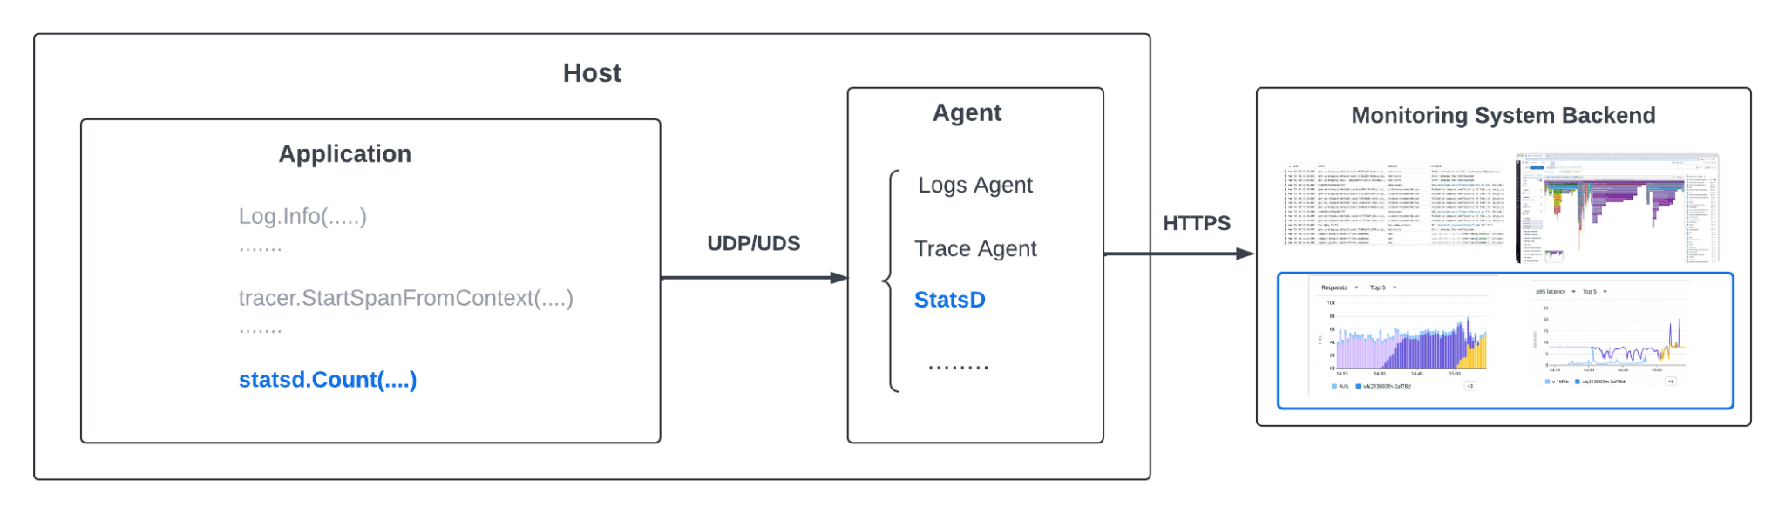
Observing Performance Using StatsD
HTTP
StatsD Client
Receiving Data Packets
Aggregate Metrics
Forwarding Aggregated Values
Notes:
Runtime stats types: count, gauge, set, histogram, distribution

Slide 8
Usage Pattern of statsd in Trading Systems
stats.Count("input.count", batch_size, []string{"env:production", "request_type:new_batch_order"}, 1)
stats.Gauge("input_queue.length", 42, []string{"env:production"}, 1)
stats.Distribution("trade.latency", 23.45, []string{“env:production”, "request_type:cancel_order"}, 1)

Slide 9
Best Practice Using Datadog-go
Client side aggregation to reduce network traffic
WithClientSideAggregation()

Slide 10
Best Practice Using Datadog-go
Client side aggregation to reduce network traffic
WithClientSideAggregation()
Asynchronous collection through channelMode
WithExtendedClientSideAggregation()
Monitor TotalDroppedOnReceive to configure the channel length using WithChannelMode BufferSize(bufferSize int)

Slide 11
Best Practice Using Datadog-go
Client side aggregation to reduce network traffic
WithClientSideAggregation()
Asynchronous collection through channelMode
WithExtendedClientSideAggregation()
Monitor TotalDroppedOnReceive to configure the channel length using WithChannelMode BufferSize(bufferSize int)
Pre-allocations of memory in buffer pool
Monitor memory allocations to configure the buffer pool size

Slide 12
Room for Improvement in the Library
Inefficient API design
Inefficient concurrent map access
Suboptimal buffer pool implementation

Slide 13
Inefficient API Design
Tagging is only supported as a string slice parameter passed to APIs
func (c *Client) Count(name string, value int64, tags []string, rate float64) error func (c *Client) Gauge(name string, value float64, tags []string, rate float64) error func (c *Client) Histogram(name string, value float64, tags []string, rate float64) error func (c *Client) Distribution(name string, value float64, tags []string, rate float64) error func (c *Client) Timing(name string, value time.Duration, tags []string, rate float64) error
Repeatedly computing metrics map key
count.Incr(name, value, tags, rate) { countMap[concatenate(name+looping_thru(tags))].Incr() }
Deficiencies: memory allocations/garbage collection, CPU consumption
Notes:
So if we instrument casually, we could end up with increased overall memory usage, especially when those functions are called frequently, and in turn higher garbage collection overhead.

Slide 14
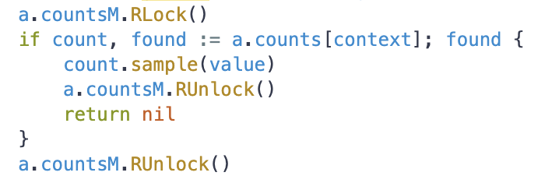

Inefficient Concurrent Map Access
A single map is used to store all metrics in every metric type
A RWMutex is used to guard against concurrent reads & writes to the map
Each metrics submission needs to acquire the lock first
Either with a Read Lock if metric exists in the map
Or with an Exclusive Lock if metric does not exist in the map
Deficiencies: potential blocking, cpu consumption

Slide 15
Suboptimal Buffer Pool Implementation
chan *statsdBuffer
In the chan implementation, operations of send, receive, or len may potentially contend for the lock
Pointers in channel point to non-contiguous memory allocations
borrowBuffer
returnBuffer

Slide 16
Improvements Experimented
Invoke endpoints with MetricHandle instead
Separate reads from writes to metric maps
Replace Channel with Disruptor for Buffer Pool

Slide 17
Introducing MetricHandle
type MetricHandle uint32
RegisterMetric(name string, tags []string) (MetricHandle, error) {
metricHandle := hash(concatenate(name, tags))
registeredStatsMap[MetricHandle] = newMetrics(name, defaultValue, tags)
return metricHandle, nil
}

Slide 18
Invoking Endpoints with MetricHandle
Current endpoints:
func (c *Client) Count(name string, value int64, tags[]string, rate float64) error
func (c *Client) Gauge(name string, value float64, tags[]string, rate float64) error
func (c *Client) Histogram(name string, value float64, tags[]string, rate float64) error
func (c *Client) Distribution(name string, value float64, tags[]string, rate float64) error
func (c *Client) Timing(name string, value time.Duration, tags[]string, rate float64) error
Newly added endpoints:
func (c *Client) CountV2(handle MetricHandle, value int64, rate float64) error
func (c *Client) GaugeV2(handle MetricHandle, value float64, rate float64) error
func (c *Client) HistogramV2(handle MetricHandle, value float64, rate float64) error
func (c *Client) DistributionV2(handle MetricHandle, value float64, rate float64) error
func (c *Client) TimingV2(handle MetricHandle, value time.Duration, rate float64) error

Slide 19
Introducing ImmutableMap
All metric types implement DogMetric interface
type DogMetric interface {
_isDogMetric() bool
}
All metric types use regular maps at write phase
All metric types use ImmutableMap at read phase
type ImmutableMap struct {
Data map[string]interface
}

Slide 20
Separated Reads From Writes Need No Locking
func (a *aggregator) count(name, value, tags) error {
…..
a.countsM.RLock()
if count, found := a.counts[concatenate(name, value)], found {
….
}
a.countsM.RUnlock()
…..
}

Slide 21
Separated Reads From Writes Need No Locking
func (a *aggregatorV2) count(metricHandle, value) error {
…..
a.countsM.RLock()
if count, found := a.counts[metricHandle], found {
….
}
a.countsM.RUnlock()
…..
}

Slide 22
Replace Channel with Disruptor for Buffer Pool
No contention for locks at all as Writer and Reader work at different indexes of the ring buffer
Reads from the pre-allocated, sequential space are fast
With proper ring buffer size no more gc needed
Reader.consume()
Writer.write()
Go-disruptor: https://github.com/smarty-prototypes/go-disruptor

Slide 23
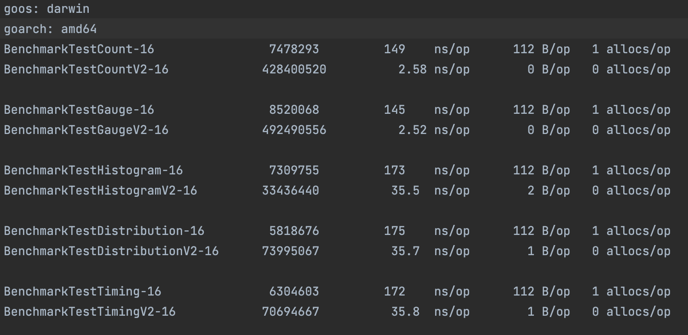
Benchmarking Result

Slide 24
CPU Tax of Enhanced Observing
Which one of the following was the actual percentage of CPU time allocated to statsd inside the trade request handling goroutine after the experiment?
1% (B) 5% (C) 15% (D) 35%

Slide 25
CPU Tax of Enhanced Observing
Which one of the following was the actual percentage of CPU time allocated to statsd inside the trade request handling goroutine after the experiment?
1% (B) 5% (C) 15% (D) 35%

Slide 26
Hope we made you proud, Heisenberg!

Slide 27
Thank you for your time!
If any Questions/Comments/Suggestions, please contact:
holly.casaletto@gmail.com
sunyucong@gmail.com

