Slide 1

ECG analysis
Serena Farina
serena.farina@mail.polimi.it
Stefania Deligia
stefania.deligia@mail.polimi.it
Politecnico di Milano,
21 July 2016
1

Slide 2


Where we get started
Start:
13 April 2016
Implementation
Results
2

Slide 3
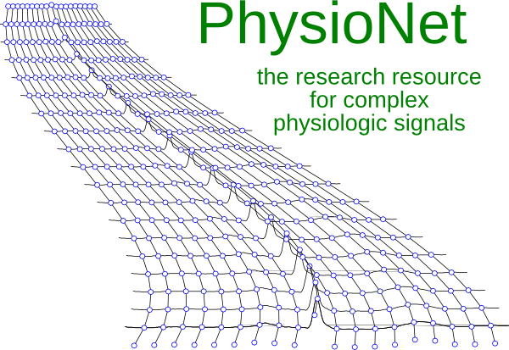
Implementation
Start:
13 April 2016
Implementation
Results
Pan-Tompkins
Algorithm
Data
Bandpass filter
Derivative filter
Squaring transformation
Moving average
3

Slide 4
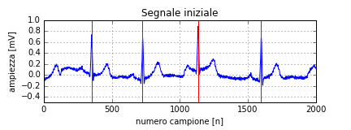
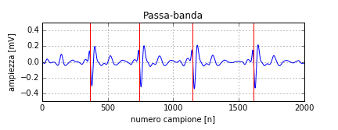
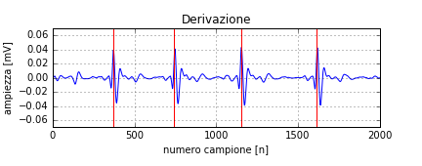
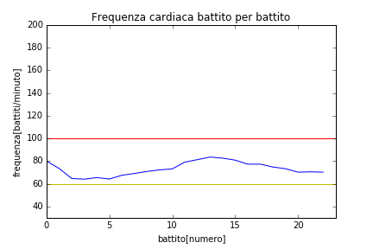
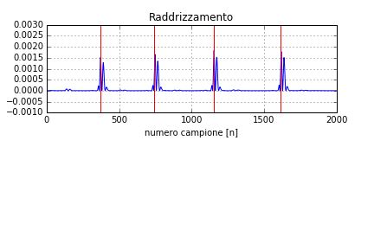
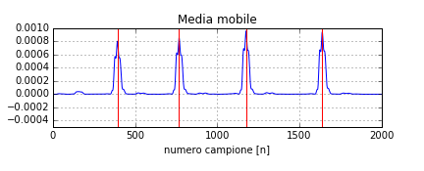
Results
Start:
13 April 2016
Implementation
Results
4

Slide 5



Thanks for your attention!
5

