Slide 1
Review 2 College news report
Guide
Presenters
2010030071 - Jyothin Movva
2010030151 - Satyavarsan K S
2010030040 - Devaraj Acharya
2010030393 - Haneesh Malepati

Slide 2
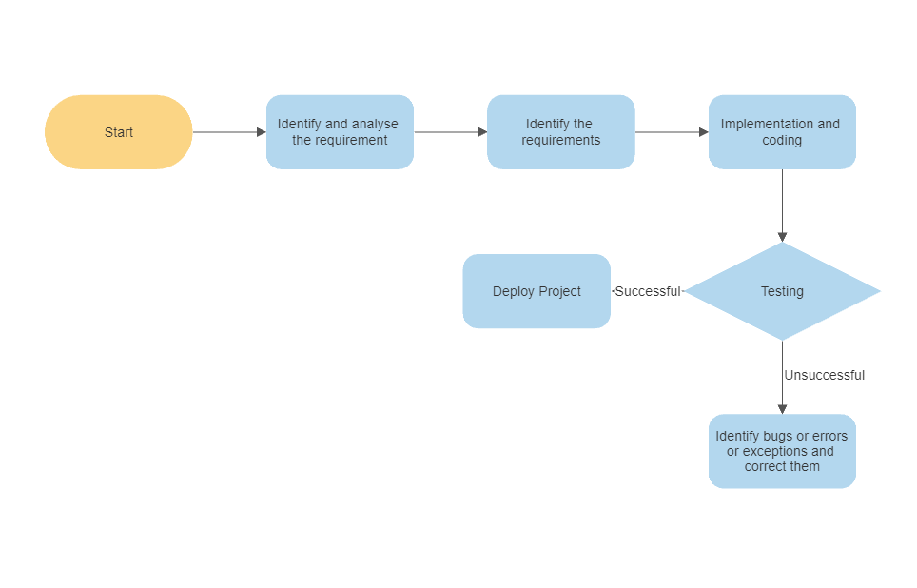
Flowchart

Slide 3
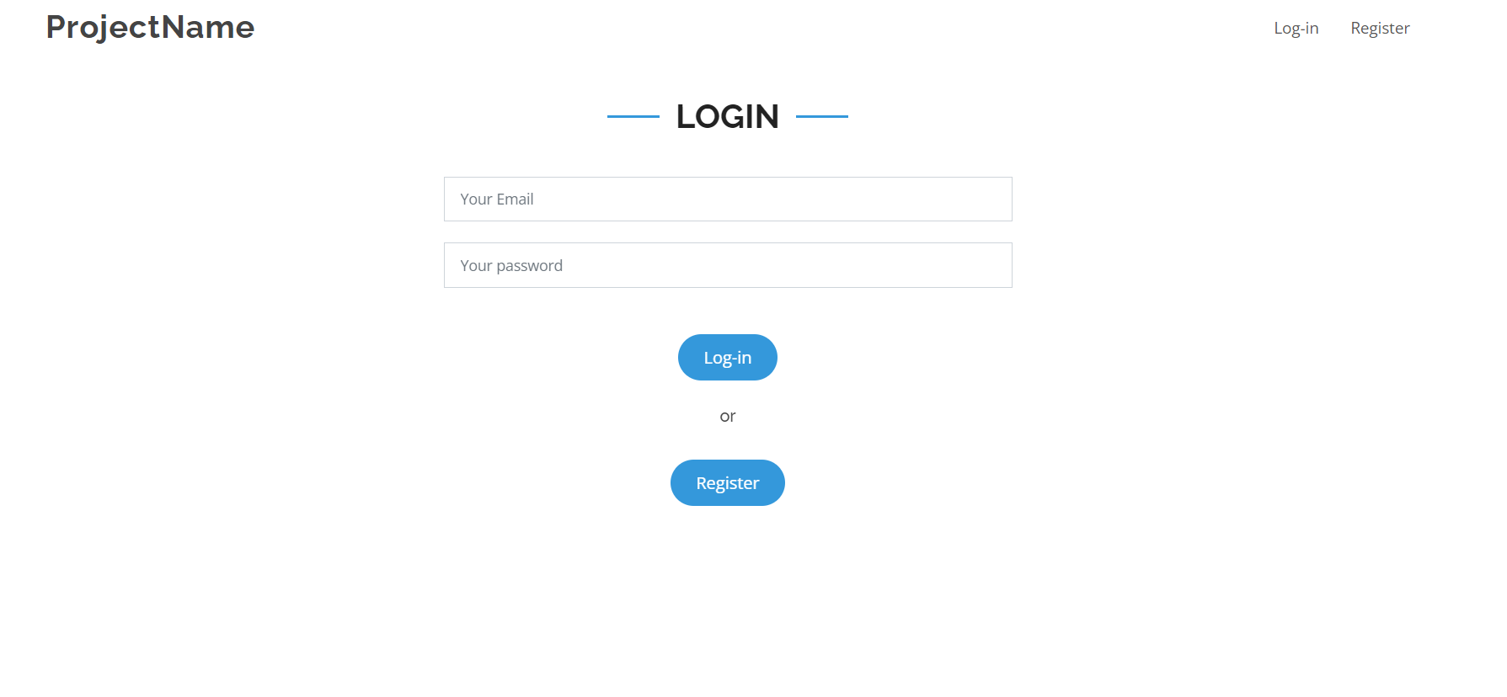
Work progress
Created HTML pages for login register and homepage

Slide 4
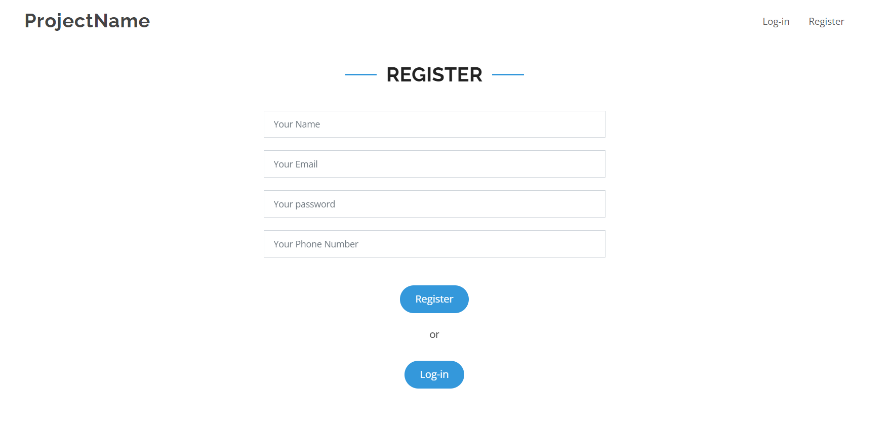
Work progress

Slide 5
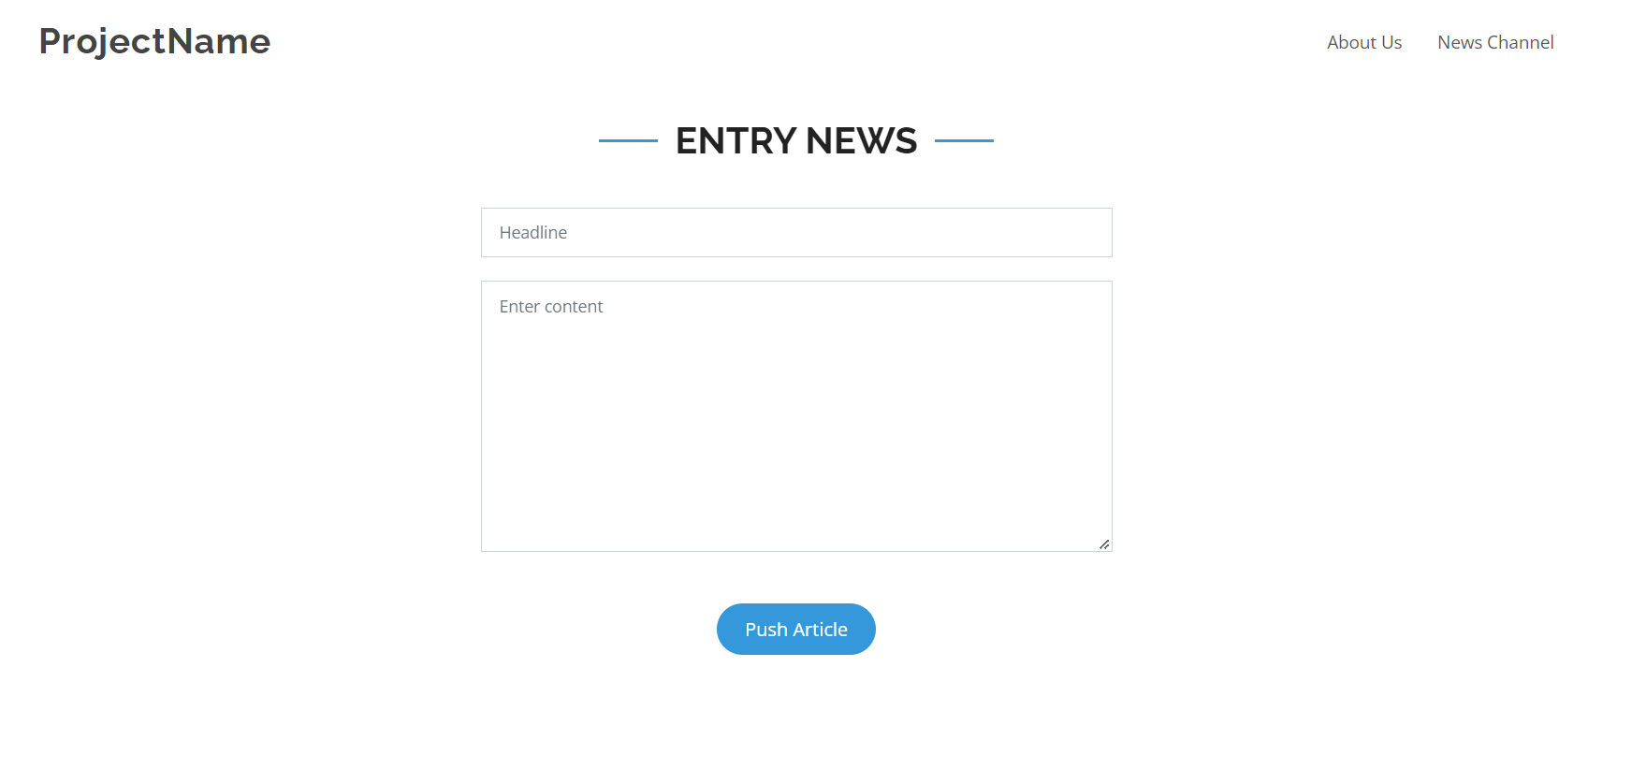
Work progress

Slide 6
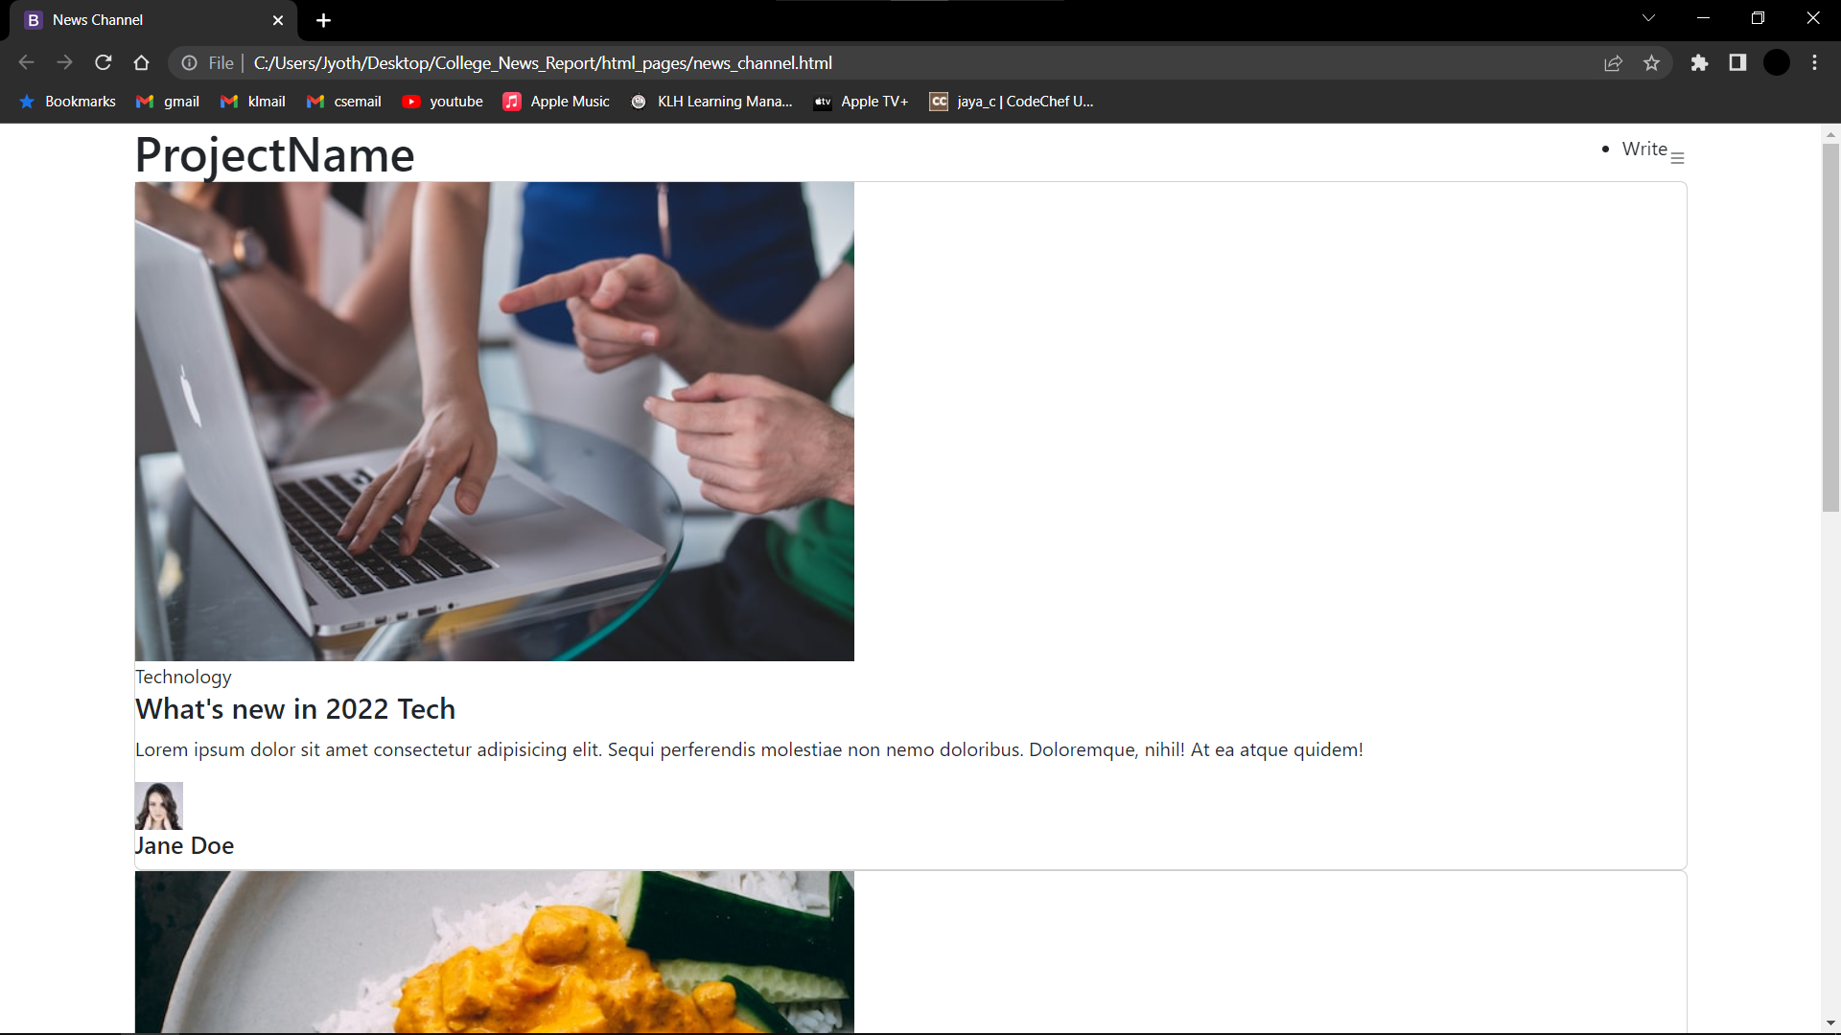
Work progress

Slide 7
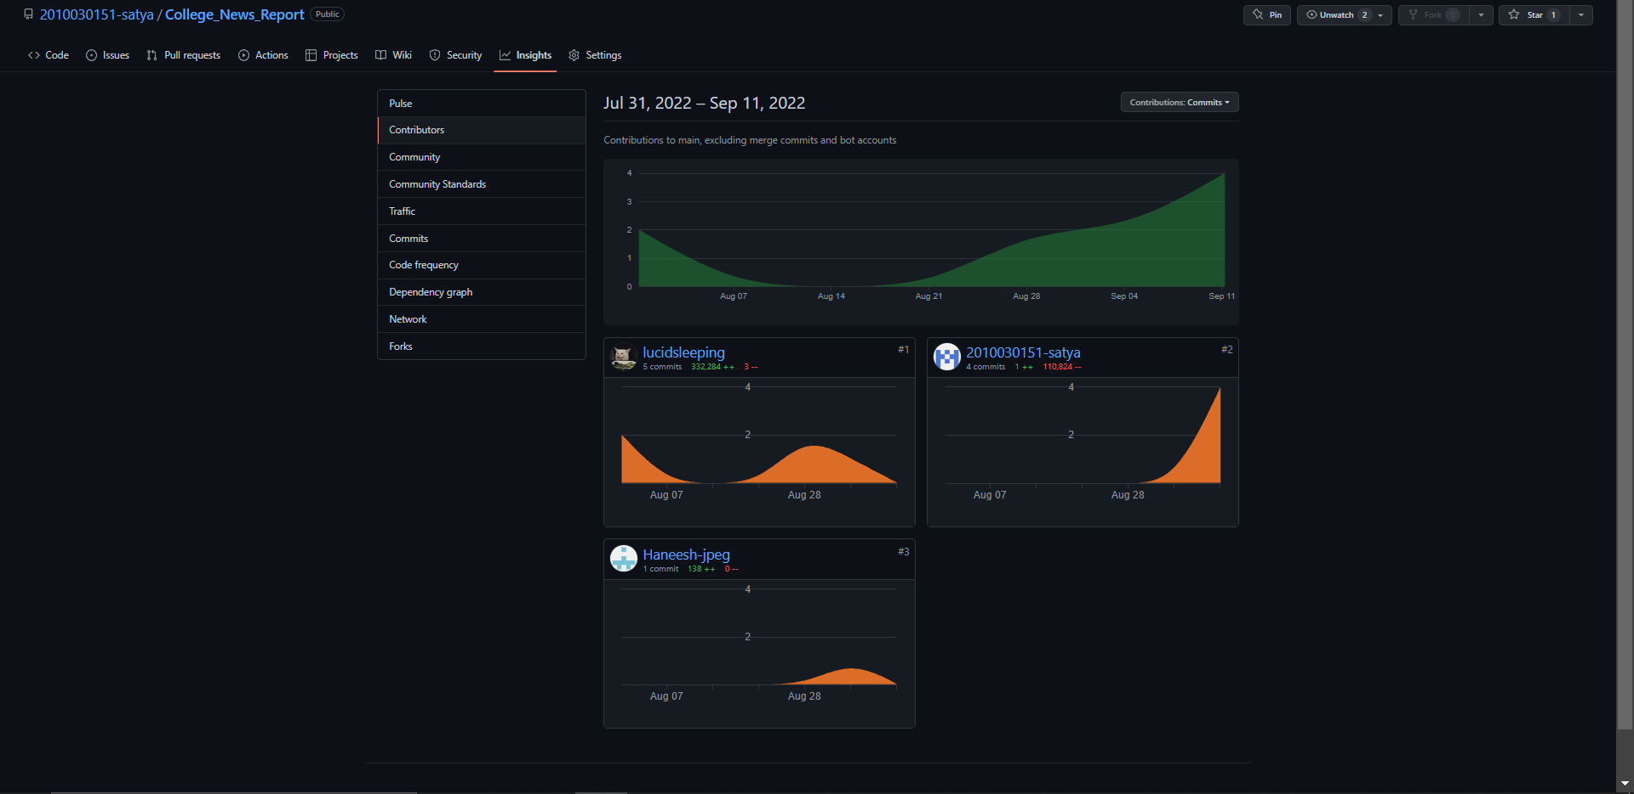
GitHub commits

Slide 8
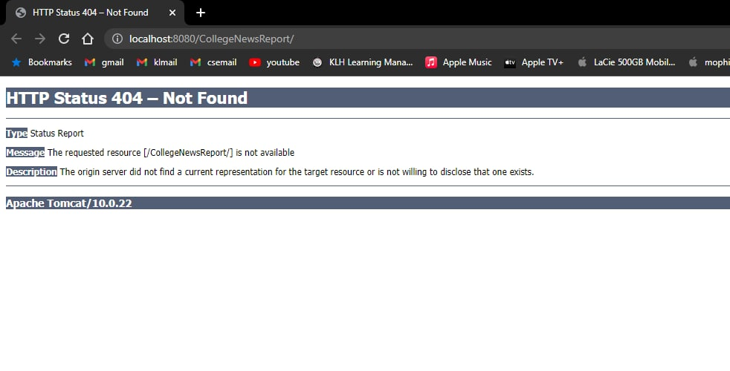
Alpha testing
Web.xml is not configured yet
Need to add functionality to the webpages

Slide 9
THANK YOU

