Slide 1
REVIEW 4 Music generation using machine learning
Guide:
Dr. Arpita Gupta
Presenters
2010030071 - Jyothin Movva
2010030151 - K S Satyavarsan
2010030040 - Devaraj Acharya

Slide 2
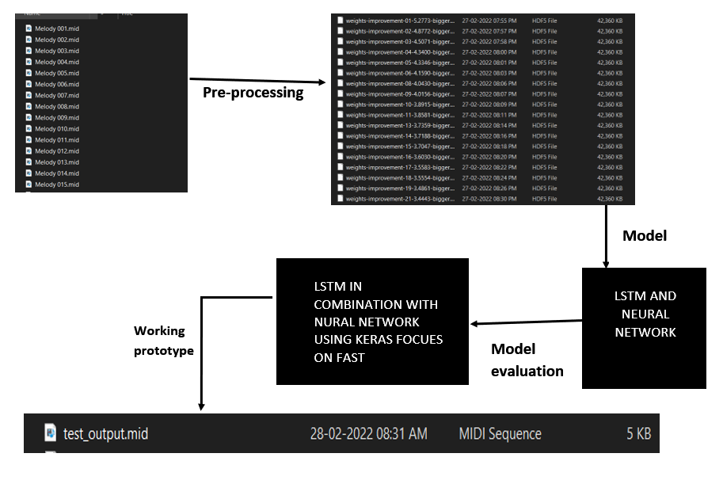
IMPLEMENTATION FLOWCHART

Slide 3
Dataset and techniques
Dataset | characteristics | Models and Technique
Midi melody files | 60 midi files | LSTM
Midi piano files | 92 midi files | LSTM
Lakh pianoroll dataset . | 174,154 multitrack piano rolls | 1)JamBot (LSTM) 2)Convolutional Generative Adversarial Networks with Binary Neurons for Polyphonic Music Generation (GAN) 3)MuseGAN (GAN)
Lo-Fi Hip Hop MIDIs | 93 midi files | 1) Lo-Fi Hip Hop Generation(LSTM)
Multi-modal MIREX Emotion Dataset | 193 midi files

Slide 4
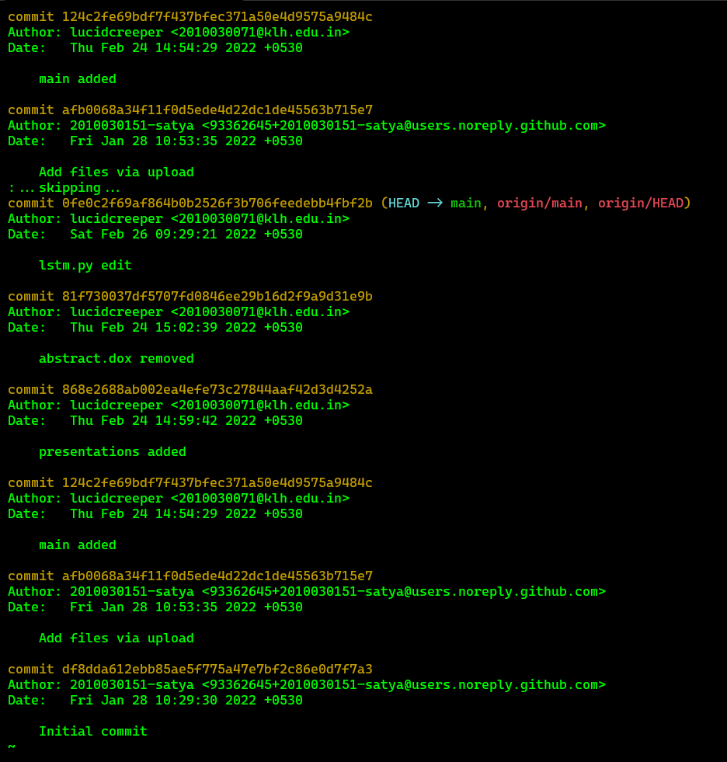
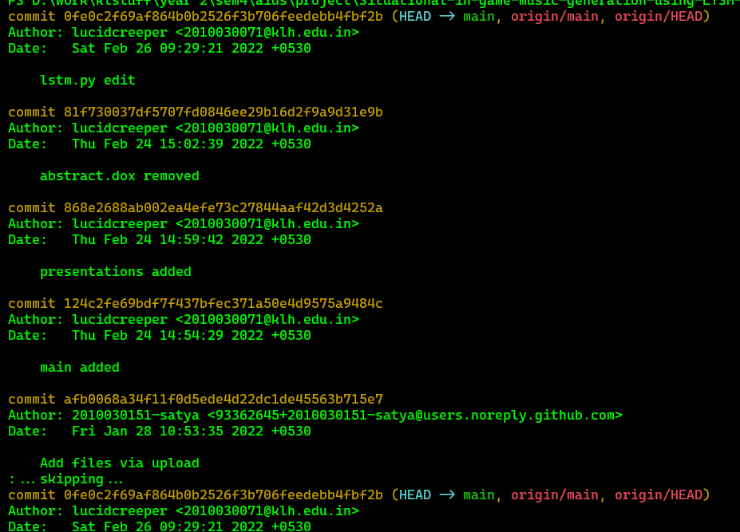
GITHUB COMMITS

Slide 5
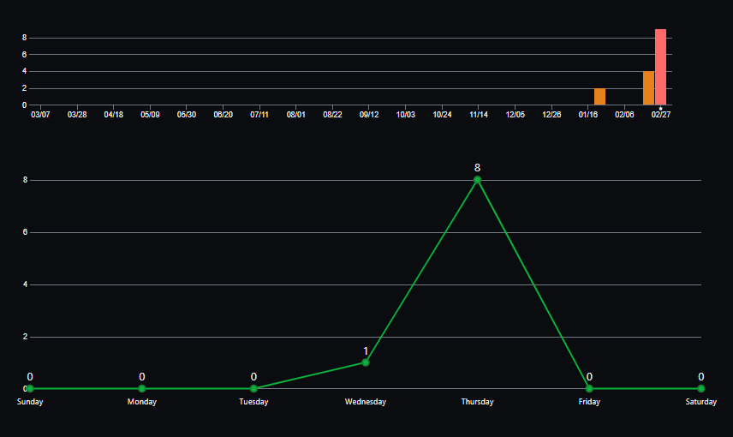

Slide 6
TECHNIQUES AND SELECTED MODELS
Neural Network in combination with LSTM
Techniques -
Keras – NN & LSTM
Music21 – toolkit used to analyze and transforming music files
Pandas – Data analysis toolkit
Pickle – serializing and de serializing a python object structure so it can be saved on to a disk.

Slide 7
IMPLEMTATION
from django.shortcuts import redirect, render
from .models import Document
from .forms import DocumentForm
import pickle
import numpy
from music21 import instrument, note, stream, chord
from keras.models import Sequential
from keras.layers import Dense
from keras.layers import Dropout
from keras.layers import LSTM
from keras.layers import BatchNormalization as BatchNorm
from keras.layers import Activation
def generate():
""" Generate a piano midi file """
#load the notes used to train the model
with open('data/notes', 'rb') as filepath:
notes = pickle.load(filepath)
# Get all pitch names
pitchnames = sorted(set(item for item in notes))
# Get all pitch names
n_vocab = len(set(notes))

Slide 8
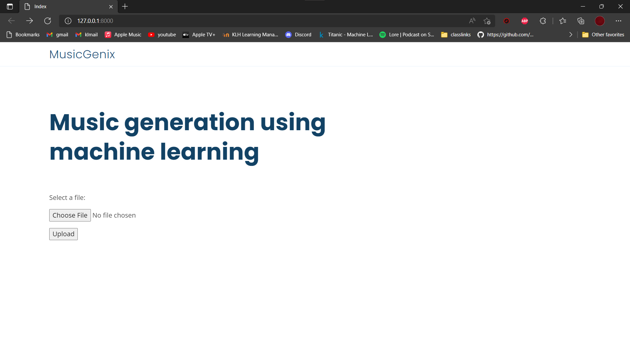
RESULTS

Slide 9
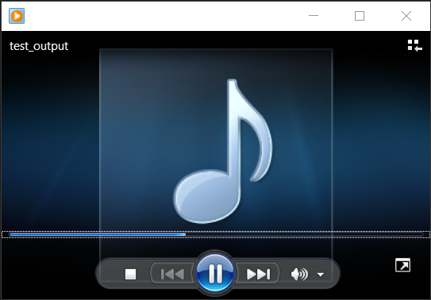

Slide 10
Suggestions

Slide 11
Thank you

