Slide 1
REVIEW 2 Music generation using LTSM
Guide:
Dr. Arpita Gupta
Presenters
2010030071 - Jyothin Movva
2010030151 - K S Satyavarsan
2010030040 - Devaraj Acharya

Slide 2
LITERATURE REVIEW

Slide 3
S.NO | Authors | Title | Publishing | Techniques & dataset | Pros | Cons
1 | Hao-Wen Dong, Wen-Yi Hsiao, Li-Chia Yang,Yi-Hsuan Yang | MuseGAN: Multi-track Sequential Generative Adversarial Networks for Symbolic Music Generation and Accompaniment | Research Center for Information Technology Innovation, Academia Sinica, Taipei, Taiwan & Department of Computer Science, National Tsing Hua University, Hsinchu, Taiwan | considering bars as the basic compositional unit for the fact that harmonic changes (e.g., chord changes) usually occur at the boundaries of bars and that human beings often use bars as the building blocks when composing songs. The dataset is derived from Lakh MIDI dataset | An easy logical solution to generate the music. Using the chords changes to train the model is an effective way to train the model to generate new music | The dataset uses only midi files which can be less rich compared to music format such as .wav
2 | Sageev Oore Ian Simon Sander Dieleman Douglas Eck Karen Simonyan | This Time with Feeling: Learning Expressive Musical Performance | Dalhousie University and Vector Institute; work done while author at Google Brain, DeepMind | The data set used is International Piano-e-Competition dataset. Modal used is LSTM – based RNN with three layers of 512 cells each. | Uses more musical convention to train the modal instead of chord changes. | With a tempo of 120 bmp each beat lasts for 500ms which corresponds to the change of 25ms. This will eventually add up to be a greater change.

Slide 4
S.NO | Authors | Title | Publishing | Techniques & dataset | Pros | Cons
3 | Nabil Hewahi ,Salman AlSaigal & Sulaiman AlJanahi | Generation of music pieces using machine learning: long short-term memory neural networks approach | Published by Informa UK Limited, trading as Taylor & Francis Group on behalf of the University of Bahrain | Based on lSTM neural networks approach. The datset is Bach’s ‘Well-Tempered Clavier Book II’. At fixed intervals durint the networking training, the network generates music and sabes it in MIDI format. For sample n the timesteps are in the range [n-w,n-1] and let the NN to predict the sample n+1 | Easy to implement as the tools used are easy to understand. Uses a neural network to generate the music from the given dataset | Having many LSTM layers makes the learning progress slower and less accurate than having one or two lateys.
4 | Prafulla Dhariwal, Heewoo Jun, Christine Payne, Jong Wook Kim, Alec Radford, Ilya Sutskever | Jukebox: A Generative Model for Music | Published by Cornell University | Curate a new dataset of 1.2 million songs (600,000 of which are in English), paired with the corresponding lyrics and metadata from LyrickWiki. The metadata includes artist, album genre, and year of the songs, along with common moods or playlist keywords associated with each song. | Music quality is comparatively better than other models. Each of these models has 72 layers of factorized self-attention on a context of 8192 codes. | Suffer from hierarchy collapse due to use of successive encoders coupled with autoregressive decoders

Slide 5
S.NO | Authors | Title | Publishing | Techniques & dataset | Pros | Cons
5 | Li-Chia Yang, Szu-Yu Chou, Yi-Hsuan Yang | MIDINET: A CONVOLUTIONAL GENERATIVE ADVERSARIAL NETWORK FOR SYMBOLIC-DOMAIN MUSIC GENERATION | Research Center for IT innovation, Academia Sinica, Taipei, Taiwan | A MIDI dataset that clearly specifies per file which channel corresponds to the melody. A collection of 1,022 MIDI tabs of pop music from TheoryTab, 4 which provides exactly two channels per tab, one for melody and the other for the underlying chord progression. | MidiNet performs comparably with MelodyRNN models in being realistic and pleasant to listen to, yet MidiNet’s melodies are reported to be much more interesting. | The dataset uses only midi files which can be less rich compared to music format such as .wav

Slide 6
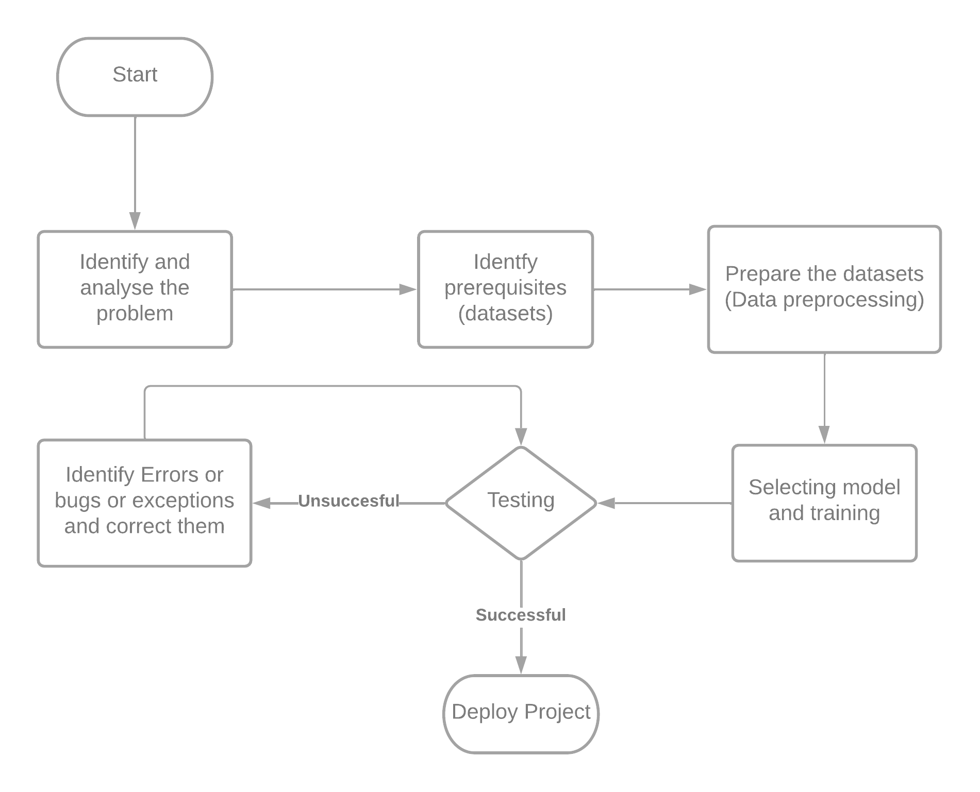
IMPLEMENTATION FLOWCHART

Slide 7
Dataset and techniques
Dataset | characteristics | Models and Technique
Midi melody files for theme song | 60 midi files | LSTM
Midi piano files | 92 midi files | LSTM
Lakh pianoroll dataset . | 174,154 multitrack piano rolls | 1)JamBot (LSTM) 2)Convolutional Generative Adversarial Networks with Binary Neurons for Polyphonic Music Generation (GAN) 3)MuseGAN (GAN)
Lo-Fi Hip Hop MIDIs | 93 midi files | 1) Lo-Fi Hip Hop Generation(LSTM)
Multi-modal MIREX Emotion Dataset | 193 midi files

Slide 8
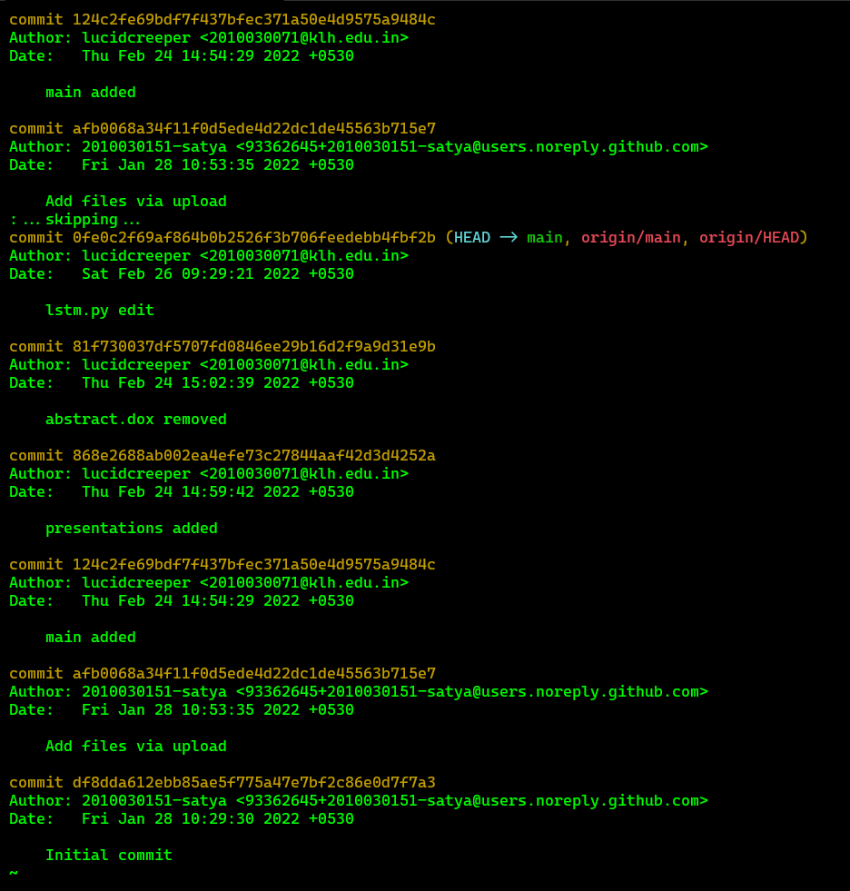
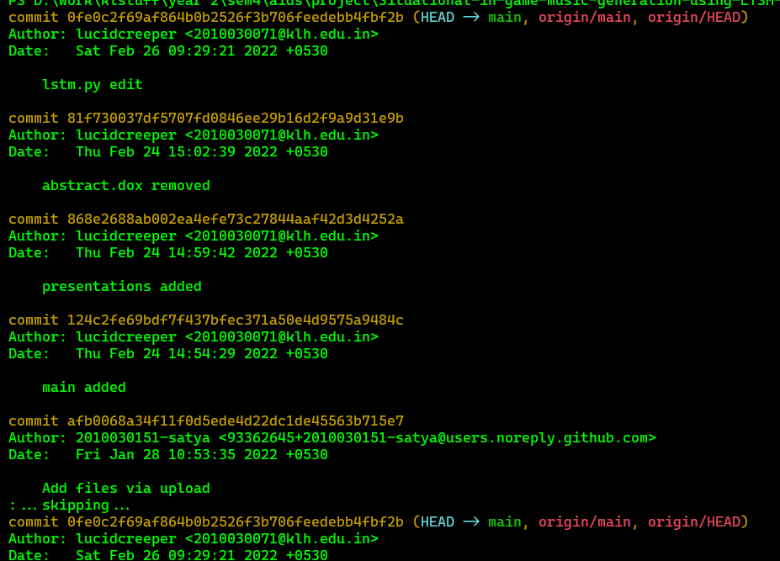
GITHUB COMMITS

Slide 9
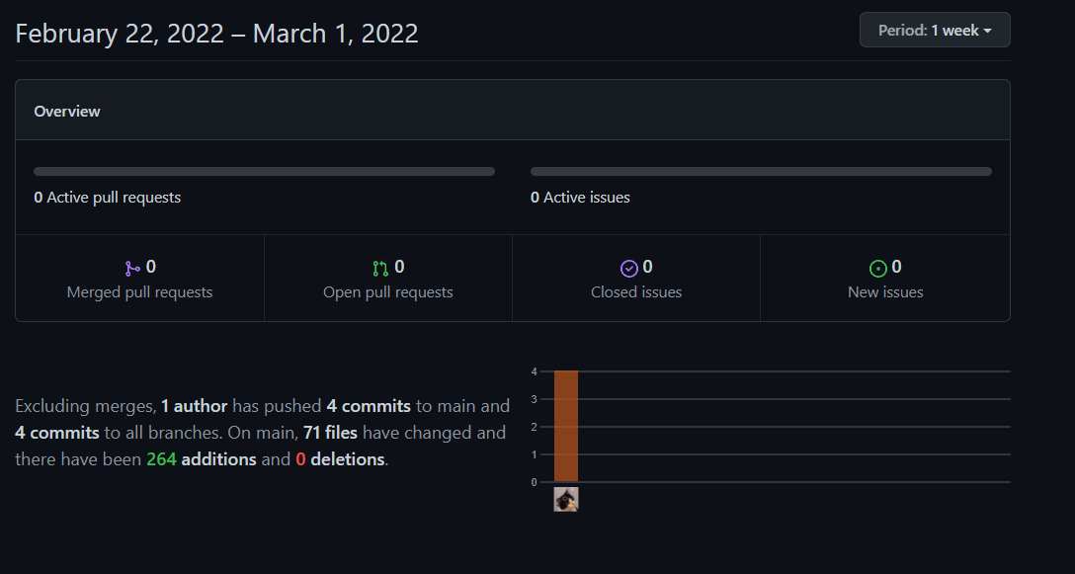

Slide 10
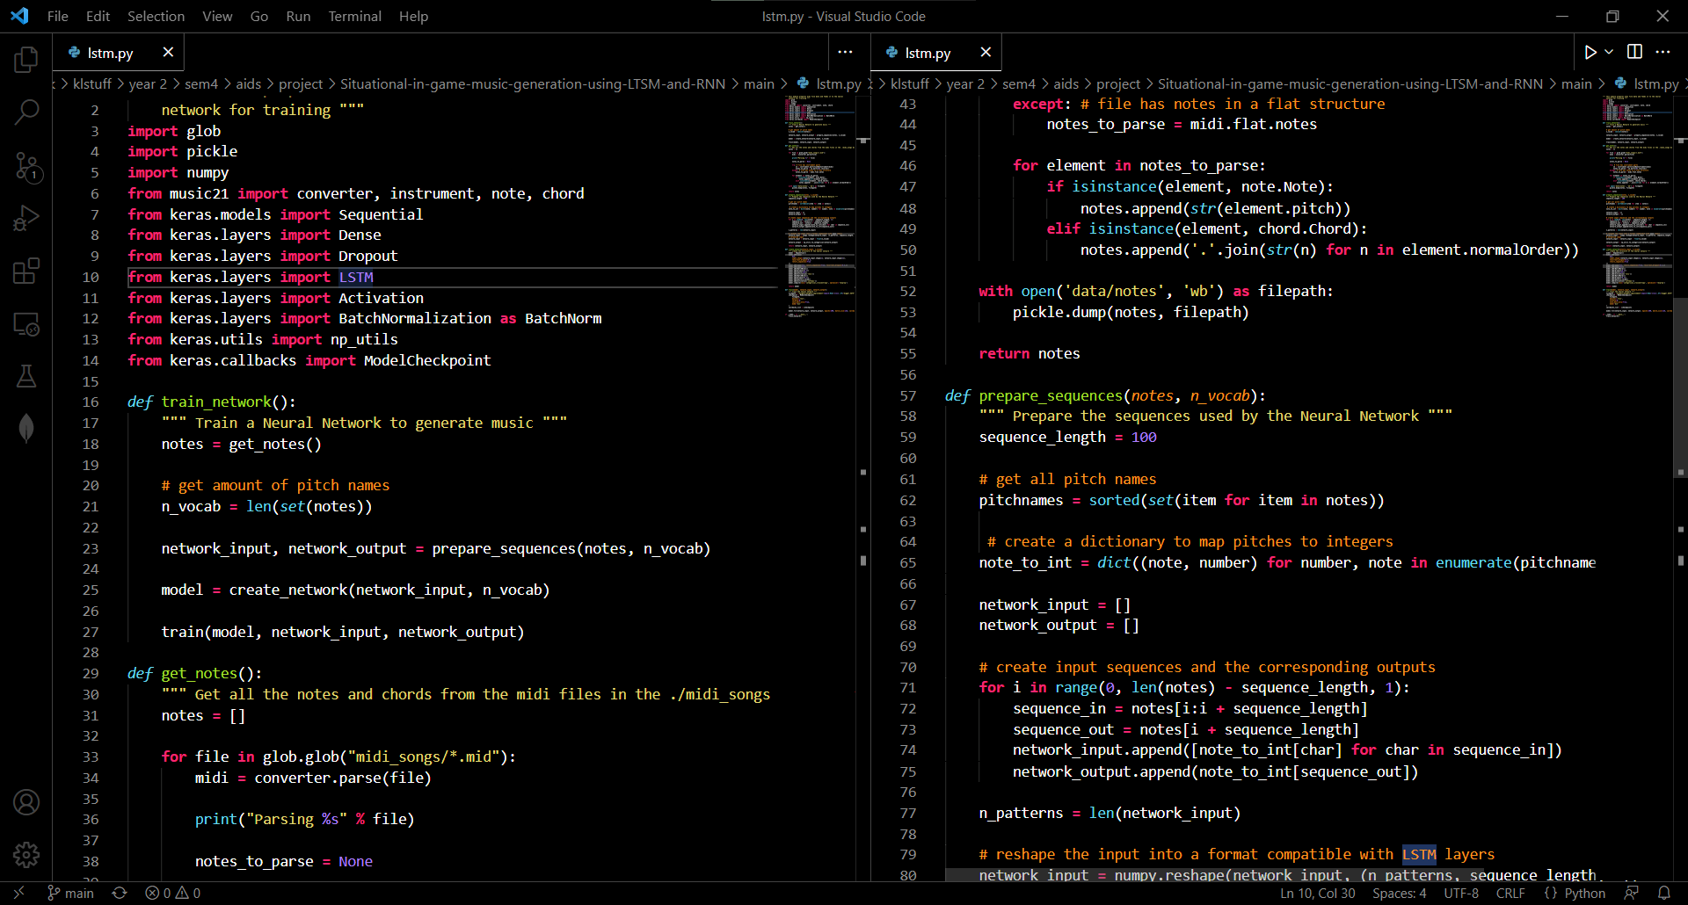
PRE-PROCESSING CODE

Slide 11
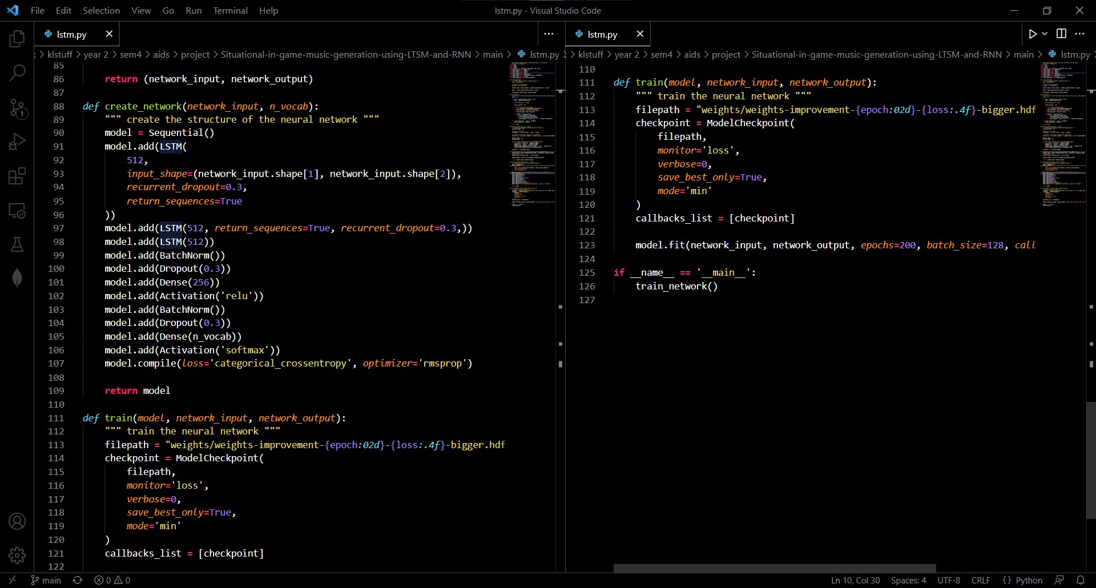

Slide 12
TECHNIQUES AND SELECTED MODELS
LSTM

Slide 13
Suggestions

Slide 14
Thank you

