Slide 1
Farmer’s All
One stop shop for agricultural needs.

Slide 2
Introduction
Farmer’s All is your one-stop destination for everything related to farming and agriculture! Whether you're a seasoned farmer, an aspiring agriculturist, or simply curious about the world of farming, you've come to the right place. Our website provides a wealth of information, resources, and a supportive community for all things agriculture.
At Farmers All, we recognize the pivotal role that paddy farmers play in ensuring a steady supply of this essential grain. Our website is on a mission to empower paddy farmers and enthusiasts alike by sharing specialized knowledge, offering practical advice, and building a strong, supportive community that centers on rice cultivation.

Slide 3
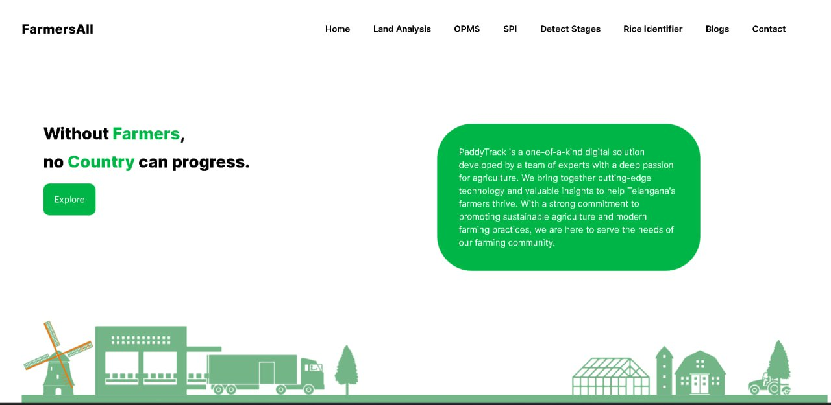
Home page
This is the primary page which
includes all navigation options
to various features. It is a
lightweight and simple to
understand homepage

Slide 5
ML models we implemented
Paddy cultivation identification (using satellite images)
Paddy cultivation identification (using uploaded images)
Stage of paddy identification
Substandard paddy identification
Rice Identification

Slide 6
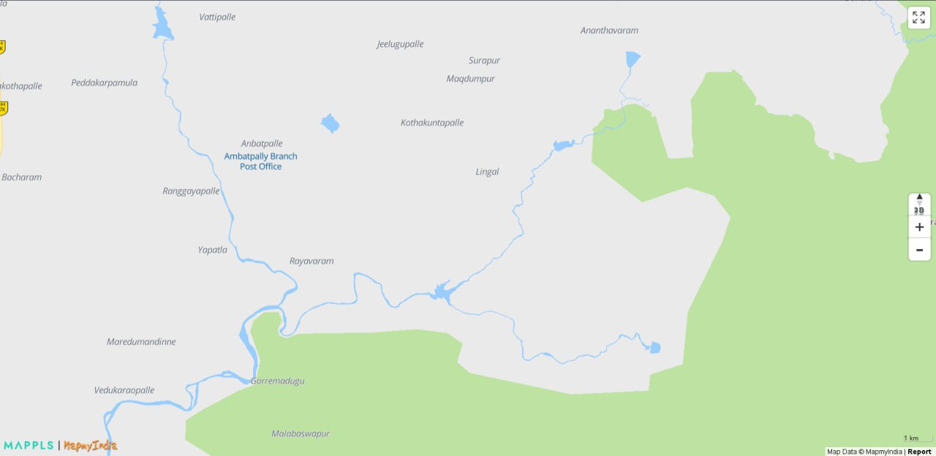
Paddy cultivation identification (using satellite images)
This is one of the main features of this project that enables us to determine whether a patch of land can be cultivable or not.
Upon selecting a location, the backend code gets the coordinates of the location and feeds it into google maps which in return provides us with the satellite image
The satellite image obtained is later classified by our model which deems whether the land is cultivable or not

Slide 7
ML models we implemented
Paddy cultivation identification (using satellite images)
Paddy cultivation identification (using uploaded images)
Stage of paddy identification
Substandard paddy identification
Rice Identification

Slide 8
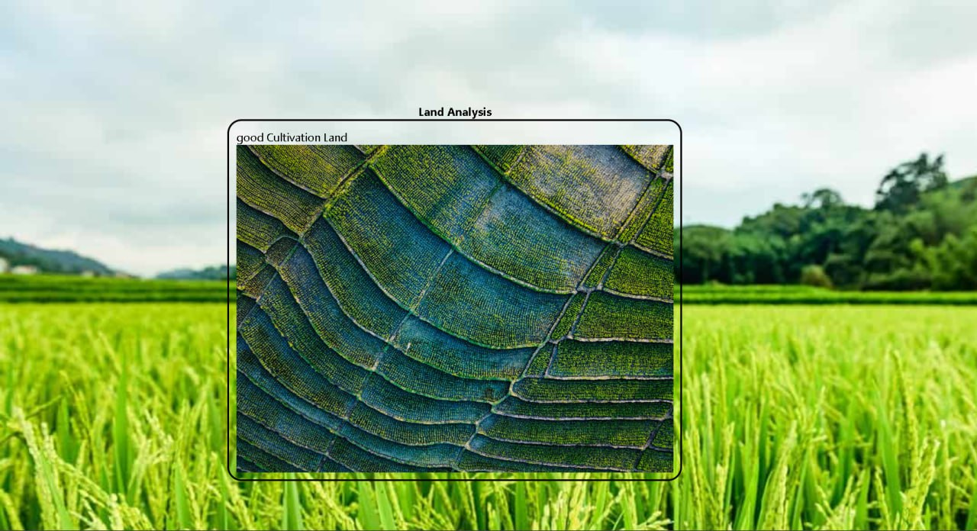
Paddy cultivation identification (using uploaded images)
This is one of the main features of this project that enables us to determine whether a patch of land can be cultivable or not.
Upon uploading like using satellite images, the backend code classifies if the field is cultivatable or not

Slide 9
ML models we implemented
Paddy cultivation identification (using satellite images)
Paddy cultivation identification (using uploaded images)
Stage of paddy identification
Substandard paddy identification
Rice Identification

Slide 10
Stage of paddy identification
Ploughing
Harvesting
Tillering
Ripening
In this webpage, we identify the stage of cultivation the paddy is in.
This can provide users with unique insights on course of action.
The input is image of the paddy and the output produces is the stage of cultivation the paddy is in which can be used more extensively in other applications

Slide 11
ML models we implemented
Paddy cultivation identification (using satellite images)
Paddy cultivation identification (using uploaded images)
Stage of paddy identification
Substandard paddy identification
Rice Identification

Slide 12
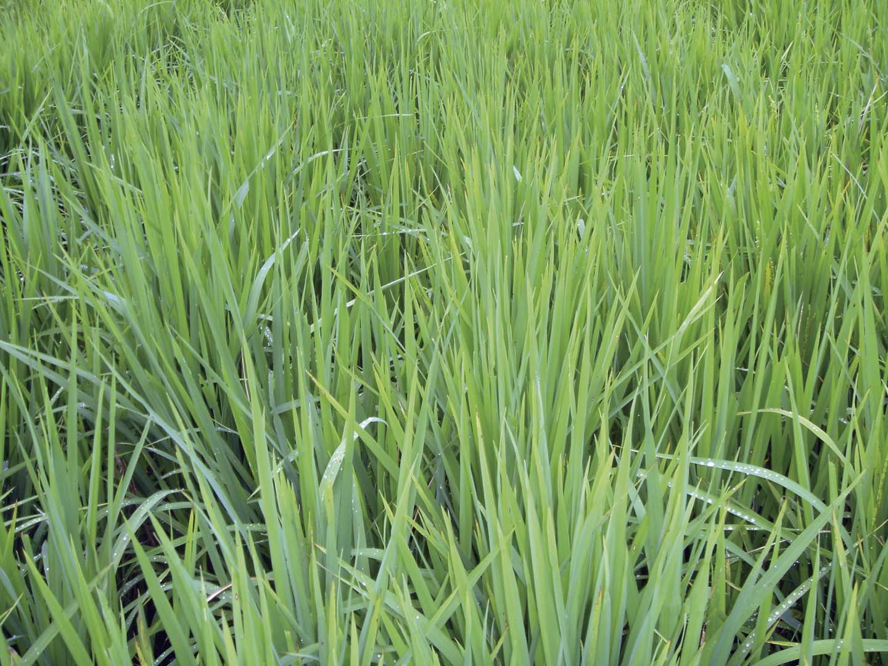
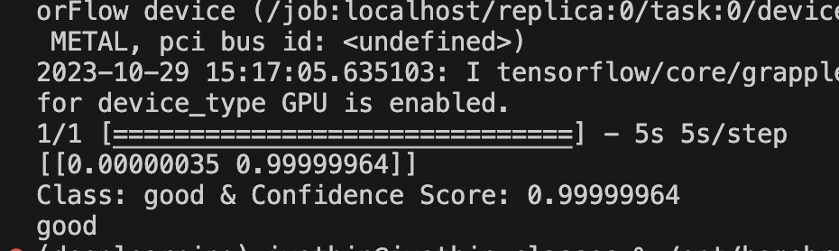
Substandard paddy identification
This part of our project will help us distinguish good quality paddy with substandard ones
The drop in quality might help the user understand and analyze what might have caused the decline

Slide 13
ML models we implemented
Paddy cultivation identification (using satellite images)
Paddy cultivation identification (using uploaded images)
Stage of paddy identification
Substandard paddy identification
Rice Identification

Slide 14
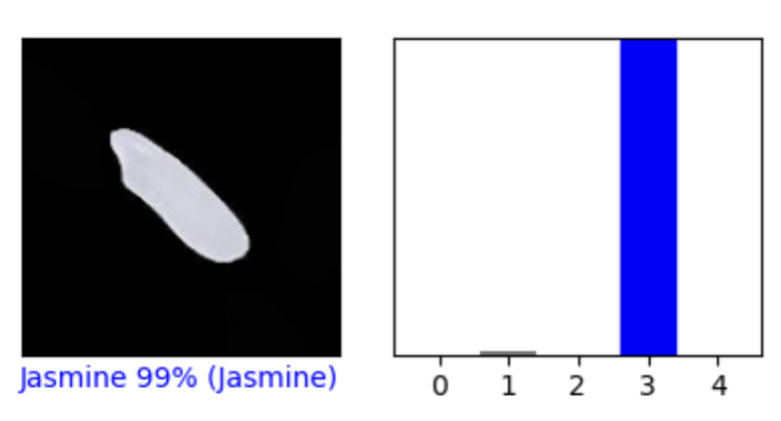
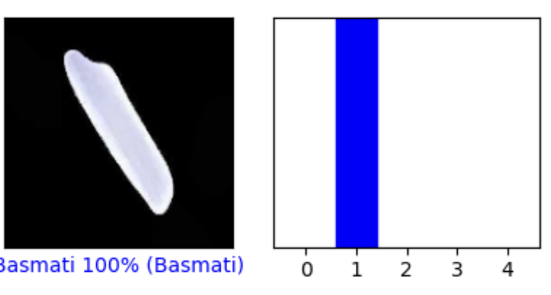
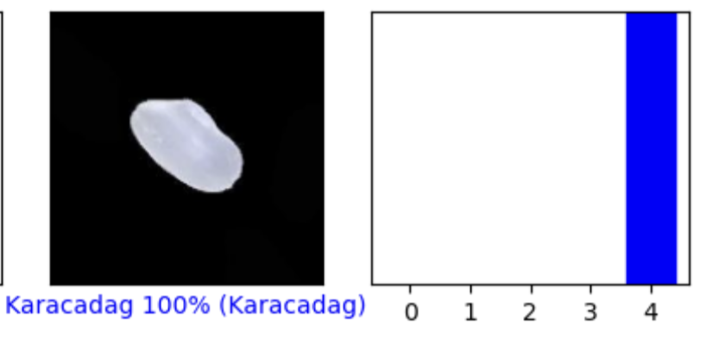
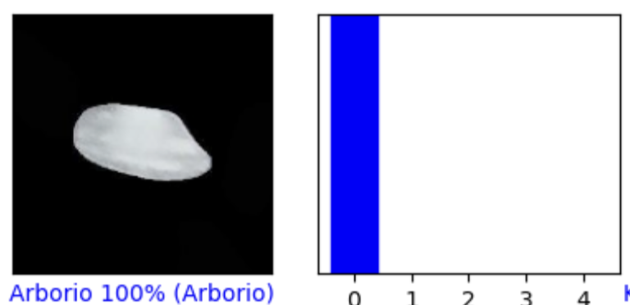
Rice Identification
This helps us identify the type of rice and can provide helpful insights to users that are not well versed with the type of rice
As each type of rice is used for a specific dishes ,using the right type might be crucial and this will help new users identify the type of rice needed for their scenario

Slide 15
Rice Identification

Slide 16
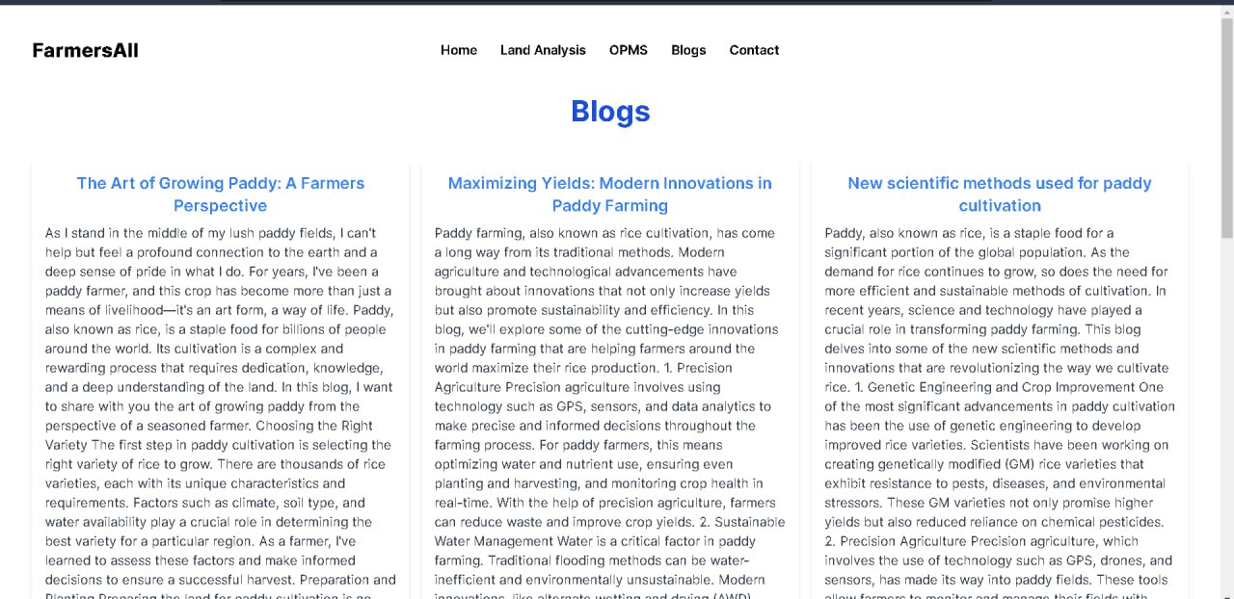
Blogs
This page enables users to share valuable insights about the paddy industry and keep in date with the current trends that help us raise the standards of paddy and other agricultural products.

Slide 18
Online procurement system
Convenient Access to Markets: Online procurement systems provide paddy farmers with easy access to a broader marketplace.
Transparent Pricing: These platforms often offer real-time price information, ensuring that farmers receive fair and competitive prices for their paddy.
Reduced Middlemen: By directly connecting with buyers through online systems, paddy farmers can eliminate middlemen, which can lead to higher profit margins.
Timely Payments: Online procurement systems typically facilitate prompt and secure payment methods as there is a record of everything unlike conventional methods being used right now
Overall, it enables the farmers to move their outcomes in a procedural manner eliminating all types of errors which could’ve aroused in case of traditional methods.

Slide 19
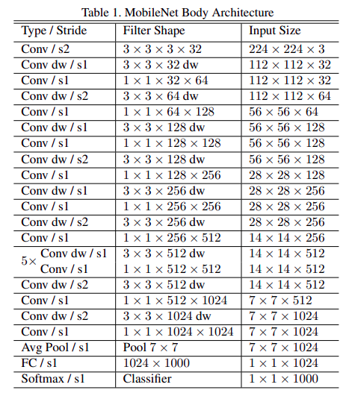
About our machine learning model
We are using MobileNet is a simple but efficient and not very computationally intensive convolutional neural networks for mobile vision applications.

Slide 20
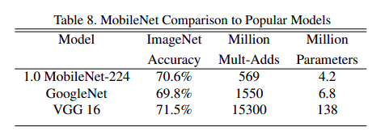
About our machine learning model
Comparison of MobileNet with Popular Models
The below image shows that MobileNet dominates over other famous and state-of-art models like GoogleNet and VGG 16 with just lesser parameters

Slide 21
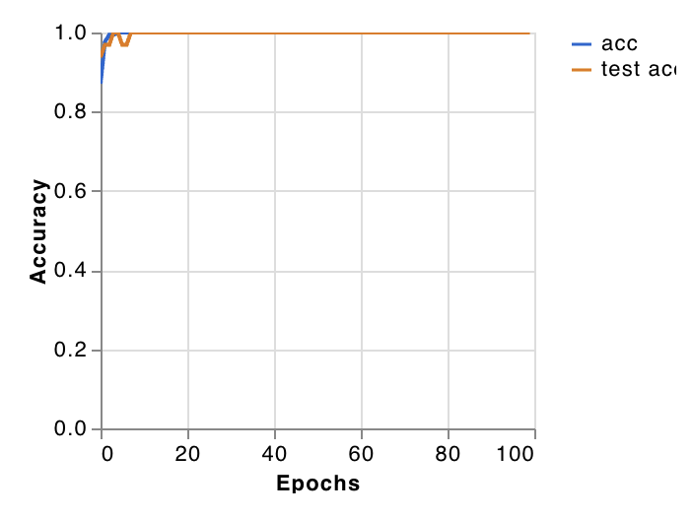
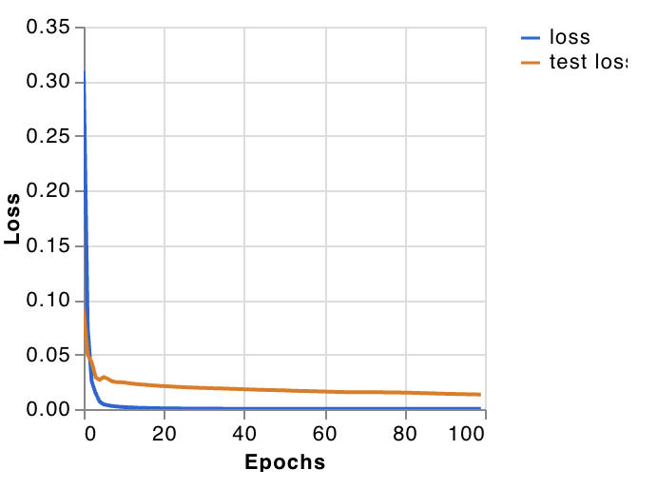
About our machine learning model
accuracy
loss

Slide 22
About our machine learning model
Snippet of transfer leaving code :
base_model=MobileNet(weights='imagenet',include_top=False)
x=base_model.output
x=GlobalAveragePooling2D()(x)
x=Dense(1024,activation='relu')(x)
x=Dense(1024,activation='relu')(x)
x=Dense(512,activation='relu')(x)
preds=Dense(2,activation='softmax')(x)

Slide 23
THANK YOU

