Slide 1

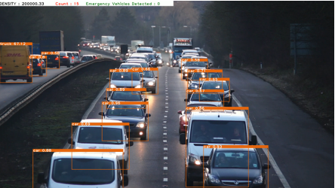
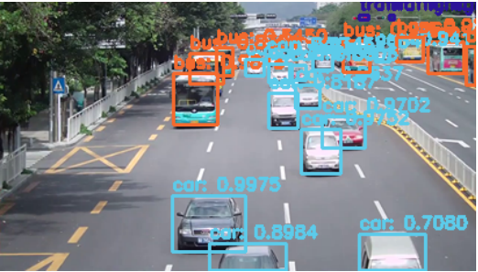
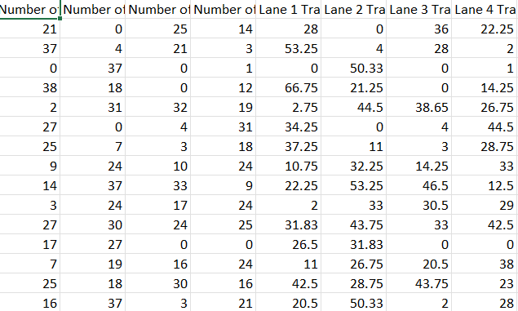
Koneru Lakshmaiah Education Foundation, Hyderabad(Aziz Nagar , Off Campus)
Intelligent Transportation System for Traffic prediction
BOLLINENI CHOOSHNITA, TELUGU ROHITH, PERLA NADA ASISH
Department of Computer Science and Engineering, Koneru Lakshmaiah Education Foundation, Hyderabad-500075, Telangana, India.
Abstract
Methods and Materials
Discussion
Congestion in traffic is a serious issue.
In existing system signal timings are fixed and they are independent of traffic density, Large red light delays leads to traffic congestion.
In this project, Video based traffic estimation system is implemented in which signal timings are updated based on the vehicle counting.
This system consists of Deep Learning module it detect the vehicle count of the current system and sends to the traffic signal.
Based on traffic density of Vehicle System will Predict the Traffic Congestion.
The proposed method for traffic control using image processing involves the calculation of traffic density using image processing techniques. The traffic density of lanes is determined by analyzing images captured by digital cameras placed on the lanes. Based on the traffic densities on all roads, the model intelligently allocates the time period of green light for each road. This approach utilizes image processing as it is a cost-effective solution compared to other devices such as sensors .
Some other common headings we see:
Image Processing
YOLOv4
MobileNet V2
Convolutional neural network
Emergency Vehicle Detection
Average Vehicle Area
One of the standout features of this system is the capacity to identify emergency vehicles in real-time. When an emergency vehicle is detected, the system can trigger adaptive traffic signal changes, creating a clear path for the vehicle and potentially saving valuable time during emergencies.
The proposed system's ability to optimize traffic flow and aid emergency vehicles enhances overall transportation efficiency and public safety which is crucial for managing incidents like accidents, medical emergencies, or natural disasters.
The computation of the average vehicle area factor allows for dynamic adjustment of traffic signals and rerouting of vehicles, which can help minimize congestion and optimize traffic flow .
Figure 1. Output detecting ambulance
Figure 2. Detect normal vechiles
Introduction
Results
Conclusions
Traffic congestion is a significant problem in urban areas, leading to delays, increased travel times, and economic, social, and environmental impacts .
The existing traffic systems are timer-based and do not consider the amount of traffic or the presence of emergency vehicles, such as ambulances and fire engines .
Vehicle flow discovery is crucial for effective traffic control and operation, and this research proposes a smart traffic system that utilizes real-time vehicle detection and emergency vehicle identification .
The proposed system employs YOLOv4 and MobileNet V2 convolutional neural network models to accurately detect the number of vehicles and identify emergency vehicles in real-time .
The proposed smart traffic system, utilizing real-time vehicle detection and emergency vehicle identification, significantly reduces average travel times and emergency response times .
The YOLOv4 and MobileNet V2 convolutional neural network models achieved a validation accuracy of 95.49% and a validation loss of 0.1810, indicating their effectiveness in accurately detecting the number of vehicles and identifying emergency vehicles in real-time .
The average vehicle area factor is computed to enhance traffic management, allowing for dynamic adjustment of traffic signals and rerouting of vehicles to minimize congestion .
The system aims to provide priority access for emergency vehicles, ensuring their swift passage and reducing delays in emergency response .
The proposed model offers a cost-effective and accurate solution for traffic management, with the potential to optimize performance further by utilizing high-resolution cameras
This project introduces a novel traffic estimation method centered around vehicle density, a highly efficient metric for assessing traffic conditions.
In contrast to traditional digital image processing methods relying on bulky computers, this method incorporates AI modules and microcomputers for image processing. This transition significantly reduces the space required and speeds up data processing.
Various object detection techniques are applied to ascertain traffic density. These techniques, based on computer vision and machine learning, enable the system to identify and count vehicles in real-time.
Table 1. Image preprocessing Data set
Chart 1. CNN Model
 | Heading | Heading | Heading
Item | 800 | 790 | 4001
Item | 356 | 856 | 290
Item | 228 | 134 | 238
Item | 954 | 875 | 976
Item | 324 | 325 | 301
Item | 199 | 137 | 186
Future Directions
Timer system can also be incorporated
While determining vehicle density if the number of vehicles on any particular side is always less, then each time the lane will be neglected and the waiting time of vehicle on that particular lane will be high.
For future expansion this has to be considered.
Contact Information
References
Acknowledgements
BOLLINENI CHOOSHNITA
KL UNIVERSITY
Email:2010030487@klh.edu.in
Website : https://github.com/2010030201/Intelligent-Transportation-System-for-Traffic-prediction
Phone:79952 42408
S. Deepajothi, D. P. Rajan, P. Karthikeyan, and S. Velliangiri, “Intelligent traffic management for emergency vehicles using convolutional neural network,” vol. 1, pp. 853–857, 2021.
N. N. S. N. Dzulkefli, S. Rohafauzi, A. N. Jaafar, R. Abdullah, R. Shafie, M. S. Selamat, N. S. Azman, and M. Z. Z. Muhammad, “Density based traffic system via ir sensor,” vol. 1529, no. 2, p. 022061, 2020.
S. Roy and M. S. Rahman, “Emergency vehicle detection on heavy traffic road from cctv footage using deep convolutional neural network,” pp. 1–6, 2019.
R. Harshitha, H. Shetty, B. Kavitharani, R. Madhura, and M. Jamuna, “Automatic traffic management system using yolo,” Available at SSRN 3328586, 2018.
U. E. Prakash, K. Vishnupriya, A. Thankappan, and A. A. Balakrishnan, “Density based traffic control system using image processing,” pp. 1–4, 2018.
G. M. Bhoomika, “Ambulance detection using image processing,” International Journal of Advanced Research in Science, Communication and Technology (IJARSCT), 2022.
K. Agrawal, M. Nigam, S. Bhattacharya, and G. Sumathi, “Ambulance detection using image processing and neural networks,” vol. 2115, no. 1, p. 012036, 2021.
S. V. Bhate, P. V. Kulkarni, S. D. Lagad, M. D. Shinde, and S. Patil, “Iot based intelligent traffic signal system for emergency vehicles,” pp. 788–793, 2018.
We would like to thank the following people for their support and guidance without whom the completion of this project in fruition would not be possible. Dr. Giridhar Urkude, our project guide, for helping us and guiding us in the course of this project . Dr. Arpita Gupta, the Head of the Department, Department of COMPUTER SCINCE OF ENGINEERING. Our internal reviewers, Dr. Sumit Hazra , Dr K Srinivas , Mrs.P sree lakshmi for their insight and advice provided during the review sessions. We would also like to thank our individual parents and friends for their constant support.

