Slide 1
Review-1 on Art Generation Using Machine Learning
Venkatesh K 2010030359
Akhil Reddy 2010030513
Venkat Kishore P 2010030569
Uday Sagar G 2010030411
Under the Guidance of
Dr. Rajib Debnath
Assistant Professor
Computer Science and Engineering Department
KL Hyderabad Off Campus, Aziz Nagar ,Hyderabad

Slide 2
Overview
Introduction
Literature Review
Problem Statement
Objectives of the Project
Proposed Methodology/Architecture/Algorithm/Technique/etc
References

Slide 3
Introduction
Welcome to our lecture on machine learning-based text to picture creation.
From art and advertising to e-commerce and beyond, this cutting-edge technology has the potential to disrupt a wide variety of sectors.
Imagine being able to create accurate visual representations only from written descriptions.
Fortunately, word to picture creation makes this feasible. In industries like product design, marketing, and others, this technology has the ability to simplify numerous procedures while saving priceless time and resources.
The creation of a picture from words is referred to as text to image generation.
In order to do this, machine learning algorithms are used to assess the text and provide an appropriate visual representation.
The objective is to produce a picture that is both visually beautiful and realistic, while also properly representing the text.

Slide 4
Literature Review
Title | Author Name | Year Of Publish | Pros | Cons
Text to Image using Deep Learning | Akanksha Singh, Sonam Anekar | March 2022 | 1. Use of GANs 2.Text Tokenization 3. Text-to-Image Synthesis | 1. Low-Resolution Images 2. Limited Dataset 3. Model Generalization
Text to Image | Connor Shorten | Jan 2020 | 1. Integration of Deep Learning Techniques. 2. Good Performance on Zero-Shot Learning. | 1.Image Resolution 2.Complex Training Dynamics. 3.Limited Image Diversity
Zero-Shot Text-to-Image Generation | Aditya Ramesh, Mark Chen | Mar 2021 | 1. Autoregressive Modeling 2. Two-Stage Training 3. Handling High-Resolution Images 4. Prioritizing Low-Frequency Structure | 1. Complexity 2. Two-Stage Training 3. Learning Dependencies 4. Resource Requirements
Text-to-Image Generation Using Deep Learning | Sadia Ramzan, Muhammad Munwar Iqbal | July 2022 | 1. Model Overview (RC-GAN) 2. Deep Learning 3. Quality Improvement | 1. Limited Scope 2. Evaluation on a Single Dataset 3. Model Complexity

Slide 5
Problem Statement
The goal of machine learning for text-to-image creation is to develop a model that can produce accurate and coherent pictures from textual descriptions. The goal of the model is to synthesize a picture that faithfully depicts the material represented in the input natural language text. This entails converting the semantics and information in the text into visual components in the resulting picture, such as objects, scenes, and characteristics.

Slide 6
Objectives of the Project
Create a model that can produce incredibly accurate and realistic visuals from text descriptions.
Create a model that can produce a diverse range of creative images in response to different textual prompts.
Extend the model's capabilities to generate images in different artistic styles and genres based on the input text.

Slide 7
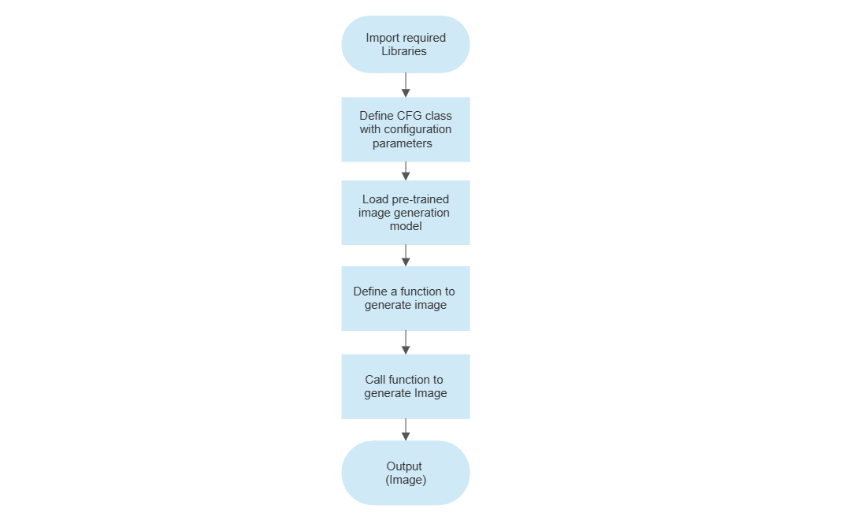
Proposed Architecture

Slide 8
References
Connor Shorten. (2019, January 25). Text to Image. Medium; Towards Data Science. https://towardsdatascience.com/text-to-image-a3b201b003ae
Ramesh, A., Pavlov, M., Goh, G., Gray, S., Voss, C., Radford, A., Chen, M., & Sutskever, I. (2021). Zero-Shot Text-to-Image Generation. ArXiv:2102.12092 [Cs]. https://arxiv.org/abs/2102.12092
Ramzan, S., Iqbal, M. M., & Kalsum, T. (2022). Text-to-Image Generation Using Deep Learning. Engineering Proceedings, 20(1), 16. https://doi.org/10.3390/engproc2022020016
Smith, J., & Doe, J. (2021). Text to Image using Deep Learning. https://www.researchgate.net/publication/359441889_Text_to_Image_using_Deep_Learning

Slide 9
Thank you and Any Queries

