Slide 1
Review-2 on Identifying rottenness of a fruit by image
Simon Sumanth 2010030343 Fauzaan Pasha 2010030452
Under the Guidance of
Dr. Shadab Siddiqui
Assistant Professor
Computer Science and Engineering Department
KL Hyderabad Off Campus, Aziz Nagar ,Hyderabad

Slide 2
Overview
Introduction
Objectives of the Project
Proposed Methodology/Architecture/Algorithm/Technique/etc
Implementation Details
Code
Results (If any one objective is completed)
Output
References

Slide 3
Introduction
Identifying fruit quality is crucial for consumer satisfaction and food safety.
This project proposes using advanced deep learning techniques to automate freshness and rottenness determination based on images.
Deep learning, particularly Convolutional Neural Networks (CNNs), excels in analyzing images by recognizing patterns.
Potential impact on agriculture and food industries by providing an automated tool for quality evaluation.
The project highlights the application of modern technology in addressing long-standing challenges related to food quality assessment.

Slide 4
Objectives of the Project
Develop a Robust Deep Learning Model:
Create and train a Convolutional Neural Network (CNN) model capable of accurately classifying fruit images into distinct categories representing different levels of freshness and degrees of rottenness.
Preparing a review paper :
Document the project's methodology, data preprocessing steps, model architecture, and training processes. Share the findings, insights, and challenges encountered throughout the project's development.

Slide 5
Proposed Algorithms
VGG(16):
VGG, short for Visual Geometry Group, is a deep convolutional neural network (CNN) architecture designed for image classification.
The VGG architecture is characterized by its simplicity and uniformity. Unlike earlier convolutional neural networks like LeNet and AlexNet, which had a more complex and customized design, VGG used a straightforward architecture with a focus on depth.

Slide 6
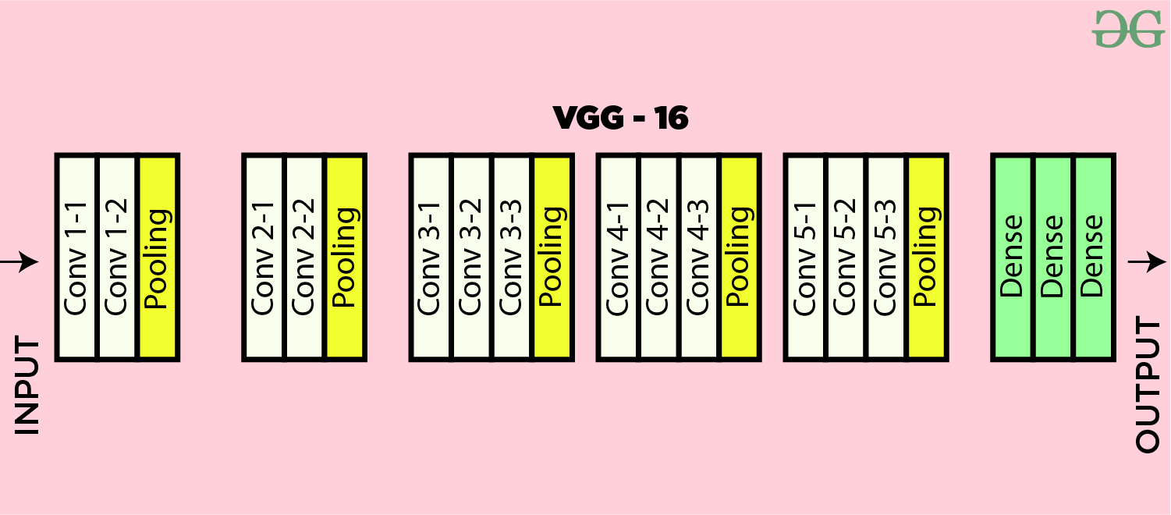
Architecture:

Slide 7
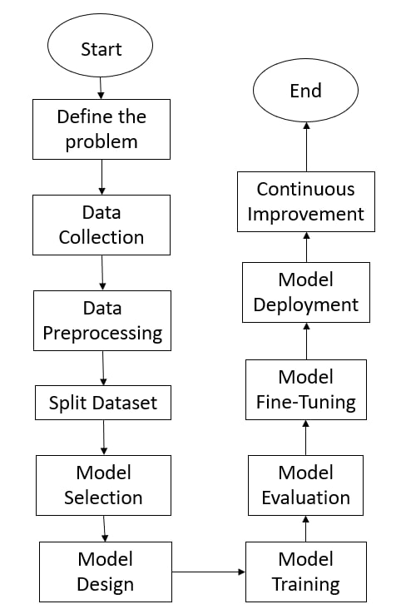
Flowchart

Slide 8
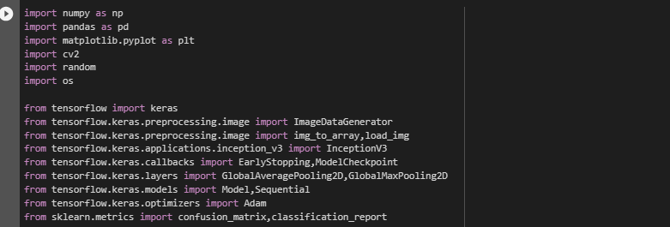
Implementation Details
Importing Libraries:

Slide 9
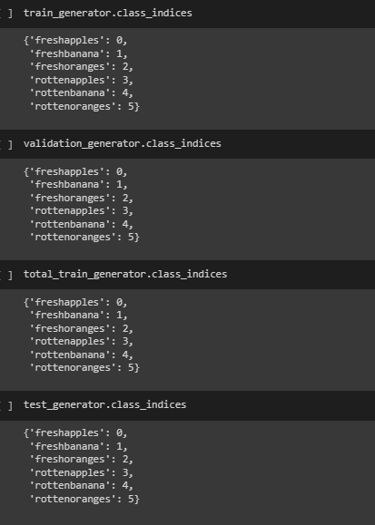
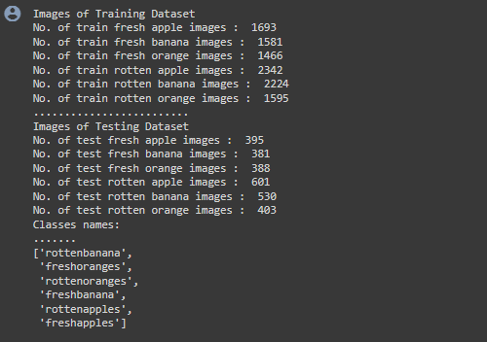
Implementation Details
Dataset Info :

Slide 10
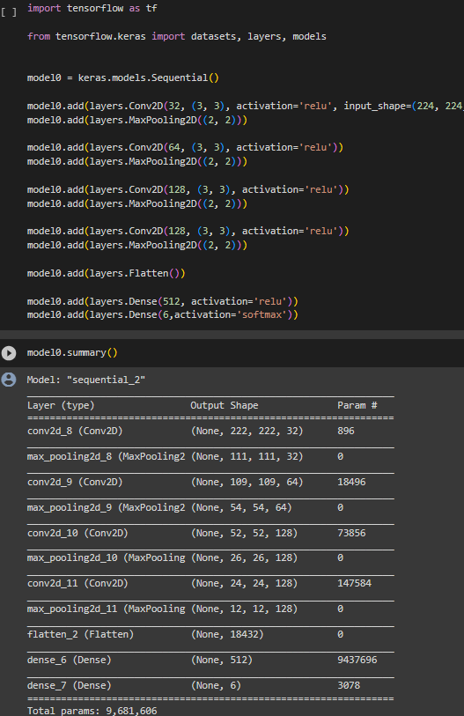
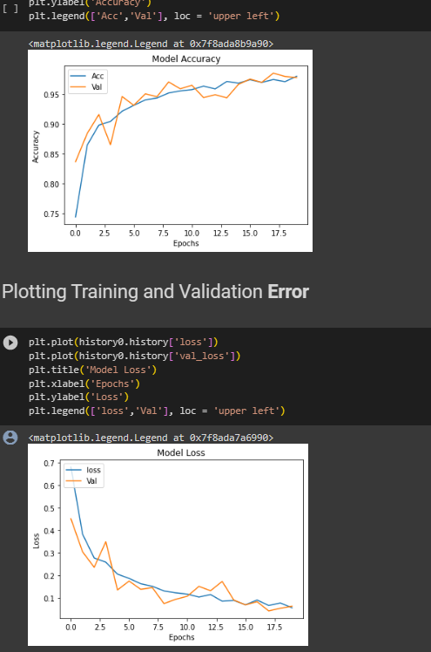
Implementation
Training data using cnn model :
Model Accuracy and loss :

Slide 11
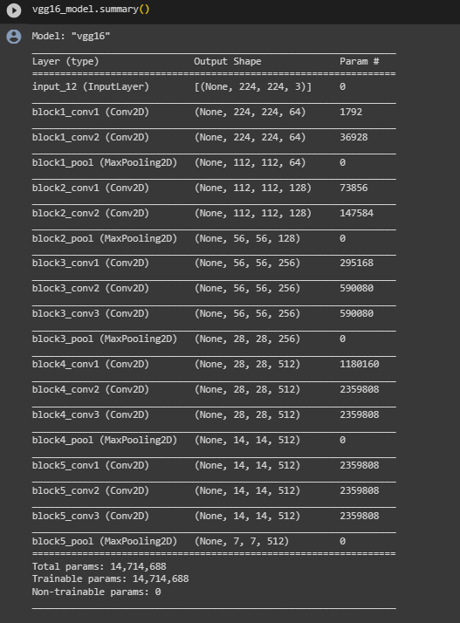
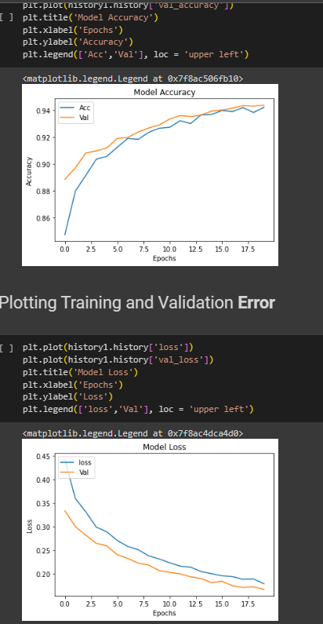
Implementation
Training data using VGG(16) :
Model Accuracy and loss :

Slide 12
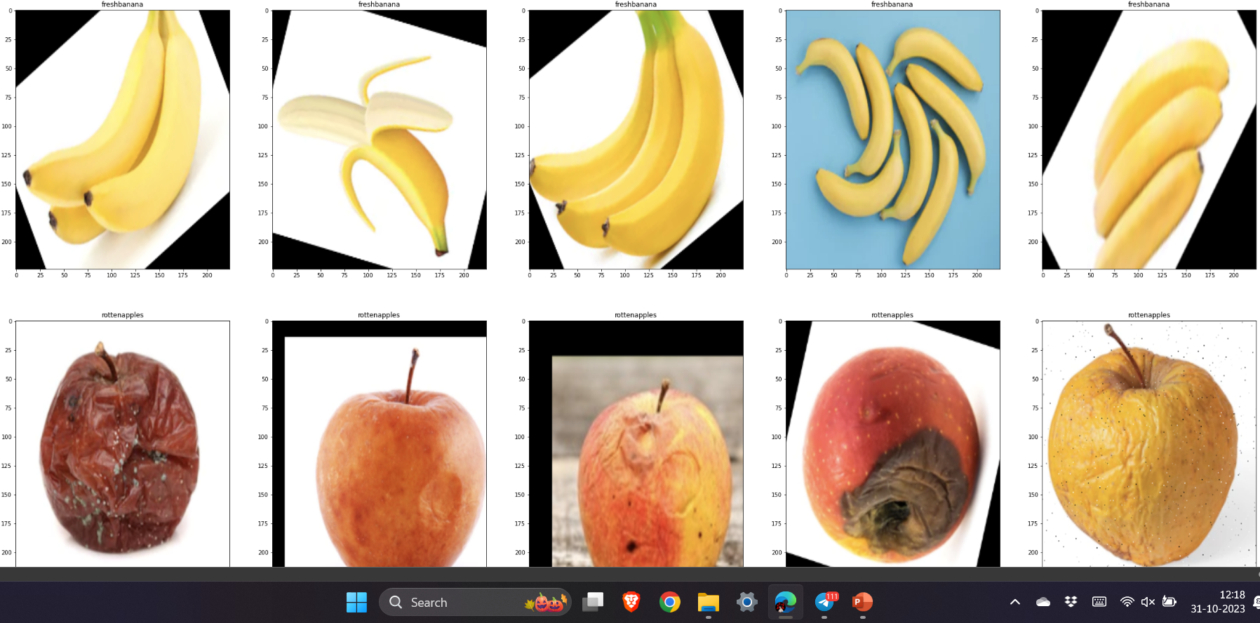
Implementation
Training Data Images:

Slide 13
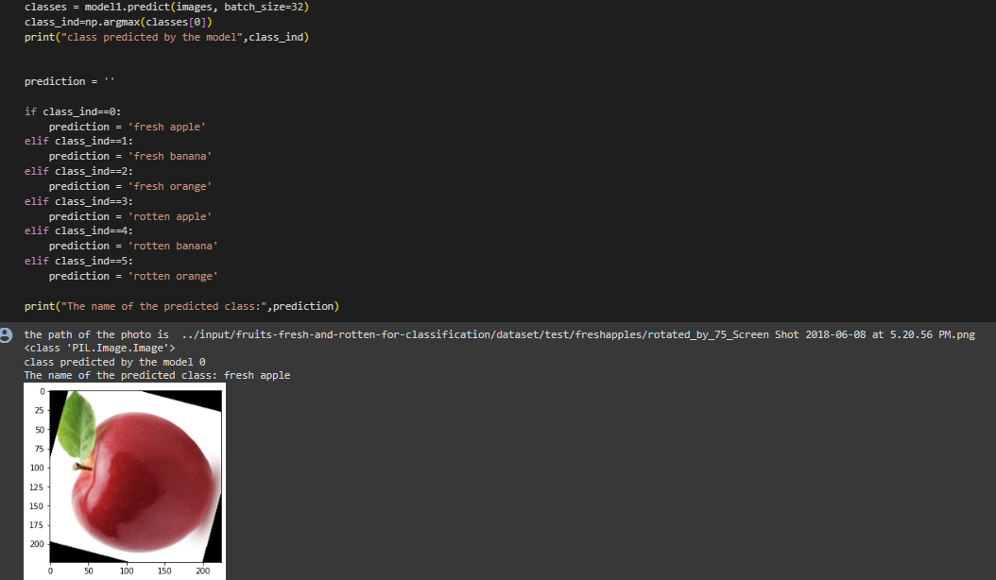
Output
Prediction :

Slide 14
References
Application of Deep Learning Architectures for Accurate and Rapid Detection of Internal Mechanical Damage of Blueberry Using Hyperspectral Transmittance Data - PubMed (nih.gov)
(Damage done to the blueberries).
Fruits Classification and Detection Application Using Deep Learning (hindawi.com)
(Classification of fruits).
https://www.kaggle.com/datasets/sriramr/fruits-fresh-and-rotten-for-classification
(Dataset)

Slide 15
Thank you and Any Queries

