Slide 1

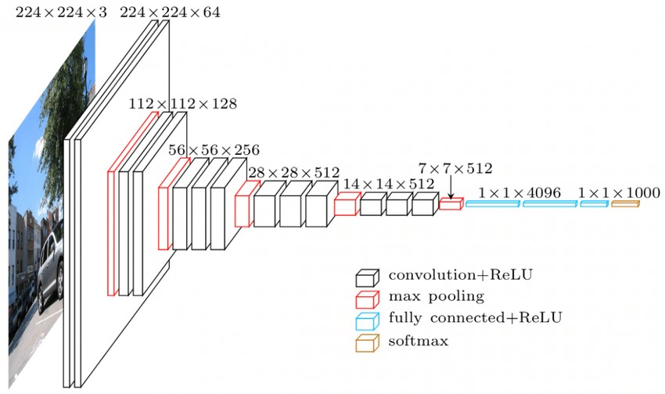
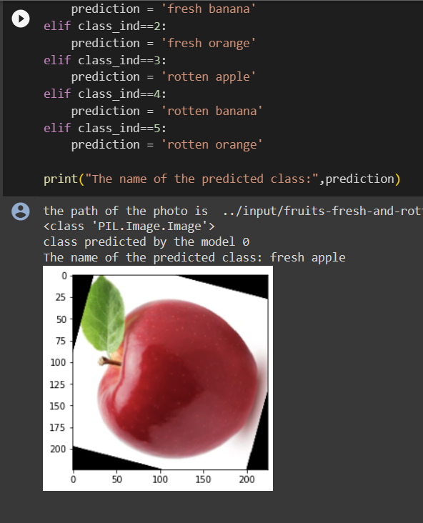
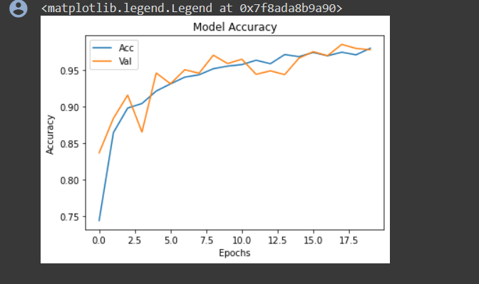
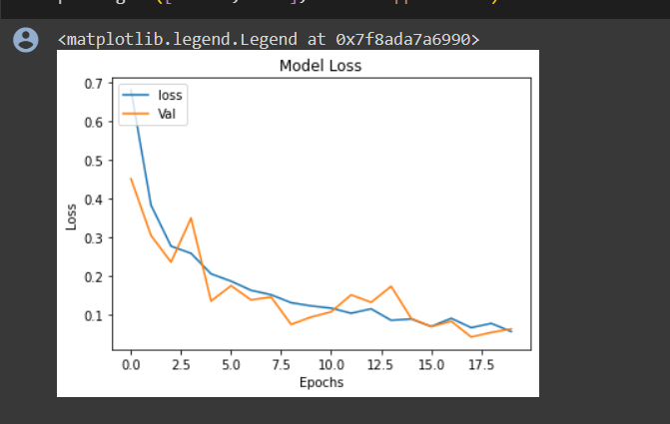
Koneru Lakshmaiah Education Foundation, Hyderabad(Aziz Nagar)
Identifying rottenness of a fruit by image
B Simon Sumanth, Mohammad Fauzaan Pasha
Department of Computer Science and Engineering, Koneru Lakshmaiah Education Foundation, Hyderabad-500075, Telangana, India.
Abstract
Methods and Materials
Discussion
The effective detection of fruit freshness and rottenness has sparked considerable interest due to its potential to decrease food waste and improve product quality in the agricultural and retail sectors. This research endeavor presents a complete framework for harnessing the potential of harnessing the potential of deep learning for this aim.
A notable aspect of the "Fruits Fresh and Rotten Classification" project is its aim to seamlessly integrate with existing fruit sorting systems and quality control processes within the industry. By automating the fruit quality assessment process, the project strives to enhance operational efficiency, reduce manual labor, and mitigate human errors. This integration is expected to provide tangible benefits to the industry in terms of cost savings and improved product quality.
VGG-16, short for Visual Geometry Group 16, is a deep convolutional neural network (CNN) architecture that gained prominence due to its impressive performance in image classification tasks. Developed by the Visual Geometry Group at the University of Oxford, VGG-16 is a variant of the VGG network, designed for the ImageNet Large Scale Visual Recognition Challenge (ILSVRC) competition in 2014. VGG-16 is renowned for its depth and uniform architecture.
The project did well in accurately classifying fresh and rotten fruits. This success was due to using advanced machine learning techniques, particularly the chosen VGG16 model.
Our project is not just for research; it has real-world potential, especially in fruit sorting systems. It can work in real-time and handle changing conditions, which is crucial in practical fruit sorting.
Our use of deep learning, especially a CNN, was a smart choice. The model's depth and architecture were great for feature extraction and classification. While there were some hurdles during model training, we proved that CNNs are a good fit for fruit quality assessment.
Figure 1. VGG16
Introduction
Results
Conclusions
The effective detection of fruit freshness and rottenness has sparked considerable interest due to its potential to decrease food waste and improve product quality in the agricultural and retail sectors. This research endeavor presents a complete framework for harnessing the potential of deep learning for this aim.
Deep learning, particularly Convolutional Neural Networks (CNNs), excels in analyzing images by recognizing patterns. Potential impact on agriculture and food industries by providing an automated tool for quality evaluation. The performance evaluation of this project is multi-faceted, employing metrics such as accuracy, precision, recall, and the F1 score. The objective is not only to create an accurate system but also to ensure that it can operate in real-time and adapt to changing environmental conditions. This focus on practicality is driven by the recognition that the system's true value lies in its applicability in dynamic fruit sorting and quality control scenarios.
Performance evaluation in a project for fruit freshness and rottenness identification using deep learning and CNNs is crucial to assess the effectiveness of the developed model.
The project aims to create an innovative system for detecting fruit freshness and rottenness using deep learning techniques, notably Convolutional Neural Networks (CNNs). The ultimate purpose is to address significant difficulties in agricultural and food supply chain management, where precise fruit quality evaluation is vital. Contributions and achievements.
The project's deep learning-based system for fruit freshness and rotteness identification offers a promising solution to a pressing challenge in the agriculture and food industry. Through rigorous model development, performance evaluation, and continuous improvement, the project seeks to contribute to reduced food waste, improved fruit quality, and enhanced supply chain efficiency.
Figure 2. Output
Graph 1. Model Accuracy
Graph 2. Model Loss
Future Directions
The project identifies several research gaps and areas for future exploration. Research should continue to focus on the development of diverse and extensive fruit datasets. Emerging technologies, such as federated learning and explainable AI, could enhance the project's capabilities. There is also a need to explore real-time adaptability further and its implications for dynamic fruit sorting scenarios.
Contact Information
References
Acknowledgements
B Simon Sumanth
Mohammad Fauzaan Pasha
Discord ID: Fauzaan#6686
Email: 2010030343@gmail.com
Phone:6302330105, 6309274468
Kritik Seth, “Fruits and vegetables image recognition dataset”, Kaggle, 2022.
Sriram Reddy Kalluri, “Fruits fresh and rotten for classification”, Kaggle, 2022.
H. Zhang, “Fruit Freshness and Rottenness Classification Using Hyperspectral Imaging”, Frontiers in Plant Science, 2021.
X. Wang, “Fruit Freshness and Rottenness Classification Using Acoustic Emission”, Food and Bioprocess Technology, 2019.
A. Kumar, "Fruit Freshness Classification Using a Vision Transformer with Hybrid Augmentation," arXiv preprint arXiv:2303.01462, 2023.
We pay our grateful acknowledgement & sincere thanks to our Head of the Department Dr. Arpita Gupta for her exemplary guidance, monitoring and constant encouragement throughout the course of the project. We pay our sincere thanks to our Project Coordinator Dr. Shadab Siddiqui who has been constantly inculcating logistic support and has given constant encouragement during our project.

