Slide 1
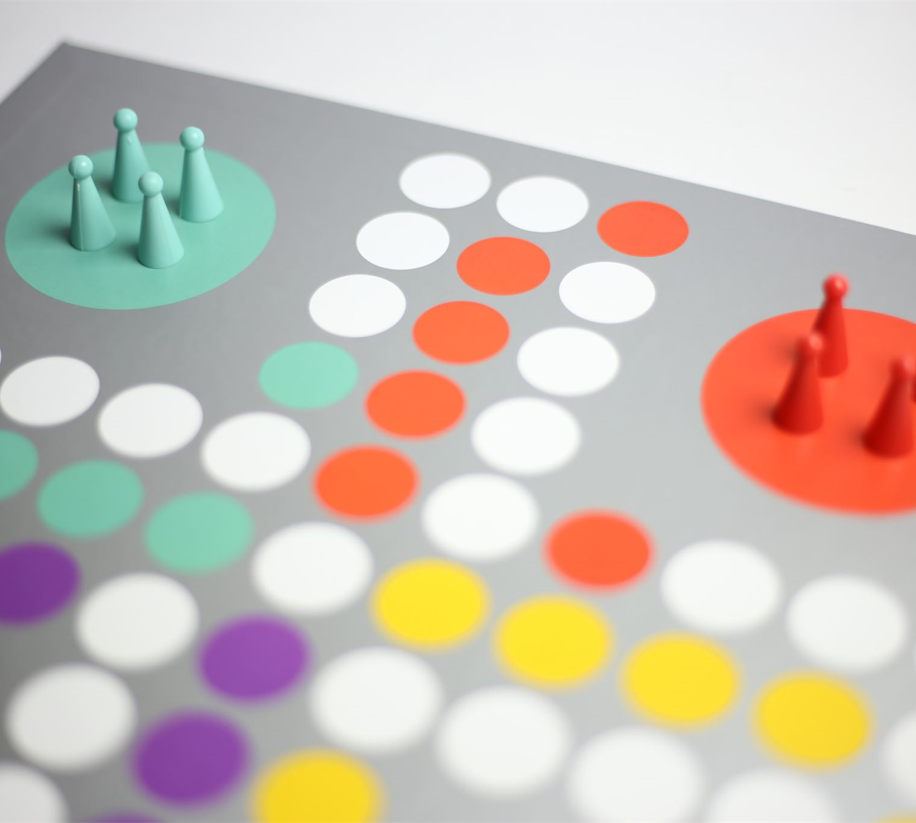

Manichand-(2010030455)
Dileep reddy-(2010030416)
Harsha vardan-(2010030173)
Prakash raj-(2010030533)
Under the guidance of:-
Udaya Rani mam

Slide 2
PROBLEM STATEMENT:-
The basic game consists of a cross-shaped board, often made of wood, together with a set of pegs (or alternatively marbles). To start the game, one fills the board with pegs except for the central hole. A jump consists of jumping one peg over another into an empty spot in the board, removing the peg jumped over from the board. Diagonal jumps are not allowed (in the standard version of the game).

Slide 3
Algorithm used- its description:-
One way to solve peg solitaire is to use a backtracking search algorithm. This algorithm searches for a solution from a given start configuration by making a legal jump J from start, after which it recursively searches for a solution from the new configuration. Since every jump reduces the number of pegs (filled holes) on the board by one, in the base case, the algorithm stops recursing when both start and final have the same number of pegs

Slide 4
Backtracking algorithm:-
General background on backtracking will be discussed in the lab. The backtracking
boolean move (board x, moveList mseq) {
if (solved(x)) return true;
curMoves = currentMoves(x); // set of all current
moves
for (every m in curMoves) {
y = makeMove(x, m);
if (move(y, mseq)) {
mseq = push(m, mseq);
return true;
}
}
return false;
}

Slide 5
FLOW DIAGRAM

Slide 6
START
Is it is possible to fill next cell
Return to previous cell
Flow chart of the proposed solution:-
It is possible to find another valid element
Are all cells filled?
Is this cell1?
Riddle is solved .register solution . continue searching
Stop

Slide 7
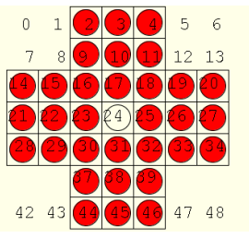
Numeric example of the algorithm (Sample input - expected output):-
One way to represent the peg-solitaire board is as a 7 by 7 square in which the four 2 x 2
corners have been removed.

Slide 8
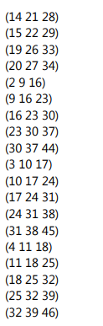


So the board can be represented as a boolean array of size 49 in which 1 represents a peg, 0 represents an empty slot. (slots like 0, 1, 5, 6, 7, 8 etc. will always be 0. A move will be represented as a triple (vector of size 3) – such as (2, 3, 4) or (16, 9, 2).

Slide 9
class Board(object):
def __init__(self, board=None):
# 0 = empty, 1 = occupied, 2 = invalid
self.board = board or [
[2, 2, 1, 1, 1, 2, 2],
[2, 2, 1, 1, 1, 2, 2],
[1, 1, 1, 1, 1, 1, 1],
[1, 1, 1, 0, 1, 1, 1],
[1, 1, 1, 1, 1, 1, 1],
[2, 2, 1, 1, 1, 2, 2],
[2, 2, 1, 1, 1, 2, 2],
]
def __hash__(self):
return hash(tuple([tuple(row) for row in self.board]))
def clone(self):
# Ca. 2x faster than copy.deepcopy()
board_copy = [[peg for peg in row] for row in self.board]
return Board(board_copy)

Slide 10
Coding status and testing:-
codding status logic completed. needed to code for website interface

Slide 11
Work division:-
Manichand – understanding the flow of game and analysis of game.
Harsha vardhan – searching for Python libraries needed for game
Dileep reddy – understanding algorithm of existing solutions
Prakash raj – understanding data structures involved in game

Slide 12
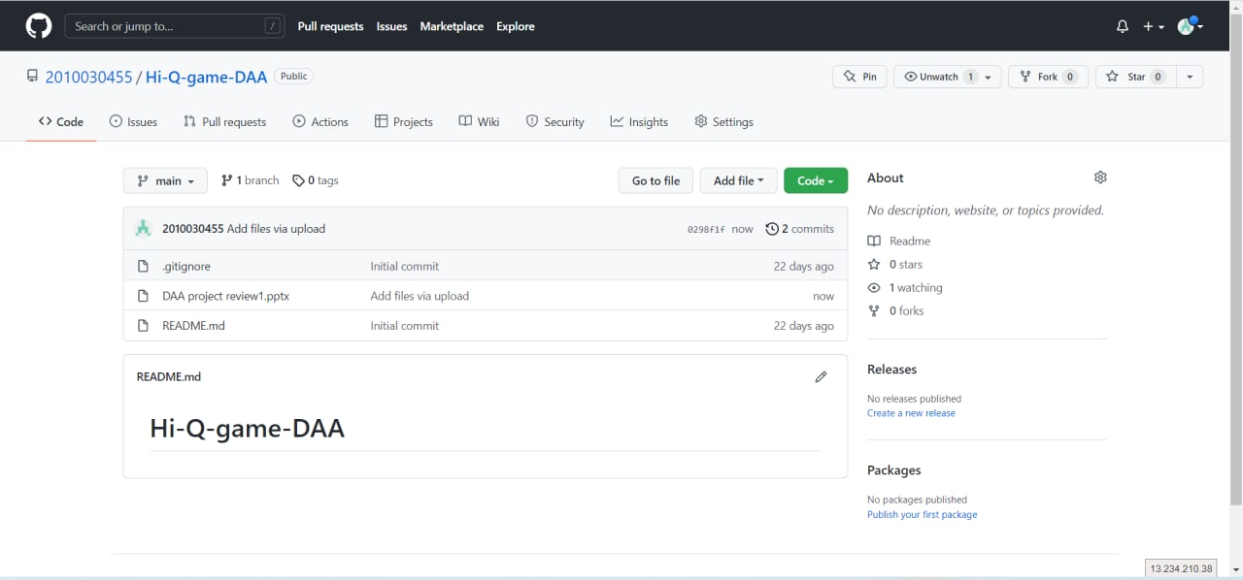
Github commits:-

Slide 13
THANK YOU

