Slide 1
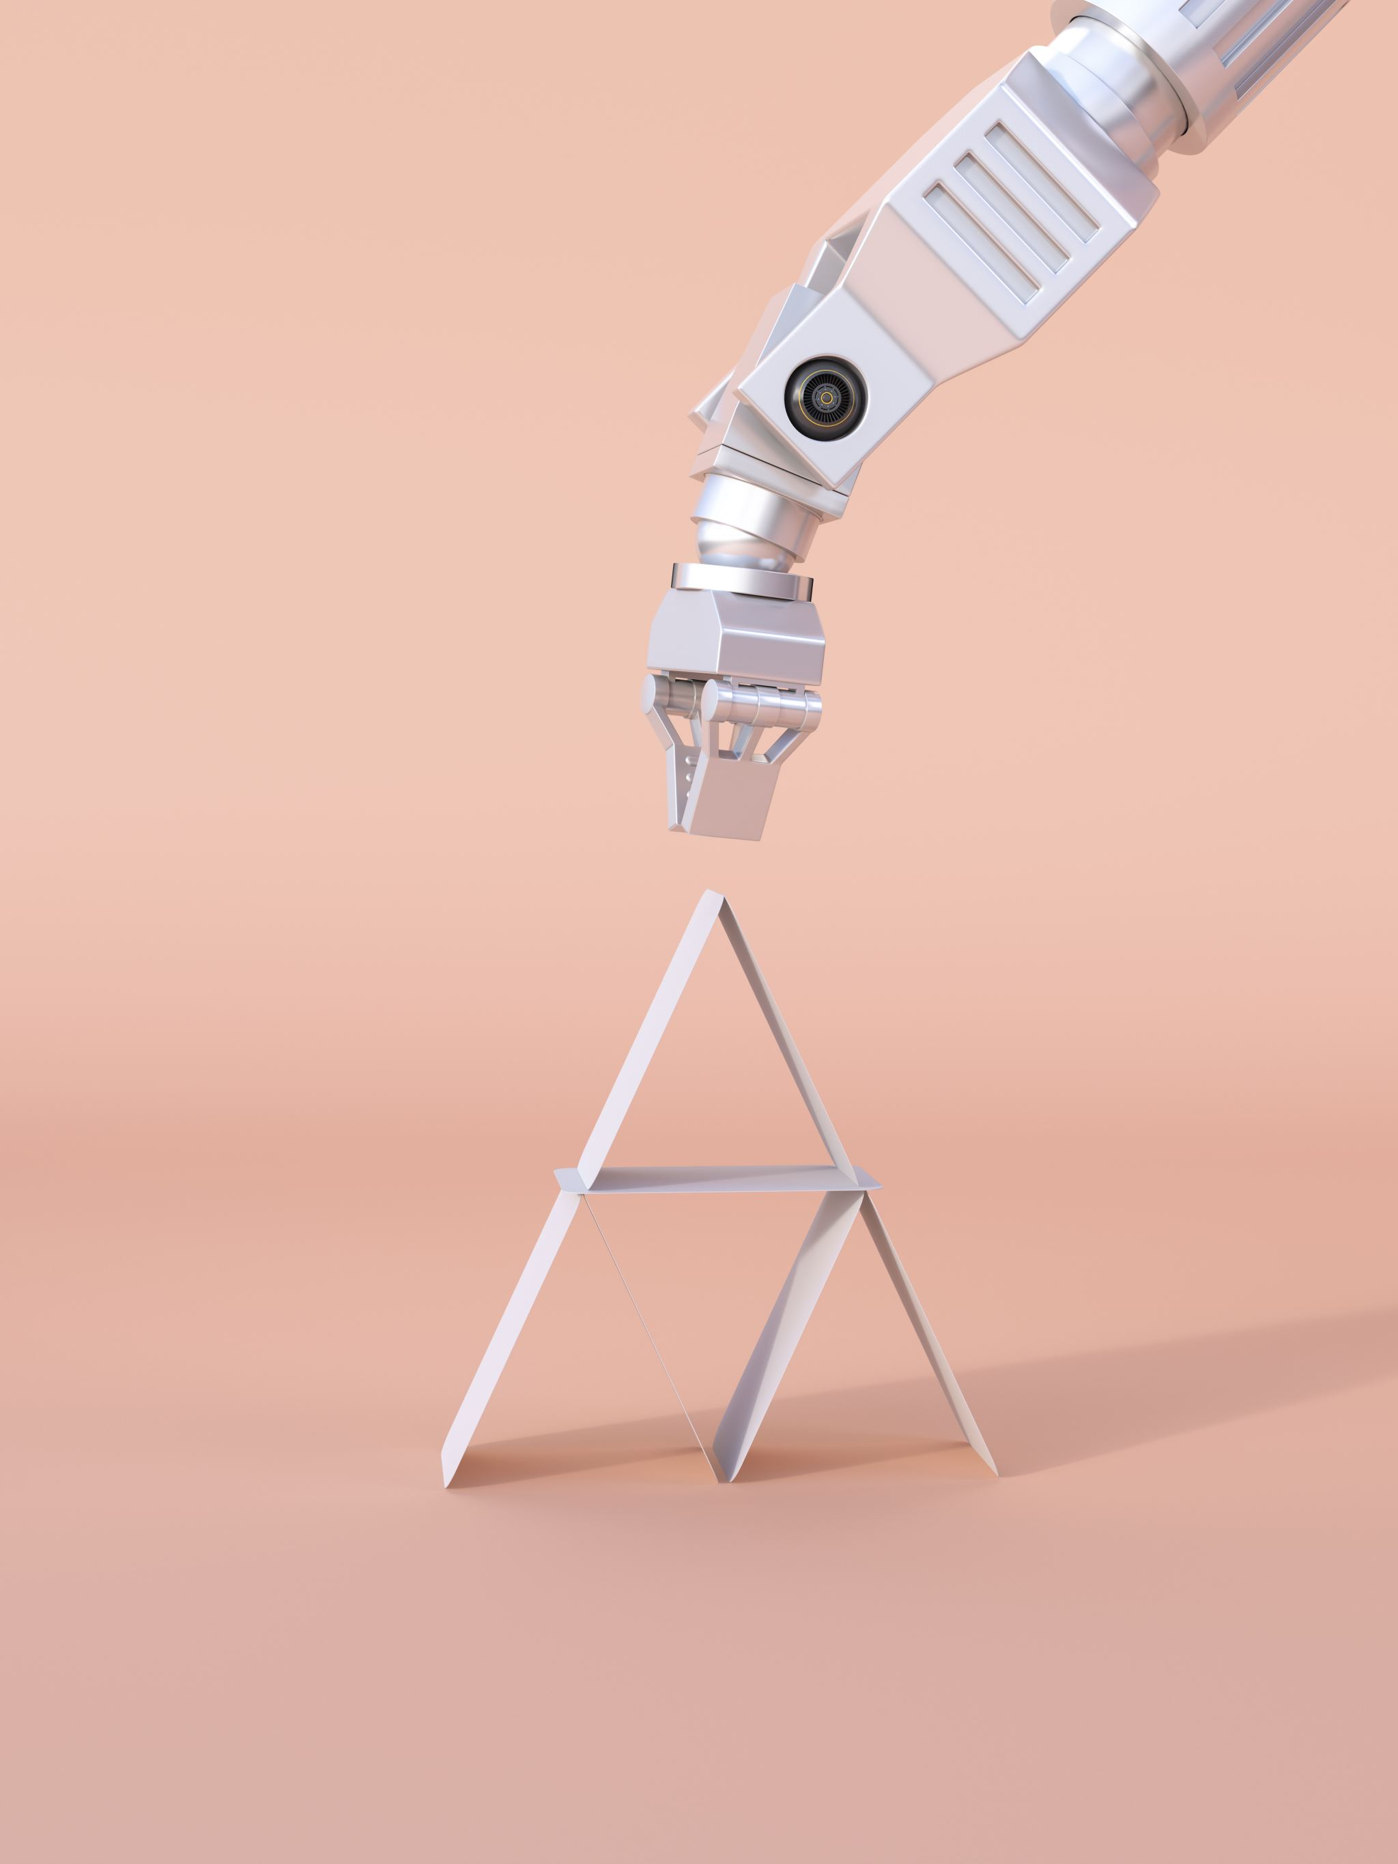
Optimal Path for Robot movement using PSO
Mathematical programming -2

Slide 2
INTRODUCTION
Now-a-days mobile robots are vastly used in many areas such as in military purposes, space research, emergency situations like fire hazard, medical use etc.
The robot completed above type of tedious tasks efficiently and effectively without any human interruption. To cope up with such situation “Path Planning” term has been introduced.
In path planning, robot needs to navigate on a particular route whether the environment is familiar or not to the robot.
During navigation of mobile robot various types of obstacles or hurdles comes across the robot and it needs to overcome those hurdles safely without collision and find the suitable path from source to goal point.

Slide 3
LITERATURE REVIEW

Slide 4
TITTLE | AUTHOR | Year of published | pros | cons
Particle Swarm Optimization in Global Path Planning for Swarm of Robots | Halder, Ritesh Kumar | 2021 | In this paper, a novel collision avoidance method was described. It uses PSO for optimizing the Ferguson splines. | if the situation in the robot space is changed, algorithm is restarted.
Optimal Trajectory Planning Analysis of Robot Manipulator Using PSO | gurjeet singh , Banga, V. K. | 2021 | This article developed to frame the inverse and forward kinematic model of 5 DOF and 6 DOF robot manipulator s velocity and acceleration increased through the proposed system. | the obstacle avoidance has been exhibited by PSO.
Path planning of mobile robot based on particle swarm optimization algorithm | Yang, Huimin, Lei Jiang, and Lijuan Wu | 2021 | The improved algorithm is tested in some test functions,and the simulation results show that the algorithm has high search speed and precision. | the algorithm converges prematurely, easily falls into local extremum,and reduces the convergence speed

Slide 5
Shortest Path Planning Algorithm – A Particle Swarm Optimization (PSO) Approach | Joshua T. Jegede, Hilary I. Okagbue and Pelumi E. Oguntunde | 2020 | The algorithm uses Particle Swarm Optimization approach to avoid convergence into a local minimum. With different experiments we show that the algorithm finds the shortest path in any known environment | No obstacles scattered in the environments to see how the algorithm gets the optimal path.
Hybrid metaheuristic approach for robot path planning in dynamic environment | Lina Bassem Amar, Wesam M. Jasim | 2021 | Some comparative results are presented on the basis of simulation results to illustrate the efficiency and the feasibility of the proposed algorithm. This approach supplies the optimal path with minimum number of iterations. | Not tested these three algorithms in a dynamic environment with moving goal.

Slide 6
PROBLEM STATEMENT
Path planning for a robot is a difficult task and has been widely studied in robotics.
The objective of recent researches is not just to find feasible paths but to find paths that are optimal with respect to distance covered and safety of the robot.
Techniques based on optimization have been proposed to solve this problem but some of them used techniques that may converge to local minimum

Slide 7
To finds the optimal path with respect to distance covered.
using particle swarm optimization (PSO) technique for convergence to global minimum and a customized algorithm which generates the coordinates of the search space
SCOPE OF PROJECT

Slide 8
Algorithm
A MPSO algorithm is used to find optimal path for the mobile robot .
The proposed algorithm (MPSO) is capable of effectively guiding a robot moving from start position to the goal position in complex environment and find optimum/shortest path without colliding any obstacles in the environment
MPSO can rightfully be regarded as a good choice due to its convergence speed and robustness in global search

Slide 9

THANK YOU

