Slide 1
Attendance management system using blockchain
Presented by:-
2010030463 – M.Anil Kumar
2010030490 – K.Varun Krishna
2010030475 – Siddarth Sri Sai
Guided by:-
Lalitha Surya Kumari Mam’m

Slide 2
Table of contents
Introduction
Documentation
Hardware and Software Requirements
Github setup
Work Allocation

Slide 3
Introduction
Many of the present attendance management systems use the conventional systems, here we cannot determine the authenticity of the databases.
Blockchain system is distributed and decentralized that make it can be applied to develop a tamper proof-employee attendance system.
using Blockchain technology, no person can deny that he did changes to the database.
The blockchain-based employee attendance system is required to provide a database that keeps its reliability and integrity and tamper proof.
The control lies in every person that can access the Blockchain.

Slide 4
Literature Review
Author : Meyliana, Yakob Utama Chandra, Cadelina Cassandra, Erick Fernando
Published on : 05 February, 2021
Title : Recording of Student Attendance with Blockchain Technology
Abstract : This research uses qualitative methods using several techniques, such as FGD with experts and literature reviews. The simulation results are carried out directly by comparing the existing system's attendance logs with multichain results. This research produces a product that can be used to implement and become solutions in recording student attendance.
Pros : Collect and store data automatically, Possible to update and maintain attendance records
Cons : Increased equipment expense.
https://pdfs.semanticscholar.org/30b6/b19a42e00665aaed7887f7eefc1b27ae3aa4.pdf

Slide 5
Author : Priyanka B. Dongre, Pushpneel Verma
Published on : 16 May 2020
Title : An IOT Based Private Blockchain Framework for Attendance Management
Abstract : The proposed private blockchain framework is implemented in python using Flask as web application framework. The data of students after scanning the QR code is added to the mark attendance block. The registration, subject creation and QR code generation blocks are generated with 0.017 seconds approximately.
Pros : Shows accurate timings, Simple to operate.
Cons : System is ineffective if there is no power supply.
https://eudl.eu/pdf/10.4108/eai.16-5-2020.2303960

Slide 6
Author : NUR SYAFIQA NABILAH BT MOHD SANOSI
Published on : JANUARY 2019
Title : STUDENT ATTENDANCE SYSTEM USING BLOCKCHAIN TECHNOLOGY
Abstract : Attendance is very important to every student. To make sure the student’s attendance is secure from other third parties, student’s attendance system using blockchain technology will be implemented. First one is, to prevent time consuming process for student’s attendance. Second one is, to develop a system for student’s attendance using blockchain technology. The last one is, to provided better security to this system.
Pros : Possible to update and maintain attendance records, Simple to operate.
Cons : Difficult to maintain and repair, Increased equipment expense.
http://umpir.ump.edu.my/id/eprint/26987/1/Student%20attendance%20system%20using%20blockchain.pdf

Slide 7
Hardware and Software Requirements
Hardware Requirements:-
processor – intel core i5
Ram – 4GB
Hard Disk – 1TB
Software Requirements:-
Remix ide
solidity
Html

Slide 8
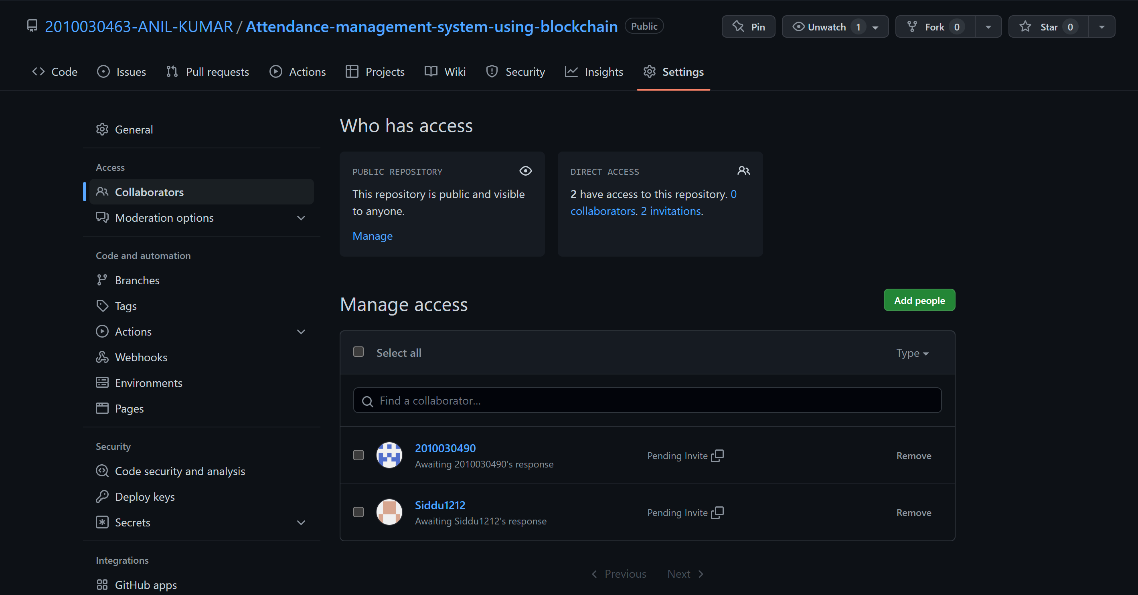
Github Setup

Slide 9
Work Allocation
Coding – M.Anil kumar
Documentation and Testing– K.Varun krishna
web design - Siddarth Sri Sai

