Slide 1
FINDING THE SHORTEST PATH BETWEEN AN INITIAL AND A FINAL POINT USING A* ALGORITHM
PRESENTED BY:
2010030490-KAJJAM VARUN KRISHNA
2010030494-SHASHIKANTH
2010030468-SATHWIK
2010030463-M.ANIL KUMAR
GUIDED BY
UDAYA RANI MA’AM

Slide 2
TABLE OF CONTENTS
Abstract
Problem statement
Algorithm used
Flowchart
Hardware and Software used
Implementation
Results
Future scope of improvement

Slide 3
ABSTRACT
It is well known that computing shortest paths over a network is an important task in many network and transportation related analyses. Choosing an adequate algorithm from the numerous algorithms reported in the literature is a critical step in many applications involving real road networks. In a recent study, a set of two shortest path algorithms that run fastest on real road networks

Slide 4
PROBLEM STATEMENT
Search algorithms are algorithms designed to search for or retrieve elements from a data structure, where they are stored. They are essential to access desired elements in a data structure and retrieve them when a need arises.
A vital aspect of search algorithms is Path Finding, which is used to find paths that can be taken to traverse from one point to another, by finding the most optimum route.
It is a handy algorithm that is often used for map traversal to find the shortest path to be taken. A* was initially designed as a graph traversal problem, to help build a robot that can find its own course. It still remains a widely popular algorithm for graph traversal.

Slide 5
ALGORITHM USED
A*ALGORITHM:
The algorithm used is A* Algorithm to find the shortest path between an initial and a final point.
It searches for shorter paths first, thus making it an optimal and complete algorithm. An optimal algorithm will find the least cost outcome for a problem, while a complete algorithm finds all the possible outcomes of a problem.
Another aspect that makes A* so powerful is the use of weighted graphs in its implementation. A weighted graph uses numbers to represent the cost of taking each path or course of action. This means that the algorithms can take the path with the least cost, and find the best route in terms of distance and time.

Slide 6

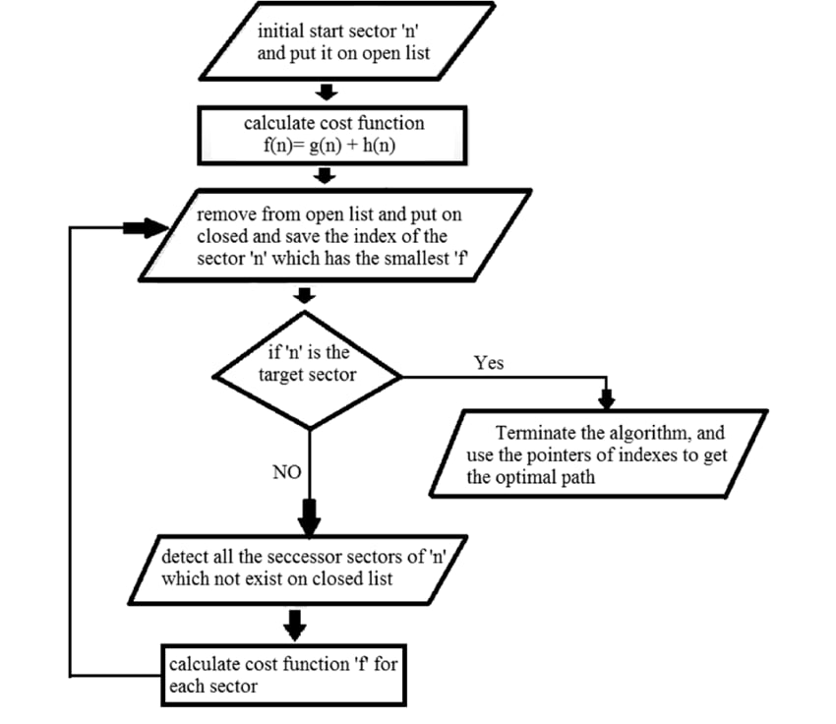



FLOW CHART

Slide 7
Hardware and Software used
HARDWARE: WINDOWS 8
Core i5 9th gen
RAM:8GB
SOFTWARE REQUIRED: python runtime environment (pycharm)

Slide 8
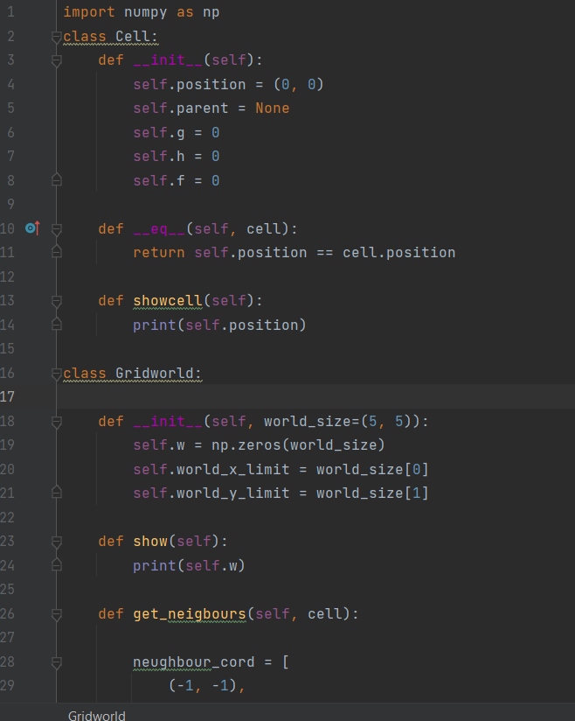
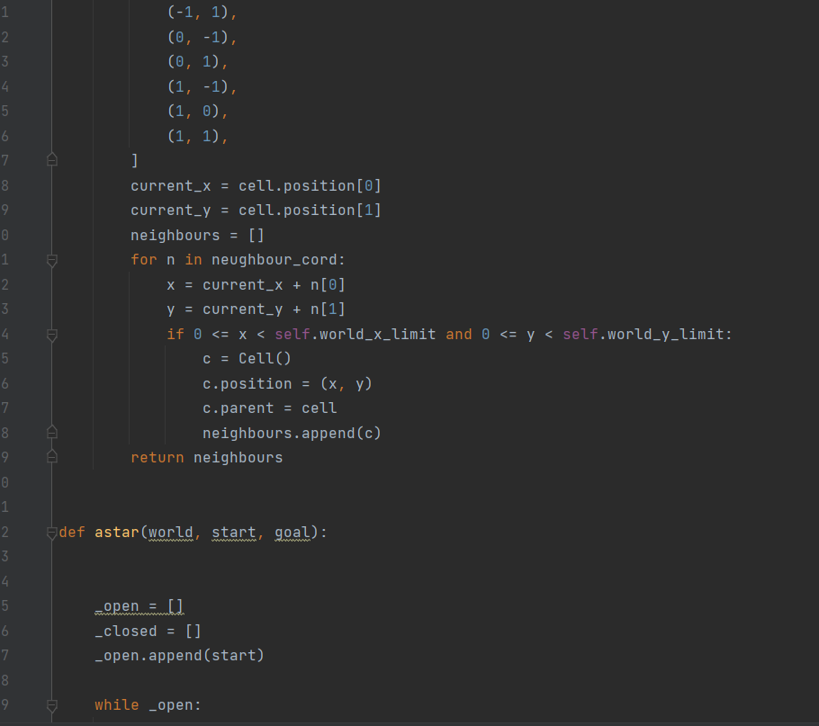

Slide 9
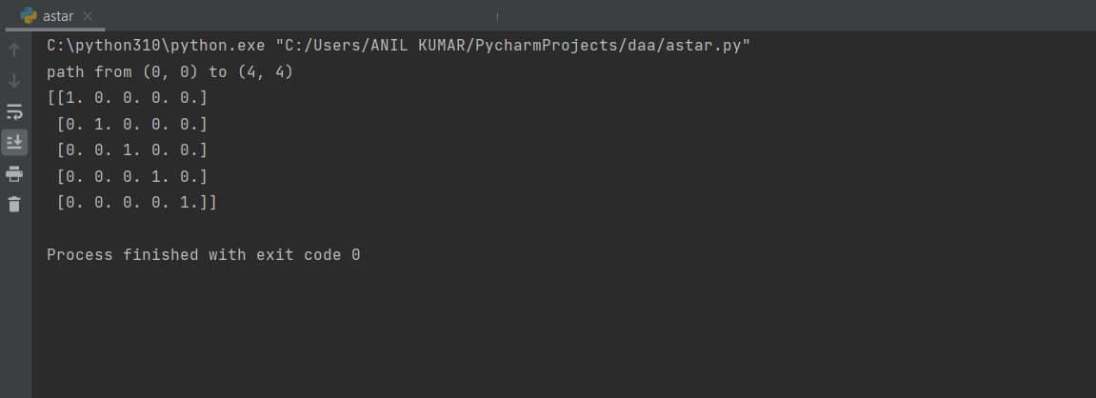
RESULTS

Slide 10
FUTURE SCOPE
Our future work is designing in hardware using proposed architecture, not modeling. If it is implemented as hardware, there are some ways to reduce cost.

Slide 11
THANK YOU

