Slide 1

GLOBAL TRADE ANALYSIS
TEAM MEMBERS:
2010030462- S. SANJANA
2010030464- V. NETHRA
2010030478- SHIVANI PATEL
2010030486- B. SOWMYA SREE
GUIDED BY: Dr. ARPITA GUPTA

Slide 2
TABLE OF CONTENTS
Project Area
Literature Survey
Problem Statement
Dataset
Conclusion

Slide 3
PROJECT AREA
The main aim of the this project is to analyze the expansion of wind energy, the use of energy consumption to compare national economies, and many more.

Slide 4
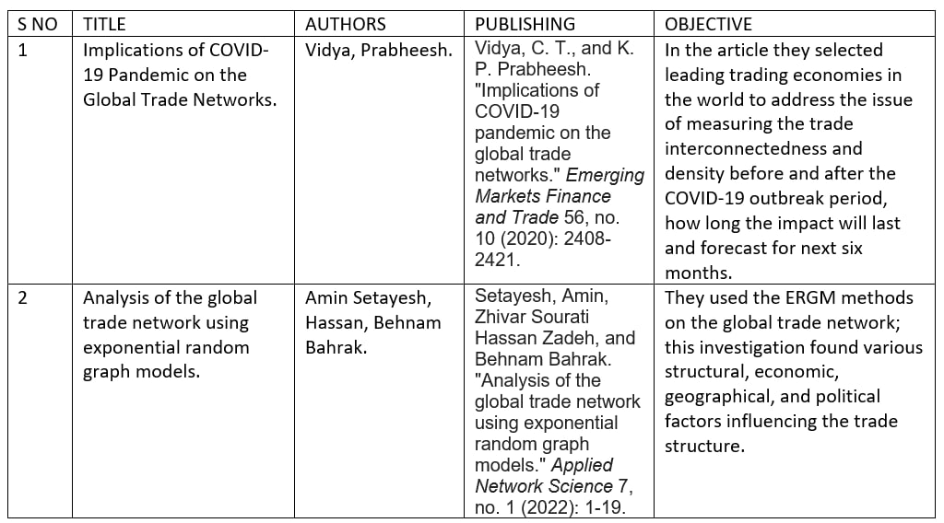
literature SURVEY

Slide 5
PROBLEM STATEMENT
Renewable energy nowadays is one of the most important fields regarding energy production. As we all know the importance of this type of energy for the environment and future generations is extremely valuable. Hence, we decide to do a small analysis on the wind, solar and nuclear energy production on a small group of selected countries. As we know nuclear energy is not renewable source but we use it here to compare the production to the wind and solar energy production.

Slide 6
DATASET TO BE USED
https://www.kaggle.com/datasets/unitednations/international-energy-statistics?select=all_energy_statistics.csv

Slide 7
CONCLUSION
In conclusion, we try to open the door for further and deeper analysis regarding renewable energy and nonrenewable energy and do not pretend to make any predictions on the topic.

Slide 8
THANK YOU

