Slide 1
Yoga Harmony Assist
P. Mounika Reddy 2010030485
Sravani Mekala 2010030104
Under the Guidance of
DR. G Madhukar Rao
<Assistant Professor>
Computer Science and Engineering Department
KL Hyderabad Off Campus, Aziz Nagar, Hyderabad

Slide 2
Overview
Introduction
Literature Review
Problem Statement
Objectives of the Project
Proposed Methodology/Architecture/Algorithm/Technique/etc
References

Slide 3
Introduction
Yoga is a 5000 years old psycho-spiritual technique that focuses on creating harmony between the mind and the body. The efficacy of Yoga has been proven for certain medical conditions.
There are more than 200 postures and pranayama's with specific benefits that constitute Yoga. One needs an able yoga teacher to identify the cause of suffering and decide postures and pranayama's.
Since nowadays globalization has increased beyond its growth, many challenges and stressful situations need to be faced by human. In Current scenario Ayurveda experts diagnose the diseases by interacting with patients and by examining the patient. They suggest medicine, yoga, raga, and diet according to their observations. Such process is very time consuming.
Designing automatic recommendation systems which recommend the yoga and raga for specific prakriti.it will help experts to reduce certain amount of time, such system recommend accurate yoga and raga according to physical and mental characteristics of person.
Yoga is a practice that originated in ancient India and has since spread to become a global phenomenon. It is a holistic practice that combines physical postures, breathing techniques, and meditation to promote physical, mental, and spiritual well-being.
However, many yoga practitioners struggle with finding the right balance and progressing at their own pace. This is where YogaHarmony Assist comes in, providing personalized guidance and effective progress tracking for yoga practitioners.

Slide 4
Literature Review
SNO | TITLE | AUTHOR | PUBLISHER | DATASET AND TECHNIQUES | CONCLUSION
01 | Machine Learning Based Yoga Recommendation System for the Physical Fitness | Anganabha Baruah, Valli Madhavi Koti | IEEE | This system can furnish clients with the data they require in light of their necessities and keeping in mind that thinking about their inclinations.. | The proposed recommendation system makes practice recommendations in light of the client's inclinations while considering comorbidities, geographic areas, and exercise and eating ways of behaving
02 | Yoga Recommendation System | Ramamoorthy S, Deepanshu Singh | International Conference on Intelligent Computing, Communication & Convergence | Creating web application and training models using machine learning. | The proposed stress prediction model has achieved an accuracy of 94.4% and the yoga pose recommendation system has achieved an accuracy of 97.3%.

Slide 5
SNO | TITLE | AUTHOR | PUBLISHER | DATASET AND TECHNIQUES | CONCLUSION
03 | Development of an AI Enabled Yoga Posture (Asanas) Prediction System | Rahul Yadav, Rajat Chaudhary | IRJET | They proposed a method to detect correct yoga postures using deep learning techniques. Using Deep Neural Network Model | The proposed model is giving an accuracy of 0.9929% and we have prepared an application is built using react java script in which the pose estimation model is integrated.
04 | Recommendation system for yoga | P.A.J. Sandaruwan | IEEE | Using decision tree Neural Networks. | Based on timing, mood and constitution raga recommendation has been done and similarly yoga recommendation has been done

Slide 6
Problem Statement
Many yoga practitioners struggle to find personalized guidance and track their progress effectively. YogaHarmony Assist aims to solve these issues by providing tailored recommendations and progress tracking features.

Slide 7
Objectives of the Project
Leverage user preferences, fitness levels, and health considerations to craft personalized yoga routines. Customize recommendations to harmonize with individual aspirations, ensuring a tailored and impactful practice.
Implement a robust tracking system to meticulously monitor users' yoga journey, capturing key metrics and milestones. Deliver personalized and constructive feedback, offering insightful guidance on specific areas of improvement and recommending tailored practices for continuous and meaningful growth.
Offering an affordable solution, the system aims to address the financial barriers that often hinder users from accessing traditional yoga centers. By providing a low-cost alternative, individuals can engage in yoga practices without the constraints of expensive memberships, making holistic well-being more accessible to a diverse audience.
Transform the challenge of limited yoga teacher availability into an opportunity for users to experience seamless virtual yoga recommendations. Deliver a curated selection of expert-crafted routines that not only compensate for the absence of a physical instructor but also provide continuous and accessible guidance.

Slide 8
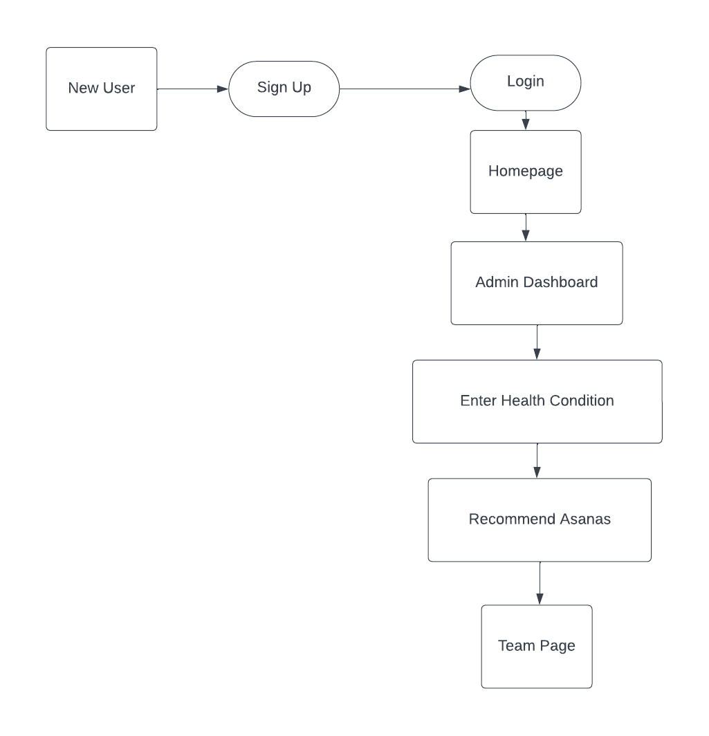
Proposed Methodology/Architecture/Algorithm/Technique

Slide 9
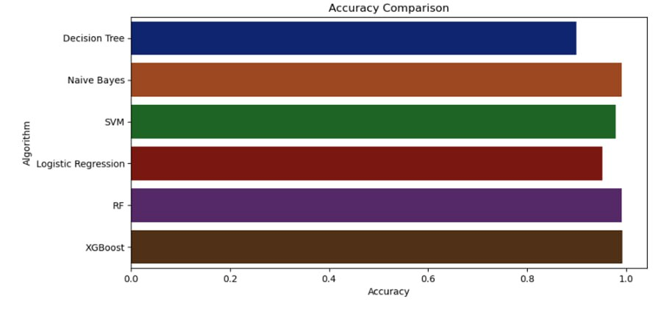
Proposed Methodology
XGBoost
XGBoost, an optimized and scalable gradient boosting library, excels in handling complex data and extracting patterns that may not be apparent through traditional algorithms. In the context of yoga recommendation, where diverse factors such as user preferences, fitness levels, and specific requirements contribute to the intricacy of the dataset, XGBoost proves valuable. XGBoost's strengths lie in its ability to handle complex relationships in data, feature importance analysis, and its robust performance in various machine learning tasks, making it a suitable choice for recommendation systems. The algorithm's ability to handle both numerical and categorical data, along with its feature importance analysis, enables a comprehensive understanding of the underlying patterns in users' preferences. XGBoost's capability to adapt to evolving datasets and its resistance to overfitting make it well-suited for a recommendation system that requires continuous learning and refinement. The incorporation of XGBoost empowers the Yoga Recommendation System to provide accurate, personalized suggestions, contributing to an enhanced and tailored yoga experience for users.

Slide 10
References
[1] Patil, Pooja, and Sonal Gore. "Recommendation system for yoga and raga for personalized health based on constitution." In 2016 International Conference on Computing Communication Control and automation (ICCUBEA), pp. 1-5. IEEE, 2016.
[2] Patil, Pooja, and Sonal Gore. "Study of recommendation system for yoga and raga for personalized health based on constitution (prakriti)." International Journal of Computer Applications 136, no. 4 (2016): 25-27.
[3] Baruah, Anganabha, Valli Madhavi Koti, Vivekanand Pandey, Savita Mohan Gungewale, N. Srikanth Reddy, and Monika Gupta. "Machine Learning Based Yoga Recommendation System for the Physical Fitness." In 2023 Eighth International Conference on Science Technology Engineering and Mathematics (ICONSTEM), pp. 1-7. IEEE, 2023.
[4] Patil, Pooja, and Sonal Gore. "Study of recommendation system for yoga and raga for personalized health based on constitution (prakriti)." International Journal of Computer Applications 136, no. 4 (2016): 25-27.

Slide 11
Thank you and Any Queries

