Slide 1
Yoga Harmony Assist
P. Mounika Reddy 2010030485
Sravani Mekala 2010030104
Under the Guidance of
DR. G Madhukar Rao
<Assistant Professor>
Computer Science and Engineering Department
KL Hyderabad Off Campus, Aziz Nagar, Hyderabad

Slide 2
Overview
Introduction
Literature Review
Proposed Methodology/Architecture/Algorithm/Technique/etc
Implementation
References

Slide 3
Introduction
Yoga is a 5000 years old psycho-spiritual technique that focuses on creating harmony between the mind and the body. The efficacy of Yoga has been proven for certain medical conditions.
There are more than 200 postures and pranayama's with specific benefits that constitute Yoga. One needs an able yoga teacher to identify the cause of suffering and decide postures and pranayama's.
Since nowadays globalization has increased beyond its growth, many challenges and stressful situations need to be faced by human. In Current scenario Ayurveda experts diagnose the diseases by interacting with patients and by examining the patient. They suggest medicine, yoga, raga, and diet according to their observations. Such process is very time consuming.
Designing automatic recommendation systems which recommend the yoga and raga for specific prakriti.it will help experts to reduce certain amount of time, such system recommend accurate yoga and raga according to physical and mental characteristics of person.
Yoga is a practice that originated in ancient India and has since spread to become a global phenomenon. It is a holistic practice that combines physical postures, breathing techniques, and meditation to promote physical, mental, and spiritual well-being.
However, many yoga practitioners struggle with finding the right balance and progressing at their own pace. This is where YogaHarmony Assist comes in, providing personalized guidance and effective progress tracking for yoga practitioners.

Slide 4
Literature Review
SNO | TITLE | AUTHOR | PUBLISHER | DATASET AND TECHNIQUES | CONCLUSION
01 | Machine Learning Based Yoga Recommendation System for the Physical Fitness | Anganabha Baruah, Valli Madhavi Koti | IEEE | This system can furnish clients with the data they require in light of their necessities and keeping in mind that thinking about their inclinations.. | The proposed recommendation system makes practice recommendations in light of the client's inclinations while considering comorbidities, geographic areas, and exercise and eating ways of behaving
02 | Yoga Recommendation System | Ramamoorthy S, Deepanshu Singh | International Conference on Intelligent Computing, Communication & Convergence | Creating web application and training models using machine learning. | The proposed stress prediction model has achieved an accuracy of 94.4% and the yoga pose recommendation system has achieved an accuracy of 97.3%.

Slide 5
SNO | TITLE | AUTHOR | PUBLISHER | DATASET AND TECHNIQUES | CONCLUSION
03 | Development of an AI Enabled Yoga Posture (Asanas) Prediction System | Rahul Yadav, Rajat Chaudhary | IRJET | They proposed a method to detect correct yoga postures using deep learning techniques. Using Deep Neural Network Model | The proposed model is giving an accuracy of 0.9929% and we have prepared an application is built using react java script in which the pose estimation model is integrated.
04 | Recommendation system for yoga | P.A.J. Sandaruwan | IEEE | Using decision tree Neural Networks. | Based on timing, mood and constitution raga recommendation has been done and similarly yoga recommendation has been done

Slide 6
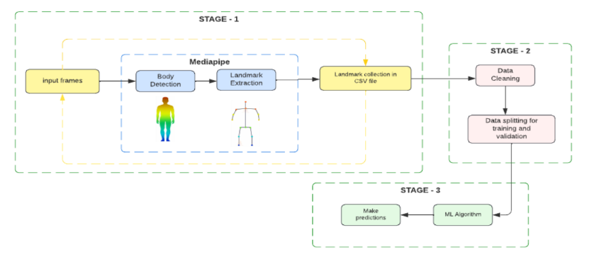
Proposed Methodology/Architecture/Algorithm/Technique
Made use of OpenCV for image processing, MediaPipe for keypoint detection and landmark extraction, Pandas for data handling, ScikitLearn for deploying machine learning models, Streamlit for hosting applications, and SQLlite for the backend.

Slide 7
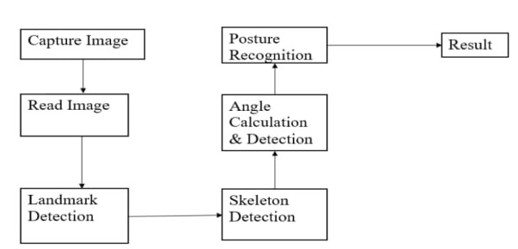
Proposed Methodology/Architecture/Algorithm/Technique
FIG 2 Camera Position Detection and Correction

Slide 8

Prototype

Slide 9
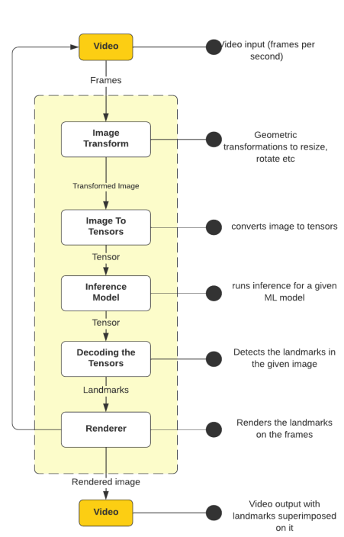
Methodology
1)OpenCV
OpenCV is an open-source library that provides a common infrastructure for performing computer-vision tasks
along with machine learning and can work alongside numerous Algorithms and frameworks. In our case,
we are using OpenCV with MediaPipe for pose estimation, Pose detection, and extracting the 3D coordinates
of the pose.
2) MediaPipe
Google's cross-platform technology for creating perception pipelines is called Mediapipe. Video streams
enter the graph as time-series data, and perceived descriptions of those video streams exit as pose landmarks.
Every frame from our real-time video enters this pipeline, which is made up of frames per second. When a
frame enters the pipeline, it is initially pre-processed by changing it to a size that the machine learning algorithm
can use efficiently. These pre-processed photos are now turned into multidimensional arrays containing tensors,
which are subsequently put into an inference model, which generates tensors once more. These tensors are
then decoded into landmarks, which are subsequently projected back to the screen, allowing us to see the landmarks
as output.

Slide 10
Implementation
Pose estimation has been performed in numerous ways, from using pre-made libraries such as OpenPose to using transfer learning and TensorFlow for a more hands-on approach. This project was undertaken by making use of MediaPipe for pose estimation. Machine learning models deployed varied from Convolutional Neural Networks to Deep Learning Networks. Accuracies of the models range from 80% to 85%.
Detection - Yoga poses being performed by the person will be captured by the camera. MediaPipe captures the live feed and marks a star skeleton on the human body. The star skeleton represents the human body and the detection of key points/landmarks is carried out, courtesy of MediaPipe. The landmarks are then extracted and captured by OpenCV, with the landmarks of the body being loaded into a CSV file in the form of coordinates(x, y, z).
Support Vector Machines (SVMs) are an advanced method used for tasks like classification, regression, and outlier detection. SVC class was used for multi-class classification.
Training Accuracy Score: 97.81%.
Testing Accuracy Score: 96.09%.

Slide 11
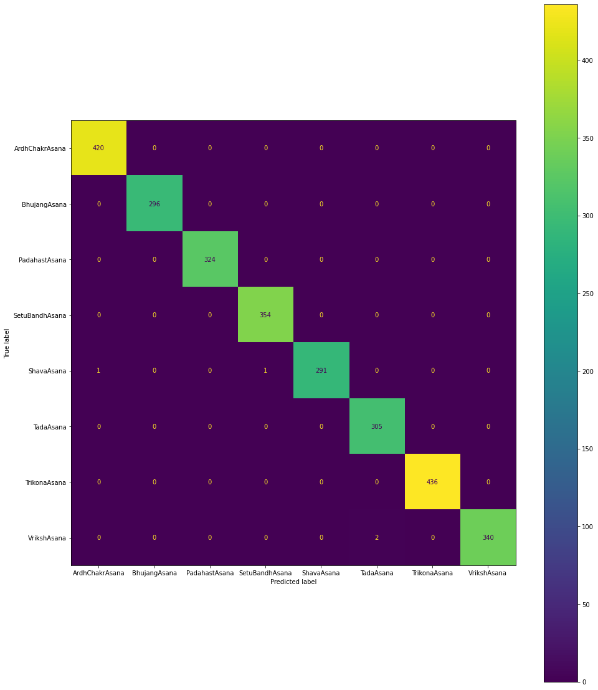
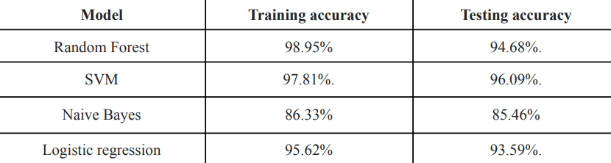
Implementation

Slide 12
References
[1] Patil, Pooja, and Sonal Gore. "Recommendation system for yoga and raga for personalized health based on constitution." In 2016 International Conference on Computing Communication Control and automation (ICCUBEA), pp. 1-5. IEEE, 2016.
[2] Patil, Pooja, and Sonal Gore. "Study of recommendation system for yoga and raga for personalized health based on constitution (prakriti)." International Journal of Computer Applications 136, no. 4 (2016): 25-27.
[3] Baruah, Anganabha, Valli Madhavi Koti, Vivekanand Pandey, Savita Mohan Gungewale, N. Srikanth Reddy, and Monika Gupta. "Machine Learning Based Yoga Recommendation System for the Physical Fitness." In 2023 Eighth International Conference on Science Technology Engineering and Mathematics (ICONSTEM), pp. 1-7. IEEE, 2023.
[4] Patil, Pooja, and Sonal Gore. "Study of recommendation system for yoga and raga for personalized health based on constitution (prakriti)." International Journal of Computer Applications 136, no. 4 (2016): 25-27.

Slide 13
Thank you and Any Queries

