Slide 1

LeafShield: Digital Solutions for Plant Health
C TEAM MEMBERS
NAME REG.NO
K. Yashwanth 2010030364
A. Sai Pranay 2010030467
S. Padmashree 2010030508
.

Slide 2
CONTENTS
01.
Introduction
02.
Problem Statement
03.
Literature Survey
04.
Conclusion

Slide 3

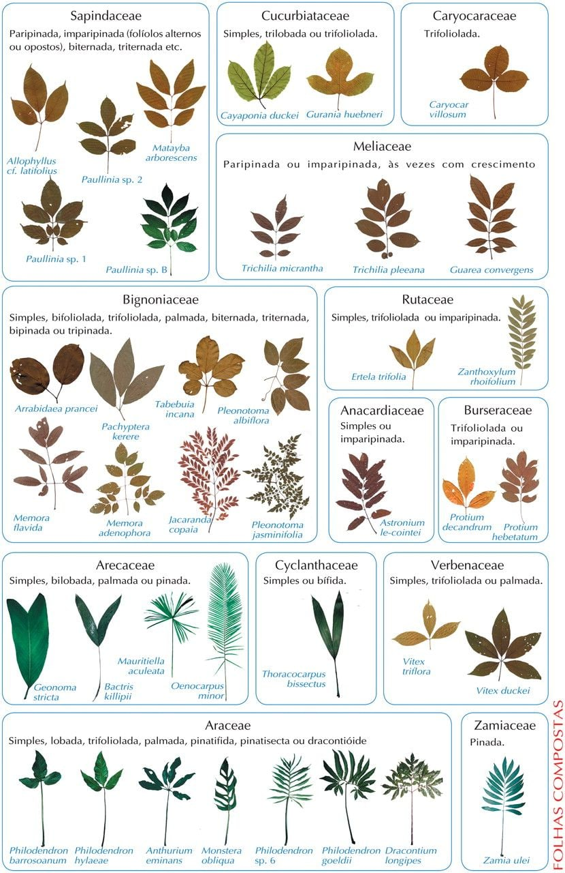
INTRODUCTION
In our everyday life we used to see a lot of plants and flower. But in most case we have no knowledge about that plants. Even we don’t know its name. In that case we choose this idea to research and develop our project. Our developed application recognizes the plant in real time by using the leaf picture of a plant . This project is an attempt at using the concepts of neural networks to create an image classifier by TensorFlow. Convolutional neural networks are a popular realm of machine learning, and are widely used in image classification. So that we choose this topic to research about image classification by CNN and Tensorflow

Slide 4
Problem Statement
Our domain is Computer Vision and sub domain is Image Classification.Our problem statement is to detect plant disease by digital image processing . By this project of LeafShield, we can detect the disease of a plant it has. By clicking a pic of that plant leaf, we can come to know about disease details of a particular plant. This will be much fast disease detecting process of a plant, so that it will be much easier to detect the disease of a plant, it ensure the fast precaution and help a farmer or Gardener to have a healthy environment.

Slide 5
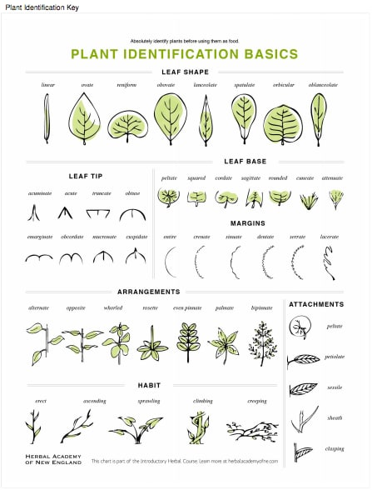
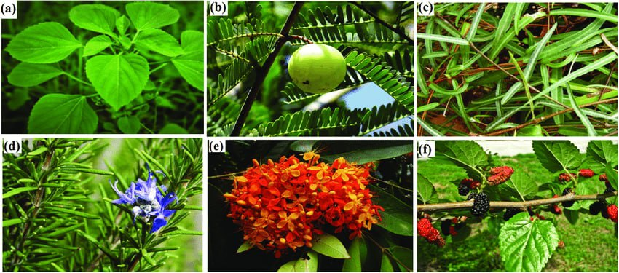
Literature Survey

Slide 6
Table
S.NO | TITLE | Author | Published on
1 | Image Processing Technique for the Detection of Alberseem Leaves Diseases Based on Soft Computing | Eimad Abdu Abusham | April , 2021
2 | A Hybrid Approach for Plant Leaf Disease Detection and Classification Using Digital Image Processing Methods | Anusha Rao , S.B. Kulkarni | October 4, 2020
3 | Image Processing Methods in Agricultural Observation Systems | Chen Zhang , Li Lin | 13 April 2021
4 | PLANT LEAF DISEASE IDENTIFICATION USING IMAGE PROCESSING AND SVM, ANN CLASSIFIER METHODS | S.Sivasakthi | may , 2020
5 | Plant diseases and pests detection based on deep learning | Jun Liu , Xuewei Wang | 24 February 2021
Your text

Slide 7
Conclusion
our project is all about identification of plants and their details .Our developed application recognizes the plant in real time by using mobile camera. and we can explore plants around the world

Slide 8
Thank you

