Slide 1
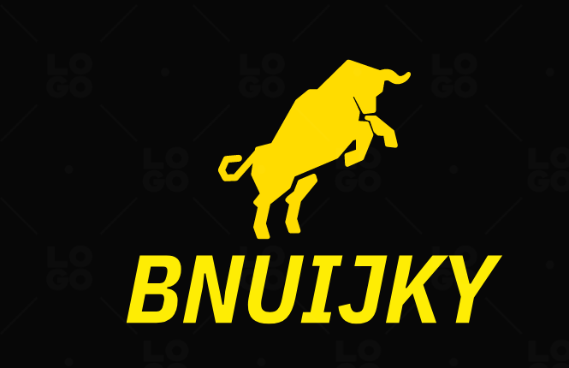

Slide 2
TEAM
NAME :- VIYYAPU V S D SAI VAMSI ID :- 2010030529

Slide 3
Abstract
Bunijky is a E commers website this website is created using spring boot framework. this website provides a lot of cool products like shirts , pants ,cap ,worth , bracelets , makeup items and a lot we have our login page , home page , about us page , contact us page where you can send us email and cart page

Slide 4
Problem statement
Most of the E commers they do not have security we provide different Security like spring boot security and login page sec and we generate our own OTP in this way It will hard to crack the code

Slide 5
Tools
We used Eclipse tool for java programing and spring tools for embedded tomcat , web spring and it also provide security the best feature of spring is we can open a starter project in it and spring boot is the best for starter projects

Slide 6
Languages
Languages we use
1.java:-A full-stack developer is a person who can develop application's backend and frontend. Java full-stack is basically a term used for a web developer that uses Java to develop the entire technology stack is referred to as Java full stack developer. A developer should have the following skills to become a Java full-stack developer
2.jsp,css,javascript:-jsp is for pages we create (html pages),CSS id for design and styling ,JavaScript is for making it dynamic and for some operations
3.spring boot module:-It is nothing but the spring boot module, which provides the spring framework’s rapid application development (RAD) feature. To create the application using the framework, we can use the spring tool suite (STS), Eclipse IDE, or spring analyzer in java.
4.mysql:-database
5.xml:- XML stands for extensible Markup Language. XML was designed to store and transport data. XML was designed to be both human- and machine-readable. Why Study XML? XML plays an important role in many different IT systems. XML is often used for distributing data over the Internet.

Slide 7
Work we do
Our Gol is to create a e commers website which is provide cool products
Spring boot is best frame work for web development and it have Rest API and dependency injection is so easy in this and it provides security for the website and it automatically creates documentation using xml

Slide 8
Business idea
Generally in e commers do not provide any bargain but our website provides if the customer want a products less than its prise he can bargain if the customer set a prise less than its actual prise and no profit the system will object the his prise and if the customer wants product less than the website prise and there is profit it will be accepted

Slide 9
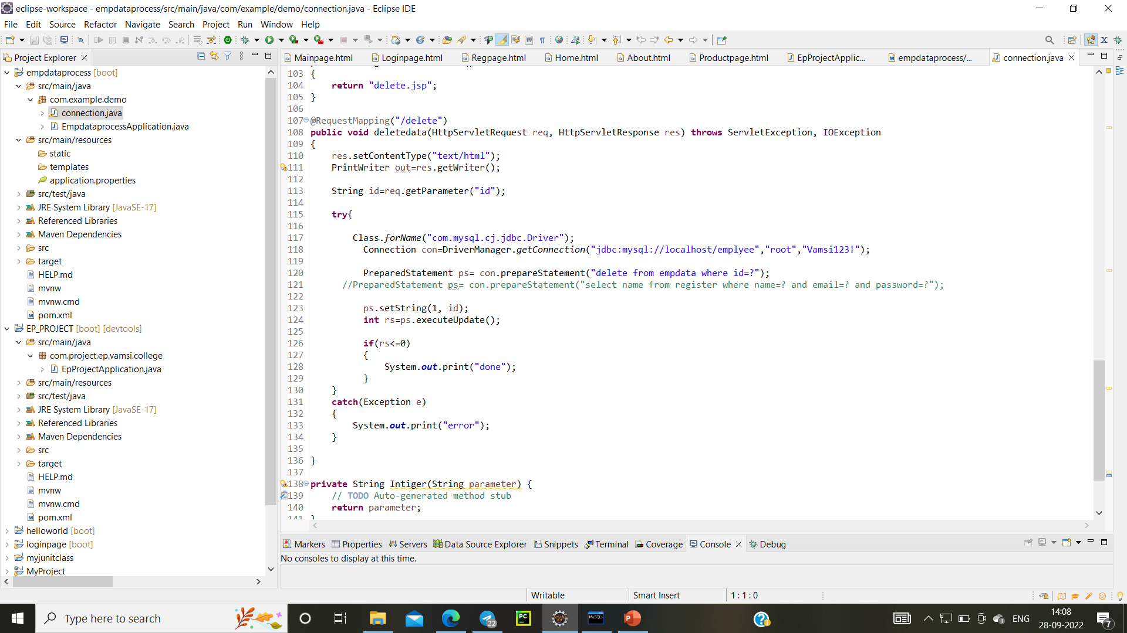
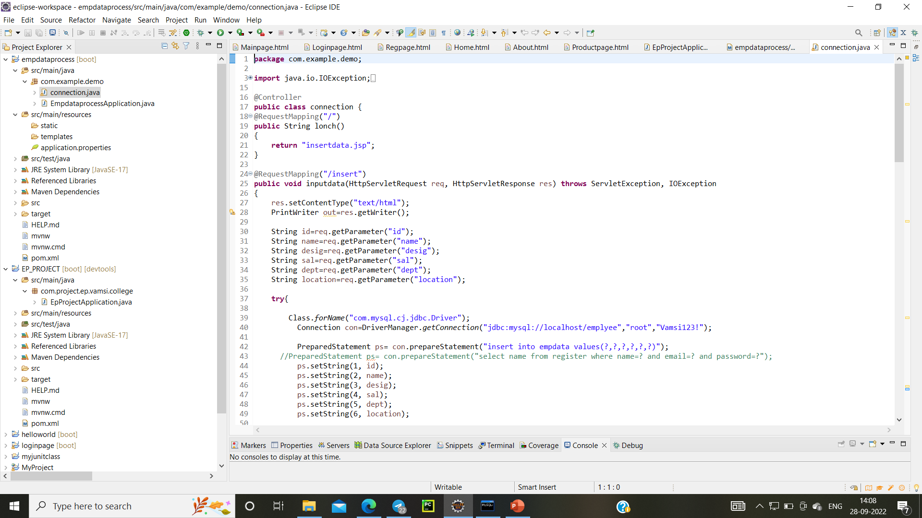
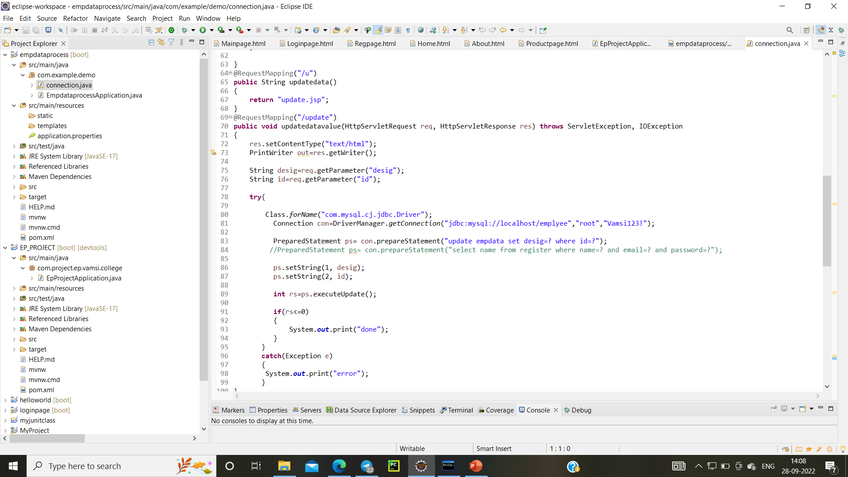

Slide 10
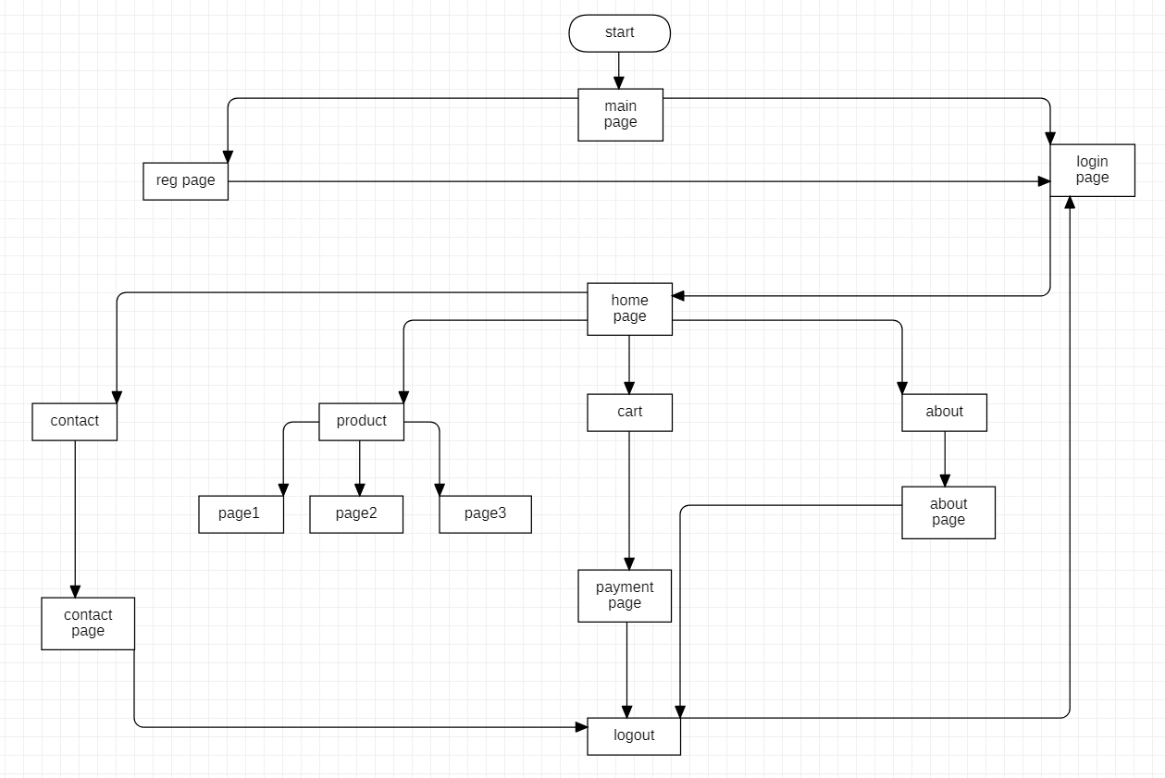
Flow diagram

